Slide 1

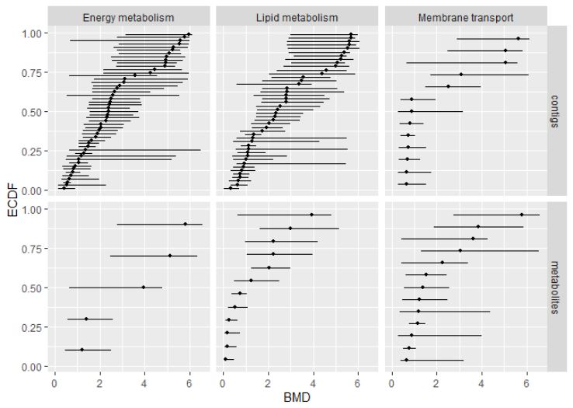
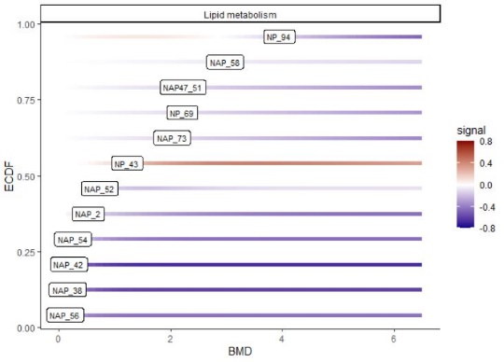
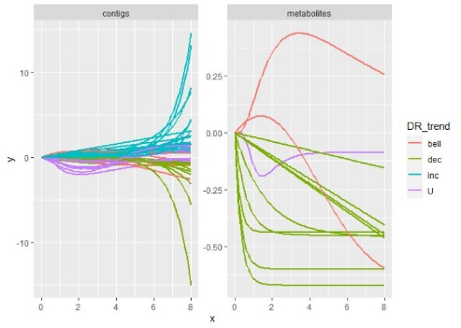
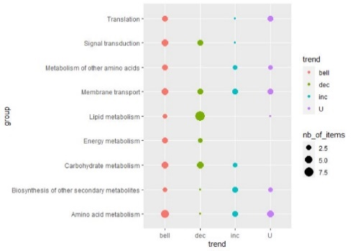
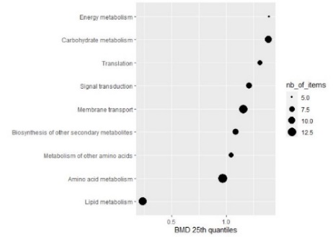
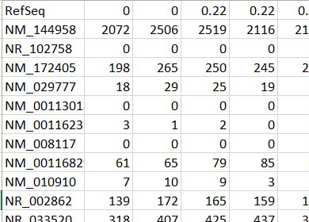
Written by the authors of the Dromics package (see https://lbbe.univ-lyon1.fr/fr/dromics ) - updated in July 2021
Cheat Sheet
Other functions to help the interpretation of results winthin a multi-omics approach using a same biological annotation
Workflow for analysis of raw data
Functions taking as a first argument extendedres, a dataframe with the main workflow results, extended with additional columns coding for example for a biological of items. Some lines of the workflow results can be replicated for items having more than one annotation. Results obtained on different molecular (see help pages for a complete description of argument of those functions)
Functions with their main arguments (see help pages for a complete description)
Step 1: import, check and pretreatment
microarraydata(file,
norm.method = c("cyclicloess", "quantile", "scale", "none"))
RNAseqdata(file, transfo.method = c("rlog", "vst"))
continuousomicdata(file)
continuousanchoringdata(file)
BMD plot
bmdplot(extendedres, add.CI, facetby, facetby2, shapeby, colorby, add.label, BMD_log_transfo)
Step 2: selection of significantly responsive items
BMD plot with gradient
itemselect(omicdata,
select.method = c("quadratic", "linear", "ANOVA"), FDR)
Step 3: dose-response modelling for responsive items
drcfit(itemselect, information.criterion = c("AICc", "BIC", "AIC"))
bmdplotwithgradient(extendedres, xmin, xmax, facetby, facetby2, shapeby, add.label, BMD_log_transfo)
Step 4: Computation of benchmark doses
bmdcalc(f, z = 1, x = 10, minBMD)
Step 5: Bootstrap to compute BMD confidence intervals
bmdboot(r, niter = 1000, conf.level = 0.95)
Format of data in input
Data can be imported from a .txt file (e.g. "mydata.txt") containing one row per item after a first row giving the doses or concentrations for each sample , with the first column corresponding to the identifier of each item. Alternatively an R object of class data.frame
can be directly given in input, corresponding to the output of read.table(file, header = FALSE) on a file described as above.
Dose-response curves plot
curvesplot(extendedres, xmin, xmax, facetby, facetby2, colorby, dose_log_transfo = FALSE)
Typical script for the workflow
Trend plot
trendplot(extendedres, group, facetby)
Sensitivity plot
Identifiers of items (contigs, probes, metabolites, …)
Tested doses or conc.
o <- RNAseq(datafilename)
s <- itemselect(o)
f <- drcfit(s)
r <- bmdcalc(f)
b <- bmdboot(r)
b$res
sensitivityplot( extendedres, group, colorby, BMDsummary = c("first.quartile", "median" , "median.and.IQR"), BMD_log_transfo)
Signal (counts or reads, continuous signal in log2, …)
Each function of this workflow returns a S3 class object that can printed and plotted.

Slide 2
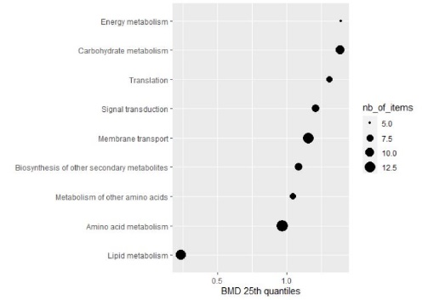
Trend plot
trendplot(extendedres, group, facetby)
Sensitivity plot
sensitivityplot( extendedres, group, colorby, BMDsummary = c("first.quartile", "median" , "median.and.IQR"), BMD_log_transfo)

