Slide 1

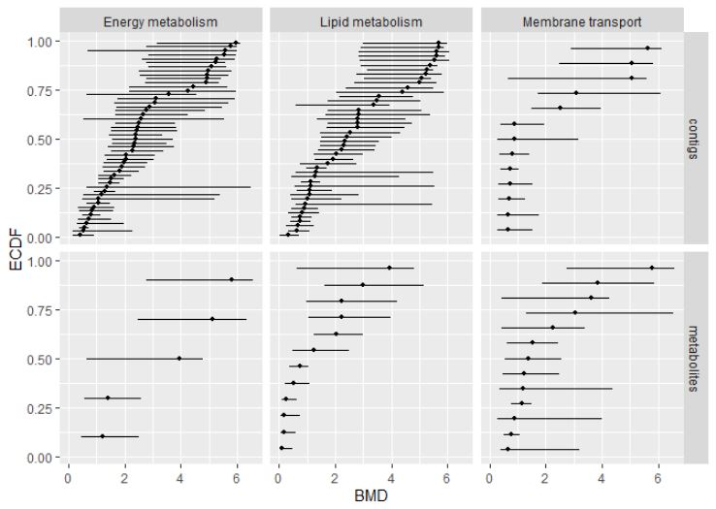
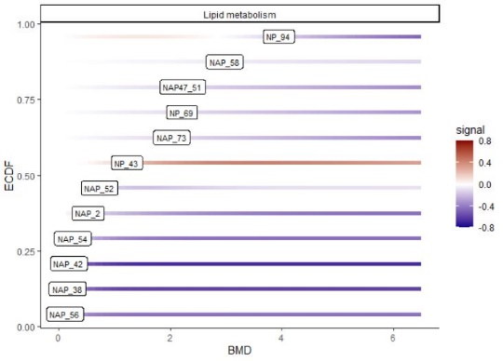
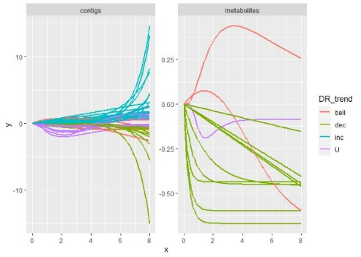
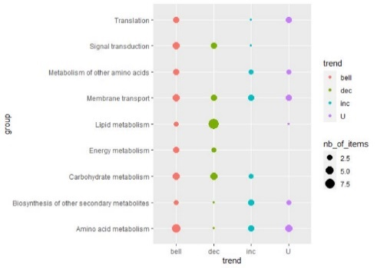
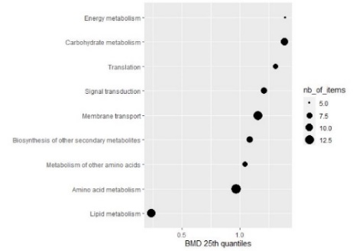
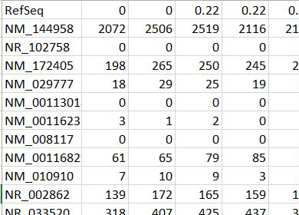
Written by the authors of the Dromics package (see https://lbbe.univ-lyon1.fr/fr/dromics ) - updated in Sept. 2021
Cheat Sheet
Other functions to help the interpretation of results within a multi-omics approach using a unique biological annotation
Workflow for analysis of raw data
Functions taking as a first argument extendedres, a dataframe with the main workflow results (optionally gathering results obtained at different modelcular levels) extended with additional columns coding for example for the biological annotation of items (and for the molecular level if needed). Some lines of the workflow results can be replicated for items having more than one annotation (see help pages for a complete description of argument of those functions)
Functions with their main arguments (see help pages for a complete description)
Step 1: import, check and pretreatment
microarraydata(file,
norm.method = c("cyclicloess", "quantile", "scale", "none"))
RNAseqdata(file, transfo.method = c("rlog", "vst"))
continuousomicdata(file)
continuousanchoringdata(file)
BMD plot
bmdplot(extendedres, add.CI, facetby, facetby2, shapeby, colorby, add.label, BMD_log_transfo)
Step 2: selection of significantly responsive items
BMD plot with gradient
itemselect(omicdata,
select.method = c("quadratic", "linear", "ANOVA"), FDR)
Step 3: dose-response modelling for responsive items
drcfit(itemselect, information.criterion = c("AICc", "BIC", "AIC"))
bmdplotwithgradient(extendedres, xmin, xmax, facetby, facetby2, shapeby, add.label, BMD_log_transfo)
Step 4: Computation of benchmark doses
bmdcalc(f, z = 1, x = 10, minBMD)
Step 5: Bootstrap to compute BMD confidence intervals
bmdboot(r, niter = 1000, conf.level = 0.95)
Format of data in input
Data can be imported from a .txt file (e.g. "mydata.txt") containing one row per item after a first row giving the doses or concentrations for each sample , with the first column corresponding to the identifier of each item. Alternatively an R object of class data.frame
can be directly given in input, corresponding to the output of read.table(file, header = FALSE) on a file described as above.
Dose-response curves plot
curvesplot(extendedres, xmin, xmax, facetby, facetby2, colorby, dose_log_transfo = FALSE)
Typical script for the workflow
Trend plot
trendplot(extendedres, group, facetby)
Sensitivity plot
Identifiers of items (contigs, probes, metabolites, …)
Tested doses or conc.
o <- RNAseq(datafilename)
s <- itemselect(o)
f <- drcfit(s)
r <- bmdcalc(f)
b <- bmdboot(r)
b$res
sensitivityplot( extendedres, group, colorby, BMDsummary = c("first.quartile", "median" , "median.and.IQR"), BMD_log_transfo)
Signal (counts or reads, continuous signal in log2, …)
Each function of this workflow returns a S3 class object that can printed and plotted.

