Slide 1
Video Game Sales Dashboard
Interactive Sales Analysis Using Power BI
Presented by: [Auryn Leon Dcosta]

Slide 2
Objective
To analyze global video game sales using an interactive Power BI dashboard and identify patterns, trends, and high-performing categories to support data-driven business decisions.

Slide 3
Methodology
- Source: vgsales.csv dataset from Kaggle
- Cleaned columns: Kept only Name, Platform, Year, Genre, Publisher, Global_Sales
- Removed regional sales (NA, EU, JP, Other)
- Created DAX measure for Total Global Sales
- Applied Top N filters, slicers, and KPI cards
- Built visual components like line charts, bar charts, and cards

Slide 4
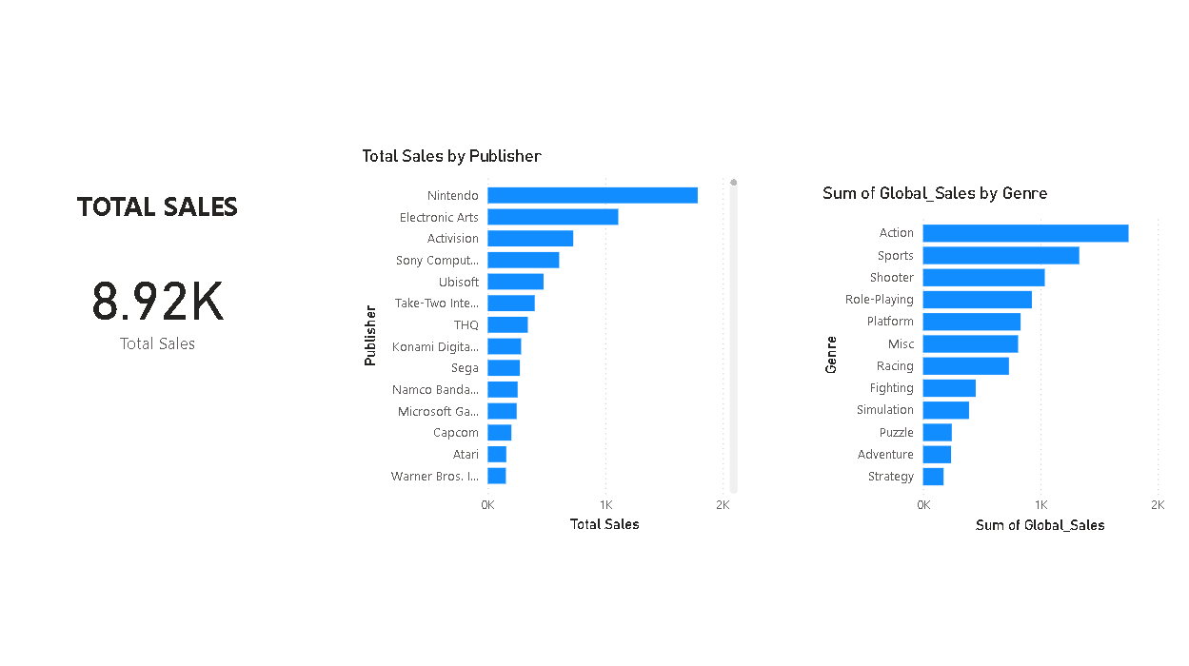
Dashboard Overview
KPI cards: Total Sales, Top Genre, Top Game
Slicers for Year, Genre, Platform, Publisher
Line chart for year-over-year sales trend
Bar charts for Genre & Platform sales

Slide 5
Key Insights
- The top-selling game globally is Wii Sports.
- Action is the most profitable game genre overall.
- Sales peaked in 2008 with 140 million units sold.
- PS2 dominates global sales compared to others.

Slide 6
Business Recommendations
- Invest more in high-performing genres like Action.
- Focus marketing on top-selling platforms such as PS2
- Re-release or remaster best-selling titles for renewed market interest
- Use past peak years’ trends to plan product launches

Slide 7
Conclusion
The Power BI dashboard provides clear, actionable insights into global video game sales. Using this data, stakeholders can make informed decisions on product development, platform focus, and marketing strategies.

