Slide 1
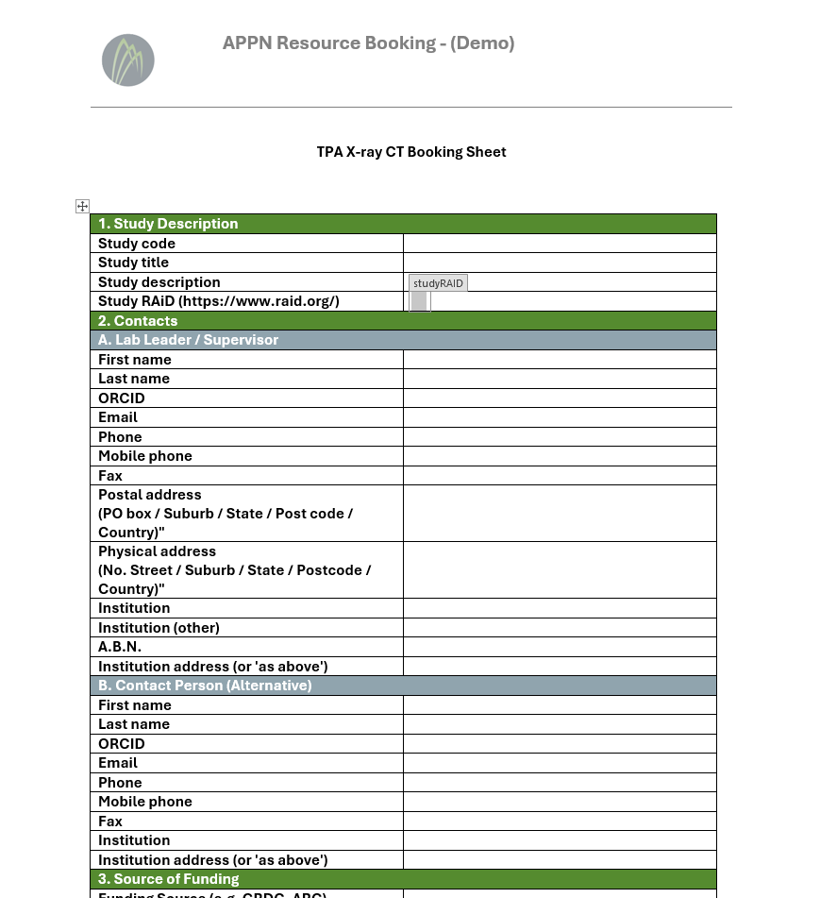
Booking forms – Microsoft docx forms
Docx form-based booking sheets can provide structured data input and output
We have a demonstration of a document generation tool:
  Accepts YAML based field definitions
  Outputs a MS Word docx file
  Input data can be extracted via automated methods (Python)

Slide 2
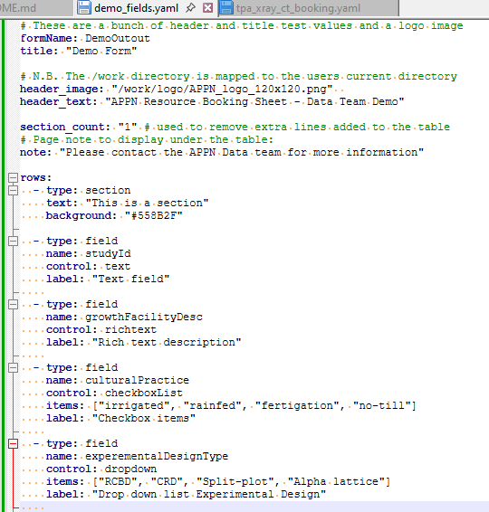
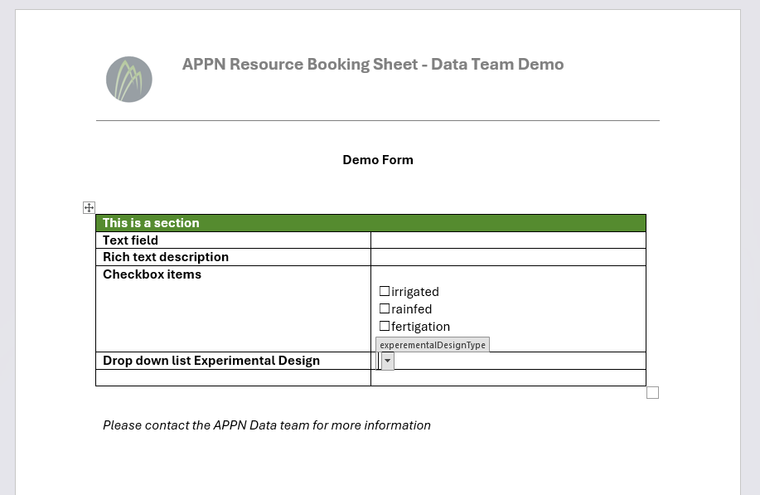
On demand or batch creation of booking forms
YAML based description of required fields
MS Word based form

Slide 3
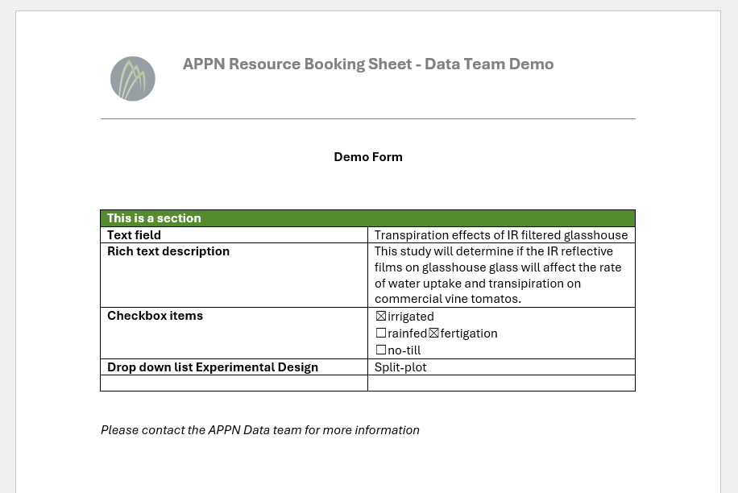
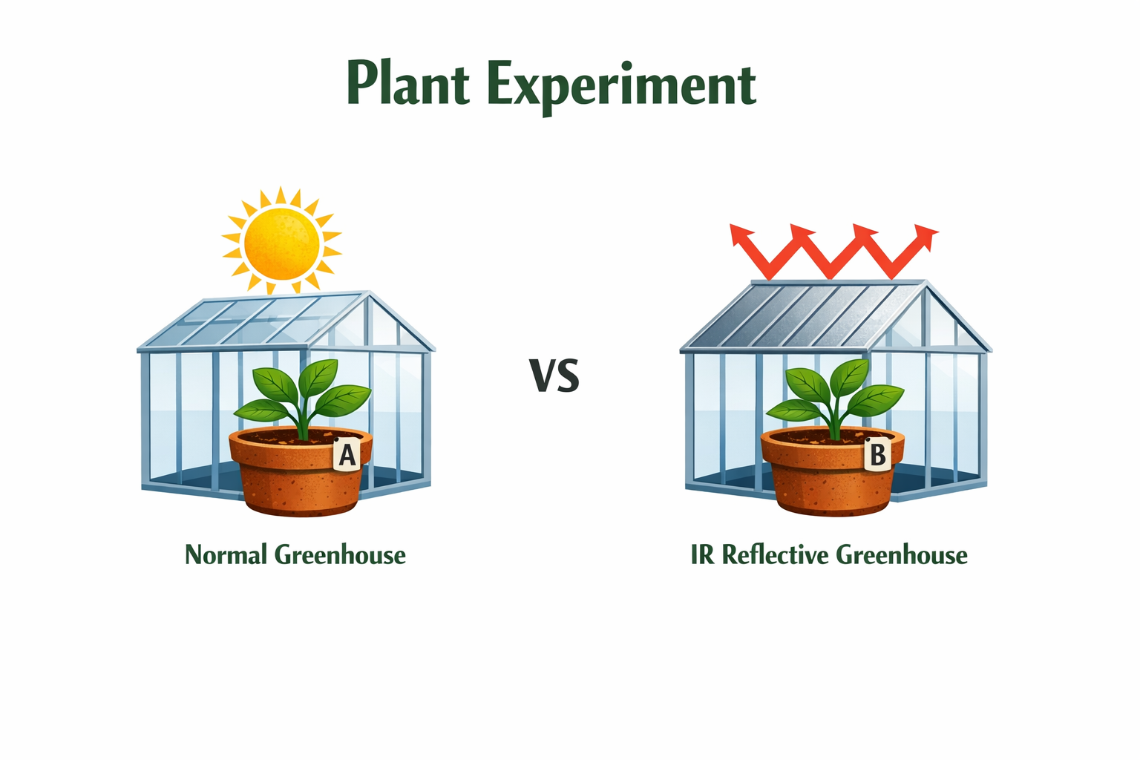
User fills form and sends to node
Study completed. Data and booking form are stored together ready for APPN data packaging
User filled and saved form is sent to node business manager. The study is accepted and entered in the Node schedule.

Slide 4
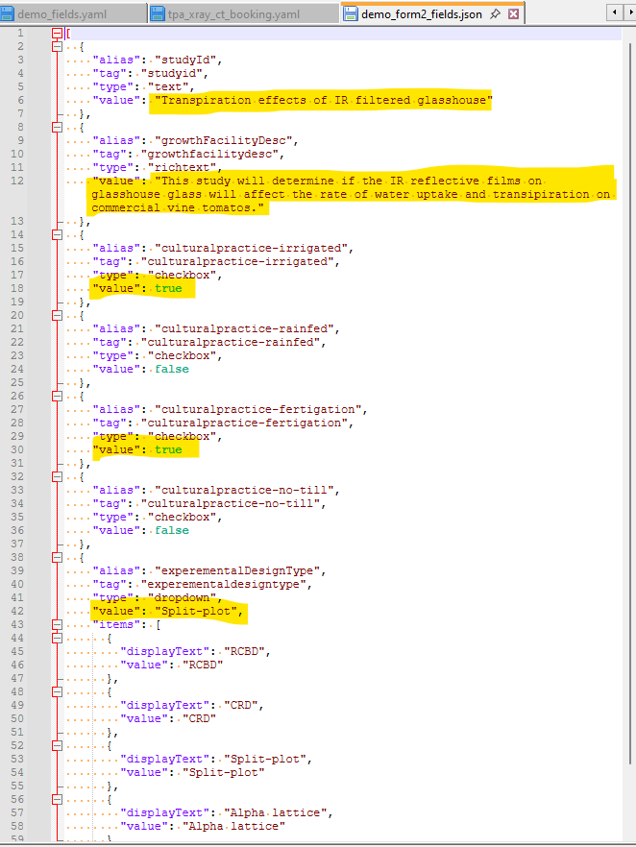
The form data is available for automated metadata retrieval.
JSON data extracted from the booking form and used to populate RO-Crate metadata record.
Form fields can be extracted

Slide 5
Further work
Test forms with unsupported data – how can users break them?
Creation of data capture classes that follow the YAML schema and output RO-Crate JSON metadata records.
Integrate Node vocabularies into YAML templates.
Use of docx metadata capture on a real dataset
  See if whole workflow for creation of RO-Crate annotated data can be simulated using new booking sheet (Xray-CT example dataset)

