Slide 1


Red Hat System Administration III
Linux Automation with Ansible
Deploying Ansible
Describe Ansible inventory concepts and manage a static inventory file.
Describe where Ansible configuration files are located
Run a single Ansible automation task using an ad hoc command and explain some use cases for ad hoc commands.

Slide 2
Red Hat System Administration III
Linux Automation with Ansible
Ansible Inventory
An inventory defines a collection of hosts that Ansible will manage. Hosts may belong to groups which are typically used to identify the hosts' role in the datacenter.
A host can be a member of more than one group. Groups can contain child groups. The inventory can also set variables that apply to the hosts and groups that it defines.
Host inventories can be defined in two different ways.
A static host inventory can be defined by a text file.
A dynamic host inventory can be generated by a script or other program as needed, using external information providers.

Slide 3
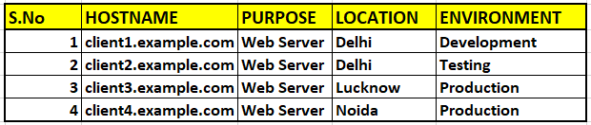
Red Hat System Administration III
Linux Automation with Ansible
Ansible Inventory
Guided Exercise

Slide 4
Red Hat System Administration III
Linux Automation with Ansible
Running AD HOC Commands With Ansible
An ad hoc command is a way of executing a single Ansible task quickly. They are simple, online operations that can be run without writing a playbook.
Ad hoc commands are useful for quick tests and changes. For example, you can use an ad hoc command to make sure that a certain line exists in the /etc/hosts file on a group of servers. You could use another ad hoc command to efficiently restart a service on many different machines, or to ensure that a particular software package is up-to-date.
Use the ansible command to run ad hoc commands:
ansible host-pattern -m module [-a 'module arguments'] [-i inventory]

Slide 5
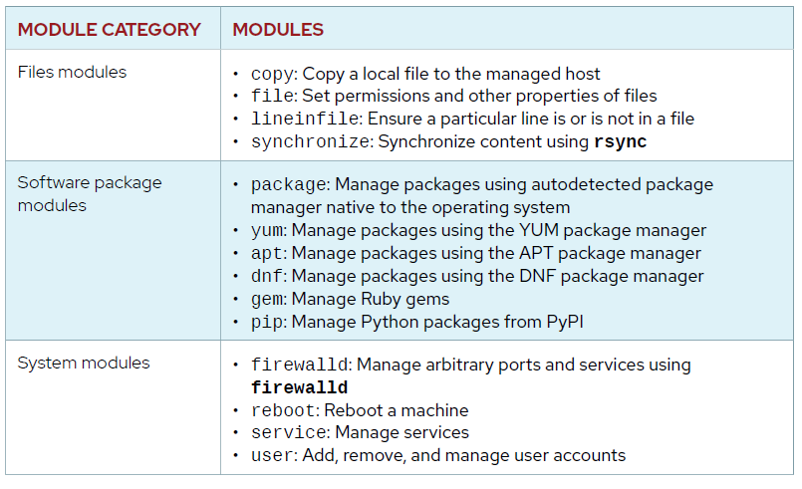

Red Hat System Administration III
Linux Automation with Ansible
Ansible Modules

Slide 6
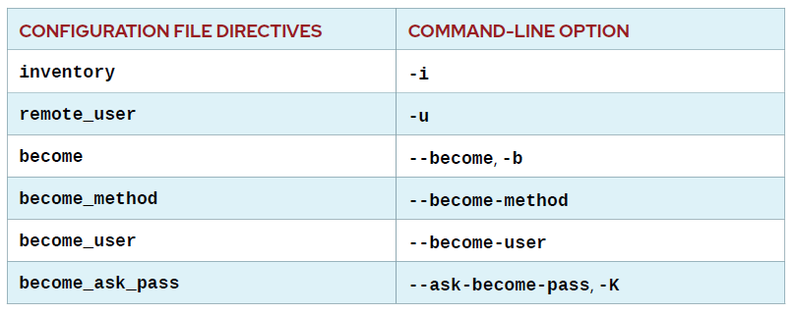
Red Hat System Administration III
Linux Automation with Ansible
Ansible Command-line Options

Slide 7
Red Hat System Administration III
Linux Automation with Ansible
Implementing Playbooks
Goal: Write Ansible plays and execute a playbook.
Objective
Write YAML files.
Implement Ansible playbooks.
Write and execute a playbook.

Slide 8
Red Hat System Administration III
Linux Automation with Ansible
Implementing Playbooks
Playbooks are the files where Ansible code is written. Playbooks are written in YAML format. Playbooks are one of the core features of Ansible and tell Ansible what to execute.
Ansible uses YAML syntax for expressing Ansible playbooks because it is very easy for humans to understand, read and write than other common data formats like XML or JSON.
Each playbook is an aggregation of one or more plays in it. Playbooks are structured using plays. There can be more than one play inside a playbook.

Slide 9
Red Hat System Administration III
Linux Automation with Ansible
Implementing Playbooks
YAML SYNTAX
YAML files optionally begin with a three dash start of document marker and are optionally terminated with a three dot end of file marker.
---
...output omitted...
...

Slide 10
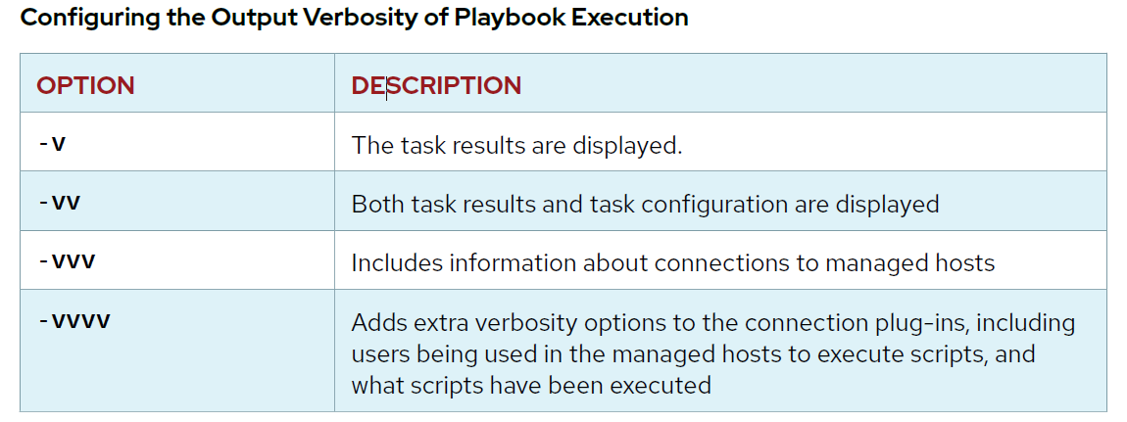
Red Hat System Administration III
Linux Automation with Ansible
Implementing Playbooks

Slide 11
Red Hat System Administration III
Linux Automation with Ansible
Implementing Playbooks
Using AD Hoc Commands
ansible -m user -a "name=sam uid=4042 state=present" test –become -K

Slide 12
Red Hat System Administration III
Linux Automation with Ansible
Guided Exercise
Installation of Apache (HTTPD) package
Creating Index.html file
Start & Enable the httpd service

Slide 13
Red Hat System Administration III
Linux Automation with Ansible
Guided Exercise
Installation of httpd, firewalld package
Creating Index.html file
Firewalld enabled and running
Firewalld permits access to httpd service
httpd enabled and running
Test intranet web server

Slide 14
Red Hat System Administration III
Linux Automation with Ansible
Implementing Playbooks
tasks:
- name: web server is enabled
service:
name: httpd
enabled: true
- name: NTP server is enabled
service:
name: chronyd
enabled: true
- name: Postfix is enabled
service:
name: postfix
enabled: true

Slide 15
Red Hat System Administration III
Linux Automation with Ansible
MANAGING SECRETS
Ansible Vault, which is included with Ansible, can be used to encrypt and decrypt any structured data file used by Ansible. To use Ansible Vault, a command-line tool named ansible-vault is used to create, edit, encrypt, decrypt, and view files.
IMPORTANT
Ansible Vault does not implement its own cryptographic functions but rather uses an external Python toolkit. Files are protected with symmetric encryption using AES256 with a password as the secret key.

Slide 16
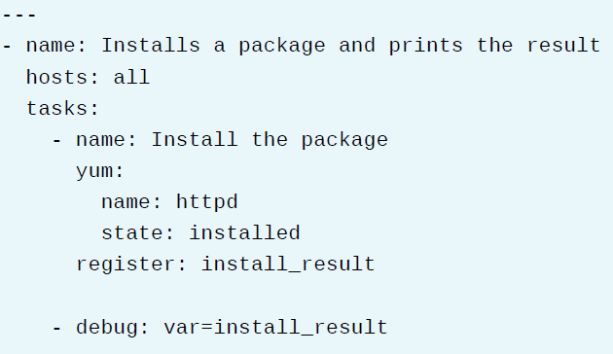
Red Hat System Administration III
Linux Automation with Ansible
Capturing Command Output With Registered Variables
Administrators can use the register statement to capture the output of a command. The output is saved into a temporary variable that can be used later in the playbook for either debugging purposes or to achieve something else, such as a particular configuration based on a command’s output.

Slide 17
Red Hat System Administration III
Linux Automation with Ansible
Implementing Task Control
Using loops saves administrators from the need to write multiple tasks that use the same module. For example, instead of writing five tasks to ensure five users exist, you can write one task that iterates over a list of five users to ensure they all exist.
Ansible supports iterating a task over a set of items using the loop keyword. You can configure loops to repeat a task using each item in a list, the contents of each of the files in a list, a generated sequence of numbers, or using more complicated structures.

Slide 18
Red Hat System Administration III
Linux Automation with Ansible
Implementing Task Control
Using loops saves administrators from the need to write multiple tasks that use the same module. For example, instead of writing five tasks to ensure five users exist, you can write one task that iterates over a list of five users to ensure they all exist.
Ansible supports iterating a task over a set of items using the loop keyword. You can configure loops to repeat a task using each item in a list, the contents of each of the files in a list, a generated sequence of numbers, or using more complicated structures.

Slide 19
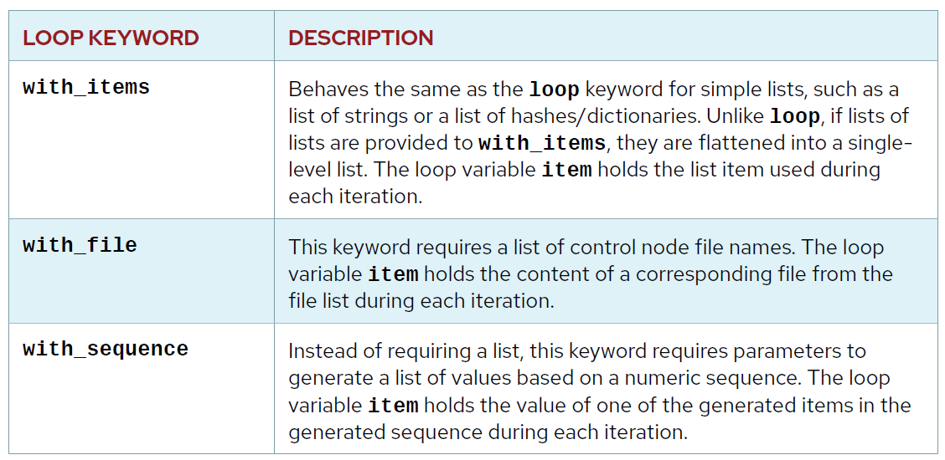
Red Hat System Administration III
Linux Automation with Ansible
Earlier-Style Ansible Loops
Before Ansible 2.5, most playbooks used a different syntax for loops. Multiple loop keywords were provided, which were prefixed with with_, followed by the name of an Ansible look-up plug-in.

Slide 20
Red Hat System Administration III
Linux Automation with Ansible
Using Register Variables with Loops
The register keyword can also capture the output of a task that loops.

Slide 21
Red Hat System Administration III
Linux Automation with Ansible
Guided Exercise
User Creation

Slide 22
Red Hat System Administration III
Linux Automation with Ansible
RUNNING TASKS CONDITIONALLY
Ansible can use conditionals to execute tasks or plays when certain conditions are met. For example, a conditional can be used to determine available memory on a managed host before Ansible installs or configures a service.
Conditional Task Syntax
The when statement is used to run a task conditionally. It takes as a value the condition to test. If the condition is met, the task runs. If the condition is not met, the task is skipped.

Slide 23
Red Hat System Administration III
Linux Automation with Ansible
RUNNING TASKS CONDITIONALLY
Ansible can use conditionals to execute tasks or plays when certain conditions are met. For example, a conditional can be used to determine available memory on a managed host before Ansible installs or configures a service.
Conditional Task Syntax
The when statement is used to run a task conditionally. It takes as a value the condition to test. If the condition is met, the task runs. If the condition is not met, the task is skipped.

Slide 24
Red Hat System Administration III
Linux Automation with Ansible
Guided Exercise
Demonstrate the "in" keyword

Slide 25
Red Hat System Administration III
Linux Automation with Ansible
Guided Exercise
Combining Loops and Conditional Tasks
In the following example, the postfix package is installed by the yum module if there is a file system mounted on / with more than 300 MB free.

Slide 26
Red Hat System Administration III
Linux Automation with Ansible
Guided Exercise
Combining Conditionals and register variables

Slide 27
Red Hat System Administration III
Linux Automation with Ansible
Handling Task Failure
MANAGING TASK ERRORS IN PLAYS
Ansible evaluates the return code of each task to determine whether the task succeeded or failed. Normally, when a task fails Ansible immediately aborts the rest of the play on that host, skipping all subsequent tasks.
Ignoring Task Failure
By default, if a task fails, the play is aborted. However, this behavior can be overridden by ignoring failed tasks. You can use the ignore_errors keyword in a task to accomplish this.

Slide 28
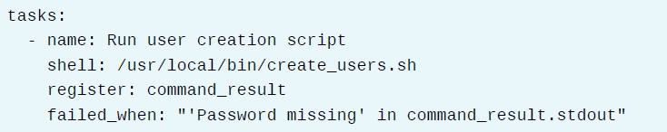
Red Hat System Administration III
Linux Automation with Ansible
Handling Task Failure
Specifying Task Failure Conditions
You can use the failed_when keyword on a task to specify which conditions indicate that the task has failed. This is often used with command modules that may successfully execute a command, but the command's output indicates a failure.

Slide 29
Red Hat System Administration III
Linux Automation with Ansible
Handling Task Failure
Specifying When a Task Reports “Changed” Results
The changed_when keyword can be used to control when a task reports that it has changed.

Slide 30
Red Hat System Administration III
Linux Automation with Ansible
Deploying Files to Managed Hosts
Goal: Deploy, manage and adjust files on hosts managed by Ansible
MODIFYING AND COPYING FILES TO HOSTS
Red Hat Ansible Engine ships with a large collection of modules (the “module library”) that are developed as part of the upstream Ansible project.
The Files modules library includes modules allowing you to accomplish most tasks related to Linux file management, such as creating, copying, editing, and modifying permissions and other attributes of files. The following table provides a list of frequently used file management modules:

Slide 31
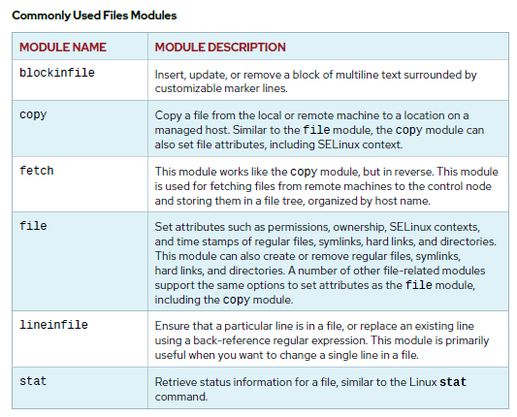
Red Hat System Administration III
Linux Automation with Ansible

Slide 32
Red Hat System Administration III
Linux Automation with Ansible
Guided Exercise
Fetch the /var/log/secure log file from managed hosts to a centralized location on Ansible Server.
Copy the file and set the attributes.
Check the status of the file.
Using the file module to ensure the default SELinux file context for user, role, type and level fields on the file.
Add a text line to an existing file.
Add block of text to a file and read the file.

Slide 33
Red Hat System Administration III
Linux Automation with Ansible
DEPLOYING CUSTOM FILES WITH JINJA2 TEMPLATES
OBJECTIVES
After completing this section, you should be able to use Jinja2 templates to deploy customized files to managed hosts.

Slide 34
Red Hat System Administration III
Linux Automation with Ansible
DEPLOYING CUSTOM FILES WITH JINJA2 TEMPLATES
TEMPLATING FILES
Red Hat Ansible Engine has a number of modules that can be used to modify existing files. These include lineinfile and blockinfile, among others. However, they are not always easy to use effectively and correctly.
A much more powerful way to manage files is to template them. With this method, you can write a template configuration file that is automatically customized for the managed host when the file is deployed, using Ansible variables and facts. This can be easier to control and is less error-prone.

Slide 35
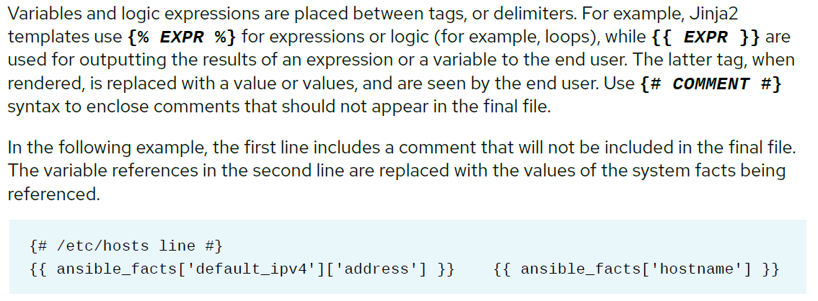
Red Hat System Administration III
Linux Automation with Ansible
DEPLOYING CUSTOM FILES WITH JINJA2 TEMPLATES
INTRODUCTION TO JINJA2
Ansible uses the Jinja2 templating system for template files. Ansible also uses Jinja2 syntax to reference variables in playbooks, so you already know a little bit about how to use it.

Slide 36
Red Hat System Administration III
Linux Automation with Ansible
DEPLOYING CUSTOM FILES WITH JINJA2 TEMPLATES
Building a JINJA2 Template
A Jinja2 template is composed of multiple elements: data, variables, and expressions. Those variables and expressions are replaced with their values when the Jinja2 template is rendered. The variables used in the template can be specified in the vars section of the playbook. It is possible to use the managed hosts' facts as variables on a template.

Slide 37
Red Hat System Administration III
Linux Automation with Ansible
DEPLOYING CUSTOM FILES WITH JINJA2 TEMPLATES
Building a JINJA2 Template
Control Structures
Using Loops

Slide 38
Red Hat System Administration III
Linux Automation with Ansible
Guided Exercise
Create a template named as example7.j2 file in the current working directory. Include the following variables and facts in the template:
ansible_facts['fqdn'], to insert the FQDN of the managed host.
ansible_facts['distribution'] and ansible_facts['distribution_version'], to provide distribution information.
admin_owner, for the system owner's email. This variable needs to be defined with an appropriate value in the vars section of the playbook template.
Create a playbook file named lab7.yml in the current working directory. Define the admin_owner variable in the vars section, and include a task for the template module that maps the example7.j2 Jinja2 template to the remote file /etc/motd on the managed hosts. Set the owner and group to root, and the mode to 0644.

Slide 39
Red Hat System Administration III
Linux Automation with Ansible
Guided Exercise
Create a template named example8.j2, in the current directory. When the sverma user logs in to server.example.com, a message should display that shows the system's total memory and processor count. Use the ansible_facts['memtotal_mb'] and ansible_facts['processor_count'] facts to provide the memory information for the message.
Create a new playbook file called lab8.yml in the current directory. Using the template module, configure the example8.j2 Jinja2 template file previously created to map to the file /etc/motd on the managed hosts. This file has the root user as owner and group, and its permissions are 0644. Using the stat and debug modules, create tasks to verify that /etc/ motd exists on the managed hosts and displays the file information for /etc/motd.

Slide 40
Red Hat System Administration III
Linux Automation with Ansible
Guided Exercise
Use the copy module to place files/issue into the /etc/ directory on the managed host, use the same ownership and permissions as /etc/motd. Use the file module to ensure that /etc/ issue.net is a symbolic link to /etc/issue on the managed host. Configure the playbook so that it uses the sverma user, and sets the become parameter to true.

Slide 41
Red Hat System Administration III
Linux Automation with Ansible
Configuring Parallelism
Objective
After completing this section, you will be able to tune the number of simultaneous connections that Ansible opens to managed hosts.
Managing Rolling Updates

Slide 42
Red Hat System Administration III
Linux Automation with Ansible
Configuring Parallelism
Managing Rolling Updates
Load Balancer
Web Server 1
Web Server 2
Web Server 3

Slide 43
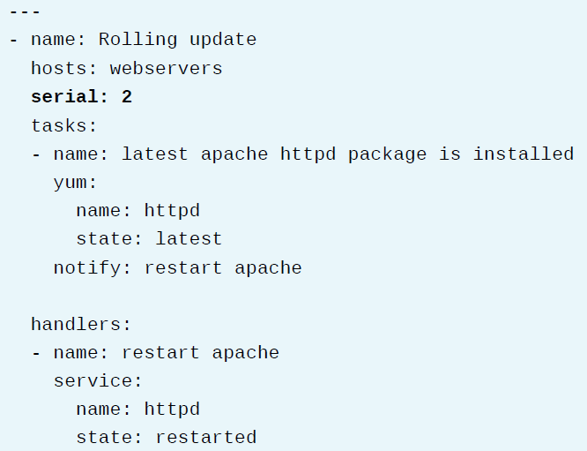
Red Hat System Administration III
Linux Automation with Ansible

Slide 44
Red Hat System Administration III
Linux Automation with Ansible
Guided Exercise
Forks parameter
Serial keyword

Slide 45
Red Hat System Administration III
Linux Automation with Ansible
Including And Importing Files
Objective
After completing this section, you will be able to manage large playbooks by importing or including other playbooks or tasks from external files.

Slide 46
Red Hat System Administration III
Linux Automation with Ansible
Guided Exercise
Installation of httpd and after that start & enabled httpd service.
Install firewalld and then start & enabled it and also firewalld permits access to http, https services
Create index.html using ansible facts
Test the connectivity of web server from your local server
Create main playbook

Slide 47
Red Hat System Administration III
Linux Automation with Ansible
Troubleshooting Playbooks
Log files for Ansible
The Debug Module
Managing Errors

Slide 48
Red Hat System Administration III
Linux Automation with Ansible
Troubleshooting Playbooks
4. Debugging

Slide 49
Red Hat System Administration III
Linux Automation with Ansible
Troubleshooting Ansible Managed Hosts
1. Using Check Mode as a Testing Tool

