Slide 1

Beam: Quick and easy engineering calculations
Isaac Alsaka

Slide 2
Purpose
Structural engineers
Working with beams is very common
May not want to learn MATLAB
Do not want to mess with finnicky online calculators
Beam Allows for quick calculations requiring little technical knowledge

Slide 3
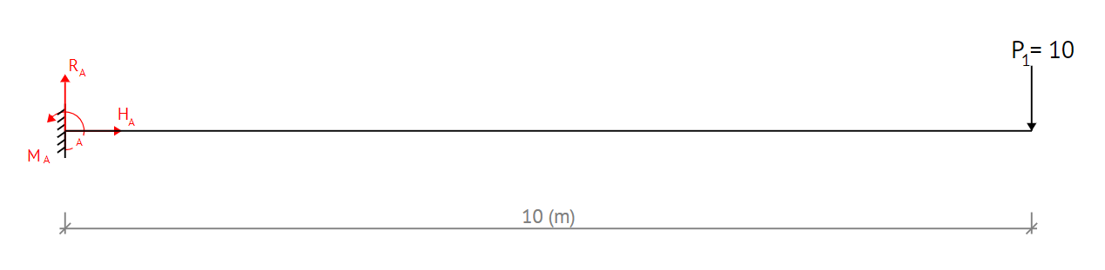
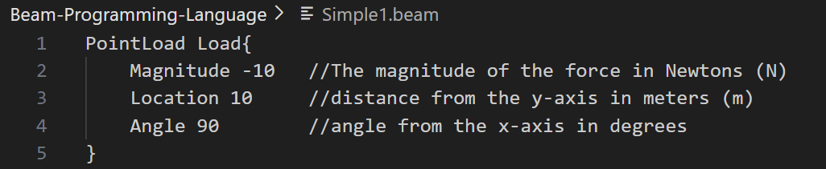
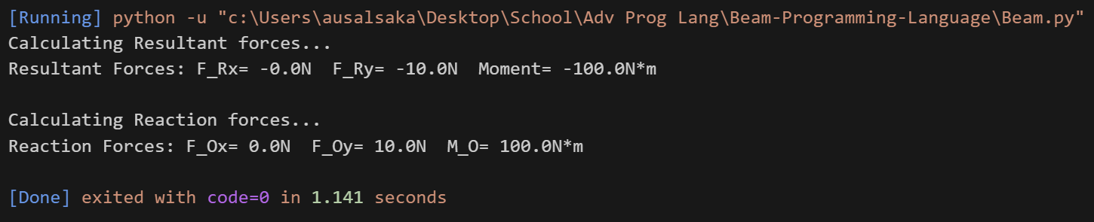
Program 1
Engineers are scared of programming
Beam only requires users to specify loading conditions
All the heavy lifting is done by the interpreter
This program defines a 10kg point load at 10m from the support
The angle is measured from the x-axis

Slide 4
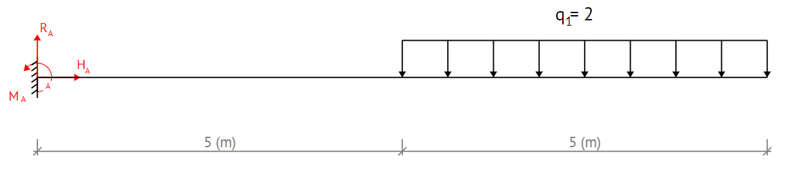
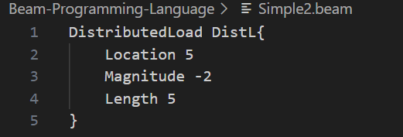
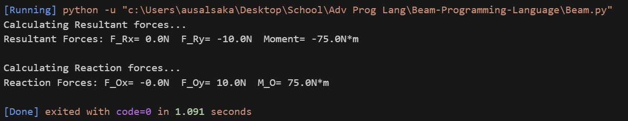
Extremely simple language
Cantilever beam
Rectangular distributed load
Starts at a distance 5 meters
Continues for another 5 meters.
The load has a magnitude of 2 Newtons per meter (N/m).
Loads are defined by stating their type, followed by their identifier, followed by their properties

Slide 5
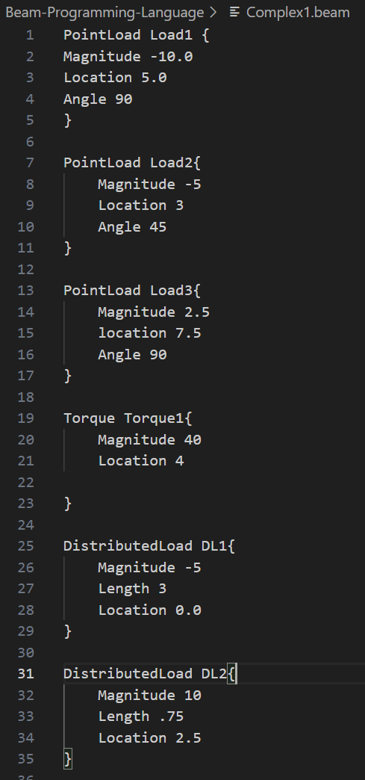
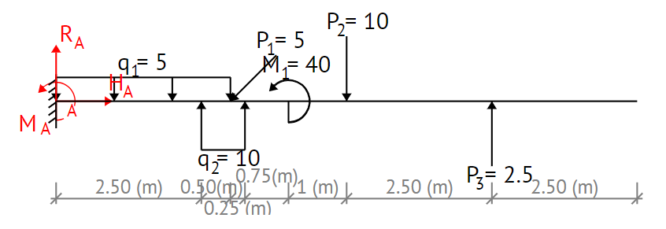
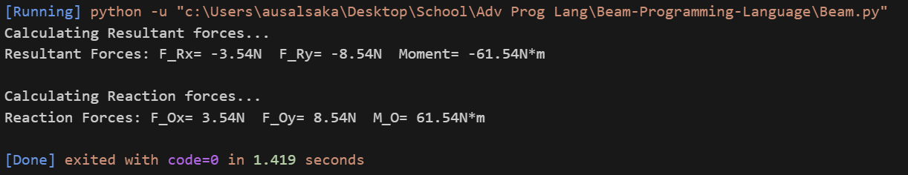
Program 2

