Slide 1

DriverPass
System Analysis
Austin Taylor
Notes:
Today I am presenting the proposed DriverPass system design. The goal is to help students prepare for DMV driving tests by combining online learning and practice tests with scheduled, in-person driving lessons. The design is based on the requirements gathered from the client interview and documented in Project One.

Slide 2

System Requirements
Functional requirements
• Create customer accounts and choose a training package
• Schedule, change, and cancel two-hour lessons
• Provide online classes and practice tests when included
• Record scores, lesson notes, and appointment changes
Nonfunctional requirements
• Web access from computers and mobile devices
• Role-based access and protected customer information
• Accurate, current appointment records
• Cloud hosting, backups, and secure connections
Notes:
These requirements describe what the system must do and how it should operate. Customers can manage their training and lessons online, while staff can support customers and maintain schedules. The system is web-based so it can be reached from a computer or mobile device. Security, accurate records, and backups are important because the system contains personal information and appointment details.

Slide 3
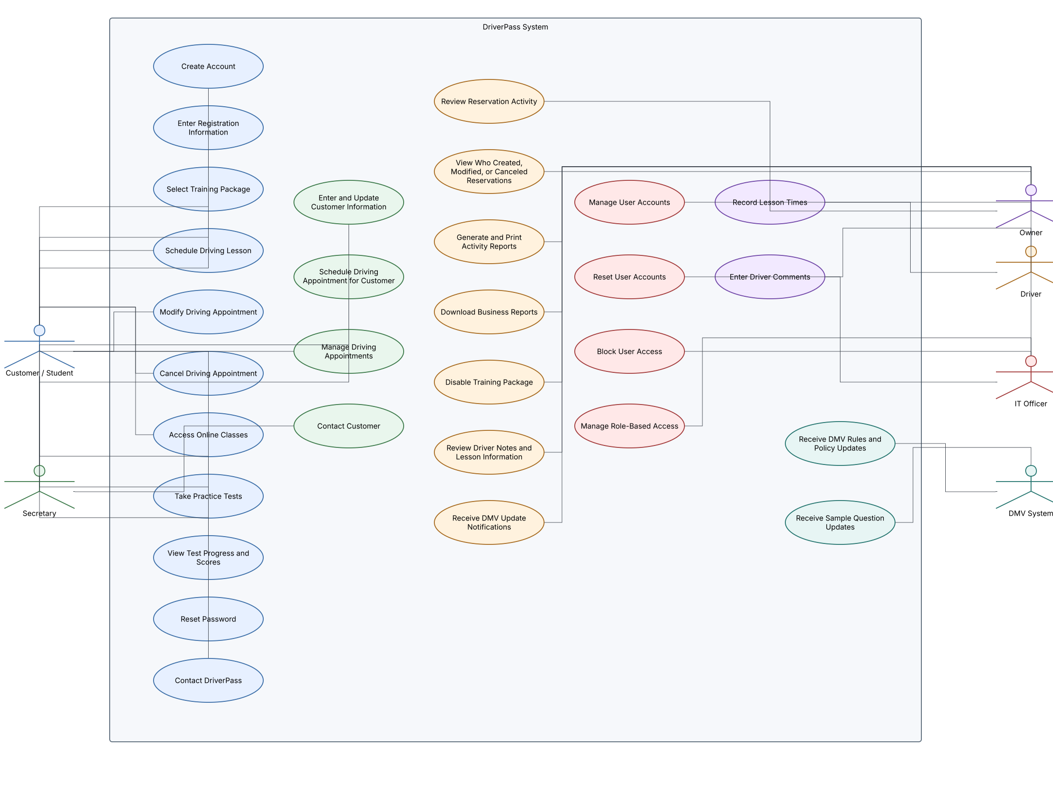
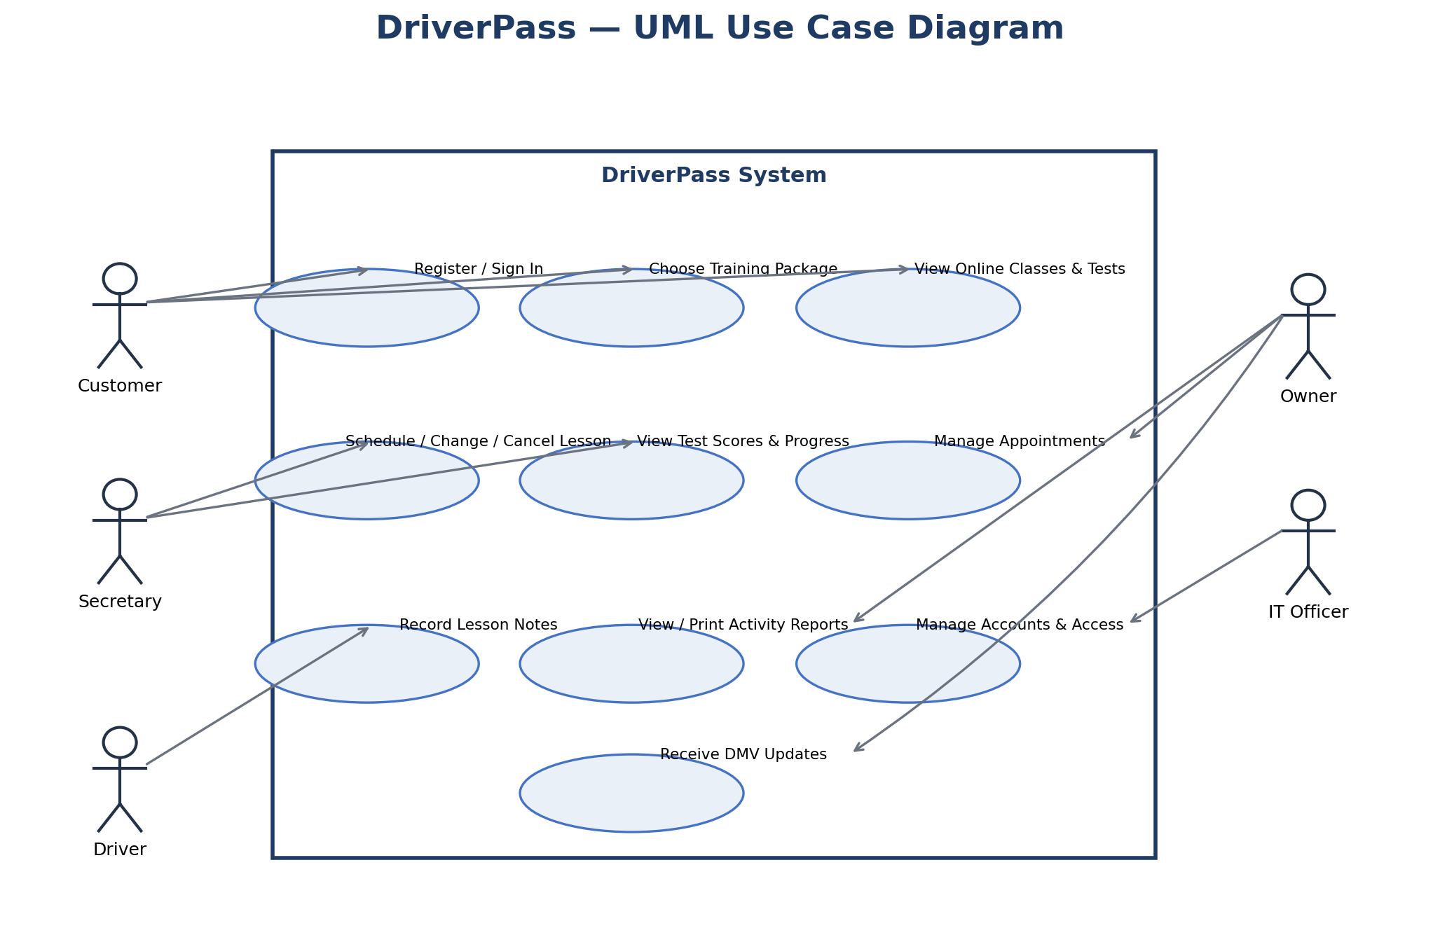
Use Case Diagram
This diagram shows the DriverPass features available to each role. Customers/students can create accounts, choose packages, manage lessons, use online classes, take practice tests, view scores, reset passwords, and contact DriverPass. The secretary can help enter customer information, schedule appointments, and contact customers. Drivers record lesson times and comments. The owner reviews reservation activity and reports. The IT officer manages accounts and access, while the DMV system provides rule, policy, and sample-question updates.
Notes:
This diagram provides a high-level view of the system from the users’ perspective. It shows that the same system supports students and employees, but that not everyone has the same permissions. This helps DriverPass serve customers while keeping business and account-management functions limited to authorized staff.

Slide 4
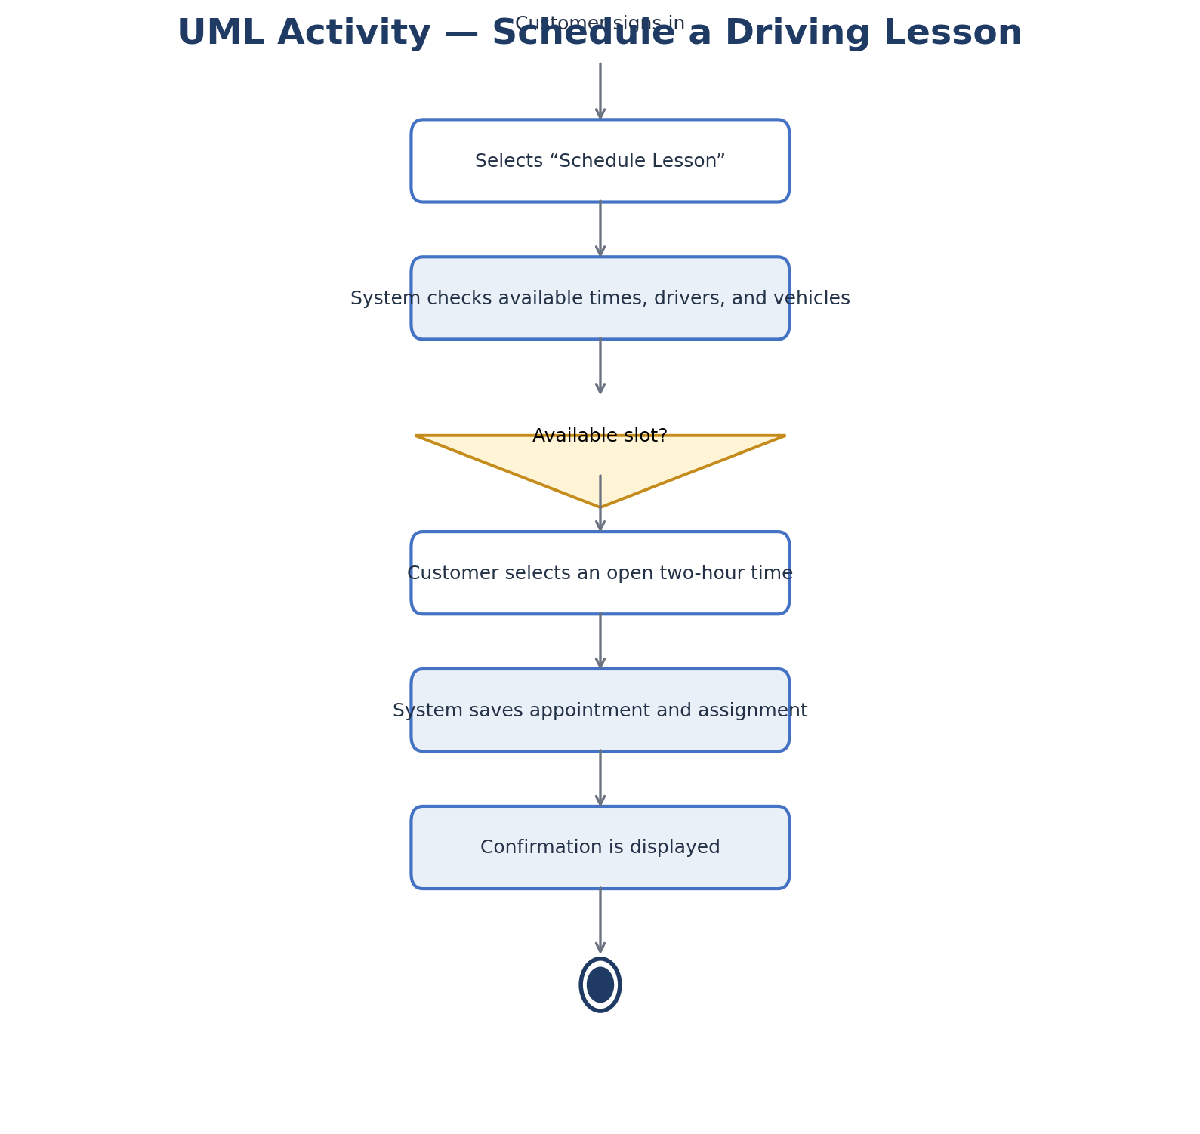
Activity
Diagram
Scheduling a driving lesson
1. Customer signs in and requests a two-hour lesson.
2. System checks available times, drivers, and vehicles.
3. Customer selects an available time.
4. System saves the appointment and displays confirmation.
If no slot is available, the customer must choose another time.
Notes:
This activity diagram explains the scheduling process from beginning to end. The system checks availability before saving the appointment so that DriverPass can reduce conflicting reservations and match each lesson with an available driver and vehicle. The customer receives confirmation after the appointment is recorded.

Slide 5
Security
• Individual sign-in and role-based permissions
• Secure password reset and account blocking by IT
• Encrypted connections between users and the service
• Activity history for appointment changes
• Cloud backups and recovery procedures
• Limit exposure of payment-card information
Notes:
Security is important because the system contains personal details and business records. Customers, drivers, the secretary, the owner, and IT staff have different responsibilities, so their access should be limited to what they need. Secure connections, password controls, activity records, and backups help protect information and support recovery if a problem occurs.

Slide 6
System Limitations
• Users need internet access to change system data.
• Online training and tests depend on the selected package.
• The first release supports the three packages identified by DriverPass.
• Creating new packages or changing training modules is planned for a future release.
• DMV updates depend on an available, supported information source.
Notes:
The design meets the client’s core needs, but there are boundaries to the initial release. Customers need internet access to make changes, and training availability depends on the package they selected. DriverPass can disable an existing package, but more flexible package creation is outside the current scope. The system can receive DMV updates only when an appropriate source is available.

