Slide 1
DR’x E-Diagnostic Assessment Guidelines & Screenshots
Prepared by: Sean Narvasa

Slide 2
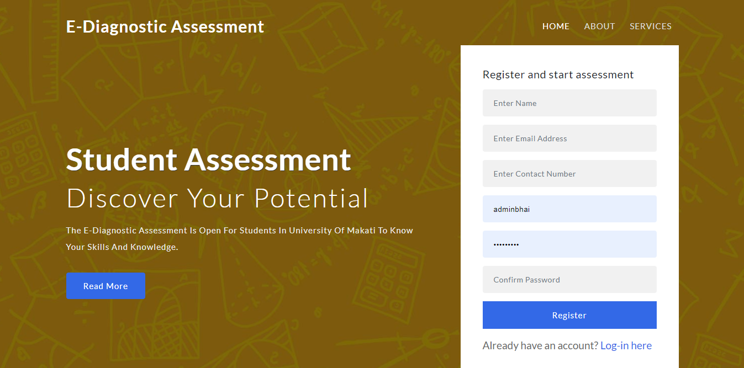
LANDING PAGE
First you can see on the website called “Landing Page” where can student can register their own user account. And if they have already account, just click the “Log in here” to redirect to the login page. Landing page also includes all the details about the website but some of them are not yet include

Slide 3
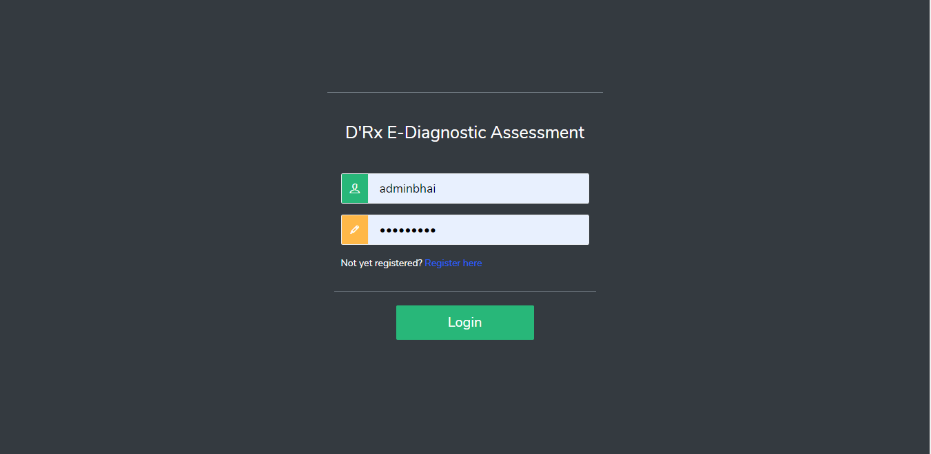
LOGIN PAGE
Student’s and Teacher’s (Admin) Login Page. If the username/password are not correct, there will be a pop-up message for checking if they existed in the database.

Slide 4
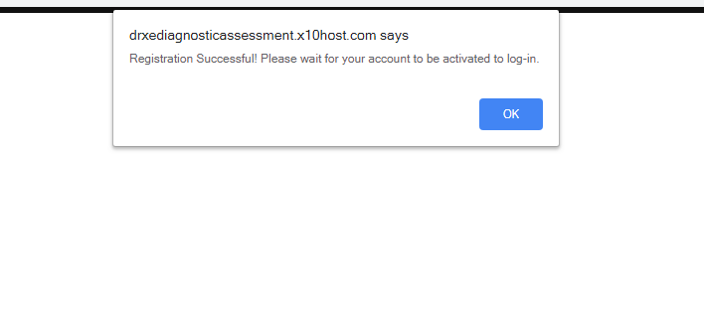
REGISTRATION STUDENT
After submitting of his/her user account details of the registration, he/she cannot be log-in the system. The student will wait until the teacher approve the registration in order to enter the system.

Slide 5
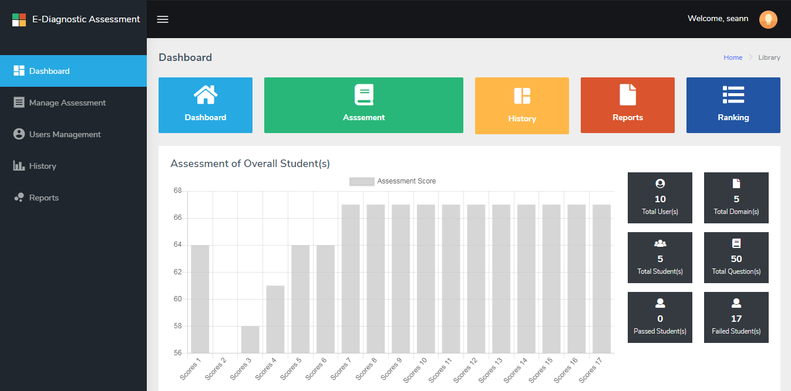
ADMIN DASHBOARD
After teacher’s (Admin) Logged in of his/her user account, it will automatically redirecting in the Admin Dashboard where you can see all the system flow and statistics of student assessment, overall users and result of assessment.

Slide 6
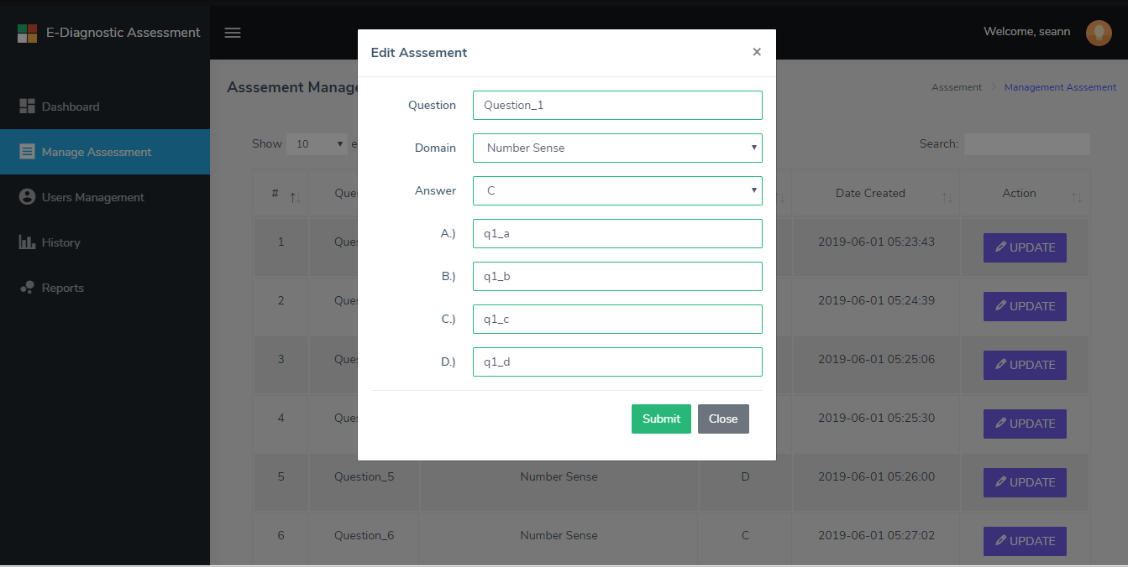
MANAGE ASSESSMENT
Manage Assessment is also a content management system or CMS that can modify a particular question or exam that included in the system. The teacher can update of the question name, domain name, correct answer, (4) choices answers of the exam by clicking the “Update” button.

Slide 7
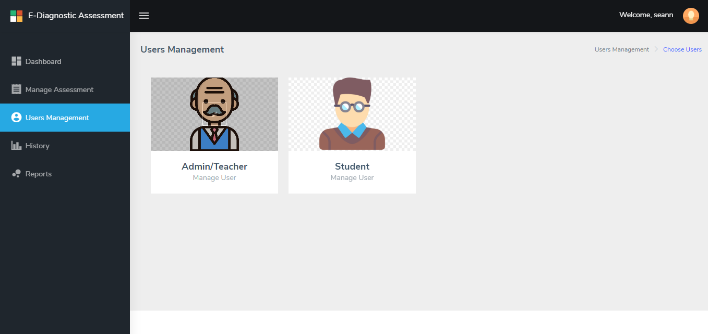
USERS MANAGEMENT
Users Management where the teacher can manage the details of all Teacher and Students. This page referring for selection of two (2) users.

Slide 8
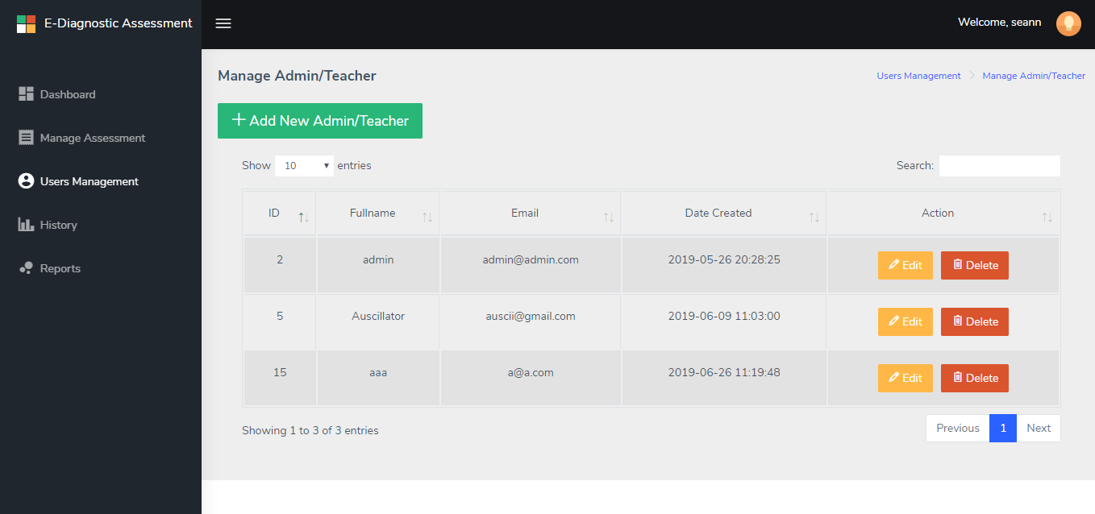
MANAGE ADMIN/TEACHER
Manage Admin/Teacher can ADD new teacher/admin user, it can also EDIT existing user and the last is the DELETE function where the user will be permanent deleted on the database of the system.

Slide 9
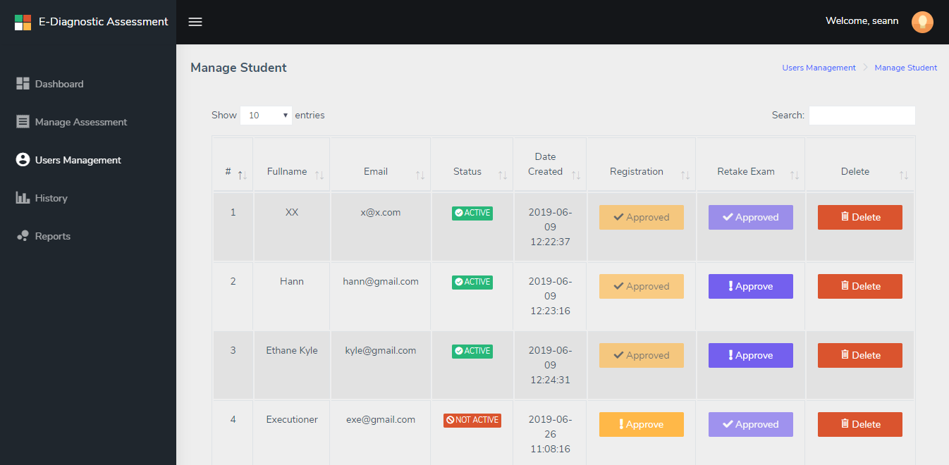
MANAGE STUDENT
Manage Student can ADD new student user, it can also EDIT existing user and the last is the DELETE function where the user will be permanent deleted on the database of the system. “Approve” yellow button refers for approval of registered students that can allow to enter in the system and “Approve” purple button refers for approval on retake exam of student(s) after he/she finished taking of the assessment/exam.

Slide 10
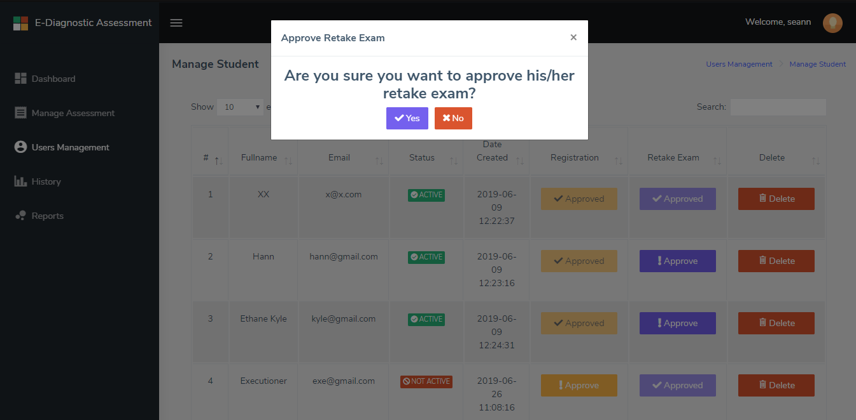
APPROVE RETAKE EXAM
After finishing the assessment/exam his/her account, it will be automatically logged-out in the system and he cannot be logged in anymore unless the teacher will approve his/her retake exam again in order to start the assessment once again.

Slide 11
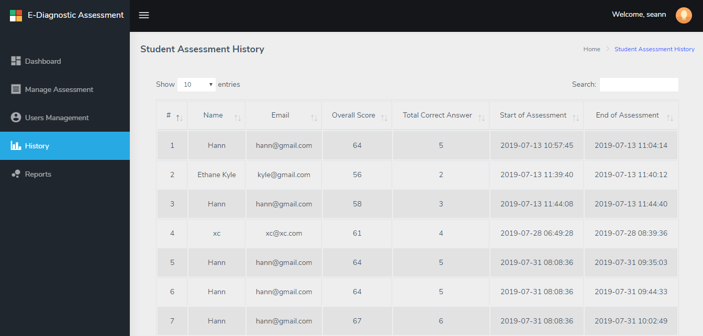
ASSESSMENT HISTORY
Student Assessment History, from the word itself it shows all the history of specific logged in student.

Slide 12
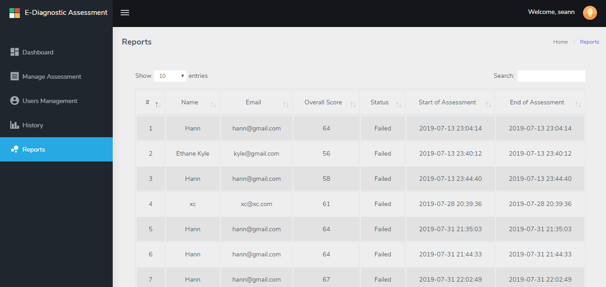
REPORTS
Reports can display all the record of taking assessment of the students.

Slide 13
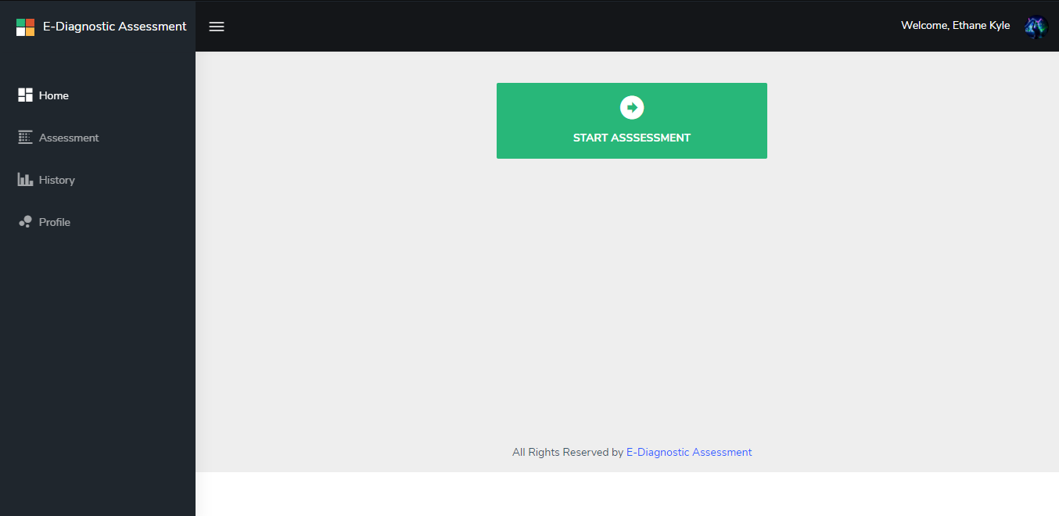
HOMEPAGE (STUDENT)
After logged-in of student user account, it will automatically redirected in student homepage. “start assessment” button is shortcut key for taking his exam/assessment.

Slide 14
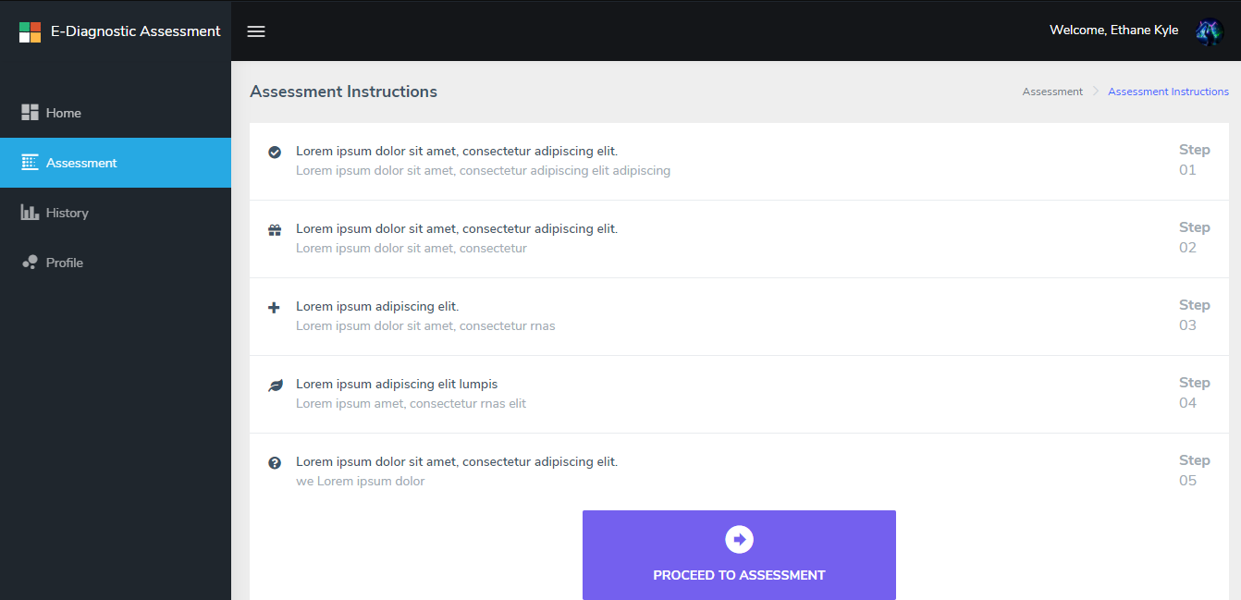
ASSESSMENT INSTRUCTION
Assessment Instructions for student(s), step 1 to step 5 details is to be announce by miss tessa.

Slide 15
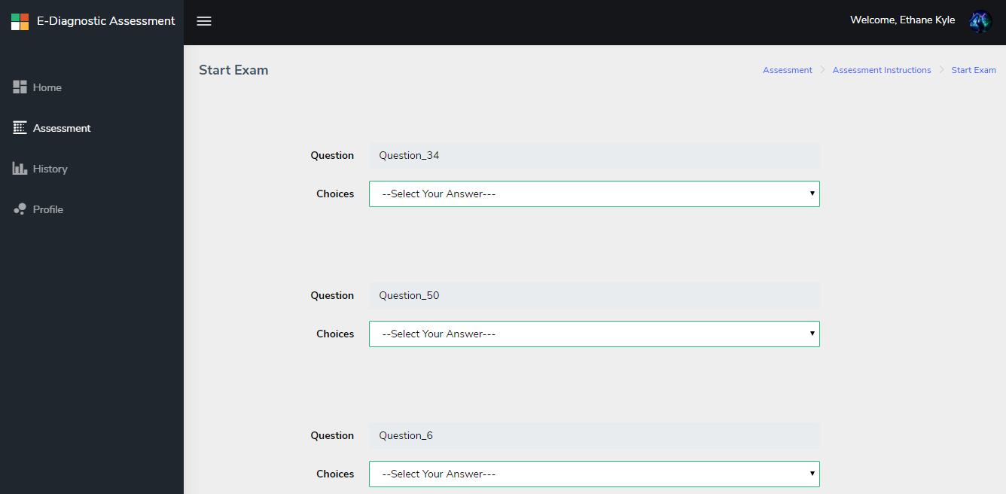
START EXAM
Start Assessment/Exam contains a fix 50 questions that can display randomly arranged depending of their particular domain name(s).

Slide 16
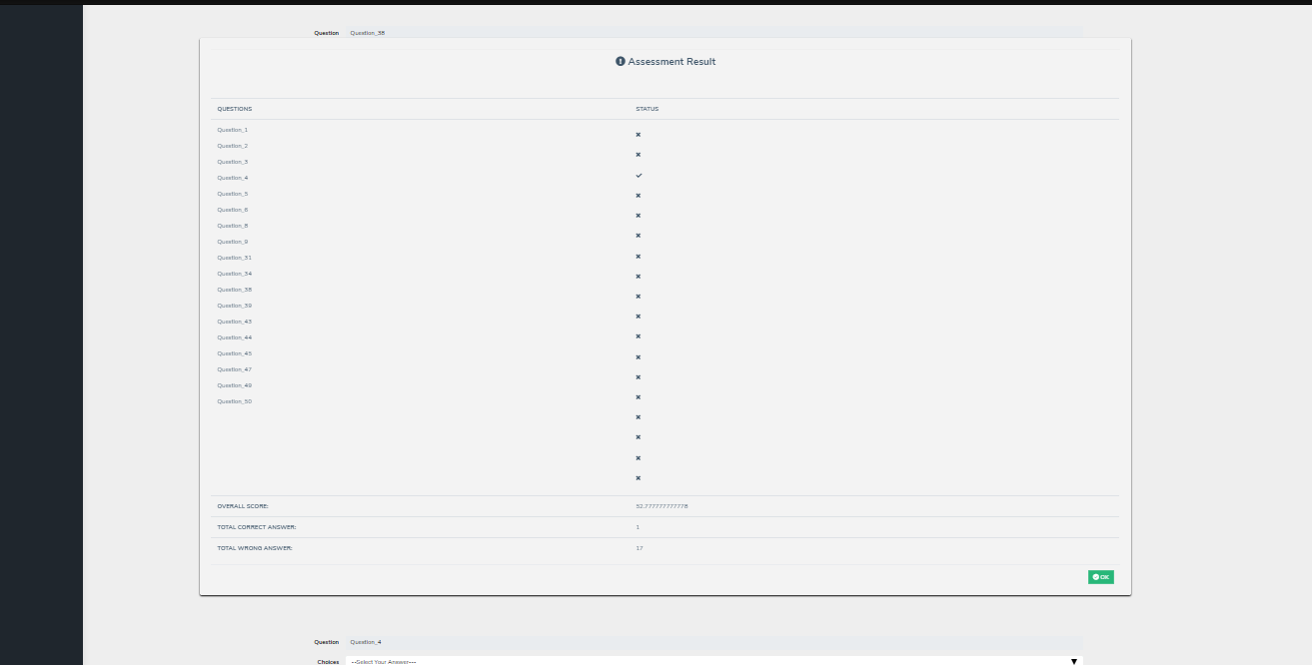
EXAM RESULT
After taking the exam/asssessment you must click the submit button and after that, the Assessment Result will automatically display the correct/wrong answer and statistics of exam. And after you click the “close” button, the student will be automatically logged out and he/she cannot take another exam unless the teacher/admin will allow him to approve in order to start again the exam.

Slide 17
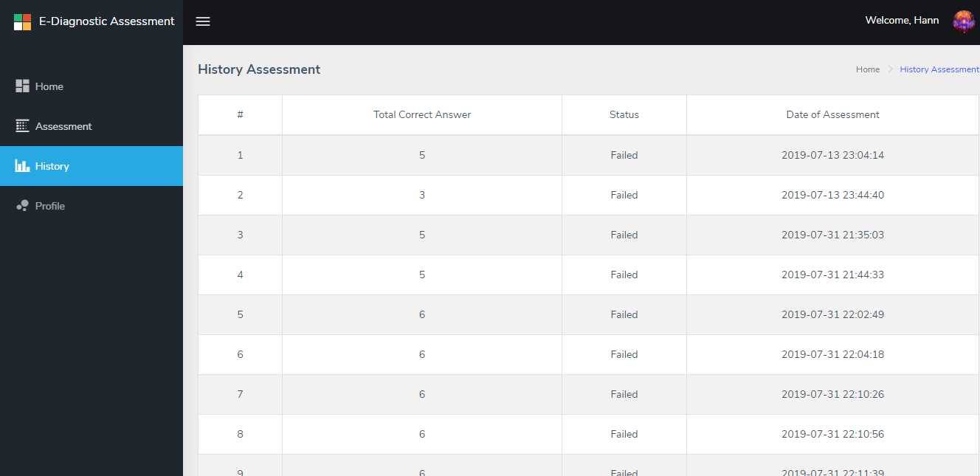
HISTORY ASSESSMENT
History Assessment display the assessment record of particular student user.

Slide 18
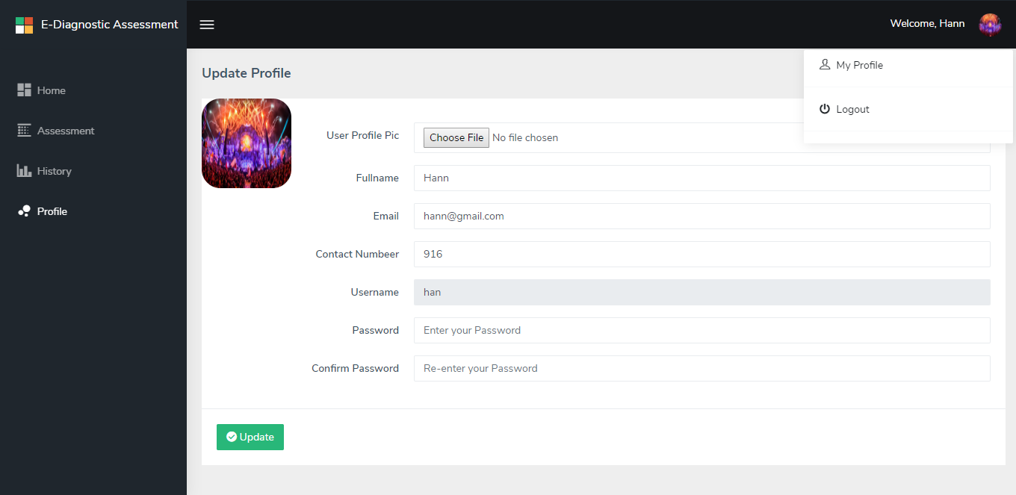
STUDENT PROFILE
Student Profile, where you can edit your own profile details like fullname, email address, contact number, username, password and upload profile picture of student.

Slide 19
FIN.

