Slide 1
Rise of Airbus: A New Era in Aviation
How Airbus Surpassed Boeing to Become the Leading Aircraft Manufacturer

Slide 2
History of Airbus
Airbus was founded in 1970 as a consortium of European aircraft manufacturers.
The company's first aircraft, the A300, was introduced in 1972.

Slide 3
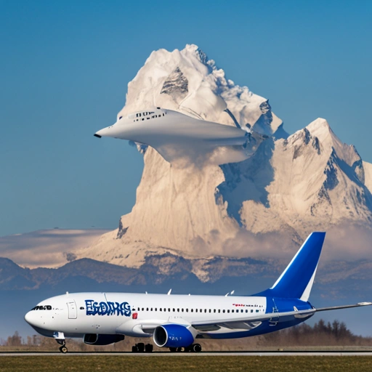
Airbus vs Boeing: Market Share
In the 1990s, Boeing dominated the market with a 60% share, while Airbus had around 30% [1]. However, by 2019, Airbus had surpassed Boeing with a 56% market share [2].

Slide 4
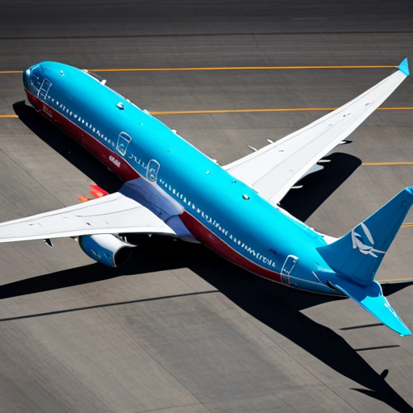
Boeing's Downfall: Factors Contributing to Airbus' Rise
Boeing's downfall can be attributed to several factors, including the 737 MAX crisis, which led to a significant decline in sales and market share [3]. This, combined with Airbus' strategic expansion and innovative products, allowed the company to capitalize on Boeing's weaknesses and gain a competitive edge.

Slide 5
Key Factors in Airbus' Success
Strategic partnerships and collaborations
Investment in research and development
Diversification of product offerings

Slide 6
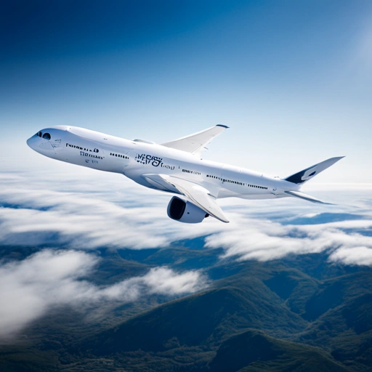
Airbus' Product Line
Airbus offers a wide range of commercial aircraft, including the A220, A320, A330, and A350 XWB, as well as military transports and helicopters.

Slide 7
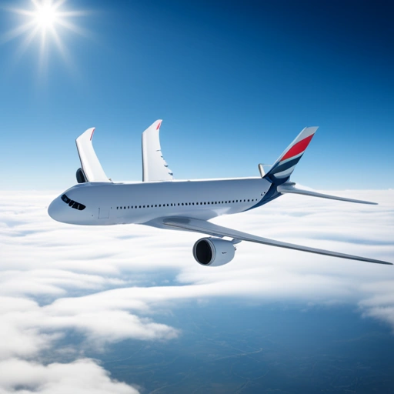
Sustainability Initiatives
Airbus is committed to reducing its environmental footprint and has launched several sustainability initiatives, including the development of electric and hybrid-electric propulsion systems [4].

Slide 8
Challenges and Opportunities
Increasing competition from emerging manufacturers
Rising demand for sustainable aviation solutions

Slide 9
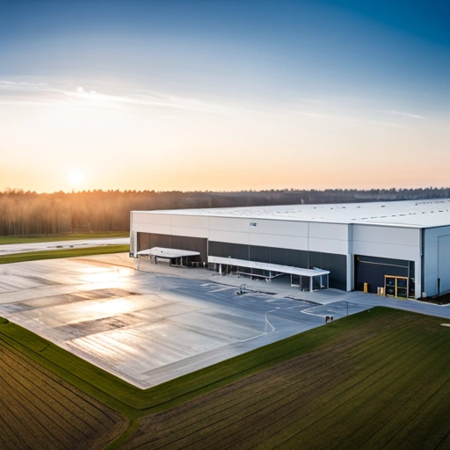
Airbus' Global Presence
Airbus has a significant global presence, with manufacturing facilities and sales offices in over 20 countries. The company's international partnerships and collaborations have played a crucial role in its success [5].

Slide 10
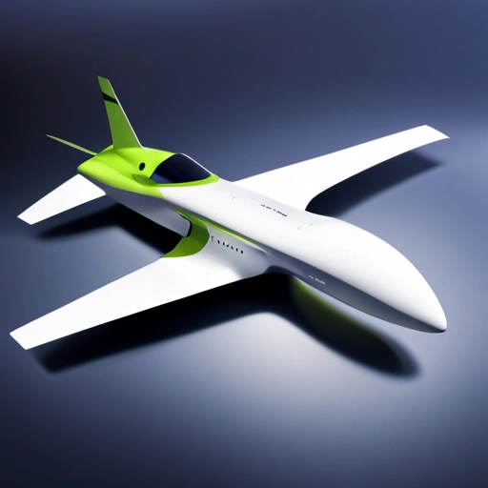
Innovation and R&D
Airbus is committed to innovation and invests heavily in research and development. The company's ZEROe concept aircraft, unveiled in 2020, is a hydrogen-powered plane that could potentially reduce emissions by up to 75% [6].

Slide 11
Airbus' Impact on the Aviation Industry
Job creation and economic growth
Advancements in aviation technology

Slide 12
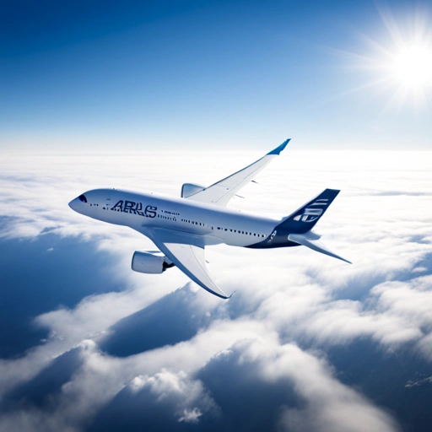
Conclusion
In conclusion, the rise of Airbus can be attributed to a combination of strategic partnerships, innovative products, and a commitment to sustainability. As the aviation industry continues to evolve, Airbus is well-positioned to remain a leader in commercial aircraft manufacturing.

Slide 13
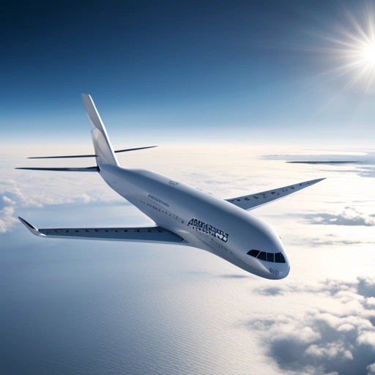
Future Prospects
Looking to the future, Airbus is exploring new opportunities in urban air mobility and electric propulsion. The company's CityAirbus concept, unveiled in 2019, is a self-flying taxi that could revolutionize urban transportation [7].

Slide 14
Key Takeaways
Airbus has surpassed Boeing as the leading commercial aircraft manufacturer
The company's success can be attributed to strategic partnerships and innovative products

Slide 15
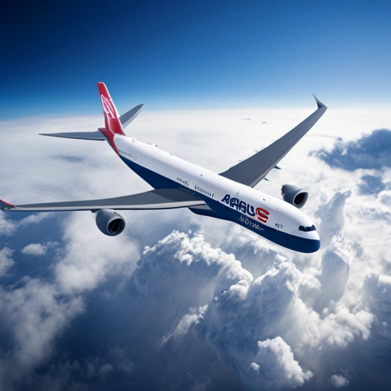
Global Market Trends
The global commercial aircraft market is projected to grow at a CAGR of 5% from 2020 to 2025, driven by increasing demand for air travel and the need for sustainable aviation solutions [8].

Slide 16
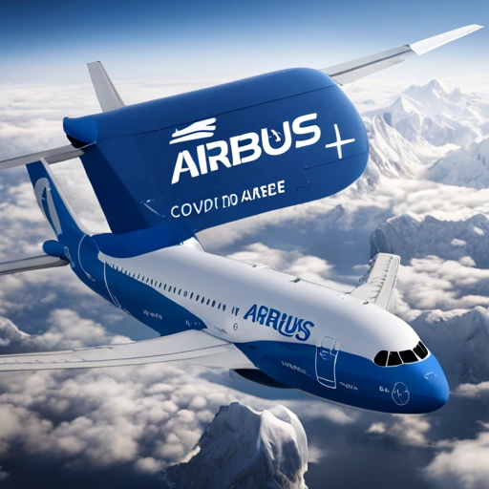
Airbus' Response to COVID-19
In response to the COVID-19 pandemic, Airbus has implemented various measures to ensure the health and safety of its employees and customers, including the development of a COVID-19 vaccine transportation solution [9].

Slide 17
Airbus' Commitment to Diversity and Inclusion
50% of Airbus' workforce is composed of international employees
The company has implemented various initiatives to promote diversity and inclusion in the workplace

Slide 18
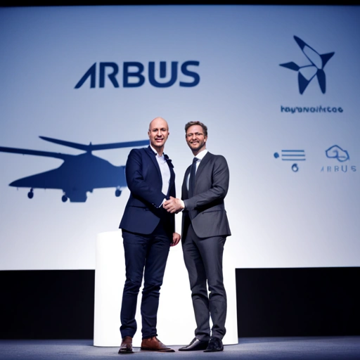
Airbus' Partnership with Startups
Airbus has partnered with various startups to accelerate innovation and develop new technologies, including electric propulsion and autonomous systems [10].

Slide 19
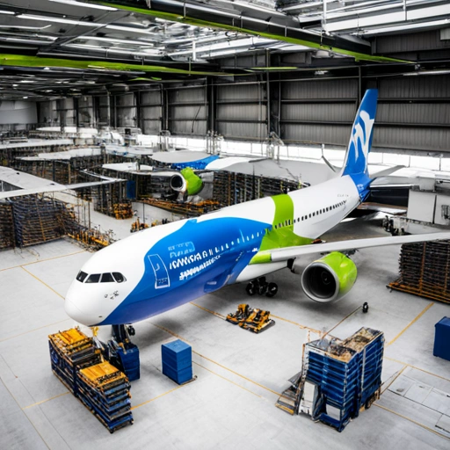
Airbus' Contribution to the Environment
Airbus is committed to reducing its environmental footprint and has implemented various measures to minimize waste and emissions, including the use of eco-friendly manufacturing processes and sustainable materials [11].

Slide 20
References
[1] Airbus. (2020). Annual Report.
[2] Boeing. (2020). Annual Report.
[3] Reuters. (2020). Boeing 737 MAX crisis.
[4] Airbus. (2020). Sustainability Report.
[5] Airbus. (2020). Global Presence.
[6] Airbus. (2020). ZEROe concept aircraft.
[7] Airbus. (2019). CityAirbus concept.
[8] MarketsandMarkets. (2020). Commercial Aircraft Market.
[9] Airbus. (2020). COVID-19 response.
[10] Airbus. (2020). Startup partnership.
[11] Airbus. (2020). Eco-friendly manufacturing.

