Slide 1
Existence of IOT and its Future
Transforming Day-to-Day Life

Slide 2
IOT Applications
Smart Home Automation
Wearable Devices
Industrial Automation

Slide 3

IOT Impact on Daily Life
IOT has made our lives more convenient, efficient, and connected [3].

Slide 4

IOT in Healthcare
IOT has revolutionized the healthcare industry with remote patient monitoring, telemedicine, and personalized medicine [4].

Slide 5
IOT Benefits
Increased Efficiency
Improved Productivity
Enhanced Customer Experience

Slide 6

IOT Challenges
Despite its benefits, IOT also poses several challenges, including security concerns, data privacy issues, and interoperability problems [6].

Slide 7

IOT Future Outlook
The future of IOT holds tremendous promise, with emerging technologies like artificial intelligence, blockchain, and 5G networks [7].

Slide 8
IOT Trends
Edge Computing
Artificial Intelligence
5G Networks

Slide 9
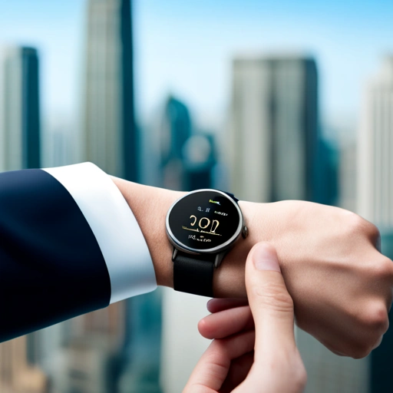
IOT and Daily Life
IOT has transformed daily life, from smart homes to wearable devices, and will continue to impact our lives in the future [9].

Slide 10
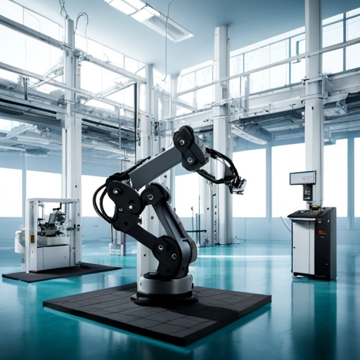
IOT and Industry
IOT has revolutionized various industries, from manufacturing to healthcare, and will continue to drive innovation and growth [10].

Slide 11
IOT Applications in Industry
Predictive Maintenance
Quality Control
Supply Chain Management

Slide 12

IOT and Society
IOT has a significant impact on society, from improving public services to enhancing citizen engagement [12].

Slide 13
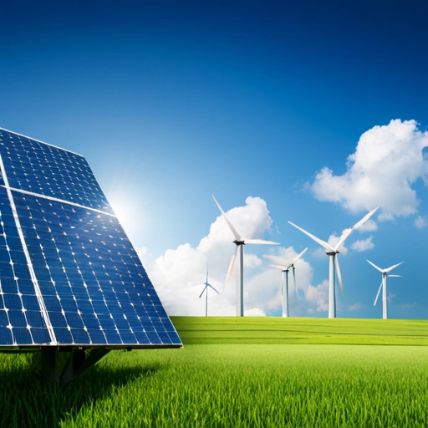
IOT and Environment
IOT can help mitigate environmental challenges, such as climate change, by optimizing resource usage and reducing waste [13].

Slide 14
IOT and Sustainability
Energy Efficiency
Water Conservation
Waste Reduction

Slide 15

IOT and Future
The future of IOT is promising, with emerging technologies and innovations that will continue to transform our lives [15].

Slide 16

IOT and Humans
IOT will continue to impact human life, from improving healthcare to enhancing daily experiences [16].

Slide 17
IOT Challenges and Opportunities
Security Concerns
Data Privacy Issues
Interoperability Problems

Slide 18

IOT and Business
IOT has transformed the business landscape, from improving operational efficiency to enhancing customer experiences [18].

Slide 19
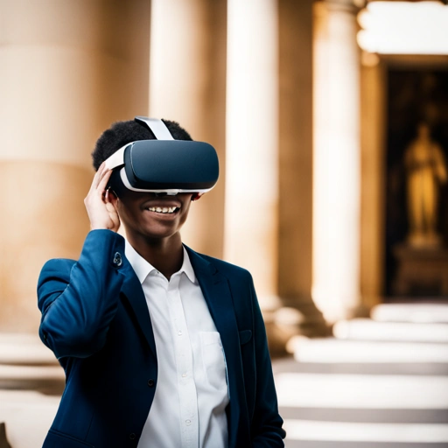
IOT and Education
IOT can improve education by providing personalized learning experiences, enhancing teacher-student interaction, and increasing access to educational resources [19].

Slide 20
References
[1] IEEE Internet of Things Journal
[2] IOT Council
[3] Harvard Business Review
[4] Journal of Medical Systems
[5] McKinsey & Company
[6] Cybersecurity and Infrastructure Security Agency
[7] Gartner
[8] International Journal of Advanced Research in Computer Science
[9] Smart Cities Council
[10] Industrial Internet Consortium
[11] Journal of Intelligent Manufacturing
[12] National League of Cities
[13] Environmental Protection Agency
[14] United Nations
[15] World Economic Forum
[16] Pew Research Center
[17] Institute of Electrical and Electronics Engineers
[18] Business Insider
[19] Education Week

