Slide 1
Impact of IoT on Daily Life
How IoT is Changing the Way We Live

Slide 2
Applications of IoT
Smart Homes: IoT enables remote monitoring and control of home appliances, lighting, and security systems [1].
Wearables: IoT-based wearables track fitness, health, and location, providing valuable insights into daily activities [2].
Industrial Automation: IoT optimizes manufacturing processes, predictive maintenance, and quality control [3].

Slide 3
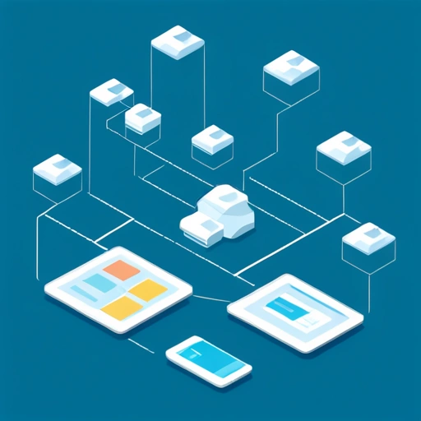
Benefits of IoT
IoT offers numerous benefits, including increased efficiency, convenience, and cost savings. It also enables real-time monitoring and data analysis, leading to better decision-making [4].

Slide 4
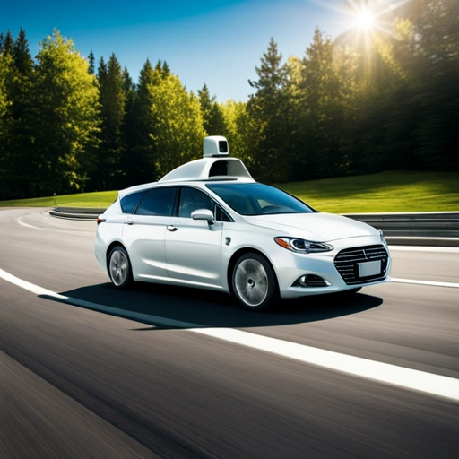
IoT in Transportation
IoT is transforming the transportation sector with self-driving cars, smart traffic management, and predictive maintenance, reducing accidents and improving commute times [5].

Slide 5
Challenges and Concerns
Security: IoT devices are vulnerable to cyber threats, compromising personal data and safety [6].
Privacy: IoT devices collect vast amounts of personal data, raising concerns about data protection and surveillance [7].
Interoperability: IoT devices from different manufacturers may not be compatible, hindering seamless integration [8].

Slide 6
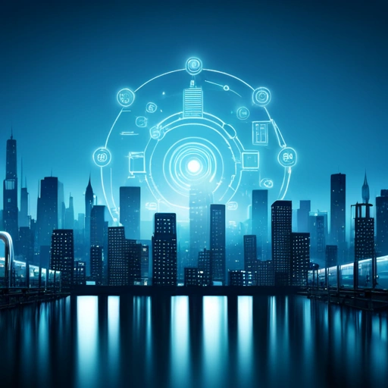
Future of IoT
The future of IoT holds tremendous potential, with emerging technologies like artificial intelligence, blockchain, and 5G networks, expected to drive innovation and growth [9].

Slide 7

IoT in Healthcare
IoT is revolutionizing healthcare with remote patient monitoring, telemedicine, and personalized medicine, improving patient outcomes and reducing costs [10].

Slide 8
Impact on Daily Life
Increased convenience: IoT enables smart home automation, making daily tasks easier and more efficient [11].
Improved safety: IoT-based security systems and wearables enhance personal safety and emergency response [12].
Enhanced productivity: IoT optimizes workflows, reduces downtime, and increases productivity in various industries [13].

Slide 9

IoT and Environment
IoT can help mitigate environmental challenges by monitoring air and water quality, detecting natural disasters, and optimizing resource consumption [14].

Slide 10

IoT in Education
IoT is transforming education with interactive learning platforms, virtual labs, and personalized learning experiences, improving student outcomes and engagement [15].

Slide 11
Conclusion
IoT is revolutionizing various aspects of daily life, from smart homes to industrial automation.
While IoT offers numerous benefits, it also raises concerns about security, privacy, and interoperability.
As IoT continues to evolve, it is essential to address these challenges and ensure a secure, efficient, and beneficial IoT ecosystem.

Slide 12
References

Slide 13
References (continued)

Slide 14
References (continued)

Slide 15
References (continued)

Slide 16
References (continued)

