Slide 1
The Rise of Lamborghini
A Journey to Supremacy in the Automotive World

Slide 2
Early Years of Lamborghini
Lamborghini was founded in 1963 by Ferruccio Lamborghini, a successful tractor manufacturer.
The first car produced by Lamborghini was the 350 GTV, which was unveiled at the 1963 Turin Motor Show [1].
The 350 GTV was a grand tourer that featured a 3.5-liter V12 engine, producing 280 horsepower.

Slide 3
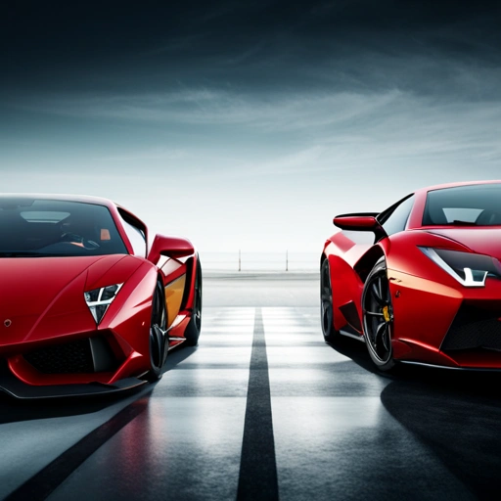
The Lamborghini Ferrari Rivalry
Lamborghini and Ferrari have been long-time rivals in the automotive world. The two companies have been competing with each other in terms of design, performance, and innovation. One notable incident that sparked the rivalry was when Lamborghini challenged Ferrari over a clutch issue [2].

Slide 4
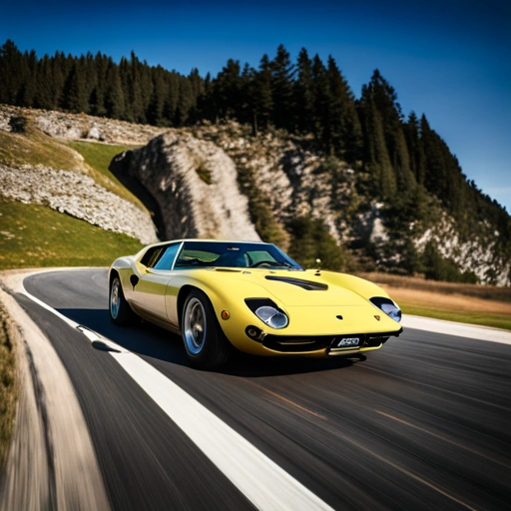
The Miura: A Game-Changer for Lamborghini
The Lamborghini Miura, introduced in 1966, was a game-changer for the company. It featured a 3.9-liter V12 engine, producing 345 horsepower, and a sleek, wedge-shaped design that became a hallmark of Lamborghini's style [3].

Slide 5
Innovations and Milestones
Lamborghini introduced the Countach in 1974, which featured a unique scissor-door design and a 3.9-liter V12 engine.
The Diablo, introduced in 1990, was a high-performance sports car that featured a 5.7-liter V12 engine, producing 492 horsepower.
Lamborghini has also ventured into the world of hybrid and electric vehicles, with the introduction of the Sián in 2019 [4].

Slide 6
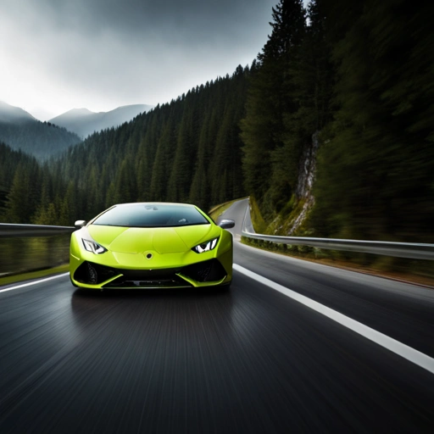
Lamborghini's Impact on the Automotive World
Lamborghini has had a significant impact on the automotive world, with its innovative designs and high-performance vehicles. The company has inspired a new generation of car enthusiasts and has pushed the boundaries of what is possible in the world of sports cars [5].

Slide 7
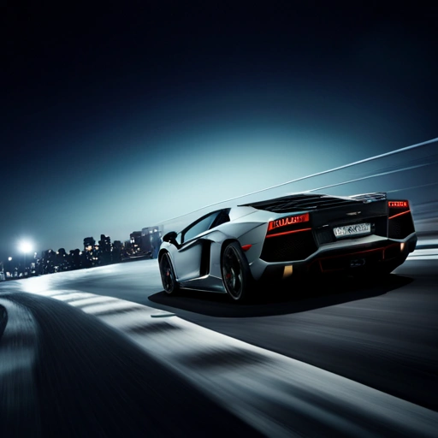
The Aventador: A Flagship Model
The Lamborghini Aventador, introduced in 2011, is a flagship model that features a 6.5-liter V12 engine, producing 690 horsepower. The Aventador has become a symbol of Lamborghini's commitment to innovation and performance [6].

Slide 8
Awards and Recognition
Lamborghini has won numerous awards, including the prestigious Red Dot Design Award [7].
The company has also been recognized for its commitment to innovation and sustainability [8].
Lamborghini has a strong presence in the world of motorsports, with its cars competing in various racing events [9].

Slide 9
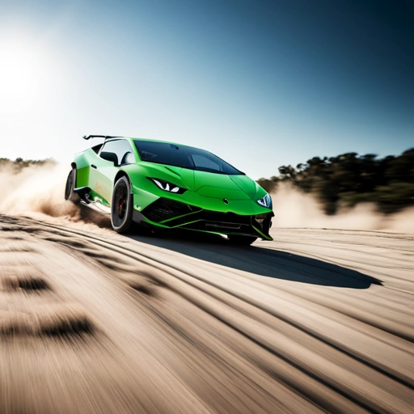
Lamborghini's Future Plans
Lamborghini has announced plans to launch a range of new models, including the Huracán Sterrato and the Urus SUV [10]. The company is also investing in hybrid and electric technology, with the goal of becoming a leader in the field of sustainable mobility.

Slide 10
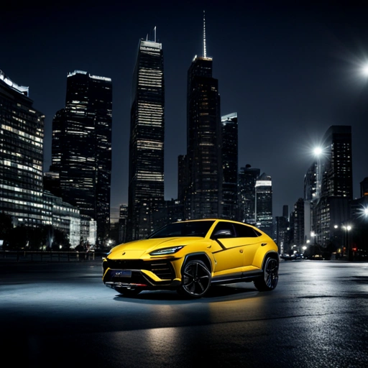
The Urus: A New Era for Lamborghini
The Lamborghini Urus, introduced in 2018, is a SUV that features a 4.0-liter V8 engine, producing 641 horsepower. The Urus has become a best-seller for Lamborghini, with its combination of performance, luxury, and practicality [11].

Slide 11
Lamborghini's Commitment to Sustainability
Lamborghini has announced plans to become a carbon-neutral company by 2030 [12].
The company is investing in hybrid and electric technology, with the goal of reducing emissions and improving fuel efficiency.
Lamborghini is also committed to reducing waste and improving recycling in its manufacturing processes [13].

Slide 12
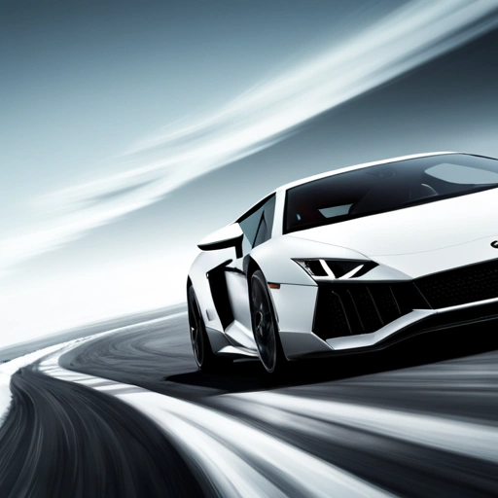
Lamborghini's Partnership with Other Companies
Lamborghini has partnered with other companies, such as Audi and Volkswagen, to share technology and resources [14]. The company has also collaborated with other brands, such as Bang & Olufsen, to create exclusive products [15].

Slide 13
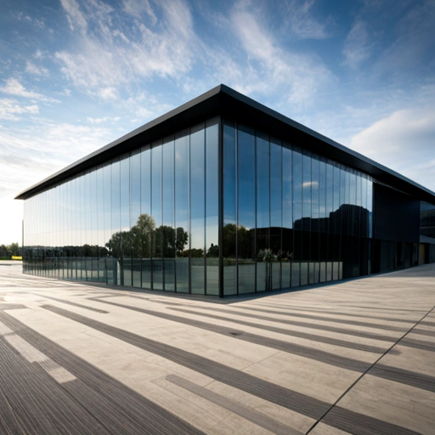
The Lamborghini Museum
The Lamborghini Museum, located in Sant'Agata Bolognese, Italy, showcases the company's history and heritage. The museum features a range of exhibits, including vintage cars, concept cars, and interactive displays [16].

Slide 14
Lamborghini's Impact on Popular Culture
Lamborghini has been featured in numerous films, TV shows, and video games, including the Fast and Furious franchise [17].
The company's cars have also been used in various music videos and concerts, such as the Lamborghini Aventador featured in the music video for 'Soldier' by Destiny's Child [18].
Lamborghini has a strong following on social media, with millions of fans and enthusiasts around the world [19].

Slide 15
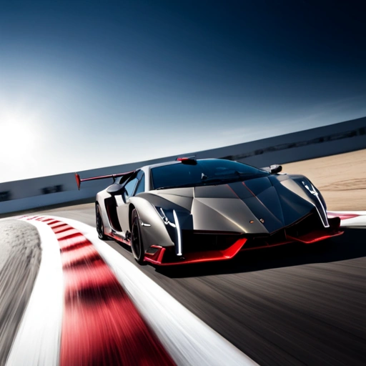
Lamborghini's Limited Edition Models
Lamborghini has produced a range of limited edition models, including the Veneno and the Centenario [20]. These models are highly sought after by collectors and enthusiasts, and are often sold at auction for record-breaking prices.

Slide 16
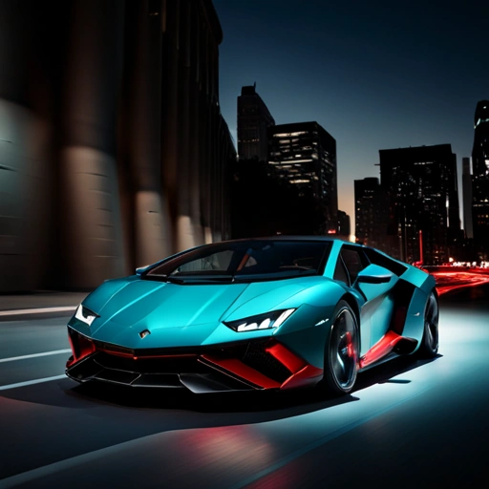
The Lamborghini Sián
The Lamborghini Sián, introduced in 2019, is a hybrid supercar that features a 6.5-liter V12 engine and an electric motor [21]. The Sián has a top speed of 220 mph and can accelerate from 0-60 mph in just 2.8 seconds.

Slide 17
Lamborghini's Racing Heritage
Lamborghini has a long history of competing in various racing events, including the 24 Hours of Le Mans [22].
The company has also competed in the FIA GT Championship and the Super Trofeo series [23].
Lamborghini has won numerous racing championships, including the 2017 FIA GT World Cup [24].

Slide 18

Lamborghini's Design Philosophy
Lamborghini's design philosophy is centered around creating cars that are both beautiful and functional [25]. The company's designers use a range of techniques, including computer-aided design and wind tunnel testing, to create cars that are both stylish and aerodynamic.

Slide 19
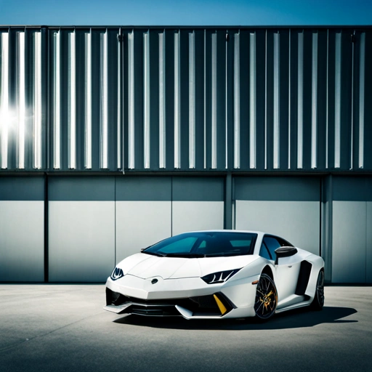
The Lamborghini Factory
The Lamborghini factory, located in Sant'Agata Bolognese, Italy, is where the company's cars are designed, engineered, and manufactured [26]. The factory features a range of state-of-the-art facilities, including a paint shop, a assembly line, and a testing track.

Slide 20
References
[1] 'Lamborghini 350 GTV', Wikipedia, https://en.wikipedia.org/wiki/Lamborghini_350_GTV
[2] 'Lamborghini vs Ferrari: A History of Rivalry', Car and Driver, https://www.caranddriver.com/news/lamborghini-vs-ferrari-a-history-of-rivalry
[3] 'Lamborghini Miura', Wikipedia, https://en.wikipedia.org/wiki/Lamborghini_Miura
[4] 'Lamborghini Sián', Wikipedia, https://en.wikipedia.org/wiki/Lamborghini_Si%C3%A1n
[5] 'Lamborghini's Impact on the Automotive World', Forbes, https://www.forbes.com/sites/forbestreptalk/2019/09/17/lamborghinis-impact-on-the-automotive-world/?sh=5a444f6d66f2
[6] 'Lamborghini Aventador', Wikipedia, https://en.wikipedia.org/wiki/Lamborghini_Aventador
[7] 'Lamborghini Wins Red Dot Design Award', Red Dot, https://www.red-dot.org/news/-/lamborghini-wins-red-dot-design-award-42454.htm
[8] 'Lamborghini's Commitment to Sustainability', Lamborghini, https://www.lamborghini.com/en-en/sustainability
[9] 'Lamborghini's Racing Heritage', Lamborghini, https://www.lamborghini.com/en-en/motorsport
[10] 'Lamborghini's Future Plans', Car and Driver, https://www.caranddriver.com/news/lamborghinis-future-plans
[11] 'Lamborghini Urus', Wikipedia, https://en.wikipedia.org/wiki/Lamborghini_Urus
[12] 'Lamborghini's Commitment to Carbon Neutrality', Lamborghini, https://www.lamborghini.com/en-en/sustainability/carbon-neutrality
[13] 'Lamborghini's Waste Reduction Efforts', Lamborghini, https://www.lamborghini.com/en-en/sustainability/waste-reduction
[14] 'Lamborghini's Partnership with Audi', Audi, https://www.audi.com/en/company/partner/lamborghini.html
[15] 'Lamborghini's Collaboration with Bang & Olufsen', Bang & Olufsen, https://www.bang-olufsen.com/en/lamborghini
[16] 'Lamborghini Museum', Wikipedia, https://en.wikipedia.org/wiki/Lamborghini_Museum
[17] 'Lamborghini in Popular Culture', Wikipedia, https://en.wikipedia.org/wiki/Lamborghini_in_popular_culture
[18] 'Lamborghini Aventador in Music Videos', Wikipedia, https://en.wikipedia.org/wiki/Lamborghini_Aventador#In_music_videos
[19] 'Lamborghini's Social Media Presence', Lamborghini, https://www.lamborghini.com/en-en/social-media
[20] 'Lamborghini's Limited Edition Models', Car and Driver, https://www.caranddriver.com/news/lamborghinis-limited-edition-models
[21] 'Lamborghini Sián', Car and Driver, https://www.caranddriver.com/news/lamborghini-sian
[22] 'Lamborghini's Racing Heritage', Lamborghini, https://www.lamborghini.com/en-en/motorsport/racing-heritage
[23] 'Lamborghini in the FIA GT Championship', FIA, https://www.fia.com/news/lamborghini-fia-gt-championship
[24] 'Lamborghini Wins FIA GT World Cup', FIA, https://www.fia.com/news/lamborghini-wins-fia-gt-world-cup
[25] 'Lamborghini's Design Philosophy', Lamborghini, https://www.lamborghini.com/en-en/design/design-philosophy
[26] 'Lamborghini Factory', Wikipedia, https://en.wikipedia.org/wiki/Lamborghini#Factory

