Slide 1

SAMSUNG PRISM
Generative AI
Hackathon
3rd Edition 2026 – 27
Theme ID - 02 · Smart Guided Troubleshooting Engine
Team Name - Terra
College Name – SRM Institute Of Science and Technology
Member Name & Email 1- Ayush Garg & aush5895@gmail.com
Member Name & Email 2- Yash Shekhar Rai & ys9432@srmist.edu.in
Member Name & Email 3- Yuvraj & yr9065@srmist.edu.in
Member Name & Email 4- Daksh Kumar & dk9052@srmist.edu.in
Submission Github link - github.com/aush5895/Prism
Notes:
Opening slide for the 3rd edition of the PRISM Generative AI Hackathon. Replace the SAMSUNG PRISM pill with the official PRISM logo image if you have the asset. Confirm the academic year label (2026-27) before circulating.

Slide 2
Theme
Theme 02 — Smart Guided Troubleshooting Engine
Customers describe faults in their own words. An agent translates that into troubleshooting steps by hand — roughly 15 minutes per scenario, across millions of calls — and the customer still has to hunt through Settings.
What the specification asks for
  Normalise a raw complaint into a technical query
  Return clean, ordered troubleshooting steps as structured JSON
  Map each step to the exact in-app Settings deeplink
  Serve pre-validated answers from a fast-path cache in under 300 ms
Constraints: Deliverable is a REST API returning JSON against a fixed Pydantic schema. Mapping must stay reusable — the production target is 10k+ scenarios.

Slide 3
Existing Solutions & Gaps
Manual triage — today's process
  An agent reads an unstructured SIIS article, selects the relevant steps and orders them by judgement. Slow, inconsistent between agents, and the output is prose.
A general-purpose chatbot
  Fluent and ungrounded. It invents plausible steps, invents URLs, and cannot be audited against a source. Nothing verifies the advice came from Samsung's own text.
Plain RAG over the knowledge base
  Retrieves the right article, then stops. It hands the customer a list, and has no mechanism to turn a sentence into the one correct Settings screen out of 578.
The gap — nobody verifies the deeplink is the RIGHT one, and nobody guides the customer through the list. We measured plain retrieval on this catalog: 31.8% of links are wrong.

Slide 4
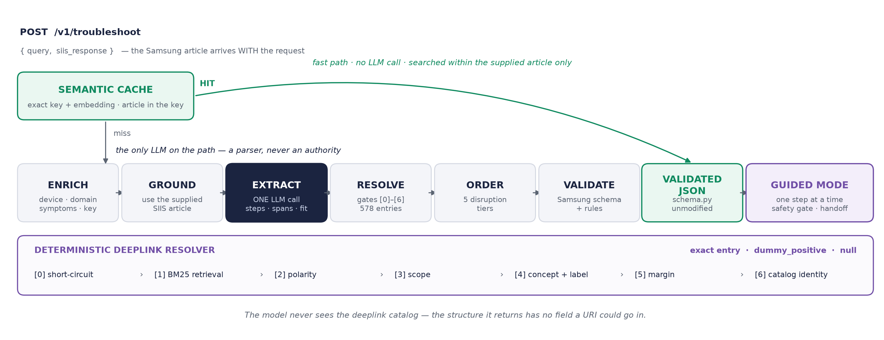
Our Solutions & Architecture Diagram
One LLM call. Everything after it is deterministic, then guided.

Slide 5
Demo & Product Walkthrough
1. Vague complaint in, grounded plan out
  “My Galaxy S22 screen inputs are delayed…” Every step is highlighted in Samsung's article; a step we cannot locate gets no span and scores nothing.
2. Told when the article does not fit the complaint
  Each problem the customer named is marked Covered, Not covered or Unverified, backed by a whole sentence quoted from the article. The gaps go to the agent.
3. The right Settings screen, and refusing a wrong label
  “Turn on” and “Turn off Touch sensitivity” resolve to different entries. A catalog entry labelled Enable Grayscale is described as mono audio, so it is refused.
4. Same issue, different words
  A reworded complaint about the same article returns from cache with no LLM call; the grounding from the cold run comes with it.
5. Guided, one step at a time
  “Did this fix it?” Before a factory reset the server stops and quotes Samsung's own warning: back up your personal data first.
6. Handed to an agent with the full record
  What was tried, each outcome, what is left. A declined step is never reported as tried, so the customer never repeats one.

Slide 6
Tools and tech stack used
Backend Python 3.11+ · FastAPI · Pydantic v2 · POST /v1/troubleshoot, GET /health, non-spec /v1/guided/*
Model Google Gemini 3.1 Flash-Lite · temperature 0, JSON-schema structured output · provider-agnostic interface with an offline deterministic fallback
Retrieval rank-bm25 over message + description + qna_description · 578-entry catalog · exhaustive NumPy cosine, no ANN index needed at this scale
Cache sentence-transformers all-MiniLM-L6-v2, TF-IDF fallback · exact + semantic tiers, partitioned by article · measured to 10,000 synthetic scenarios
Frontend React + Vite, no component library · customer view, guided mode, engineer view
Quality pytest — 265 tests, none needing an API key · seeded fuzz tests · guided flow walked in Chromium · independent review before submission
Deliberately not used: FAISS, Redis, a cross-encoder reranker, LangChain, multi-agent orchestration. Each was evaluated and rejected with a stated reason — 578 entries do not need an ANN index, and a single process does not need a network cache.

Slide 7
Impact & Use case
15 minutes of manual triage becomes one API call, and a guided fix
Trust schema-valid, ordered by disruption, every step traced to the article it came from, and a plain warning when that article does not match the complaint.
Safety last-resort steps sit behind a confirmation, and the warning shown is Samsung's own sentence, never ours.
Agent time when self-service fails, the agent receives what was already tried, so the customer is not asked to repeat anything.
Where it is used
  Support agent console — the plan is drafted before the agent finishes reading
  Customer self-service — a help page that walks the customer through one step at a time
  Samsung's catalog team — docs/catalog_health.md lists what no resolver can fix

Slide 8
Innovation highlights, results and limitations
Wrong deeplinks: 31.8% → 1.2%
850 labelled cases. Plain BM25 retrieval scores 68.2% precision; the deterministic gates lift it to 98.7% at 88.1% accuracy@1, with 0 answers on a catalog entry whose own description contradicts its label (18 without that check). Generated by the harness, never typed.
Across all 20 SIIS rows: 100% schema-valid · 100% rule-compliant · 0 URL leaks · 0 deeplinks outside the catalog · 20/20 rows answered
Cache: cross-article hits impossible by construction · a 10,000-scenario run found three scaling bugs a 20-row test could not; all fixed and regression-tested
Limitations, stated
  Article fit is a model judgment with a verified quote, not proof, and is measured on only 4 mismatched pairings in 20 rows; the plan is still built from the article
  10 wrong answers remain, mostly a short catalog name matching inside a longer step
  Guided mode has no resolution rate: that needs real customers
  The gold set is derived from catalog labels, not human-labelled

Slide 9
What’s next
Measure resolution with real sessions
  Guided mode already records every outcome. With real customers that becomes a resolution rate, and only then a case for reordering steps within a tier.
Act on a mismatched article
  Article fit already reports it. Withholding the plan on a "none" fit needs a labelled set of pairings to validate; 20 rows cannot.
Close the subset-coverage gap
  “Zen Mode” resolving to Screen mode. A step-side coverage term fixed 1 of the 10 remaining errors, so a stronger fix is needed.
Multi-intent complaints
  Samsung's own input set has three faults in one message. Splitting them is the next real capability.
Fix the catalog with Samsung
  50 labels that name another screen, 5 indistinguishable groups, and no entry for Factory data reset.

Slide 10
Brownie points slide( differentiation)
It says when Samsung's article does not fit
  Everyone else trusts the supplied article. We check each problem the customer named against it, and believe "covered" only with a whole sentence quoted from it.
Guided, not just listed
  A server-enforced safety gate before every last-resort step, quoting Samsung's own warning. A restart is gated but never shown the factory-reset warning beside it.
We audited Samsung's catalog
  50 entries name a different screen from their own description. Refusing them dropped gold-set precision from 99.2% to 98.7%. We shipped the lower number.
We published a number that got worse, twice
  0 of 29 model-reported source offsets pointed at relevant text. Relocating spans by content dropped our confidence score from 0.82 to 0.76.
Every claim is traceable
  Design decisions cited to Samsung's spec (C1–C12), metrics generated not typed, an independent review before submission, and schema.py checksummed in CI.

Slide 11
Checklist- Updated on Public GitHub
Working prototype code — public GitHub repo · Yes
README with reproducible setup instructions · Yes, verified on a fresh clone
Demo video, max 5 minutes · Demo video Link
Presentation file (PPT) · this file

Slide 12
Thank you
Organised by the Language AI Team and the PRISM Team, Samsung R&D Institute India
Notes:
Closing slide. Add the Google Form URL and a contact email before sharing. Edition 2 organising team for reference: Language AI - Sourabh Tiwari, Gaurav, Sanjeeth Pothireddy, Gorang Maniar; PRISM - Binny Lakra, Prakhar Chandrakar, Vishu Kumar; Kick-off and mentors - Giridhar Jakki, Deepraj Prabhakar Patkar (Language AI), Srimanu Prasad Nagaraju, Ashish Kumar (Tech Strategy).

