Slide 1
Batch 44- MiTH
ABHISHEK SHETTY
ID: 2139

Slide 2
Problem Statement
Predict readmission of a Diabetic patient in order to improve the quality of care and also reduces the medical expenses on readmission..
Yes – Patient will be readmitted
No - Patient will not be readmitted
Approaches taken
Logistic regression
Naiver Bayes
XG Boost

Slide 3
Data Analysis and Visualization
31513 observations of 41 predictor variables, 1 target variable and 1 ID
Target Variable
Yes – Patient will be readmitted
No – Patient will not be readmitted
No. of Numeric Attributes - 07
No. of Categorical Attributes - 34
NA values observed

Slide 4
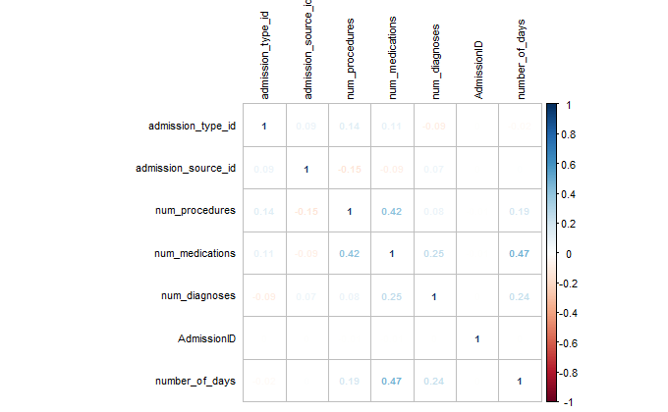
Exploratory Data Analysis
Central Imputation of missing values
Multi-Collinearity check for Numeric Data
Separation of train and test data from the column “istrain”

Slide 5
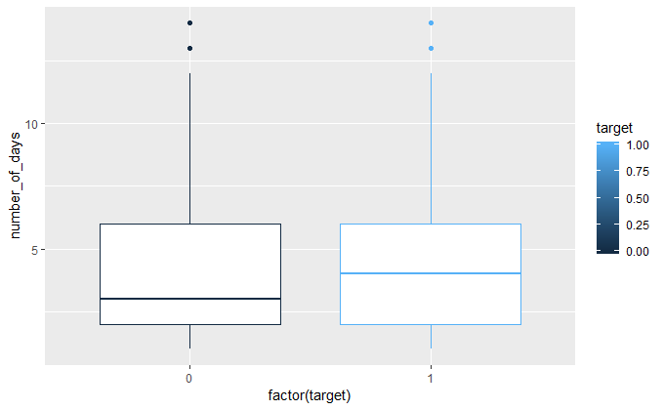
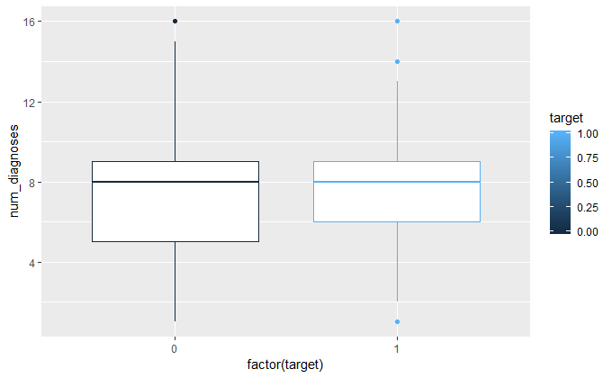
Box Plot Analysis
People spending more days also have been observed to get readmitted
Few outliers observed in readmission of patients who did undergo 8 or more than 8 diagnosis.

Slide 6
Data Pre-Processing
Removed the variables with no variation
Converted the below Categorical variables to Factor
Converted the below variables to Date
-

Slide 7
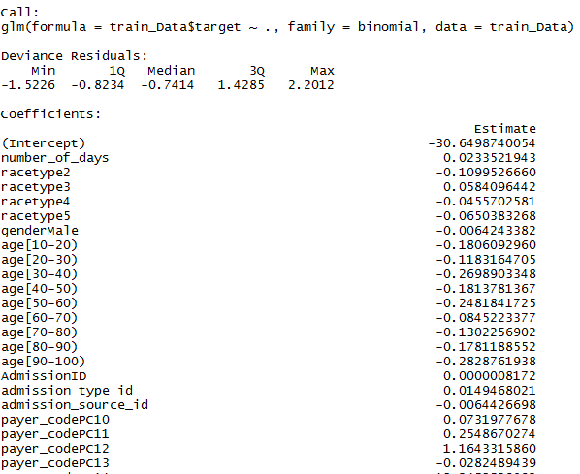
Collinear Attributes(Numeric and Categorical) -
- Built a Logistic Model and then run a VIF to check the
correlation
- Also saw some insignificant variables

Slide 8
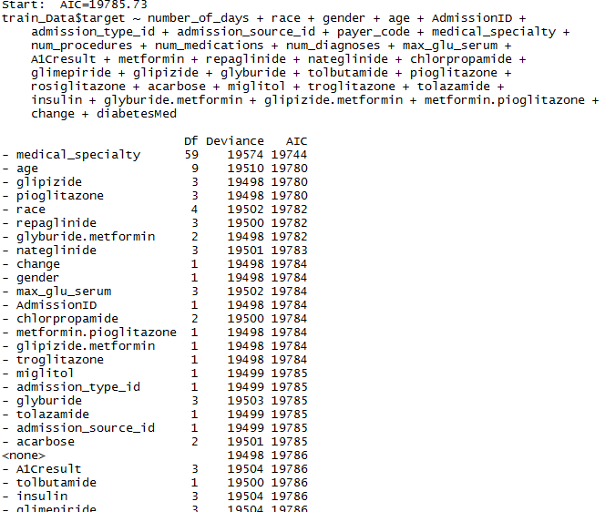
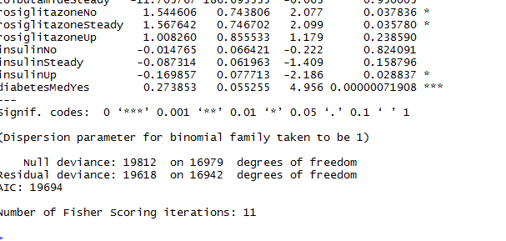
Performed STEP AIC operation to obtain significant variables .
VIF values provided better visibility in selecting columns.

Slide 9
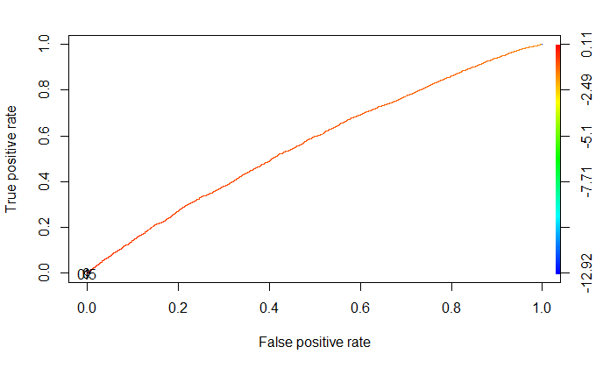
Model Building
Base Logistic Model ( Model 1)
Split the data into train(70) and validation(30)
Built a base model using Logistic Regression after all the Pre-Processing
AUC - 0.56595307

Slide 10
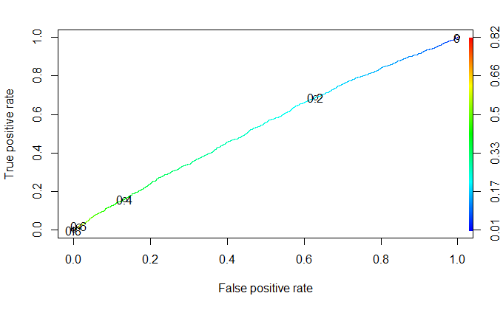
Xgboost Model
Dummifying the train and validation data using the dummy object
Tuning parameter list
AUC:- 0.53914

Slide 11
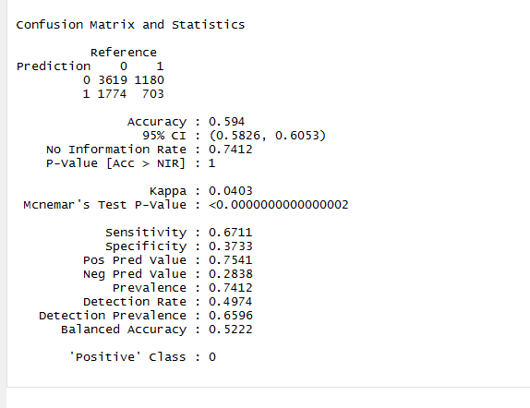
Accuracy – 63.84% and Sensitivity – 60.58%
attained in Test Data

