Slide 1

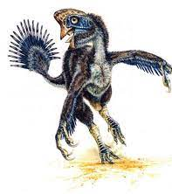
Hangry Hagryphi Analytics Team
App Trader Presentation

Slide 2
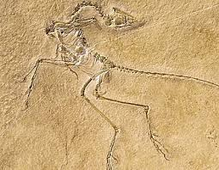
These are the apps you should buy
Hitman Sniper
H*nest Meditation
Where’s My Water?
sugar, sugar
Fruit Ninja Classic
AJ Jump: Animal Jam Kangaroos!
Five Nights at Freddy’s 3
Riptide GP: Renegade
Tsuro - The Game of the Path
Bloons TD 5

Slide 3
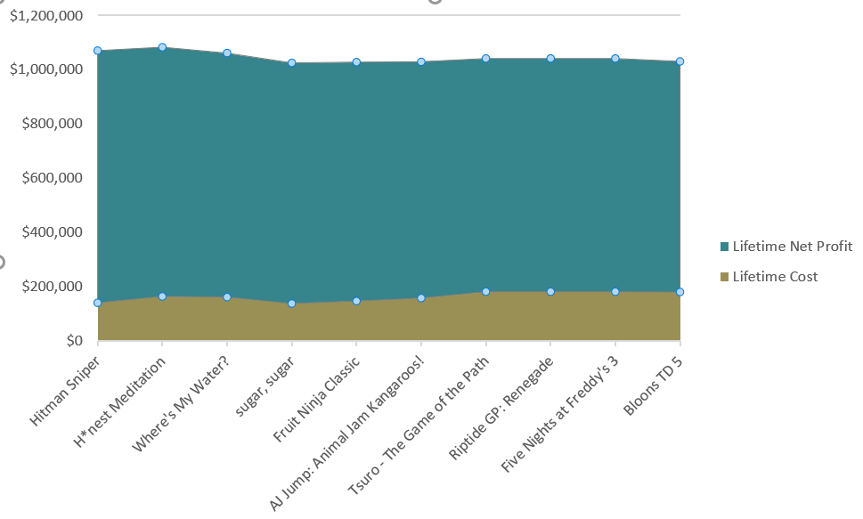
Lifetime Net Profit Per App in Both Stores

Slide 4
App | Rating | Store | Cost | Category | Lifespan in Years | Lifetime Earnings | Lifetime Cost | Lifetime Net Profit
Hitman Sniper | 4.5 | Apple | $0.99 | Games | 10 | $300,000.00 | $70,000.00 | $230,000.00
Hitman Sniper | 4.6 | Google | $0.99 | Games | 11.2 | $306,000.00 | $71,200.00 | $234,800.00
H*nest Meditation | 4.5 | Apple | $1.99 | Entertainment | 10 | $300,000.00 | $79,900.00 | $220,100.00
H*nest Meditation | 4.9 | Google | $1.99 | Lifestyle | 11.8 | $324,000.00 | $84,700.00 | $239,300.00
Where's My Water? | 4.5 | Apple | $1.99 | Games | 10 | $300,000.00 | $79,900.00 | $220,100.00
Where's My Water? | 4.7 | Google | $1.99 | Family | 11.4 | $312,000.00 | $82,300.00 | $229,700.00
sugar, sugar | 4.2 | Google | $1.20 | Family | 10.4 | $282,000.00 | $68,400.00 | $213,600.00
sugar, sugar | 4.5 | Apple | $0.99 | Games | 10 | $300,000.00 | $70,000.00 | $230,000.00
Fruit Ninja Classic | 4.3 | Google | $0.99 | Games | 10.6 | $288,000.00 | $67,600.00 | $220,400.00
Fruit Ninja Classic | 4.5 | Apple | $1.99 | Games | 10 | $300,000.00 | $79,900.00 | $220,100.00
AJ Jump: Animal Jam Kangaroos! | 4.4 | Google | $1.99 | Games | 10.8 | $294,000.00 | $78,700.00 | $215,300.00
AJ Jump: Animal Jam Kangaroos! | 4.5 | Apple | $1.99 | Games | 10 | $300,000.00 | $79,900.00 | $220,100.00
Five Nights at Freddy's 3 | 4.5 | Apple | $2.99 | Games | 10 | $300,000.00 | $89,900.00 | $210,100.00
Five Nights at Freddy's 3 | 4.7 | Google | $2.99 | Games | 11.4 | $312,000.00 | $92,300.00 | $219,700.00
Riptide GP: Renegade | 4.5 | Apple | $2.99 | Games | 10 | $300,000.00 | $89,900.00 | $210,100.00
Riptide GP: Renegade | 4.7 | Google | $2.99 | Games | 11.4 | $312,000.00 | $92,300.00 | $219,700.00
Tsuro - The Game of the Path | 4.5 | Apple | $2.99 | Games | 10 | $300,000.00 | $89,900.00 | $210,100.00
Tsuro - The Game of the Path | 4.7 | Google | $2.99 | Family | 11.4 | $312,000.00 | $92,300.00 | $219,700.00
Bloons TD 5 | 4.5 | Apple | $2.99 | Games | 10 | $300,000.00 | $89,900.00 | $210,100.00
Bloons TD 5 | 4.6 | Google | $2.99 | Family | 11.2 | $306,000.00 | $91,100.00 | $214,900.00
Grand Total |  |  |  |  |  | $6,048,000.00 | $1,640,100.00 | $4,407,900.00

Slide 5
Assumptions
Apps available in both the App Store and Google Play Store
Apps with purchase cost greater than $0.00
Apps with a rating above 4.0

Slide 6
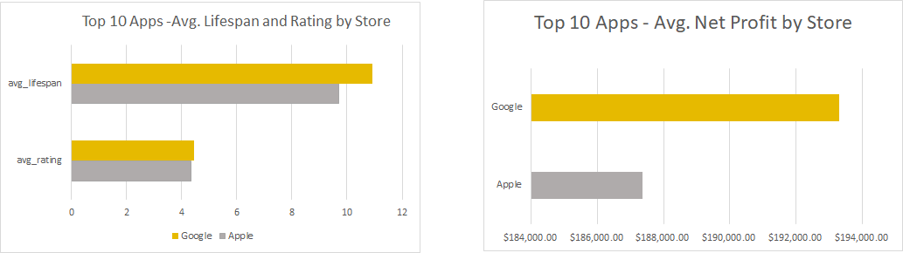

Slide 7
Questions?

