Slide 1
Intelligent Ethernet-to-Fiber
Converter
ECE 4015 Capstone, Fall 2026
Redundant optical paths with real-time SFP health monitoring
Notes:
Project scope summary. Target demonstration date: December 8, 2026.

Slide 2
Project target and scope
A media converter that monitors optical health and transfers Ethernet traffic before a fiber path fails.
TARGET
PROTOTYPE
SUCCESS CRITERIA
Maintain a 1 Gb/s Ethernet connection between two laptops across redundant 1000BASE-SX fiber paths.
Two identical converter boards. Each board combines an STM32N6, LAN96455F switch, two SFP modules, and copper Ethernet ports.
Report SFP diagnostics, identify a degrading primary path, coordinate both boards, and move traffic to the backup path.
Notes:
Scope reflects the current two-board architecture. The first prototype targets 1 Gb/s multimode fiber and a controlled break-before-make failover demonstration.

Slide 3
Market research and problem–solution
MARKET EVIDENCE
CURRENT GAP
OUR SOLUTION
Redundant SFP infrastructure already exists.
Redundancy is usually reactive.
Turn telemetry into proactive failover.
Cisco documents dual-SFP uplinks for redundant connectivity to the network core. Perle also sells dual-SFP media converters with primary/backup fiber failover.
This means some deployments can leverage ports and fiber paths that are already provisioned rather than adding a new backup link solely for our feature.
Commercial redundancy products switch after link failure; Perle specifies failover when the primary link fails. Basic industrial converters from Advantech expose Link Fault Pass-through but only one fiber port.
Meanwhile, SFP DOM/DDM already exposes Rx/Tx optical power, temperature, voltage and laser-bias data.
Our controller continuously evaluates SFP health, applies thresholds/hysteresis, and coordinates both converter boards to move 1 Gb/s traffic to the standby path before a hard loss-of-signal event.
Value proposition: use existing redundancy more intelligently, with little or no added optical-infrastructure cost where a backup SFP path is already deployed.
DIFFERENTIATION
Existing: “detect failure → switch” → Proposed: “detect degradation → switch before failure”
Research basis: Cisco dual-SFP uplink guidance + SFP DOM/DDM; Perle dual-fiber redundancy; Advantech Link Fault Pass-through.

Slide 4
System architecture
Data path
Laptop A
Laptop B
Laptop traffic passes through the LAN96455F hardware switch. The active SFP pair carries user data and in-band management frames.
BOARD A
BOARD B
LAN96455F
Ethernet switch
STM32N6
control
LAN96455F
Ethernet switch
STM32N6
control
Control path
Each STM32 reads local SFP diagnostics. Board A arbitrates the active path while Board B applies the coordinated port state.
PRIMARY AND BACKUP 1000BASE-SX
SFP0 / SFP1
SFP0 / SFP1
Full duplex fiber pairs
Notes:
The diagram is intentionally simplified. Ethernet data and STM32-to-STM32 management frames share whichever optical path is active. Sources: https://www.microchip.com/en-us/product/lan96455 and https://www.st.com/en/microcontrollers-microprocessors/stm32n6-series.html

Slide 5
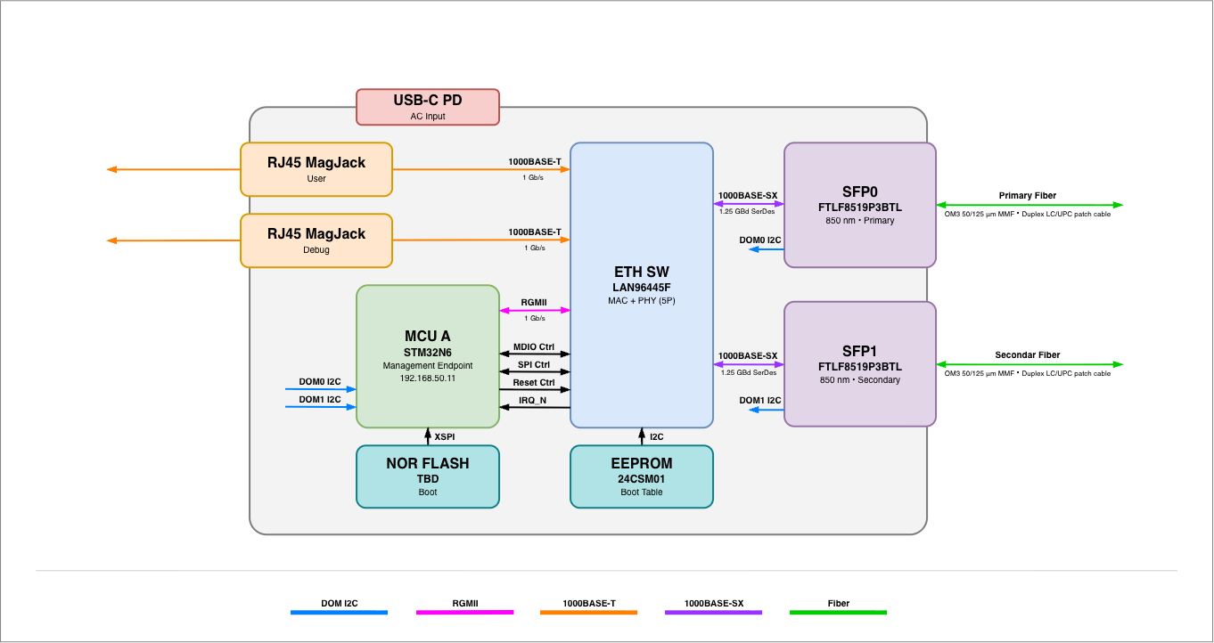
System architecture
Notes:
The diagram is intentionally simplified. Ethernet data and STM32-to-STM32 management frames share whichever optical path is active. Sources: https://www.microchip.com/en-us/product/lan96455 and https://www.st.com/en/microcontrollers-microprocessors/stm32n6-series.html

Slide 6
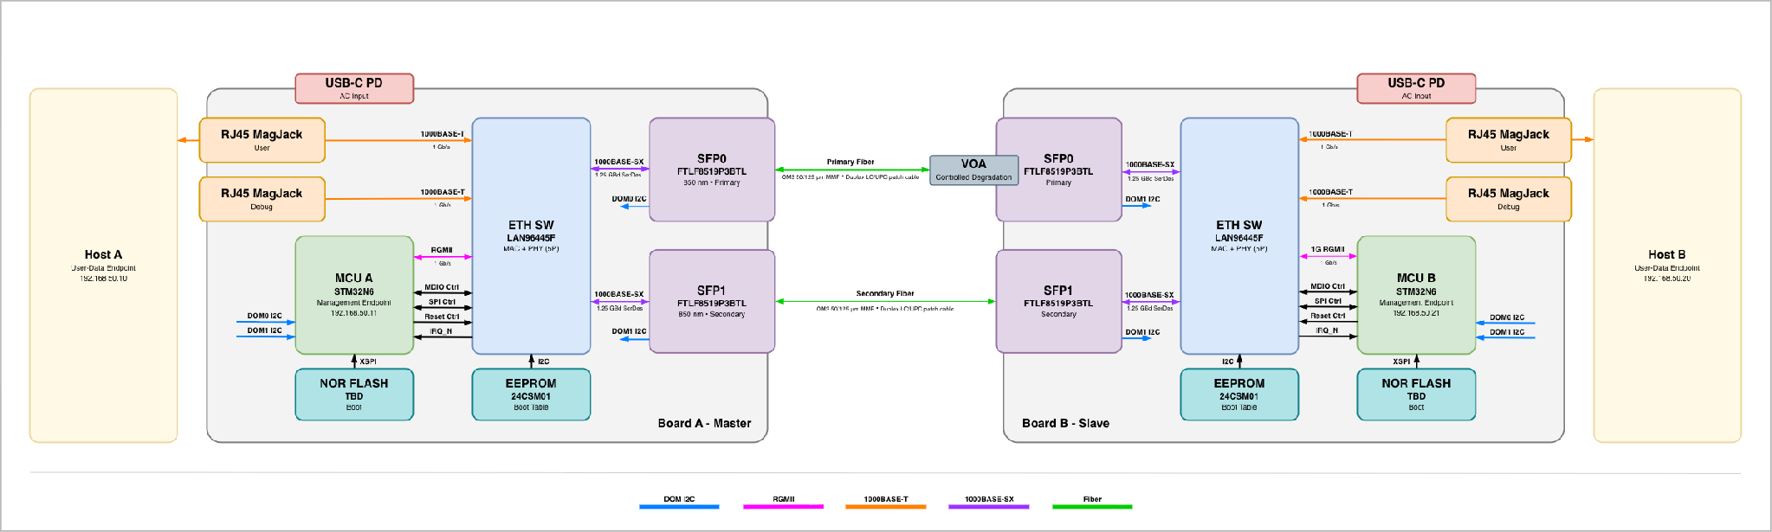
System architecture
Notes:
The diagram is intentionally simplified. Ethernet data and STM32-to-STM32 management frames share whichever optical path is active. Sources: https://www.microchip.com/en-us/product/lan96455 and https://www.st.com/en/microcontrollers-microprocessors/stm32n6-series.html

Slide 7
Implementation plan
Critical path
HARDWARE
STM32N6 boot and debug
LAN96455F unmanaged boot
RGMII and 1000BASE-X routing
SFP power and diagnostics
1 Freeze interfaces, straps, power rails, clocks, and component selections
2 Complete schematic review and controlled-impedance PCB layout
3 Bring up power, STM32 boot flash, switch management, copper ports, and each SFP path
4 Add telemetry thresholds, coordinated failover, and repeatable fault injection
FIRMWARE AND VALIDATION
SPI switch control and SFP I²C reads
Health scoring and hysteresis
Cross-board arbitration
Traffic and failover measurements
Notes:
The highest schedule risks are first-pass board bring-up, LAN96455 configuration, and coordinated failover behavior. Keep manual port switching available as an early demonstration fallback.

Slide 8
Working timeline to the December 8 expo
SEP 8–30
OCT 1–NOV 15
NOV 16–DEC 8
Architecture and schematic
Freeze parts, interfaces, boot straps, power tree, schematic pages, and layout.
PCB and bring-up
Fabrication, assembly, rail checks, STM32 boot, switch access, and individual links.
Integration and demo
Telemetry thresholds, coordinated failover, traffic testing, enclosure, and presentation rehearsal.
Notes:
Working schedule prepared September 8, 2026. The December 8 expo date comes from the project requirement. Intermediate dates are planning assumptions and should be updated after fabrication lead time is confirmed.

