Slide 1

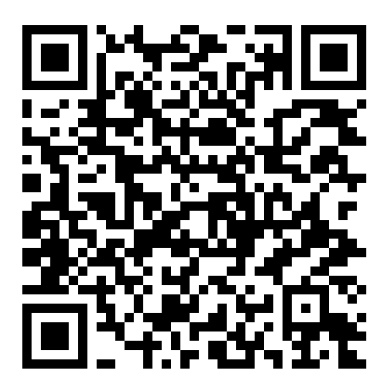
Machine Learning in Practice for Research – Session 1
Foundations & Dataset Understanding
Lecturer: Dr. Rattapol Kasemrat
Program: PhD & Master
University: Rangsit University

Slide 2
Why This Course Matters for Graduate Research
Machine Learning is now common in academic research
Many theses use ML incorrectly
Reviewers expect correct methodology
This course focuses on research usage, not coding mastery

Slide 3
What This Course Is NOT
Not advanced mathematics
Not deep learning or AI engineering
This course IS about using ML correctly in research

Slide 4
What Is Machine Learning?
Machine Learning allows computers to learn patterns from data
and make predictions without being explicitly programmed.
Data → Patterns → Predictions

Slide 5
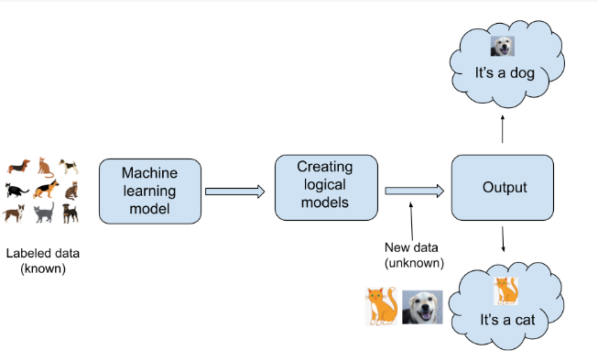
Machine Learning vs Traditional Programming
Traditional Programming:
Rules + Data → Output
Machine Learning:
Data + Output → Model (learned rules)

Slide 6
Machine Learning vs Statistics
Statistics:
• Focus on explanation
• Strong assumptions
Machine Learning:
• Focus on prediction
• Fewer assumptions
Both are valuable in research

Slide 7
Machine Learning vs Statistics
Key characteristics of Machine Learning
Requires fewer strict assumptions about data structure
Handles complex and non-linear relationships well
Scales effectively to large datasets
Makes it easy to compare multiple models based on performance
👉 This is not because statistics cannot predict
👉 but because machine learning emphasizes a different objective

Slide 8
Machine Learning vs Statistics
Different Thinking Order: Statistics vs Machine Learning
Statistics (traditional approach)
  Theory → Model → Test whether the theory holds
  Starts from hypotheses or prior knowledge
  Focuses on explanation and inference
  Prediction is often secondary

Slide 9
Machine Learning vs Statistics
Machine Learning
  Data → Model learns patterns → Evaluate prediction performance
  Starts from data
  Focuses on predictive accuracy and generalization
  Explanation may come later (or be partial)

Slide 10
Machine Learning vs Statistics
Statistics (Example) :
Question:
“Does study time affect exam score?”
What statistics does:
Collect data: study hours + exam scores
Build a model (e.g., linear regression)
Answer:
  How much does one extra hour of study increase the score?
  Is this relationship statistically significant?
Goal:
Explain the relationship between variables.
“Statistics is like asking why and how much.”

Slide 11
Machine Learning vs Statistics
Machine Learning (Example):
Question:
“Will this student pass the exam?”
What machine learning does:
Use many inputs:
  Study time
  Attendance
  Past grades
  Assignment submission
Train a model
Output:
  Pass or Fail
  Probability of passing
📌 Goal:
Predict the outcome, even if the relationship is complex.
“Machine learning is like asking what will happen next.”

Slide 12
Machine Learning vs Statistics
Another Example
Statistics View
“Which factors are significantly associated with customer churn?”
Focus on:
  Coefficients
    The coefficients tell us the direction of the relationship (increase or decrease)
    Customers who have stayed longer are less likely to churn
  p-values
    he p-values tell us whether the relationship is statistically significant
    Higher monthly fees are associated with higher churn
  Interpretation
    The goal is to explain which factors matter, not to predict individual behavior

Slide 13
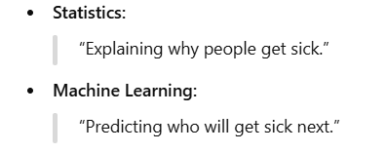
Machine Learning vs Statistics
Machine Learning View
“Will this customer churn next month?”
Focus on:
  Prediction accuracy
  Validation
  Generalization
Same data — different purpose.

Slide 14
Why We Use the Customer Churn Dataset
Real-world and easy to understand
Binary outcome (Yes / No)
Common structure in many research domains
https://www.kaggle.com/datasets/blastchar/telco-customer-churn?resource=download
The data set includes information about:
Customers who left within the last month – the column is called Churn
Services that each customer has signed up for – phone, multiple lines, internet, online security, online backup, device protection, tech support, and streaming TV and movies
Customer account information – how long they’ve been a customer, contract, payment method, paperless billing, monthly charges, and total charges
Demographic info about customers – gender, age range, and if they have partners and dependents

Slide 15
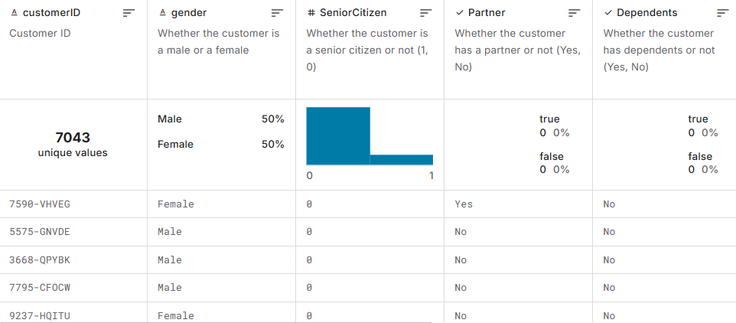
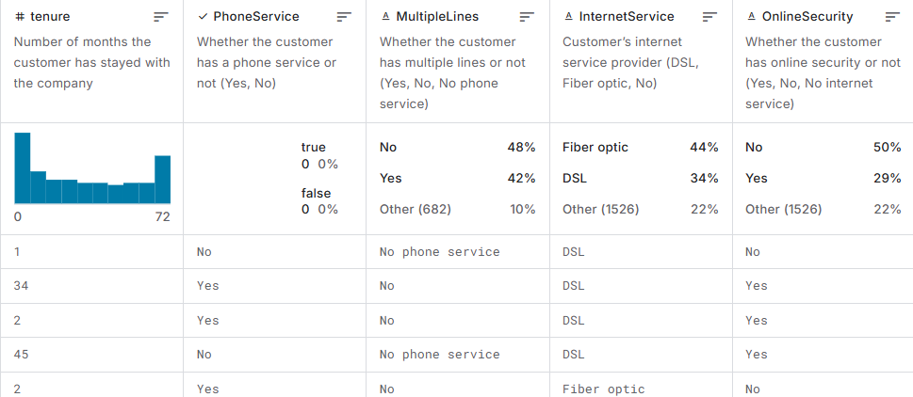

Slide 16
Research Question Example
Can customer demographic and service information
be used to predict customer churn?
P.S. This is a prediction problem, not a causal study

Slide 17
Understanding the Target Variable (y)
Churn = Yes → customer left the service
Churn = No → customer stayed
This is an observed outcome from historical data

Slide 18
Understanding the Input Variables (X)
Demographic information
Service usage information
Contract and billing information
All inputs exist before churn happens

Slide 19
Dataset Size and Structure
About 7,000 records
Around 20 variables
Mix of numerical and categorical data
Large enough for ML, small enough to understand

Slide 20
Mapping Dataset to ML Concepts
Features (X): customer attributes
Target (y): churn
One row = one customer
Prediction = probability of churn

Slide 21
What the Model Can and Cannot Do
The model can learn patterns from past data
The model cannot explain reasons or cause
Predictions are probabilities, not certainties

Slide 22
Why Logistic Regression Is Our First Model
Suitable for binary outcomes
Interpretable
Widely accepted in academic research
Strong baseline model

Slide 23
What Results Should We Expect
Accuracy around 75–82%
Some errors are normal

Slide 24
Common Research Mistakes to Avoid
Training and testing on the same data
Overclaiming results
Ignoring limitations
Treating ML as causal analysis

Slide 25
Transition to Hands-On Session
Now that we understand the dataset and research context,
We are ready to move to Google Colab.
Next steps:
1. Load the dataset
2. Define X and y
3. Train the first model

