Slide 1
EDES 301 PCB Project
Austin Burke
Due 05/06/2025 @ 11:59pm

Slide 2
Project Options
Can choose one of two options:
Create a PCB based on your Project #1
Create a PCB based on an example project
See Project #2 assignment for specific details
If choosing Option 1
Replace Background Information and System Block Diagram slides with your slides from the Project #1 proposal
Create a Mechanical Drawing
If choosing Option 2
Used provided Background Information and System Block Diagram slides
Create a Mechanical Drawing
Remove this slide in your submission

Slide 3
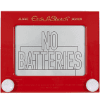
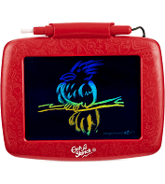
Background Information
Create a PCB for an “Etch-a-Sketch”
Hardware:
SPI Display Screen
Two Potentiometers
Two Buttons (Reset the Game, Change Color)
Three LEDs (Red, Green, and Blue for Color)
USB Port (Expansion)
Replace this slide with your own if you are doing a PCB around your Project #1

Slide 4
System Block Diagram – “Etch-a-Sketch”
5V
3.3V
PocketBeagle
USB Host
VCC
SPI Display
USB
SPI
SPI
VCC
USB
SPI
GPIO
GPIO
GPIO
GND
3.3V
GND
GND
1k
1.8V
Potentiometer
3.3V
GPIO
1k
AIN
GPIO
AGND
GPIO
1.8V
Potentiometer
GPIO
AIN
AGND
GPIO

Slide 5
Mechanical Drawing
5”
SPI Display (~4.5”x~3”)
Open access all around
Pocket Beagle
1”
Micro-USB
4”
USB Host
Pot
Button
Button
Pot
USB
LEDs
.5”
FRONT
.5”
FRONT
BACK
BACK
1”

