Slide 1
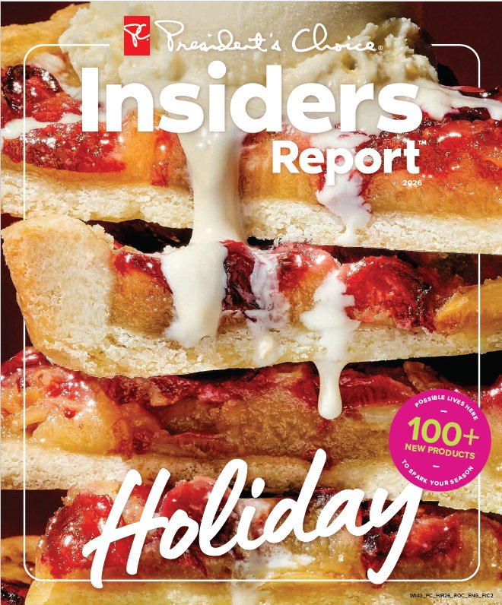
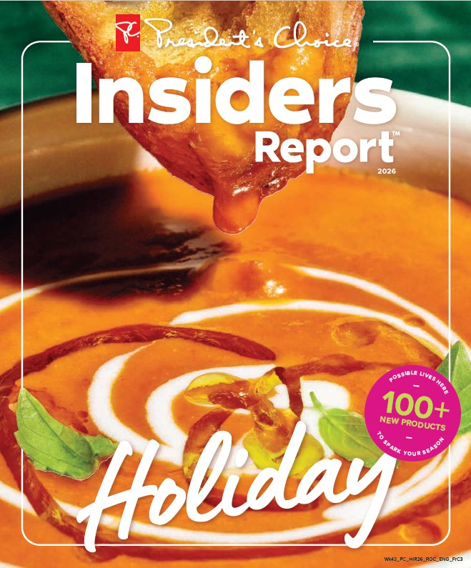
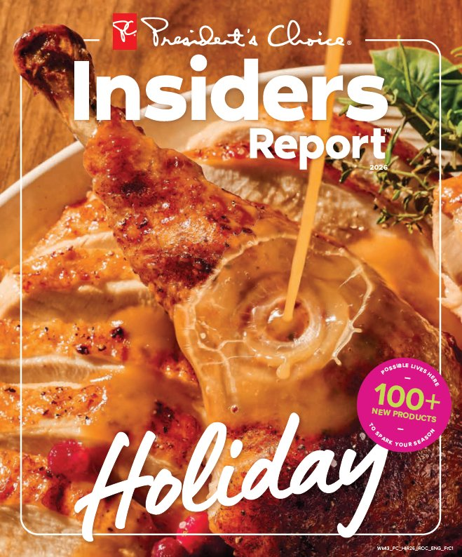
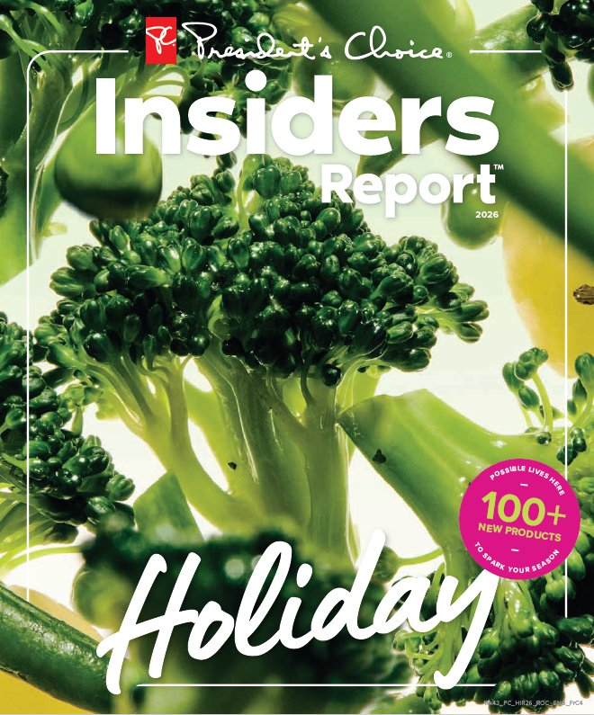
PC INSIDERS REPORT
Guess the Price!
Holiday Edition
Grab a pen — one guess per table
Notes:
Welcome everyone. Backup version of the game: each table writes its guess on paper and holds it up when time is up.

Slide 2
The Rules
There are 5 baskets. Guess the total price of all the items in each basket.
1
Write your table's guess on paper and hold it up when time is up.
2
The table that is closest to the total without going over wins that round!
3
The table with the most correct guesses wins a prize!
4
Notes:
Each basket: 45 seconds (time it on your phone). Practice first: 2 baskets that don't count.

Slide 3
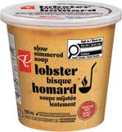
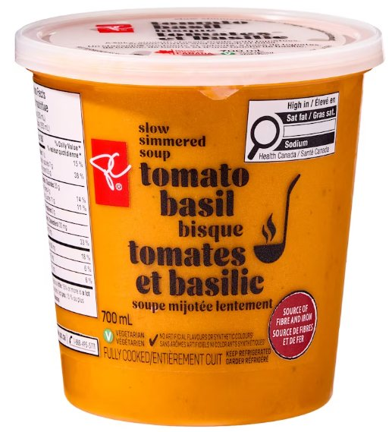
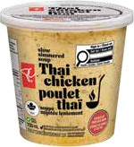
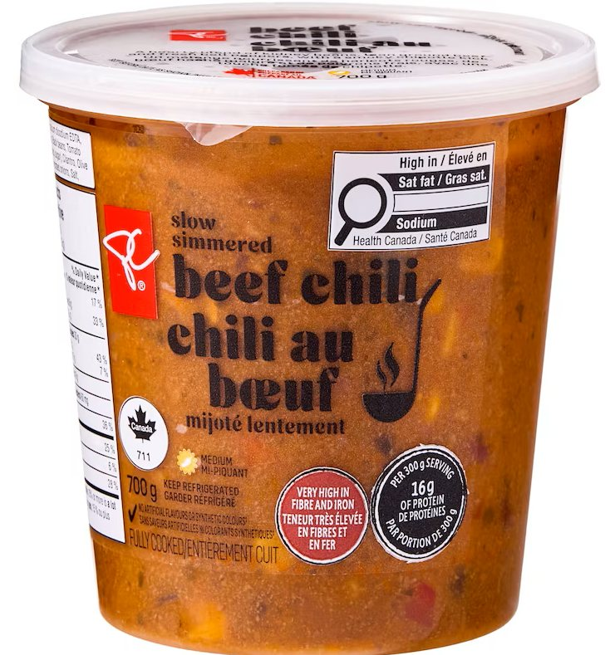
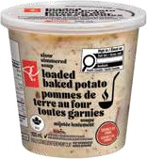
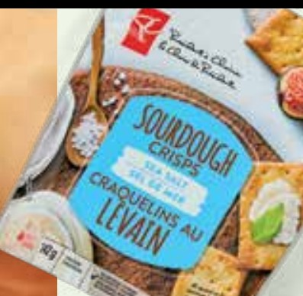
Soup Night Basket
Practice 1 of 2 · doesn't count
45
SECONDS
Guess the total price of everything below (before tax)
Lobster Bisque
700 mL
Slow Simmered Tomato Basil Bisque Soup
700 ml
Thai Chicken
700 mL
Slow Simmered Beef Chili
700 g
Loaded Baked Potato
700 mL
Sourdough Crisps Sea Salt
142 g
Notes:
Practice 1 of 2 · doesn't count: Soup Night Basket. Start a 45-second timer. Tables write their guess on paper and hold it up when time is up.

Slide 4
Soup Night Basket
Practice 1 of 2 · doesn't count · Answer
Total
$40.50
Closest without going over wins!
$7.50
$7.50
$7.50
Lobster Bisque
700 mL
Slow Simmered Tomato Basil Bisque Soup
700 ml
Thai Chicken
700 mL
$7.50
$7.50
$3.00
Slow Simmered Beef Chili
700 g
Loaded Baked Potato
700 mL
Sourdough Crisps Sea Salt
142 g
Notes:
Answer: $40.50.
Lobster Bisque: $7.50
Slow Simmered Tomato Basil Bisque Soup: $7.50
Thai Chicken: $7.50
Slow Simmered Beef Chili: $7.50
Loaded Baked Potato: $7.50
Sourdough Crisps Sea Salt: $3.00

Slide 5
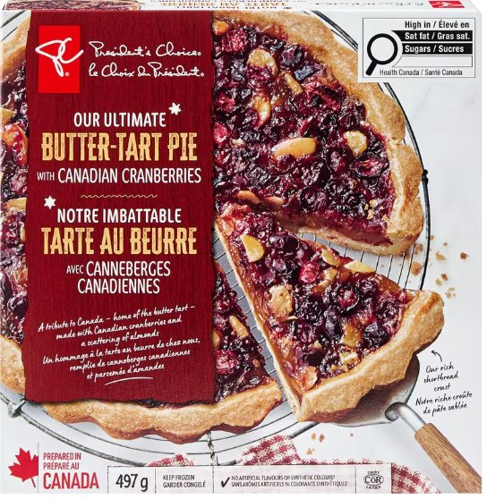
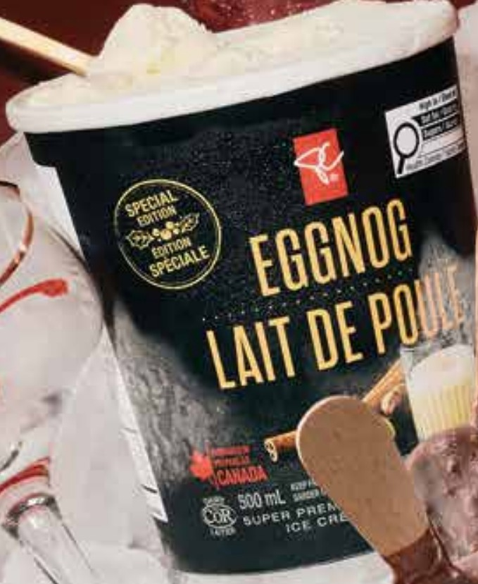
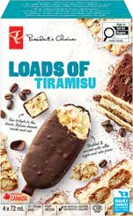
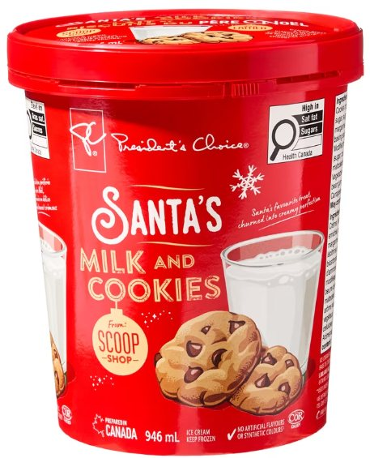
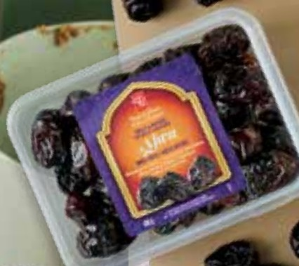
Holiday Sweets Basket
Practice 2 of 2 · doesn't count
45
SECONDS
Guess the total price of everything below (before tax)
Our Ultimate Butter-Tart Pie with Canadian Cranberries
497 g
Black Label Eggnog Ice Cream
500 mL
Loads of Tiramisu Ice Cream
4 x 72 mL
Scoop Shop Santa's Milk and Cookies Ice Cream
946 ml
Ajwa Whole Dates
400 g
Notes:
Practice 2 of 2 · doesn't count: Holiday Sweets Basket. Start a 45-second timer. Tables write their guess on paper and hold it up when time is up.

Slide 6
Holiday Sweets Basket
Practice 2 of 2 · doesn't count · Answer
Total
$34.50
Closest without going over wins!
$10.00
$4.50
$5.00
Our Ultimate Butter-Tart Pie with Canadian Cranberries
497 g
Black Label Eggnog Ice Cream
500 mL
Loads of Tiramisu Ice Cream
4 x 72 mL
$5.00
$10.00
Scoop Shop Santa's Milk and Cookies Ice Cream
946 ml
Ajwa Whole Dates
400 g
Notes:
Answer: $34.50.
Our Ultimate Butter-Tart Pie with Canadian Cranberries: $10.00
Black Label Eggnog Ice Cream: $4.50
Loads of Tiramisu Ice Cream: $5.00
Scoop Shop Santa's Milk and Cookies Ice Cream: $5.00
Ajwa Whole Dates: $10.00

Slide 7
Now it counts!
5 rounds · 45 seconds each

Slide 8
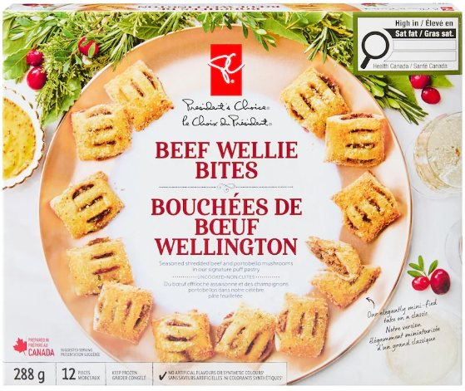
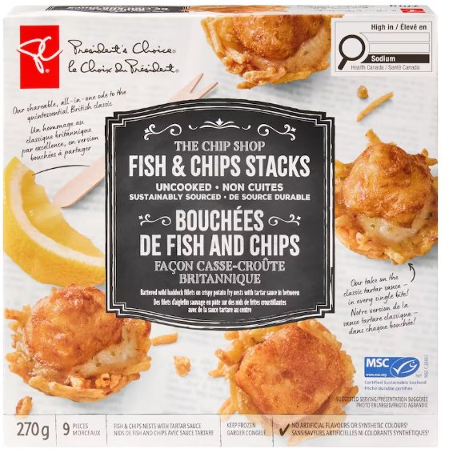
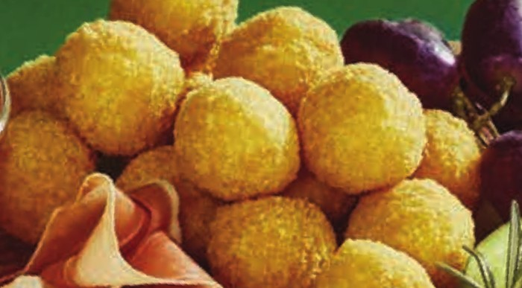
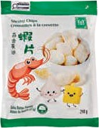
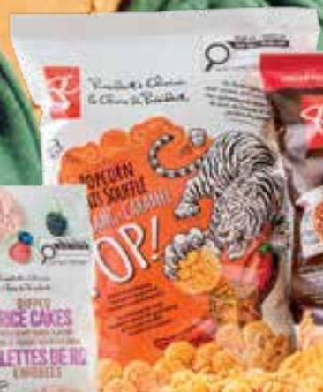
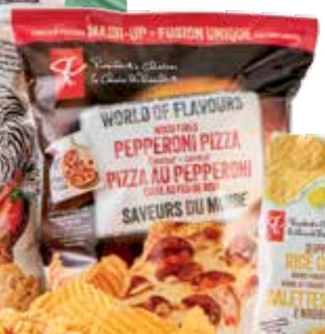
Holiday Party Snacks
Round 1 of 5
45
SECONDS
Guess the total price of everything below (before tax)
Beef Wellie Bites
288 g
The Chip Shop Fish and Chips Stacks
270 g
Bombas
240 g
T&T® Garlic Butter Shrimp Chips
240 g
Gochujang-Caramel Popcorn
220 g
World of Flavours Pepperoni Pizza Flavour Potato Chips
200 g
Notes:
Round 1 of 5: Holiday Party Snacks. Start a 45-second timer. Tables write their guess on paper and hold it up when time is up.

Slide 9
Holiday Party Snacks
Round 1 of 5 · Answer
Total
$41.00
Closest without going over wins!
$10.00
$10.00
$7.00
Beef Wellie Bites
288 g
The Chip Shop Fish and Chips Stacks
270 g
Bombas
240 g
$7.00
$4.00
$3.00
T&T® Garlic Butter Shrimp Chips
240 g
Gochujang-Caramel Popcorn
220 g
World of Flavours Pepperoni Pizza Flavour Potato Chips
200 g
Notes:
Answer: $41.00.
Beef Wellie Bites: $10.00
The Chip Shop Fish and Chips Stacks: $10.00
Bombas: $7.00
T&T® Garlic Butter Shrimp Chips: $7.00
Gochujang-Caramel Popcorn: $4.00
World of Flavours Pepperoni Pizza Flavour Potato Chips: $3.00

Slide 10
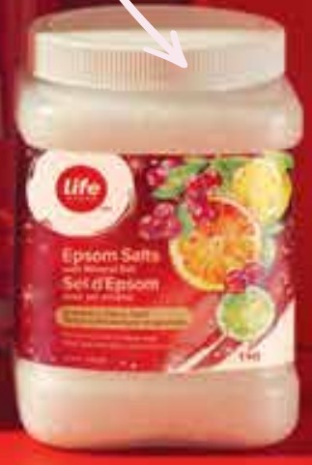
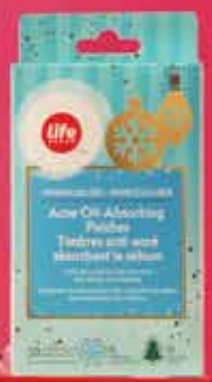
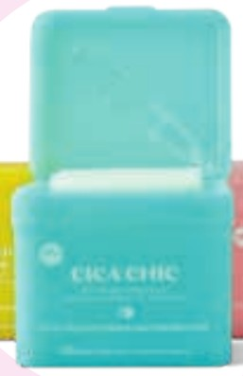
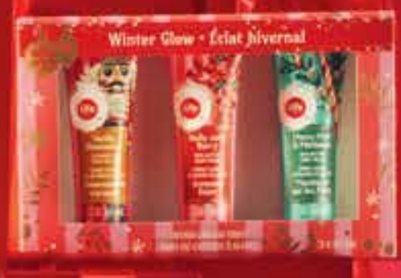
Favourite Things Gift Box
Round 2 of 5
45
SECONDS
Guess the total price of everything below (before tax)
Life Brand™ Winter Glow Hand Cream Trio
3 x 30 mL
Life Brand™ Cranberry Citrus Twist Epsom Salts with Mineral Salt
1 kg
Life Brand™ Acne Oil-Absorbing Patches
Life Brand™ Toner Pads – Cica Chic Soothing
Notes:
Round 2 of 5: Favourite Things Gift Box. Start a 45-second timer. Tables write their guess on paper and hold it up when time is up.

Slide 11
Favourite Things Gift Box
Round 2 of 5 · Answer
Total
$47.00
Closest without going over wins!
$7.00
$7.00
$8.00
$25.00
Life Brand™ Winter Glow Hand Cream Trio
3 x 30 mL
Life Brand™ Cranberry Citrus Twist Epsom Salts with Mineral Salt
1 kg
Life Brand™ Acne Oil-Absorbing Patches
Life Brand™ Toner Pads – Cica Chic Soothing
Notes:
Answer: $47.00.
Life Brand™ Winter Glow Hand Cream Trio: $7.00
Life Brand™ Cranberry Citrus Twist Epsom Salts with Mineral Salt: $7.00
Life Brand™ Acne Oil-Absorbing Patches: $8.00
Life Brand™ Toner Pads – Cica Chic Soothing: $25.00

Slide 12
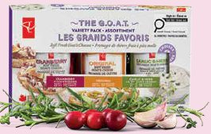
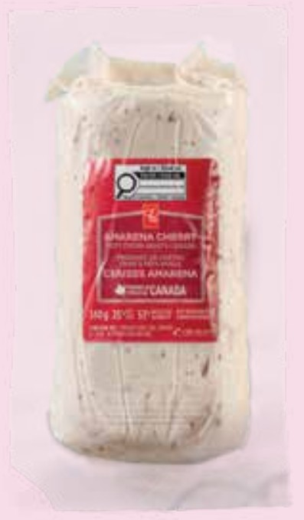
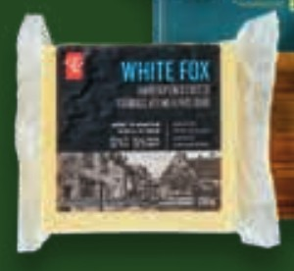
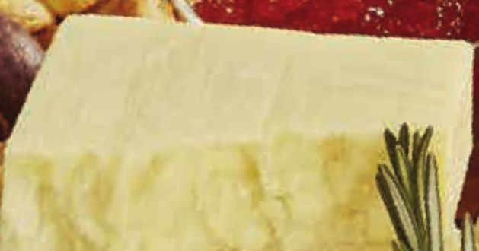
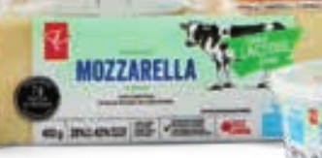
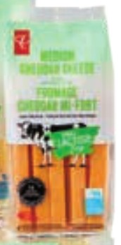
Cheese Board
Round 3 of 5
45
SECONDS
Guess the total price of everything below (before tax)
The G.O.A.T. Soft Fresh Goat's Cheeses Variety Pack
420 g
Amarena Cherry Soft Fresh Goat's Cheese
140 g
Black Label White Fox
250 g
Black Label Isle Of Man
250 g
Lactose Free Mozzarella Cheese Block
400 g
Lactose Free Cheese Stick
210 g
Notes:
Round 3 of 5: Cheese Board. Start a 45-second timer. Tables write their guess on paper and hold it up when time is up.

Slide 13
Cheese Board
Round 3 of 5 · Answer
Total
$46.50
Closest without going over wins!
$12.00
$6.00
$8.00
The G.O.A.T. Soft Fresh Goat's Cheeses Variety Pack
420 g
Amarena Cherry Soft Fresh Goat's Cheese
140 g
Black Label White Fox
250 g
$8.00
$6.50
$6.00
Black Label Isle Of Man
250 g
Lactose Free Mozzarella Cheese Block
400 g
Lactose Free Cheese Stick
210 g
Notes:
Answer: $46.50.
The G.O.A.T. Soft Fresh Goat's Cheeses Variety Pack: $12.00
Amarena Cherry Soft Fresh Goat's Cheese: $6.00
Black Label White Fox: $8.00
Black Label Isle Of Man: $8.00
Lactose Free Mozzarella Cheese Block: $6.50
Lactose Free Cheese Stick: $6.00

Slide 14


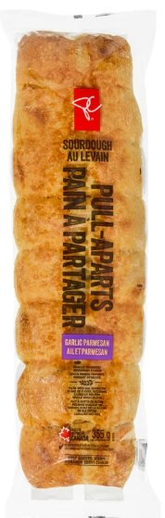
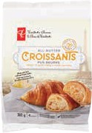
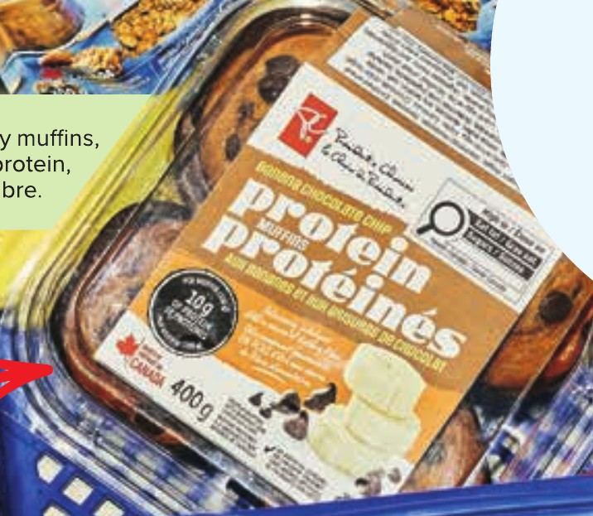
Bakery Basket
Round 4 of 5
45
SECONDS
Guess the total price of everything below (before tax)
Sourdough Focaccia – Rosemary Sea Salt
560 g
Sourdough Focaccia – Green Olive
560 g
Sourdough Baguette Ciabatta
400 g
Garlic Parmesan Sourdough Pull-Aparts
365 g
All-Butter Croissants
312 g
Protein Muffins – Banana Chocolate Chip
400 g
Notes:
Round 4 of 5: Bakery Basket. Start a 45-second timer. Tables write their guess on paper and hold it up when time is up.

Slide 15
Bakery Basket
Round 4 of 5 · Answer
Total
$29.00
Closest without going over wins!
$5.00
$5.00
$3.50
Sourdough Focaccia – Rosemary Sea Salt
560 g
Sourdough Focaccia – Green Olive
560 g
Sourdough Baguette Ciabatta
400 g
$3.50
$6.00
$6.00
Garlic Parmesan Sourdough Pull-Aparts
365 g
All-Butter Croissants
312 g
Protein Muffins – Banana Chocolate Chip
400 g
Notes:
Answer: $29.00.
Sourdough Focaccia – Rosemary Sea Salt: $5.00
Sourdough Focaccia – Green Olive: $5.00
Sourdough Baguette Ciabatta: $3.50
Garlic Parmesan Sourdough Pull-Aparts: $3.50
All-Butter Croissants: $6.00
Protein Muffins – Banana Chocolate Chip: $6.00

Slide 16
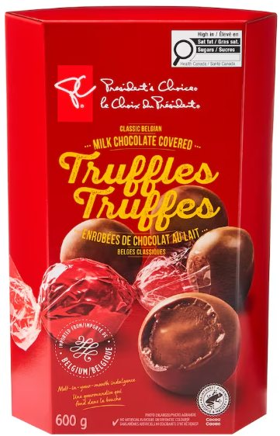
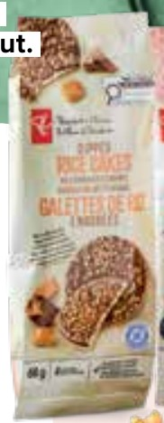
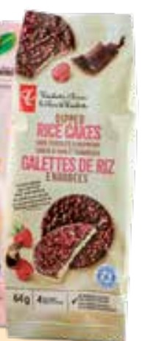
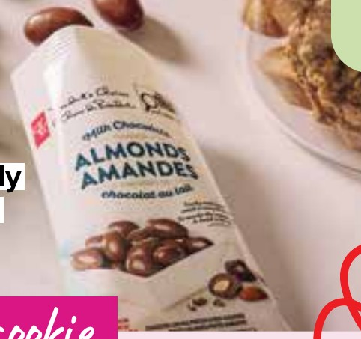
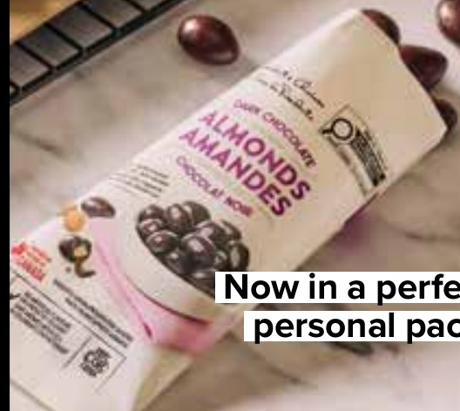
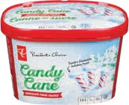
Chocolate Lover's Basket
Round 5 of 5
45
SECONDS
Guess the total price of everything below (before tax)
Classic Belgian Milk Chocolate Covered Truffles
600 g
Dipped Rice Cakes – Milk Chocolate + Caramel
70 g
Dipped Rice Cakes – Dark Chocolate + Raspberry
64 g
Chocolate Covered Almonds – Milk Chocolate
70 g
Chocolate Covered Almonds – Dark Chocolate
70 g
Candy Cane Chocolate Fudge Crackle Ice Cream
1.5 L
Notes:
Round 5 of 5: Chocolate Lover's Basket. Start a 45-second timer. Tables write their guess on paper and hold it up when time is up.

Slide 17
Chocolate Lover's Basket
Round 5 of 5 · Answer
Total
$31.50
Closest without going over wins!
$15.00
$3.00
$3.00
Classic Belgian Milk Chocolate Covered Truffles
600 g
Dipped Rice Cakes – Milk Chocolate + Caramel
70 g
Dipped Rice Cakes – Dark Chocolate + Raspberry
64 g
$2.00
$2.00
$6.50
Chocolate Covered Almonds – Milk Chocolate
70 g
Chocolate Covered Almonds – Dark Chocolate
70 g
Candy Cane Chocolate Fudge Crackle Ice Cream
1.5 L
Notes:
Answer: $31.50.
Classic Belgian Milk Chocolate Covered Truffles: $15.00
Dipped Rice Cakes – Milk Chocolate + Caramel: $3.00
Dipped Rice Cakes – Dark Chocolate + Raspberry: $3.00
Chocolate Covered Almonds – Milk Chocolate: $2.00
Chocolate Covered Almonds – Dark Chocolate: $2.00
Candy Cane Chocolate Fudge Crackle Ice Cream: $6.50

Slide 18
Tiebreaker!
Only the tables tied for first place answer.
Closest without going over wins. If everyone goes over, the closest guess wins.
Still tied? Another basket decides.
Notes:
Use these only if tables are tied for first place. Otherwise skip to the last slide.

Slide 19
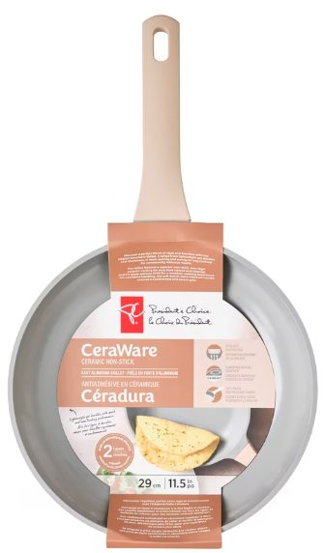
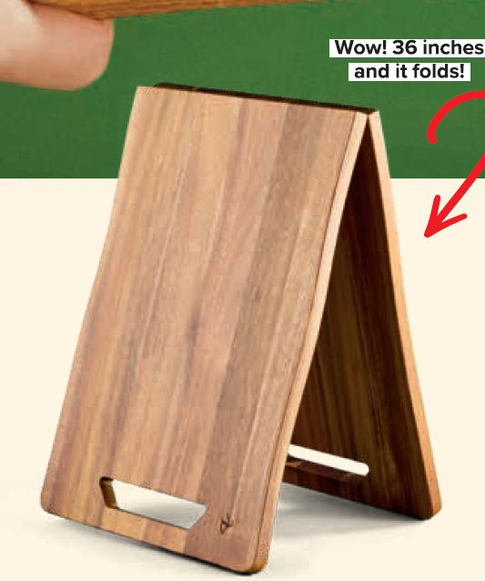
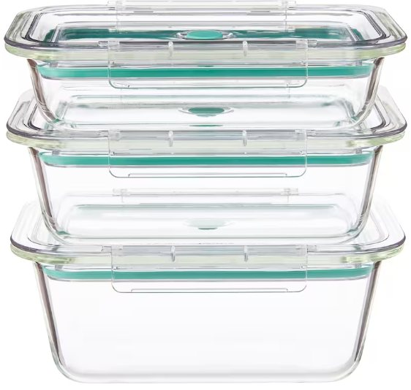
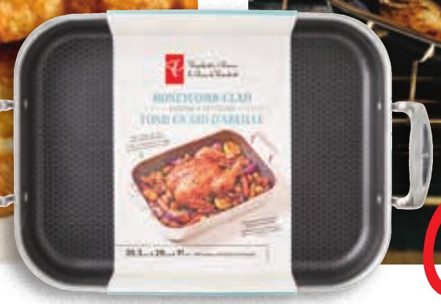
Kitchen & Home Basket
Tiebreaker 1
45
SECONDS
Guess the total price of everything below (before tax)
Oversized Acacia Charcuterie Board
1 board
Honeycomb Clad Roaster
CeraWare Ceramic Non-Stick Cast Aluminum Skillet
11.5 in
TidyStack Glass Containers
3 pack
Notes:
Tiebreaker 1: Kitchen & Home Basket. Start a 45-second timer. Tables write their guess on paper and hold it up when time is up.

Slide 20
Kitchen & Home Basket
Tiebreaker 1 · Answer
Total
$130.00
Closest without going over wins!
$40.00
$50.00
$20.00
$20.00
Oversized Acacia Charcuterie Board
1 board
Honeycomb Clad Roaster
CeraWare Ceramic Non-Stick Cast Aluminum Skillet
11.5 in
TidyStack Glass Containers
3 pack
Notes:
Answer: $130.00.
Oversized Acacia Charcuterie Board: $40.00
Honeycomb Clad Roaster: $50.00
CeraWare Ceramic Non-Stick Cast Aluminum Skillet: $20.00
TidyStack Glass Containers: $20.00

Slide 21
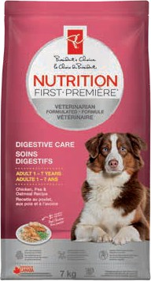
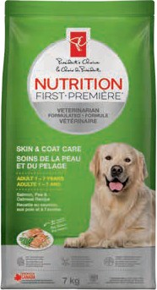
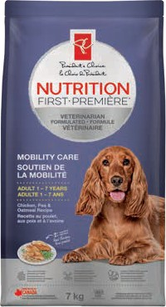
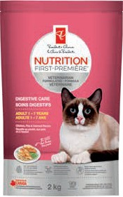
Pampered Pets Basket
Tiebreaker 2
45
SECONDS
Guess the total price of everything below (before tax)
Nutrition First Digestive Care Dry Dog Food
7 kg
Nutrition First Skin & Coat Care Dry Dog Food
7 kg
Nutrition First Mobility Care Dog Food
7 kg
Nutrition First Digestive Care Cat Food
2 kg
Notes:
Tiebreaker 2: Pampered Pets Basket. Start a 45-second timer. Tables write their guess on paper and hold it up when time is up.

Slide 22
Pampered Pets Basket
Tiebreaker 2 · Answer
Total
$104.00
Closest without going over wins!
$30.00
$30.00
$30.00
$14.00
Nutrition First Digestive Care Dry Dog Food
7 kg
Nutrition First Skin & Coat Care Dry Dog Food
7 kg
Nutrition First Mobility Care Dog Food
7 kg
Nutrition First Digestive Care Cat Food
2 kg
Notes:
Answer: $104.00.
Nutrition First Digestive Care Dry Dog Food: $30.00
Nutrition First Skin & Coat Care Dry Dog Food: $30.00
Nutrition First Mobility Care Dog Food: $30.00
Nutrition First Digestive Care Cat Food: $14.00

Slide 23
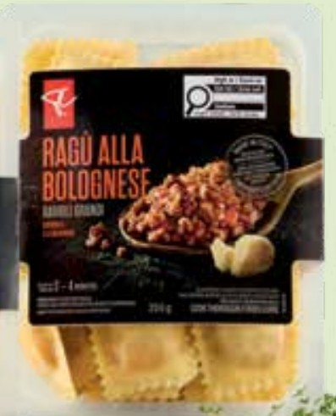
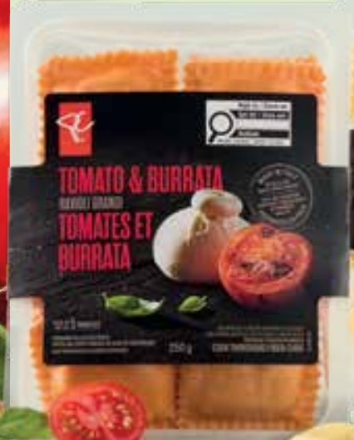


Pasta Night Basket
Tiebreaker 3
45
SECONDS
Guess the total price of everything below (before tax)
Black Label Ragù alla Bolognese Ravioli Grandi
250 g
Black Label Tomato & Burrata Ravioli Grandi
250 g
Solerama San Marzano-Type Roma Tomatoes
454 g
Flavour Explosion Truffle & Ricotta Stuffed Gnocchi
280 g
Notes:
Tiebreaker 3: Pasta Night Basket. Start a 45-second timer. Tables write their guess on paper and hold it up when time is up.

Slide 24
Pasta Night Basket
Tiebreaker 3 · Answer
Total
$24.00
Closest without going over wins!
$7.00
$7.00
$5.00
$5.00
Black Label Ragù alla Bolognese Ravioli Grandi
250 g
Black Label Tomato & Burrata Ravioli Grandi
250 g
Solerama San Marzano-Type Roma Tomatoes
454 g
Flavour Explosion Truffle & Ricotta Stuffed Gnocchi
280 g
Notes:
Answer: $24.00.
Black Label Ragù alla Bolognese Ravioli Grandi: $7.00
Black Label Tomato & Burrata Ravioli Grandi: $7.00
Solerama San Marzano-Type Roma Tomatoes: $5.00
Flavour Explosion Truffle & Ricotta Stuffed Gnocchi: $5.00

Slide 25
Thank you for participating!
Have a good holiday!

