Slide 1
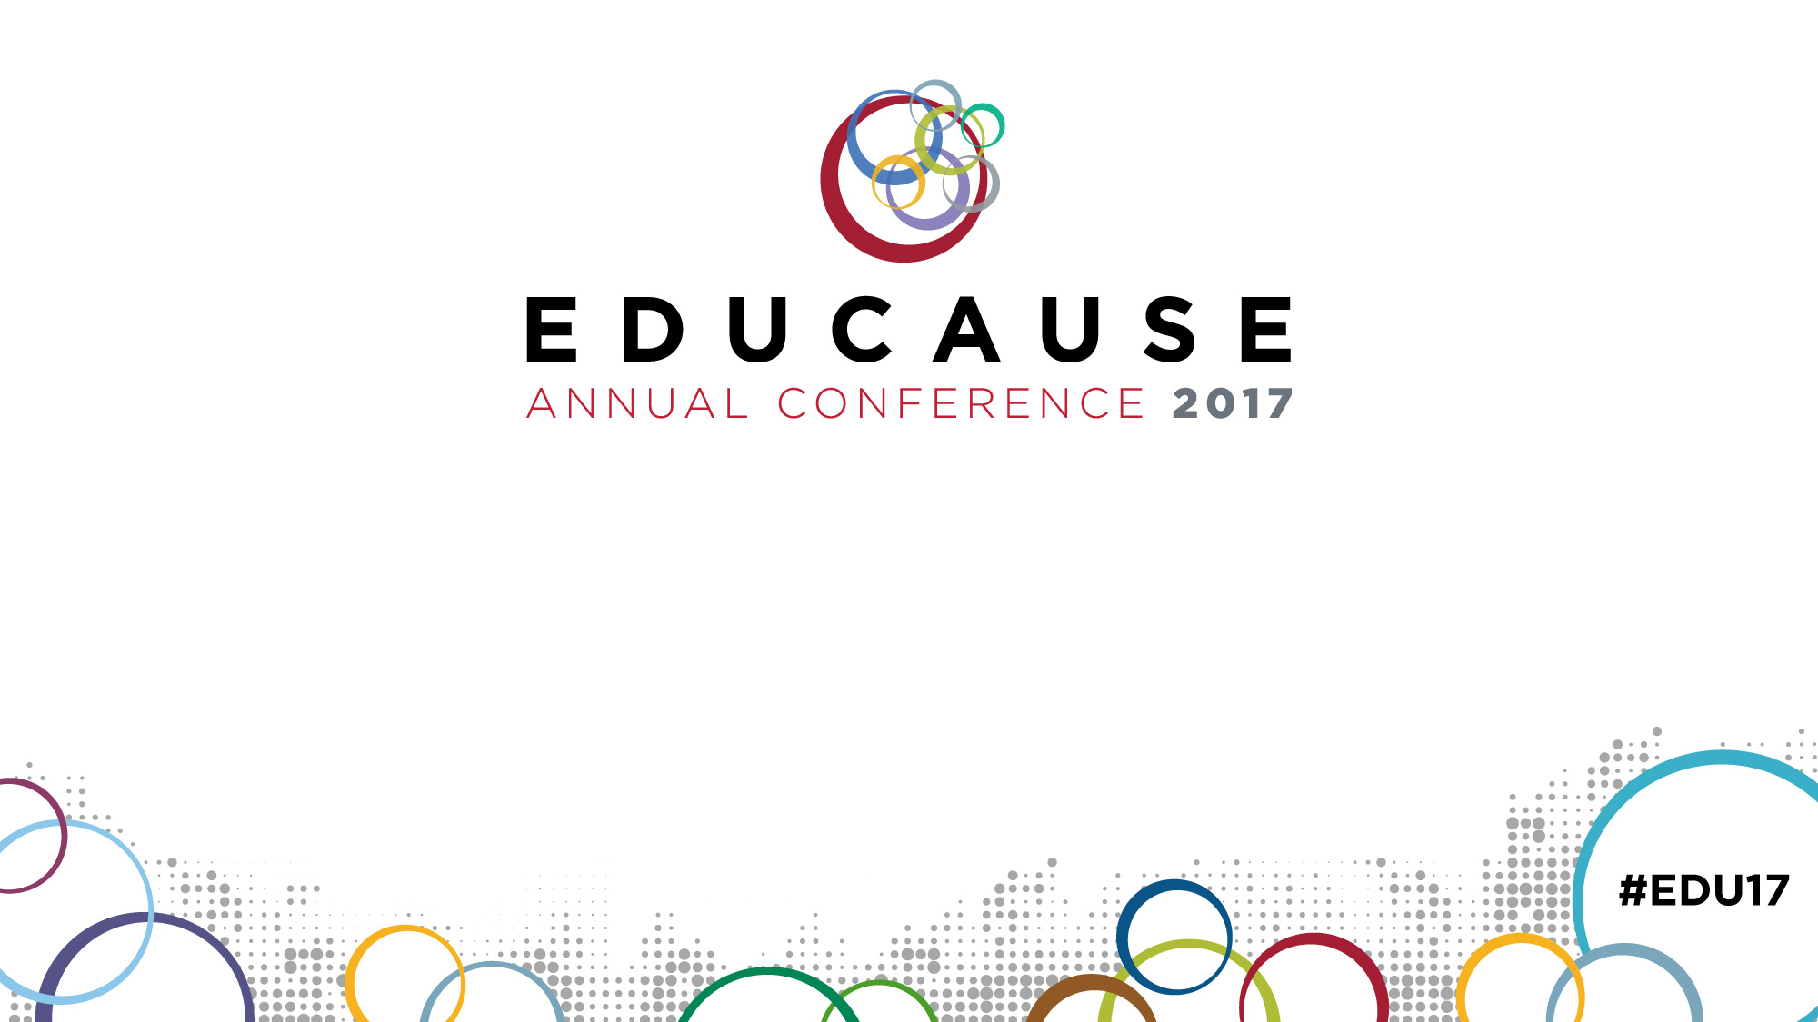
Empowering Students with Disabilities through an Online Student Support Portal
PRESENTED BY:
Dr Casey Frechette • Sharon Austin
WITH SPECIAL THANKS TO:
Mr. Berrie Watson • Mr. Robert Beasey

Slide 2
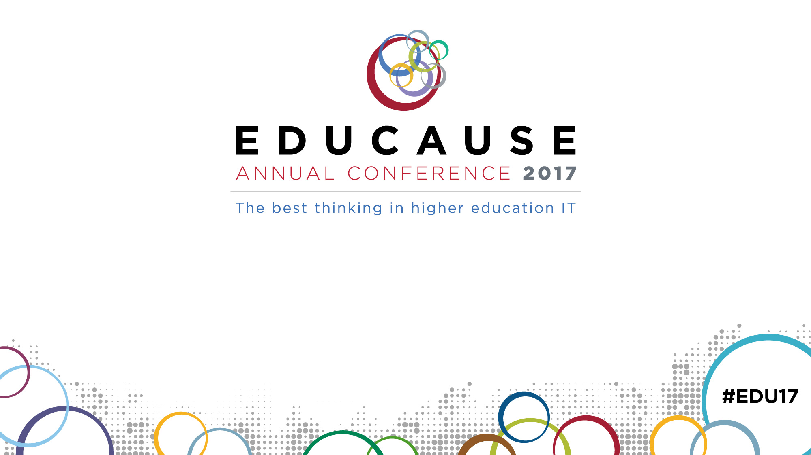
Empowering Students with Disabilities through an Online Student Support Portal
"This presentation leaves copyright of the content to the presenter. Unless otherwise noted in the materials, uploaded content carries the Creative Commons Attribution-NonCommercial-ShareAlike license, which grants usage to the general public with the stipulated criteria."

Slide 3

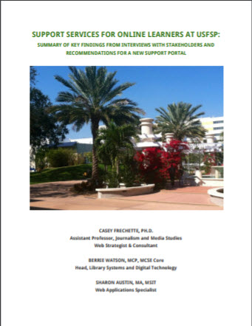
Background
In 2015, a USFSP Online Student Support Portal team was tasked with designing a robust web presence that would help USFSP’s online students to accomplish tasks to advance their academic careers without coming to campus. 27 key stake holders from the institution were interviewed in order to understand the concerns of the university. From those interviews, ten critical concerns emerged.
Among those ten critical concerns was one that specifically addressed accessibility.
https://austin-2017.github.io/reports/SupportPortalInterviewSummaryDocumentFeb17.pdf

Slide 4
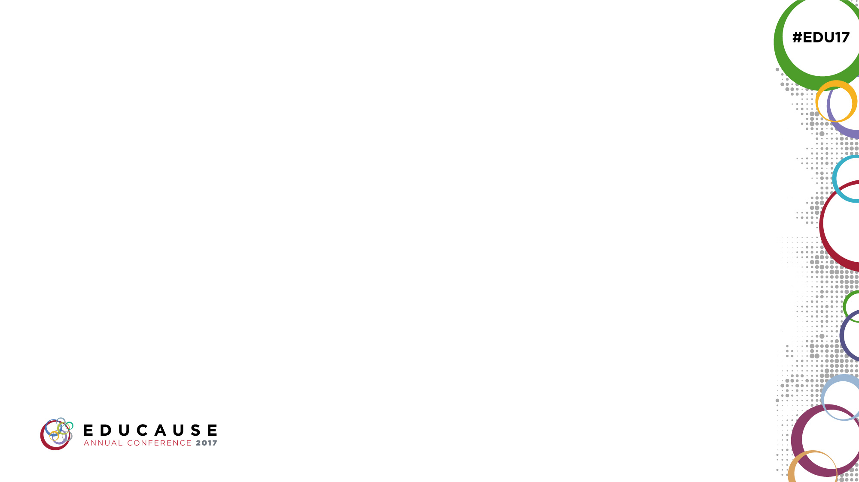
Background
Accessibility for students with disabilities is still a challenge.
Various systems and software packages provide a wide range of support and access to students with disabilities.
The list item above reflected our concern with both hardware and software.
For the software component, we sought to address accessibility using WCAG guidelines, and VPAT.
WCAG: Web Content Accessibility Guidelines (WCAG) 2.0
VPAT: Voluntary Product Accessibility Template

Slide 5
Background
Accessibility for students with disabilities is still a challenge.
Various systems and software packages provide a wide range of support and access to students with disabilities.
Accessibility hardware presents its own challenges. Funding hardware for the various disabilities was problematic for both the student, and the institution. It was not simple justification of the hardware alone that was the problem.
For students with disabilities, their slow pace in filling out forms sometimes forced them past deadline dates for financial aid.
For managers, it was time-consuming and expensive to maintain current versions of accessibility equipment, as well as the browsers necessary for optimal performance.

Slide 6
Background
Accessibility for students with disabilities is still a challenge.
Various systems and software packages provide a wide range of support and access to students with disabilities.
Specialized expertise is needed to create code for content that is dynamically generated, such as in the case of AJAX.
AJAX: Asynchronous JavaScript And XML
WAI-ARIA (Accessible Rich Internet Applications or ARIA)
The addition of ARIA labels can do more harm than good if not implemented correctly. They can hijack functionality.
The time dimension of what content appears when must be considered when adding ARIA labels to dynamic content.
https://www.w3.org/WAI/intro/aria#issues

Slide 7
Background
Accessibility for students with disabilities is still a challenge.
Various systems and software packages provide a wide range of support and access to students with disabilities.
What *IS* content? For us, that meant *web* content.
WCAG 2.0 defines CONTENT as:
content (web content)
information and sensory experience to be communicated to the user by means of a user agent, including code or markup that defines the content's structure, presentation, and interactions
https://www.w3.org/TR/wcag2ict/

Slide 8
Background
Accessibility for students with disabilities is still a challenge.
Various systems and software packages provide a wide range of support and access to students with disabilities.
And, what does it actually mean to be accessible?
According to the Office of Civil Rights:
“Accessible” means a person with a disability is afforded the opportunity to acquire the same information, engage in the same interactions, and enjoy the same services as a person without a disability in an equally effective and equally integrated manner, with substantially equivalent ease of use.” (OCR Compliance Review No. 11-11-6002)
.

Slide 9
We Started Testing…
Accessibility for students with disabilities is still a challenge.
Various systems and software packages provide a wide range of support and access to students with disabilities.
We did some preliminary testing with what we believed to be accessibly-coded web pages. Initial tests involved free or trial versions of screen-readers. We recognized that we were not experts, and that we would need to call in blind users for authentic testing. But there was much that could be learned from the initial testing. There was also this to consider: There was great diversity in how an expert used screen-readers.
..there is no typical screen reader user.

Slide 10
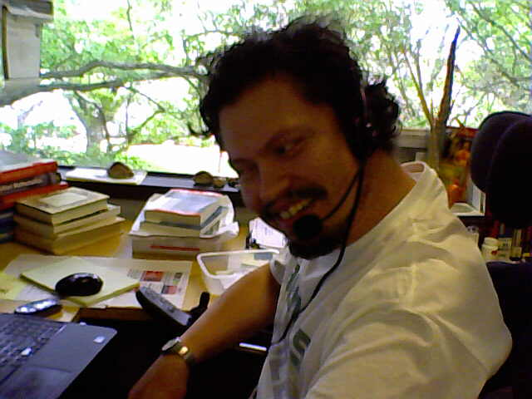
We Started Testing…
Accessibility for students with disabilities is still a challenge.
Various systems and software packages provide a wide range of support and access to students with disabilities.
We set screen-reader testing aside, and brought in…. Robert.

Slide 11
We Started Testing…
Accessibility for students with disabilities is still a challenge.
Various systems and software packages provide a wide range of support and access to students with disabilities.
Robert Beasey is a student at USFSP who has multiple disabilities – and opinions. Lots of opinions.
In terms of accessibility testing, the two of his disabilities that we focused on were his low vision, and motor-skills challenges.

Slide 12
We Started Testing…
Accessibility for students with disabilities is still a challenge.
Various systems and software packages provide a wide range of support and access to students with disabilities.
We found, a little to our horror, that as Robert navigated our test pages with his personal version of Dragon Naturally Speaking, that he was taking advantage of none of the accessibility initiatives that we had coded in.
It went downhill from there.

Slide 13
We Started Testing…
Accessibility for students with disabilities is still a challenge.
Various systems and software packages provide a wide range of support and access to students with disabilities.
We wanted to record his interaction with the web interface. Because he was a student, he was only able to afford the “inexpensive” version of Dragon Naturally Speaking, not the professional version. It would have meant that Robert would have had to go through a grueling process of “retraining” Dragon Naturally Speaking on any computer we wanted to test.
Because of his mobility problems, shooting films and videos of him working forced him into awkward, uncomfortable positions. Pain.

Slide 14
Work Cell Design
Accessibility for students with disabilities is still a challenge.
Various systems and software packages provide a wide range of support and access to students with disabilities.
In essence, we realized that those with disabilities such as his were in a specialized work cell environment.
Enter the consideration of MODAPTS
“The MODAPTS (Modular Arrangements of Predetermined Time Standards) system was developed by G.C.Heyde as an instrument to improve ergonomics in the workplace.” https://www.isixsigma.com/dictionary/modapts/

Slide 15
Work Cell Design
Accessibility for students with disabilities is still a challenge.
Various systems and software packages provide a wide range of support and access to students with disabilities.
“MODAPTS divides work into two basic elements:
1. Body part being used – alphabetical .
The following basic categories are defined:
-Movement : actions of the finger, hand or arm; -Get: actions required to grasp an object; -Put: actions required to place an object; -Body: movements linked to the body (e.g. bend,walk).
2. Degree of effort involved – numerical (MOD=0.129 seconds)”
https://www.isixsigma.com/dictionary/modapts/

Slide 16
Work Cell Design
Accessibility for students with disabilities is still a challenge.
Various systems and software packages provide a wide range of support and access to students with disabilities.
EVERY TIME A USER CLICKS A LINK OR PUSHES A BUTTON:
1. Body parts are being used.
-Movement : actions of the finger, hand or arm; -Get: actions required to grasp an object; -Put: actions required to place an object; -Body: movements linked to the body (e.g. bend,walk).

Slide 17
Work Cell Design
Accessibility for students with disabilities is still a challenge.
Various systems and software packages provide a wide range of support and access to students with disabilities.
USING VOICE ELIMINATED THE USE OF BODY PARTS:
1. Body parts are NOT being used.
-Movement : actions of the finger, hand or arm; -Get: actions required to grasp an object; -Put: actions required to place an object; -Body: movements linked to the body (e.g. bend,walk).

Slide 18
Work Cell Design
Accessibility for students with disabilities is still a challenge.
Various systems and software packages provide a wide range of support and access to students with disabilities.
USING VOICE ELIMINATED THE REQUIREMENT FOR CERTAIN MACHINE OR OPERATING SYSTEM SETTINGS:
There are many web features that require a “double click” to start a process.
This is problematic if a user must ensure the second click occurs within a certain time frame after the first one. Mouse clicks must fall within a range of a certain time limit to actuate the website

Slide 19
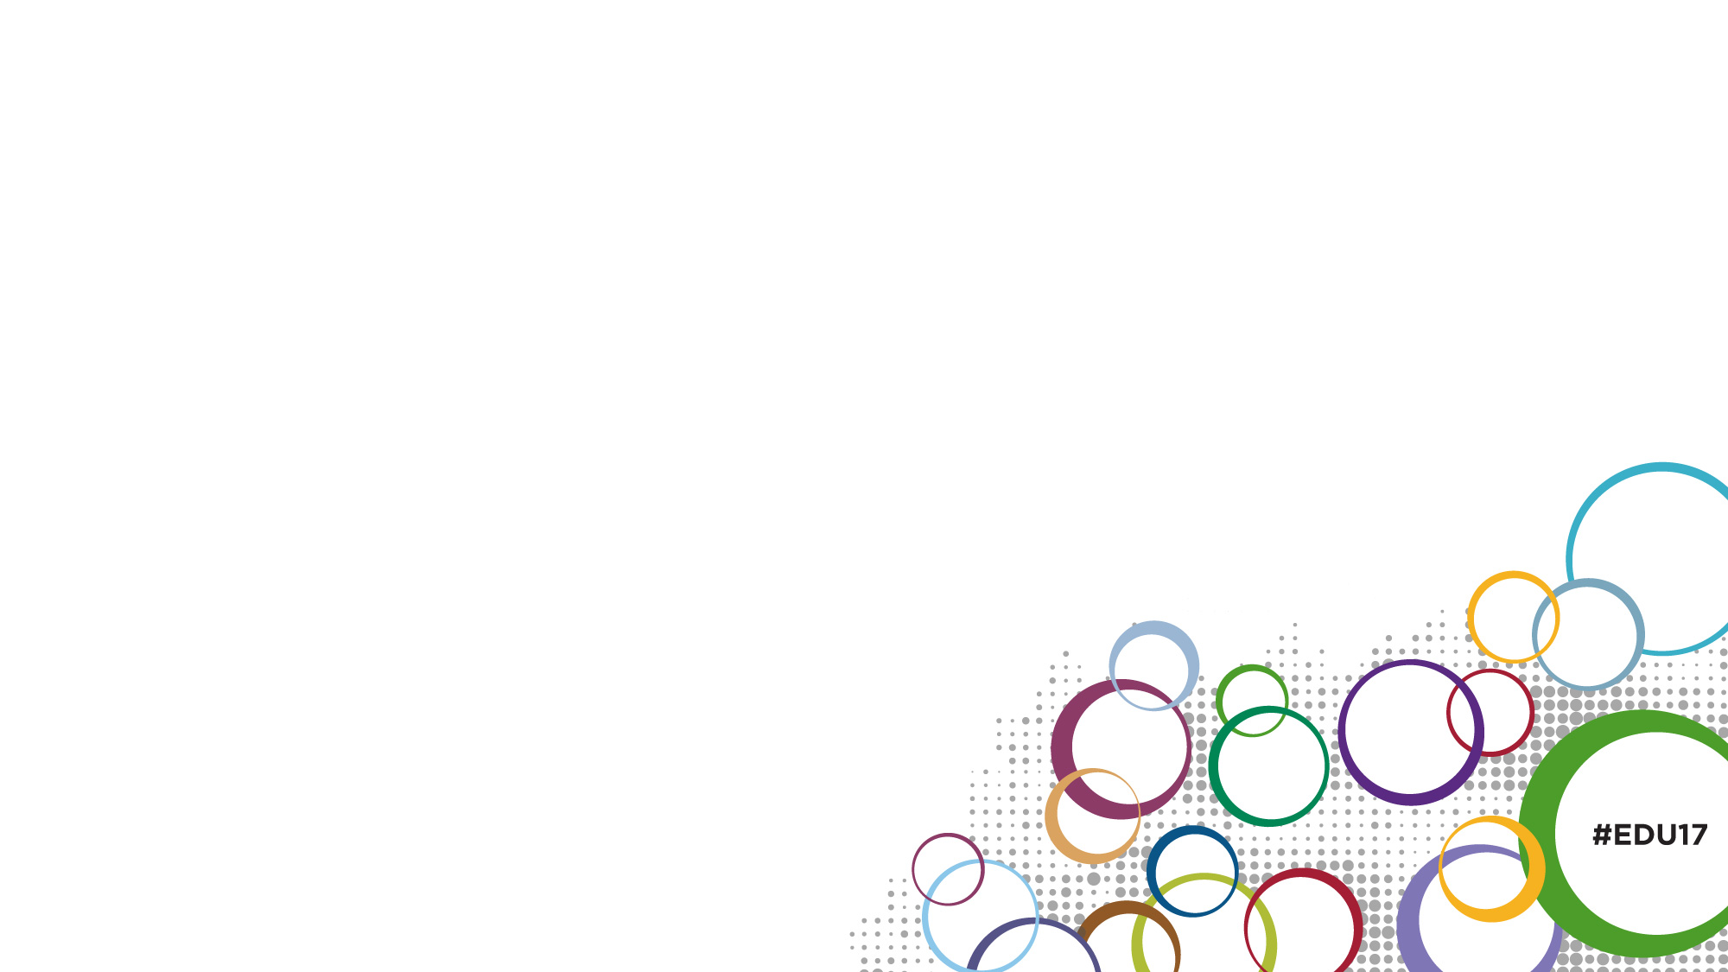

Slide 20
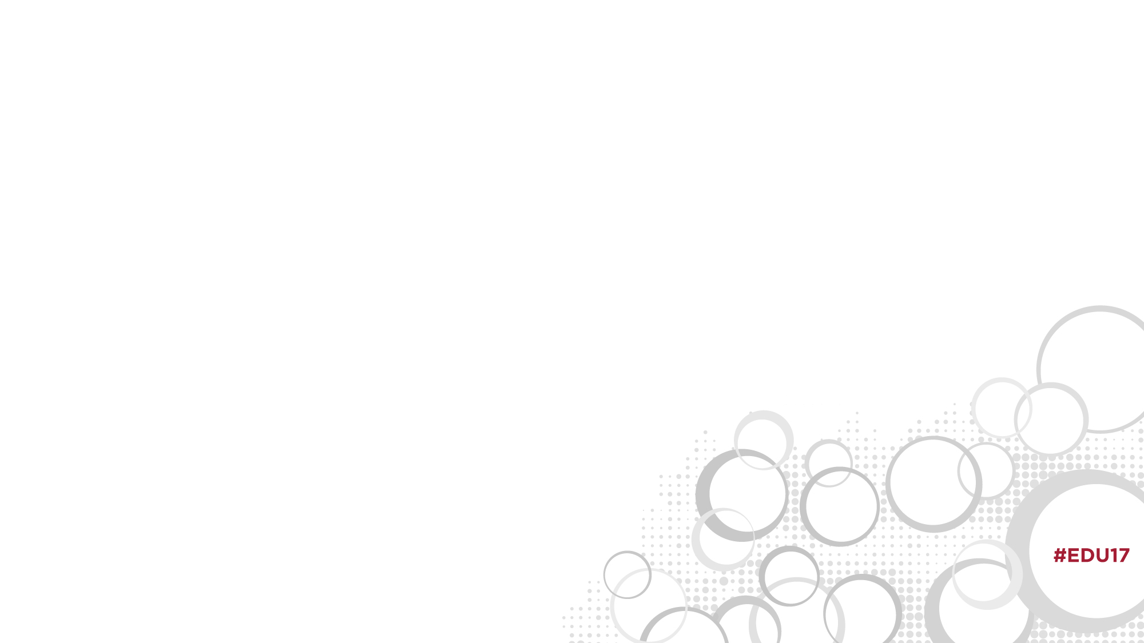

Slide 21


Slide 22
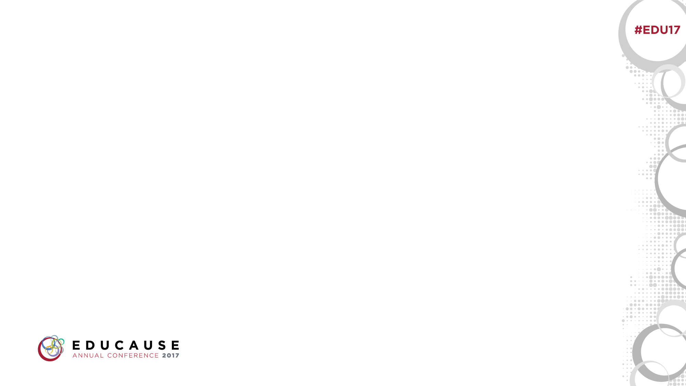

Slide 23
Level 1
Level 2
Level 3
Level 4

