Slide 1
The Cave Arcade
A SQL Solution For A Modern-Day Recreational Facility

Slide 2
Business Situation
The Cave Arcade’s management team needs a database in order to complete day to day tasks such as creating email lists, keeping track of platform software, machine repairs, and business traffic flow.
Other useful data points assumed include gender and age demographics in order to best determine marketing.

Slide 3
Business Situation
The way the arcade works is players register with the arcade, and then create a user account per desired platform.
Platforms host games exclusive to that platform, and one platform is installed on each machine.
Players agree to a EULA per game played.

Slide 4
Business Situation
SELECT, COUNT, FROM, JOIN, GROUP BY, UPDATE, INSERT INTO, and WHERE are supported operations.
The data which needs to be stored includes customer and account information, machine usage data, platform installation data, game information, and EULA data which can be used to look up which accounts play which games.

Slide 5
Project Schedule
March 15

Slide 6
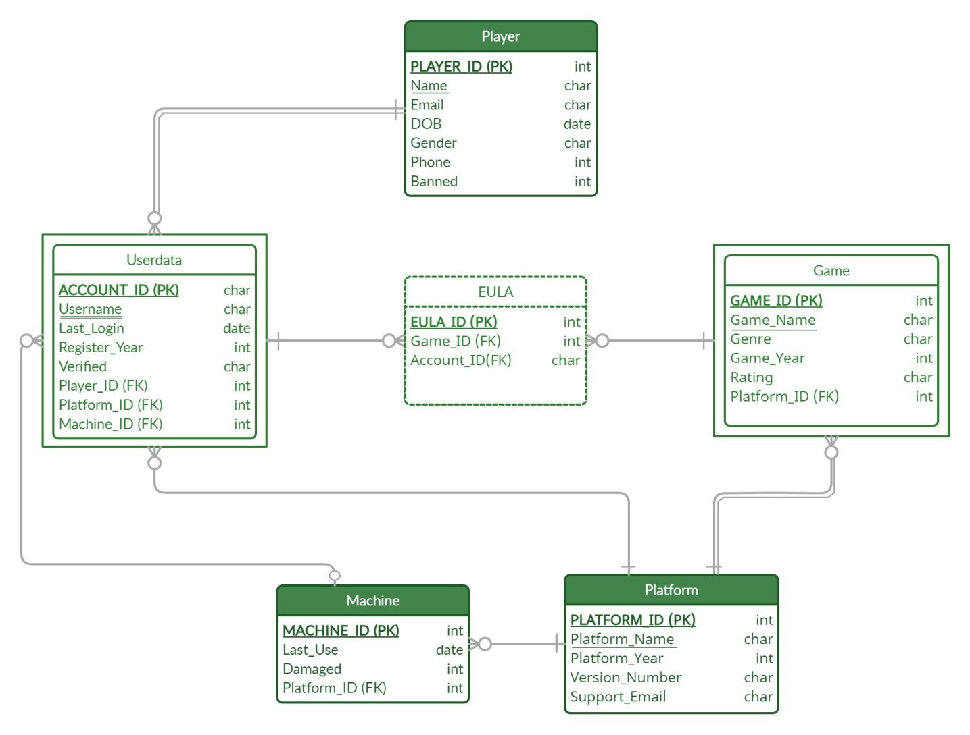
ER Diagram

Slide 7
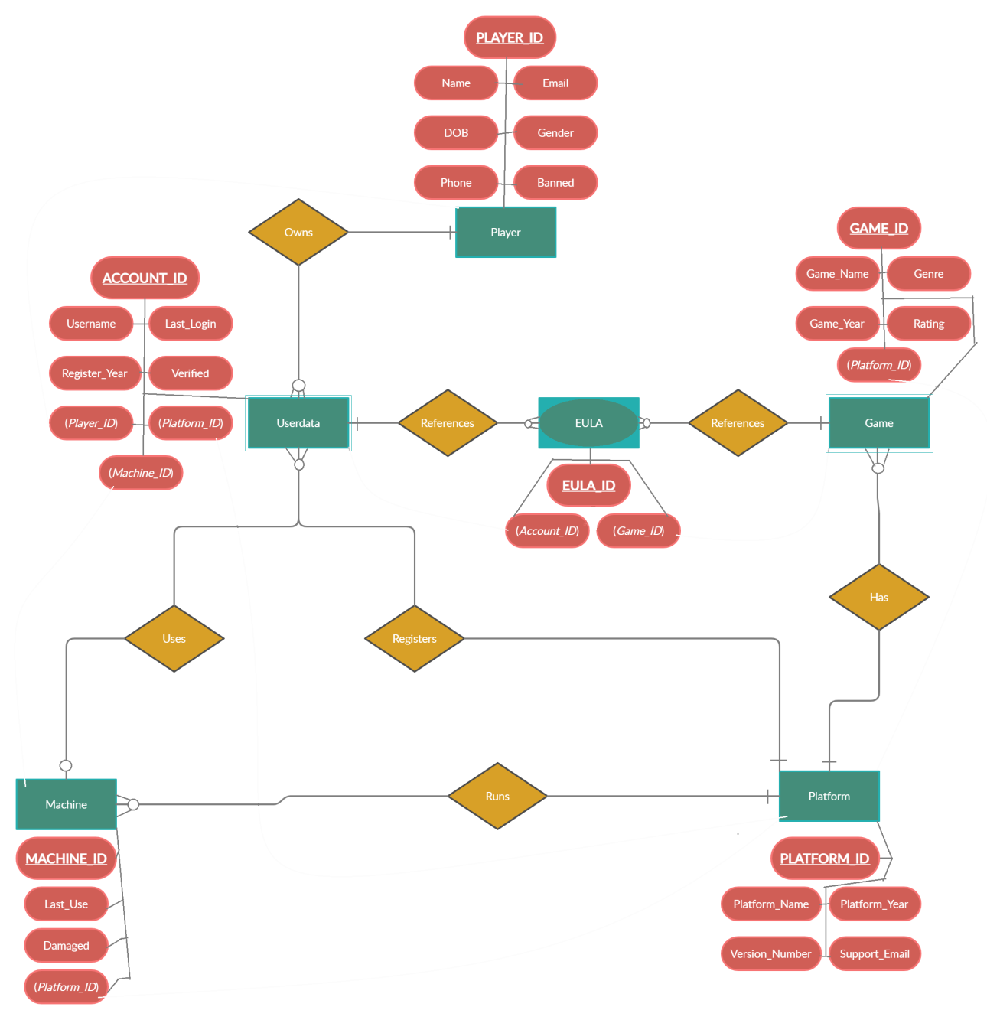
EER Diagram

Slide 8
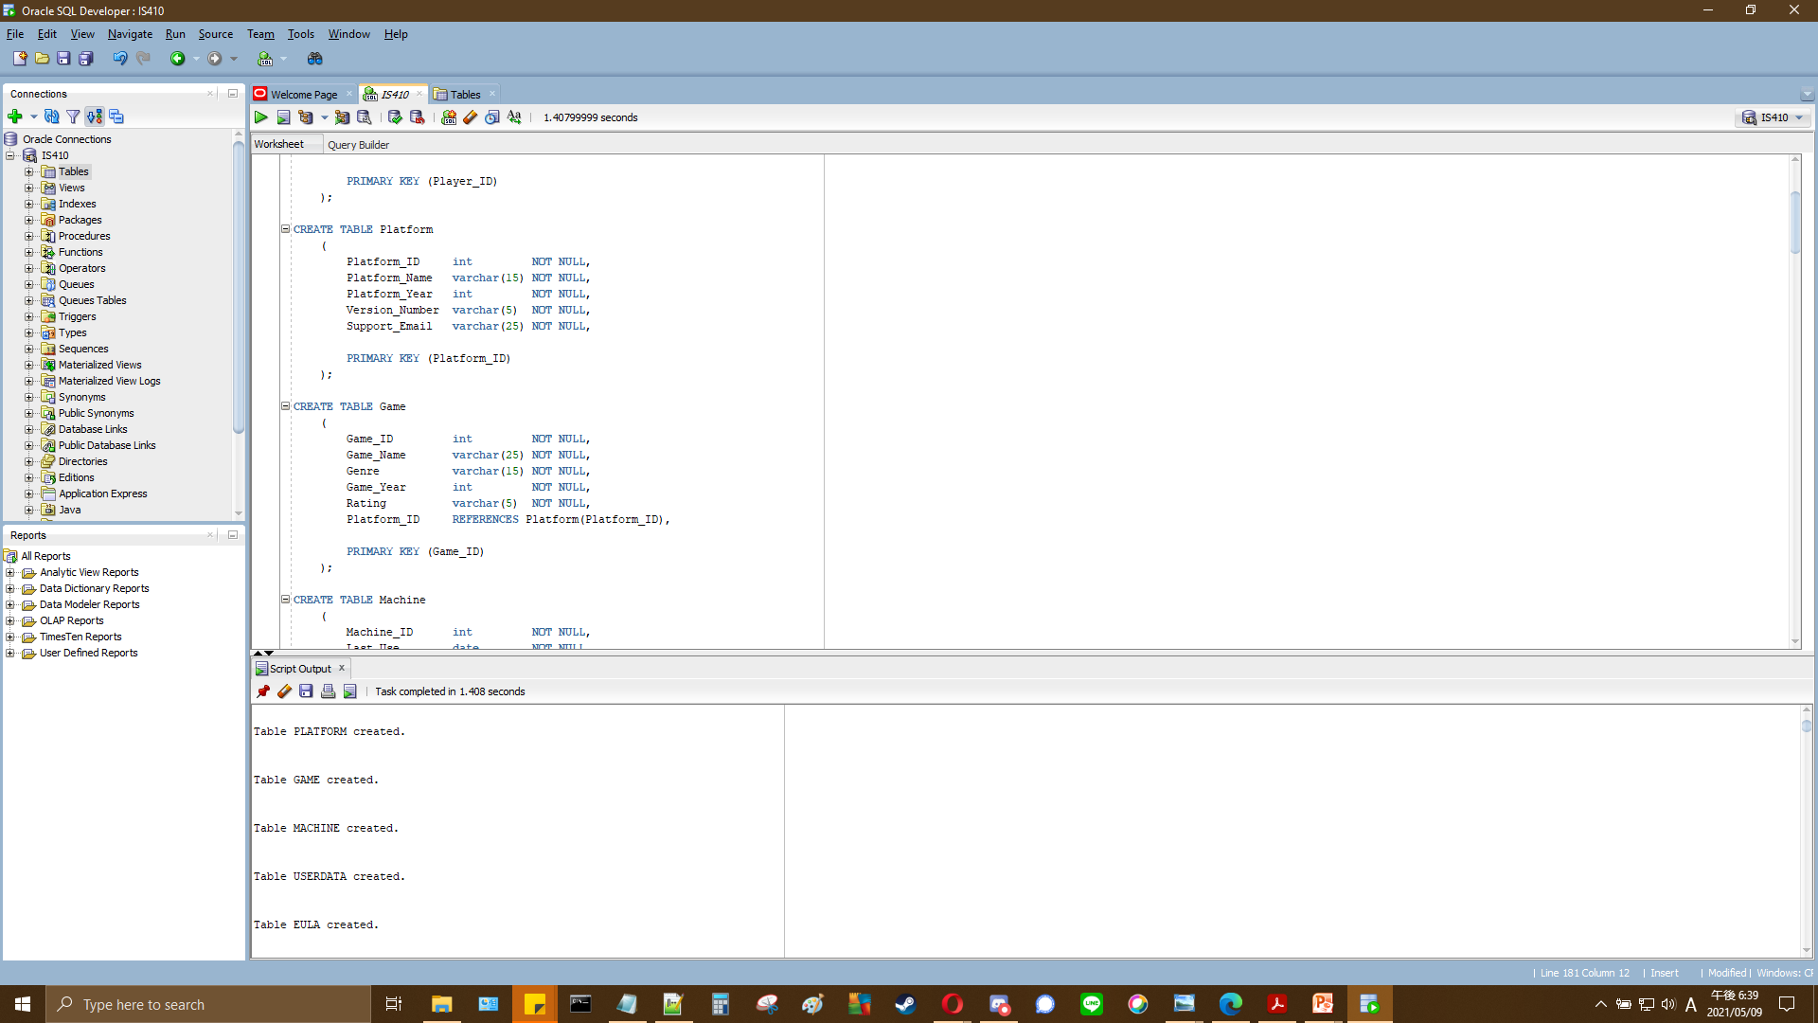
Creation Of Tables
Notes:
CREATE TABLE Player
(
Player_ID int NOT NULL,
Player_Name varchar(25) NOT NULL,
Email varchar(25) NOT NULL,
DOB date NOT NULL,
Gender varchar(1) NOT NULL
CHECK (Gender IN ('M', 'F', 'O')),
Phone int NOT NULL,
Banned int NOT NULL,
PRIMARY KEY (Player_ID)
);
CREATE TABLE Platform
(
Platform_ID int NOT NULL,
Platform_Name varchar(15) NOT NULL,
Platform_Year int NOT NULL,
Version_Number varchar(5) NOT NULL,
Support_Email varchar(25) NOT NULL,
PRIMARY KEY (Platform_ID)
);
CREATE TABLE Game
(
Game_ID int NOT NULL,
Game_Name varchar(25) NOT NULL,
Genre varchar(15) NOT NULL,
Game_Year int NOT NULL,
Rating varchar(5) NOT NULL,
Platform_ID REFERENCES Platform(Platform_ID),
PRIMARY KEY (Game_ID)
);
CREATE TABLE Machine
(
Machine_ID int NOT NULL,
Last_Use date NOT NULL,
Damaged int NOT NULL,
Platform_ID REFERENCES Platform(Platform_ID),
PRIMARY KEY (Machine_ID)
);
CREATE TABLE Userdata
(
Account_ID varchar(7) NOT NULL,
Username varchar(10) NOT NULL,
Last_Login date NOT NULL,
Register_Year int NOT NULL,
Verified varchar(1) NOT NULL
CHECK (Verified IN ('Y', 'N')),
Player_ID REFERENCES Player(Player_ID),
Platform_ID REFERENCES Platform(Platform_ID),
Machine_ID REFERENCES Machine(Machine_ID),
PRIMARY KEY (Account_ID)
);
CREATE TABLE Eula
(
Eula_ID int NOT NULL,
Game_ID REFERENCES Game(Game_ID),
Account_ID REFERENCES Userdata(Account_ID),
PRIMARY KEY (Eula_ID)
);

Slide 9
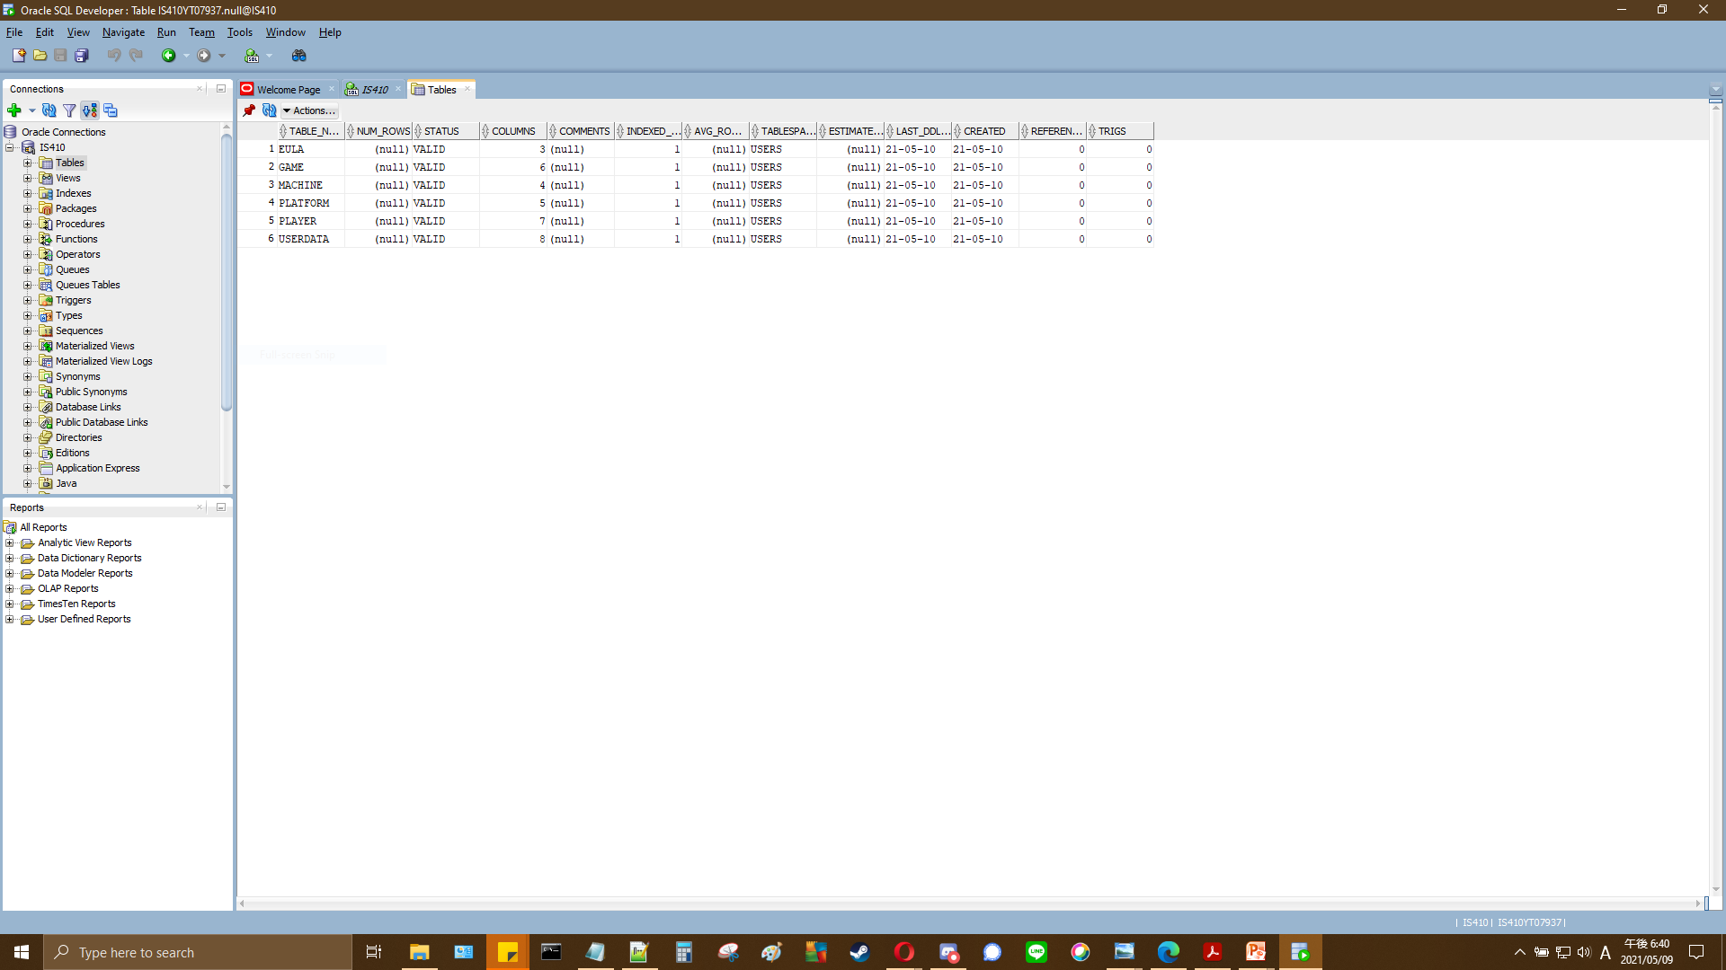
Creation Of Tables

Slide 10
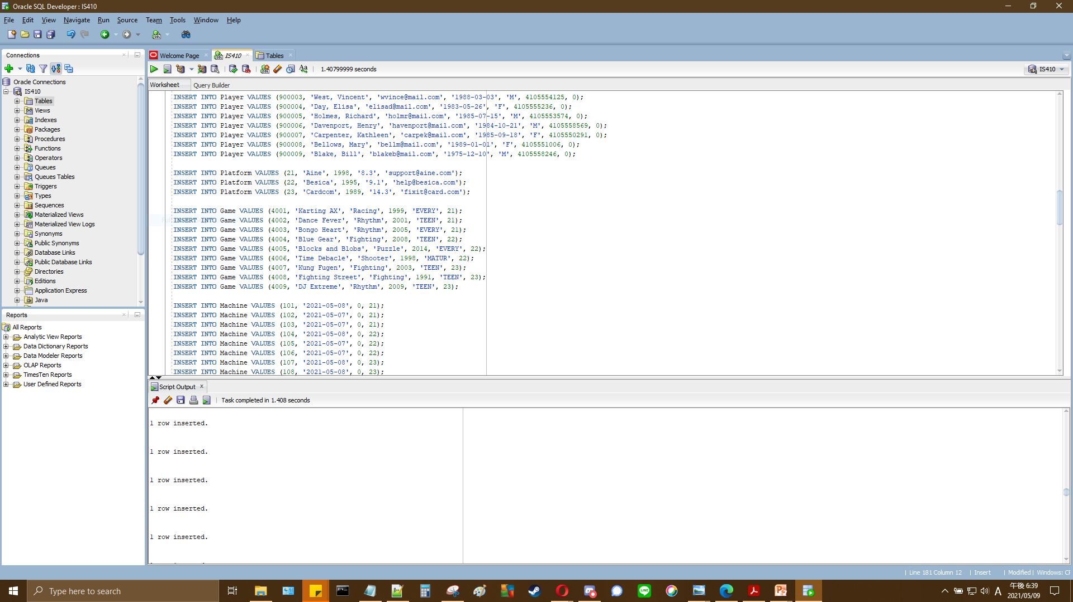
Input of Table Data
Notes:
INSERT INTO Player VALUES (900000, 'Crow, Jane', 'jcrow@mail.com', '1981-10-31', 'F', 4105557295, 0);
INSERT INTO Player VALUES (900001, 'Lee, Stagger', 'staggerl@mail.com', '1972-02-12', 'M', 4105557892, 0);
INSERT INTO Player VALUES (900002, 'Finn, John', 'jfinn@mail.com', '1984-04-19', 'M', 4105554563, 0);
INSERT INTO Player VALUES (900003, 'West, Vincent', 'wvince@mail.com', '1988-03-03', 'M', 4105554125, 0);
INSERT INTO Player VALUES (900004, 'Day, Elisa', 'elisad@mail.com', '1983-05-26', 'F', 4105555236, 0);
INSERT INTO Player VALUES (900005, 'Holmes, Richard', 'holmr@mail.com', '1985-07-15', 'M', 4105553574, 0);
INSERT INTO Player VALUES (900006, 'Davenport, Henry', 'havenport@mail.com', '1984-10-21', 'M', 4105558569, 0);
INSERT INTO Player VALUES (900007, 'Carpenter, Kathleen', 'carpek@mail.com', '1985-09-18', 'F', 4105550291, 0);
INSERT INTO Player VALUES (900008, 'Bellows, Mary', 'bellm@mail.com', '1989-01-01', 'F', 4105551006, 0);
INSERT INTO Player VALUES (900009, 'Blake, Bill', 'blakeb@mail.com', '1975-12-10', 'M', 4105558246, 0);
INSERT INTO Platform VALUES (21, 'Aine', 1998, '8.3', 'support@aine.com');
INSERT INTO Platform VALUES (22, 'Besica', 1995, '9.1', 'help@besica.com');
INSERT INTO Platform VALUES (23, 'Cardcom', 1989, '14.3', 'fixit@card.com');
INSERT INTO Game VALUES (4001, 'Karting AX', 'Racing', 1999, 'EVERY', 21);
INSERT INTO Game VALUES (4002, 'Dance Fever', 'Rhythm', 2001, 'TEEN', 21);
INSERT INTO Game VALUES (4003, 'Bongo Heart', 'Rhythm', 2005, 'EVERY', 21);
INSERT INTO Game VALUES (4004, 'Blue Gear', 'Fighting', 2008, 'TEEN', 22);
INSERT INTO Game VALUES (4005, 'Blocks and Blobs', 'Puzzle', 2014, 'EVERY', 22);
INSERT INTO Game VALUES (4006, 'Time Debacle', 'Shooter', 1998, 'MATUR', 22);
INSERT INTO Game VALUES (4007, 'Kung Fugen', 'Fighting', 2003, 'TEEN', 23);
INSERT INTO Game VALUES (4008, 'Fighting Street', 'Fighting', 1991, 'TEEN', 23);
INSERT INTO Game VALUES (4009, 'DJ Extreme', 'Rhythm', 2009, 'TEEN', 23);
INSERT INTO Machine VALUES (101, '2021-05-08', 0, 21);
INSERT INTO Machine VALUES (102, '2021-05-07', 0, 21);
INSERT INTO Machine VALUES (103, '2021-05-07', 0, 21);
INSERT INTO Machine VALUES (104, '2021-05-08', 0, 22);
INSERT INTO Machine VALUES (105, '2021-05-07', 0, 22);
INSERT INTO Machine VALUES (106, '2021-05-07', 0, 22);
INSERT INTO Machine VALUES (107, '2021-05-08', 0, 23);
INSERT INTO Machine VALUES (108, '2021-05-08', 0, 23);
INSERT INTO Machine VALUES (109, '2021-05-06', 1, 23);
INSERT INTO Userdata VALUES ('A000000', 'TheCrow', '2021-05-08', 2011, 'Y', 900000, 21, 101);
INSERT INTO Userdata VALUES ('B000000', 'TheCrow', '2021-05-08', 2011, 'Y', 900000, 22, 104);
INSERT INTO Userdata VALUES ('C000001', 'LeStag', '2021-05-06', 2016, 'Y', 900001, 23, 109);
INSERT INTO Userdata VALUES ('A000010', 'Sharkfin', '2021-04-19', 2013, 'Y', 900002, 21, 102);
INSERT INTO Userdata VALUES ('B000011', 'Westward', '2021-05-07', 2015, 'Y', 900003, 22, 105);
INSERT INTO Userdata VALUES ('C000100', 'GoodDay', '2021-05-08', 2018, 'Y', 900004, 23, 107);
INSERT INTO Userdata VALUES ('A000100', 'GoodDay', '2021-05-07', 2017, 'Y', 900004, 21, 103);
INSERT INTO Userdata VALUES ('B000101', 'Homeboy', '2021-05-01', 2012, 'Y', 900005, 22, 106);
INSERT INTO Userdata VALUES ('C000101', 'Homeboy', '2021-05-08', 2012, 'Y', 900005, 23, 108);
INSERT INTO Userdata VALUES ('A000110', 'Porty', '2021-05-05', 2008, 'Y', 900006, 21, 101);
INSERT INTO Userdata VALUES ('B000110', 'Pouty', '2021-05-06', 2009, 'Y', 900006, 22, 105);
INSERT INTO Userdata VALUES ('C000110', 'Pointy', '2021-05-05', 2010, 'Y', 900006, 23, 107);
INSERT INTO Userdata VALUES ('A000111', 'Karpet', '2021-05-07', 2015, 'Y', 900007, 21, 102);
INSERT INTO Userdata VALUES ('B001000', 'WindyMary', '2021-05-07', 2014, 'Y', 900008, 22, 106);
INSERT INTO Userdata VALUES ('C001001', 'Balakey', '2021-04-28', 2017, 'Y', 900009, 23, 109);
INSERT INTO Eula VALUES (88880001, 4001, 'A000000');
INSERT INTO Eula VALUES (88880002, 4004, 'B000000');
INSERT INTO Eula VALUES (88880003, 4006, 'B000000');
INSERT INTO Eula VALUES (88880004, 4007, 'C000001');
INSERT INTO Eula VALUES (88880005, 4008, 'C000001');
INSERT INTO Eula VALUES (88880006, 4002, 'A000010');
INSERT INTO Eula VALUES (88880007, 4003, 'A000010');
INSERT INTO Eula VALUES (88880008, 4005, 'B000011');
INSERT INTO Eula VALUES (88880009, 4009, 'C000100');
INSERT INTO Eula VALUES (88880010, 4003, 'A000100');
INSERT INTO Eula VALUES (88880011, 4006, 'B000101');
INSERT INTO Eula VALUES (88880012, 4008, 'C000101');
INSERT INTO Eula VALUES (88880013, 4001, 'A000110');
INSERT INTO Eula VALUES (88880014, 4004, 'B000110');
INSERT INTO Eula VALUES (88880015, 4009, 'C000110');
INSERT INTO Eula VALUES (88880016, 4002, 'A000111');
INSERT INTO Eula VALUES (88880017, 4005, 'B001000');
INSERT INTO Eula VALUES (88880018, 4007, 'C001001');

Slide 11
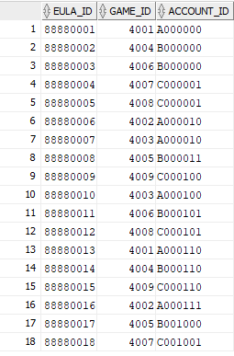
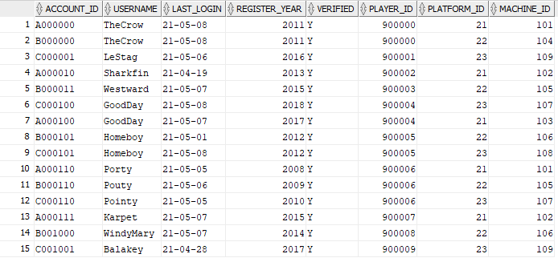
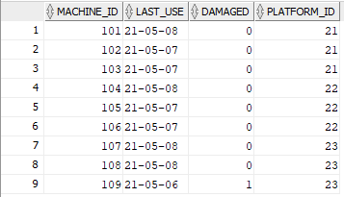
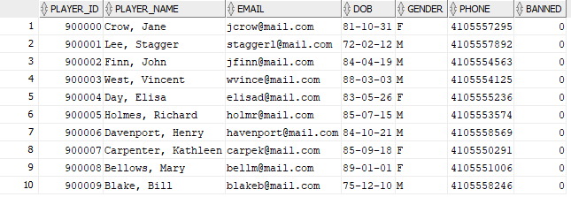
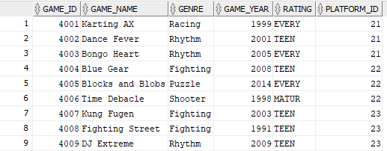

Tables

Slide 12
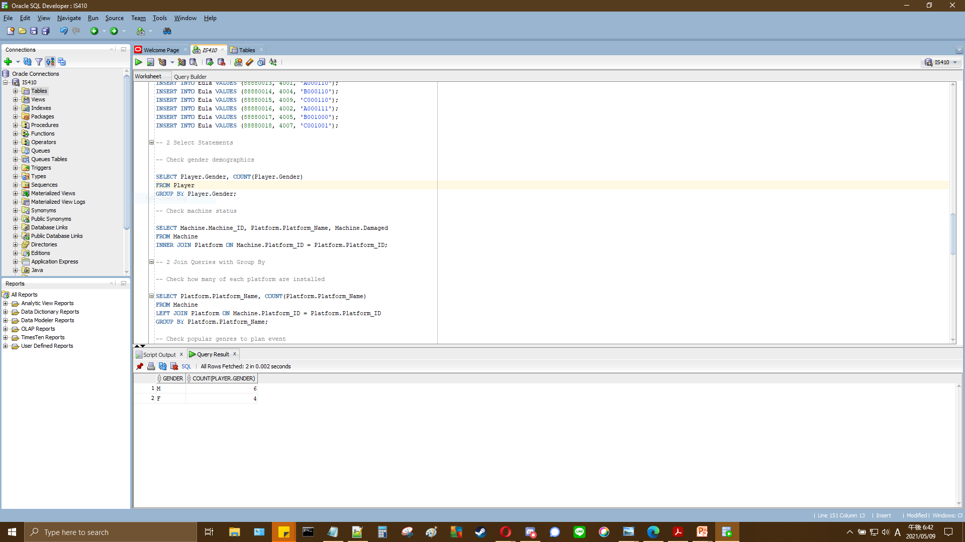
Select Statement 1
Notes:
SELECT Player.Gender, COUNT(Player.Gender)
FROM Player
GROUP BY Player.Gender;

Slide 13
Select Statement 1 Explained
Scenario: Management would like to check gender demographic information in order to best plan advertisements.
Results: We can see the ratio of men to women is 6:4.
Notes:
SELECT Player.Gender, COUNT(Player.Gender)
FROM Player
GROUP BY Player.Gender;

Slide 14
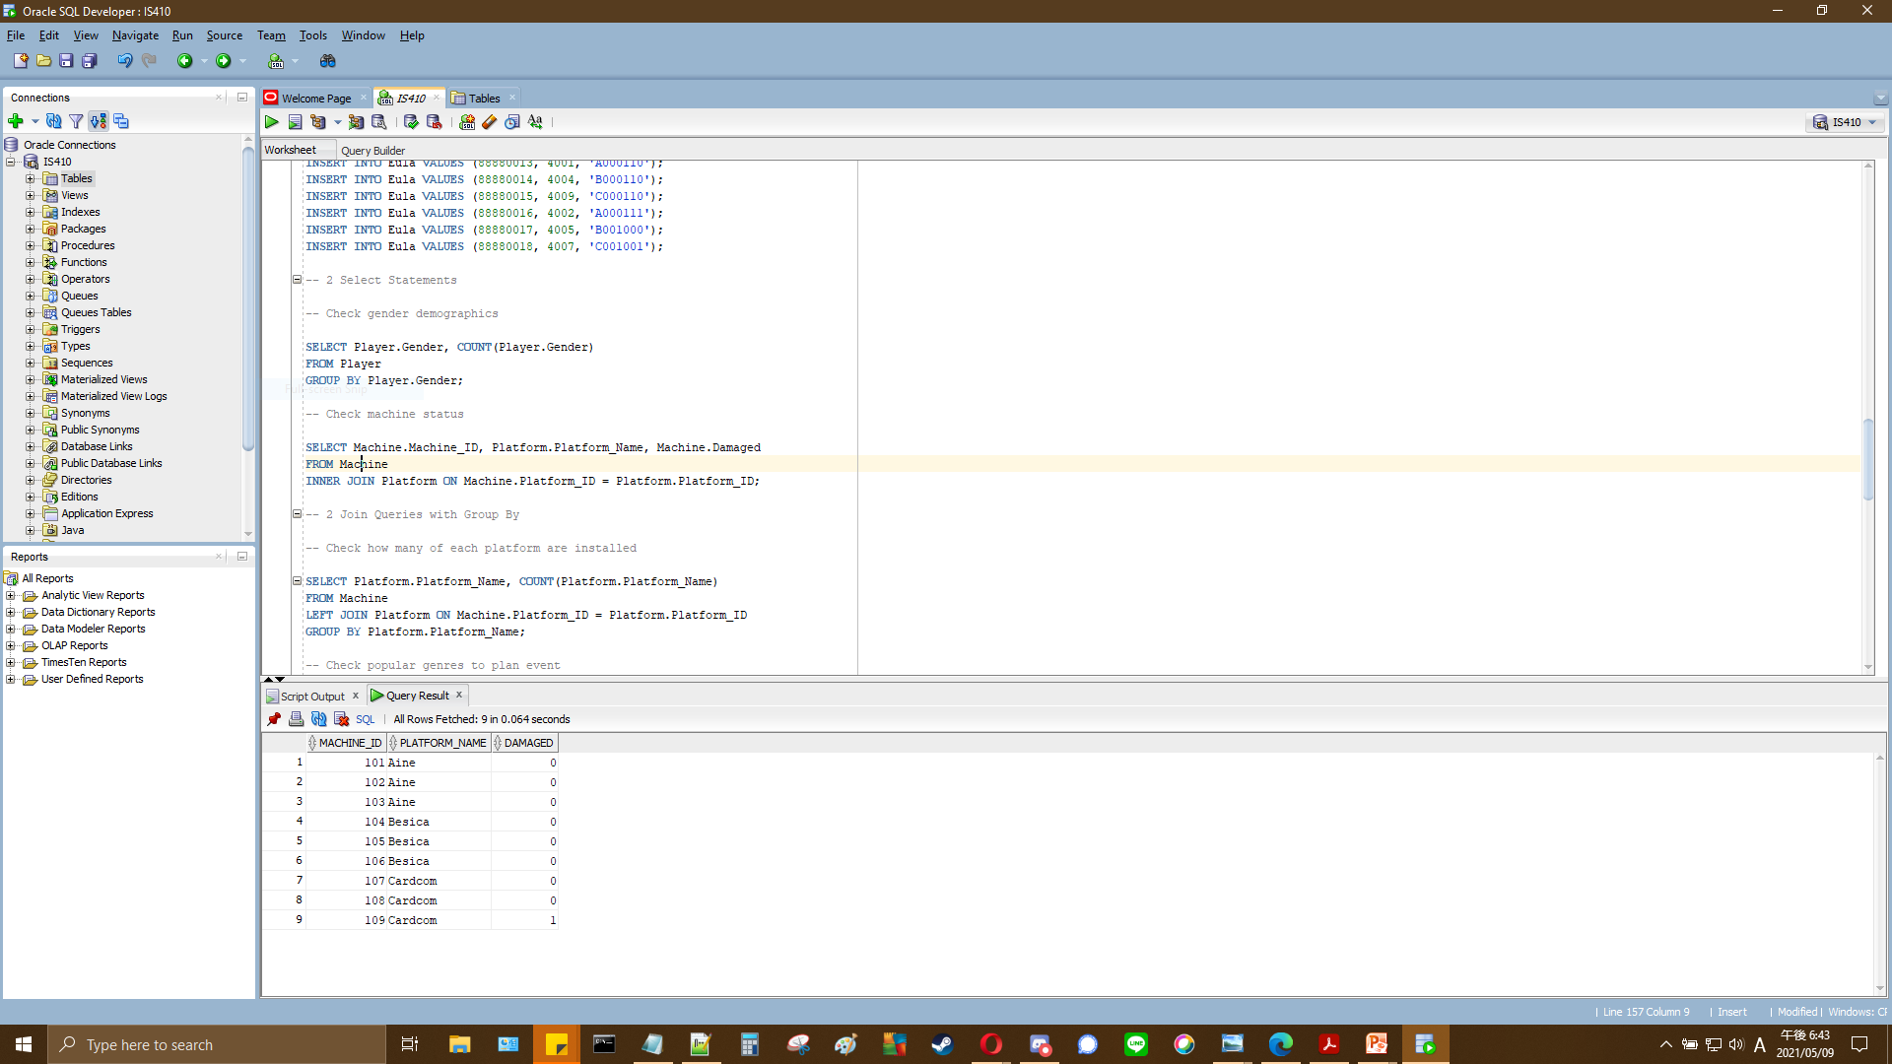
Select Statement 2
Notes:
SELECT Machine.Machine_ID, Platform.Platform_Name, Machine.Damaged
FROM Machine
INNER JOIN Platform ON Machine.Platform_ID = Platform.Platform_ID;

Slide 15
Select Statement 2 Explained
Scenario: Management would like to see the status of their arcade machines.
Results: We can see that machine 109 is currently damaged.
Notes:
SELECT Machine.Machine_ID, Platform.Platform_Name, Machine.Damaged
FROM Machine
INNER JOIN Platform ON Machine.Platform_ID = Platform.Platform_ID;

Slide 16
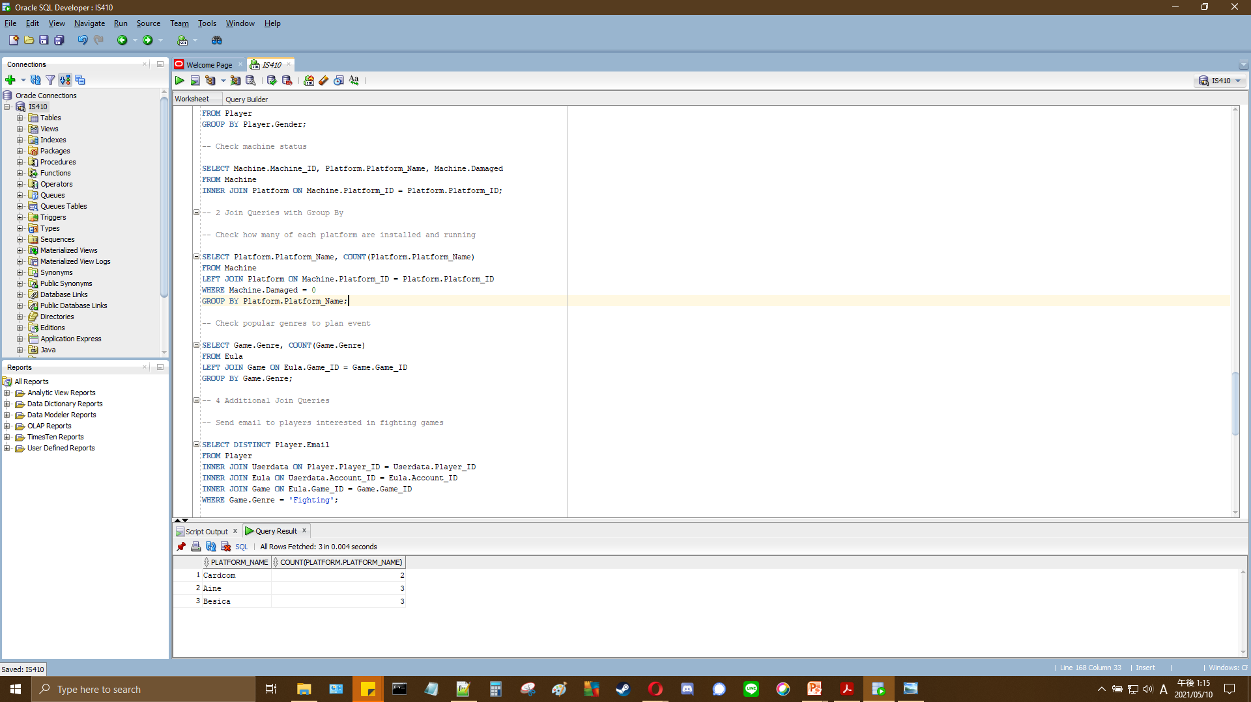
Select Statement 3
Notes:
SELECT Platform.Platform_Name, COUNT(Platform.Platform_Name)
FROM Machine
LEFT JOIN Platform ON Machine.Platform_ID = Platform.Platform_ID
WHERE Machine.Damaged = 0
GROUP BY Platform.Platform_Name;

Slide 17
Select Statement 3 Explained
Scenario: Management would like to see how many platforms are running on undamaged machines.
Results: We can see that 3 of each platform are running on undamaged machines aside from Cardcom, which has two, as machine 109 was running Cardcom.
Notes:
SELECT Platform.Platform_Name, COUNT(Platform.Platform_Name)
FROM Machine
LEFT JOIN Platform ON Machine.Platform_ID = Platform.Platform_ID
WHERE Machine.Damaged = 0
GROUP BY Platform.Platform_Name;

Slide 18
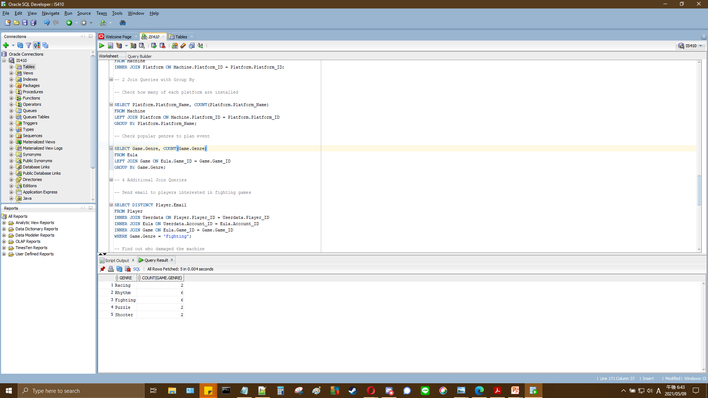
Select Statement 4
Notes:
SELECT Game.Genre, COUNT(Game.Genre)
FROM Eula
LEFT JOIN Game ON Eula.Game_ID = Game.Game_ID
GROUP BY Game.Genre;

Slide 19
Select Statement 4 Explained
Scenario: Management would like to plan an event. In order to do so, they would like to see which genre of game is most popular per account according to the EULA lookup table.
Results: We can see that ‘Rhythm’ and ‘Fighting’ are the most popular genres.
Notes:
SELECT Game.Genre, COUNT(Game.Genre)
FROM Eula
LEFT JOIN Game ON Eula.Game_ID = Game.Game_ID
GROUP BY Game.Genre;

Slide 20
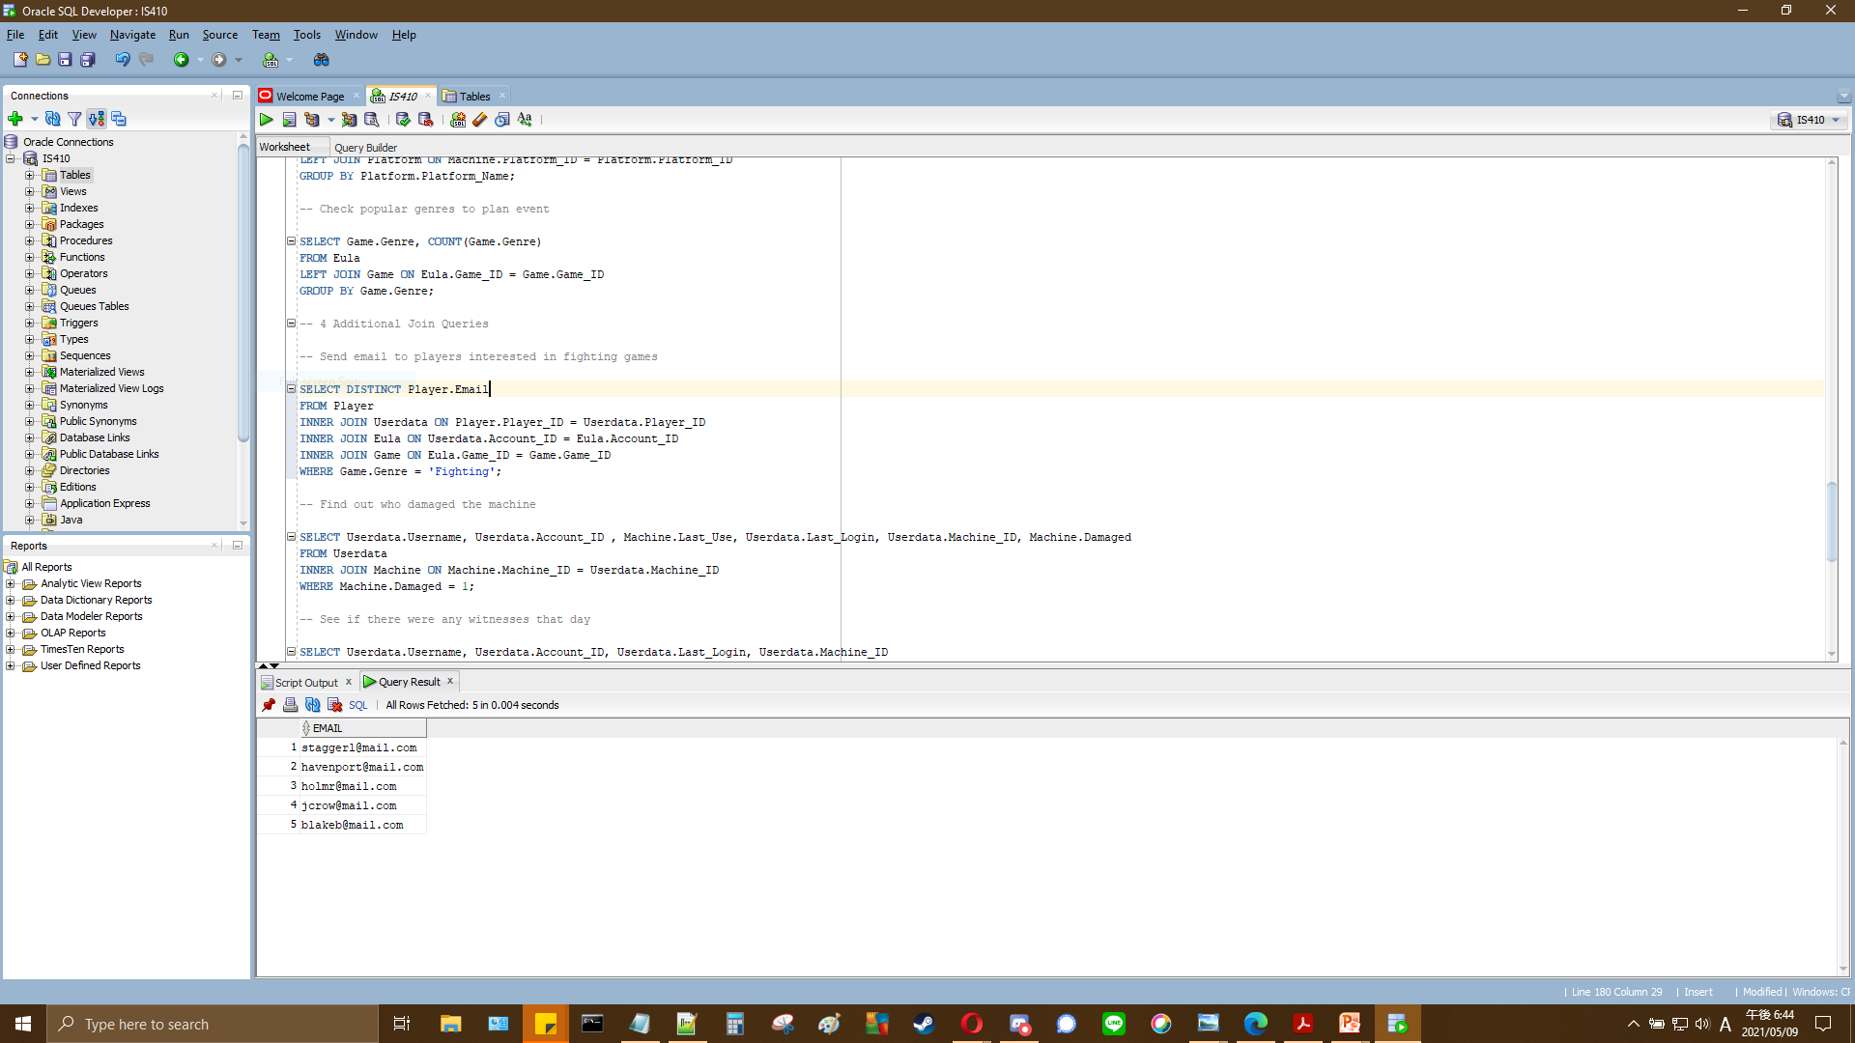
Select Statement 5
Notes:
SELECT DISTINCT Player.Email
FROM Player
INNER JOIN Userdata ON Player.Player_ID = Userdata.Player_ID
INNER JOIN Eula ON Userdata.Account_ID = Eula.Account_ID
INNER JOIN Game ON Eula.Game_ID = Game.Game_ID
WHERE Game.Genre = 'Fighting';

Slide 21
Select Statement 5 Explained
Scenario: Management would like to send an email ad to all players interested in fighting games.
Results: We can see that through using the EULA lookup table alongside other tables, we now have a list of 5 unique emails.
Notes:
SELECT DISTINCT Player.Email
FROM Player
INNER JOIN Userdata ON Player.Player_ID = Userdata.Player_ID
INNER JOIN Eula ON Userdata.Account_ID = Eula.Account_ID
INNER JOIN Game ON Eula.Game_ID = Game.Game_ID
WHERE Game.Genre = 'Fighting';

Slide 22
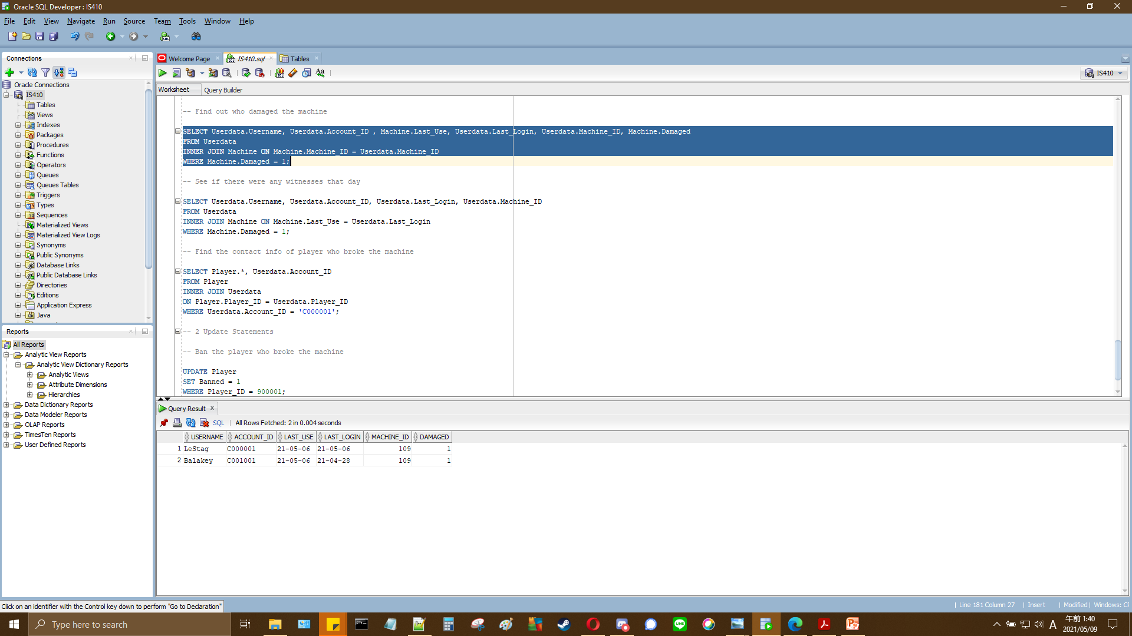
Select Statement 6
Notes:
SELECT Userdata.Username, Userdata.Account_ID , Machine.Last_Use, Userdata.Last_Login, Userdata.Machine_ID, Machine.Damaged
FROM Userdata
INNER JOIN Machine ON Machine.Machine_ID = Userdata.Machine_ID
WHERE Machine.Damaged = 1;

Slide 23
Select Statement 6 Explained
Scenario: Management would like to know who damaged machine 109 by looking at who used the machine.
Results: We can see that 1 out of the two usernames that used machine 109, ‘LeStag’, was logged in on the day it was damaged.
Notes:
SELECT Userdata.Username, Userdata.Account_ID , Machine.Last_Use, Userdata.Last_Login, Userdata.Machine_ID, Machine.Damaged
FROM Userdata
INNER JOIN Machine ON Machine.Machine_ID = Userdata.Machine_ID
WHERE Machine.Damaged = 1;

Slide 24
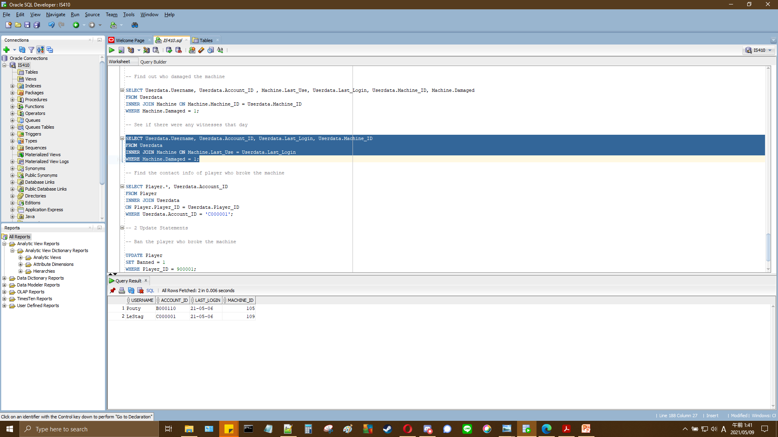
Select Statement 7
Notes:
SELECT Userdata.Username, Userdata.Account_ID, Userdata.Last_Login, Userdata.Machine_ID
FROM Userdata
INNER JOIN Machine ON Machine.Last_Use = Userdata.Last_Login
WHERE Machine.Damaged = 1;

Slide 25
Select Statement 7 Explained
Scenario: Management would like to see if there were any witnesses to machine 109 being damaged.
Results: We can see that there was one other user, ‘Pouty’, who last logged in on the same day machine 109 was damaged.
Notes:
SELECT Userdata.Username, Userdata.Account_ID, Userdata.Last_Login, Userdata.Machine_ID
FROM Userdata
INNER JOIN Machine ON Machine.Last_Use = Userdata.Last_Login
WHERE Machine.Damaged = 1;

Slide 26
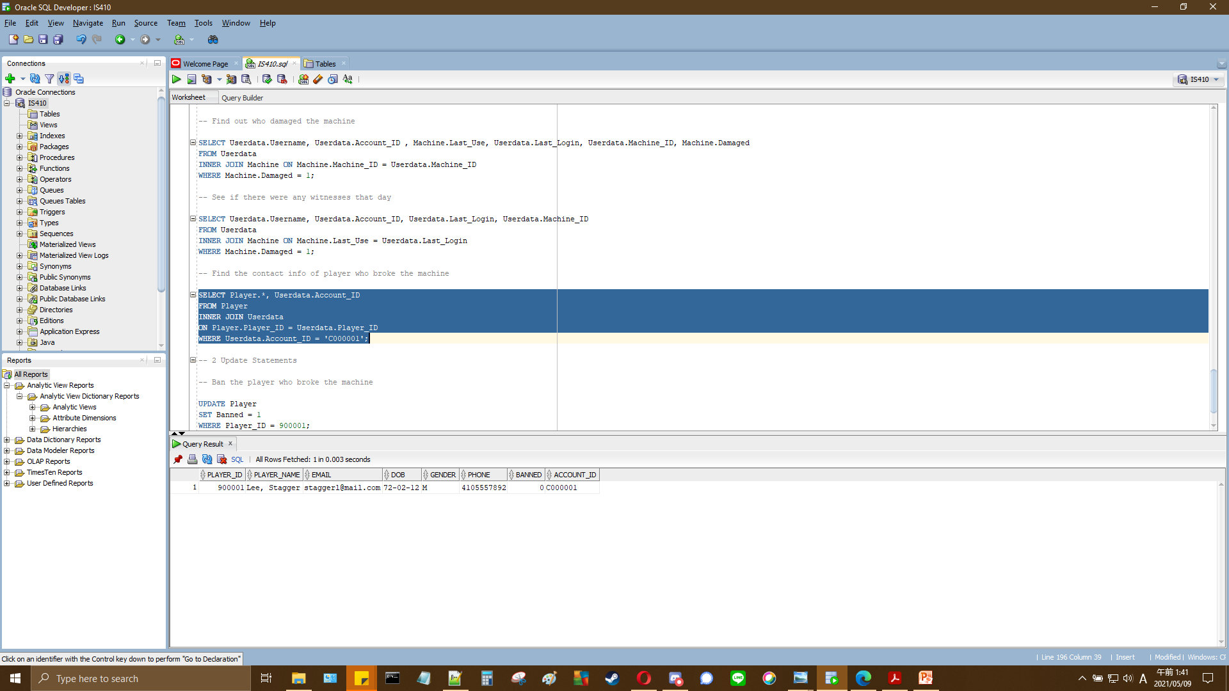
Select Statement 8
Notes:
SELECT Player.*, Userdata.Account_ID
FROM Player
INNER JOIN Userdata
ON Player.Player_ID = Userdata.Player_ID
WHERE Userdata.Account_ID = 'C000001';

Slide 27
Select Statement 8 Explained
Scenario: Management would like to get the contact information of the player who damaged machine 109.
Results: We can see all information at player ID 900001; ‘Lee, Stagger’.
Notes:
SELECT Player.*, Userdata.Account_ID
FROM Player
INNER JOIN Userdata
ON Player.Player_ID = Userdata.Player_ID
WHERE Userdata.Account_ID = 'C000001';

Slide 28
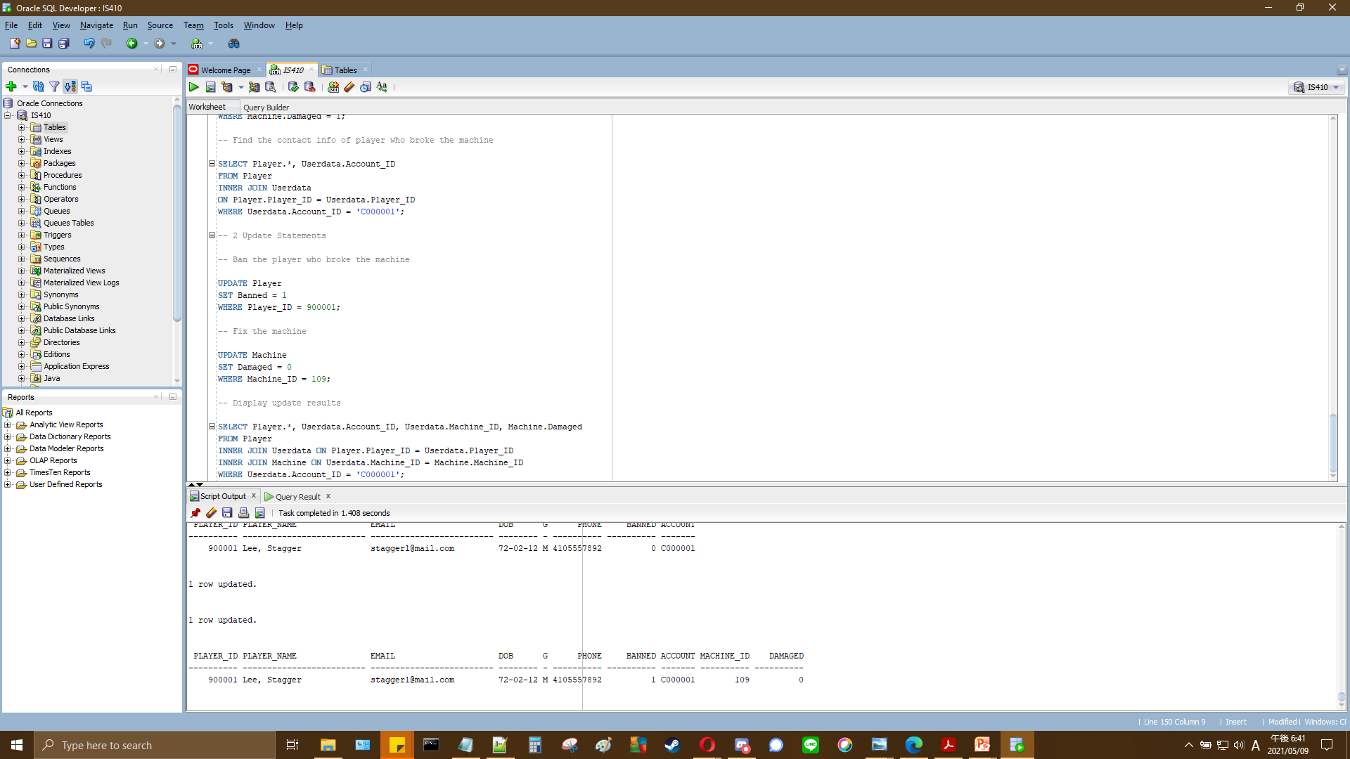
Update Statements
Notes:
-- Ban the player who broke the machine
UPDATE Player
SET Banned = 1
WHERE Player_ID = 900001;
-- Fix the machine
UPDATE Machine
SET Damaged = 0
WHERE Machine_ID = 109;

Slide 29
Update Statements Explained
Scenario: Management would like to ban player ID 900001 and report machine 109 as undamaged after the repairs.
Results: We can see that after both update statements, the records were successfully updated to reflect the changes.
Notes:
-- Ban the player who broke the machine
UPDATE Player
SET Banned = 1
WHERE Player_ID = 900001;
-- Fix the machine
UPDATE Machine
SET Damaged = 0
WHERE Machine_ID = 109;

