Slide 1
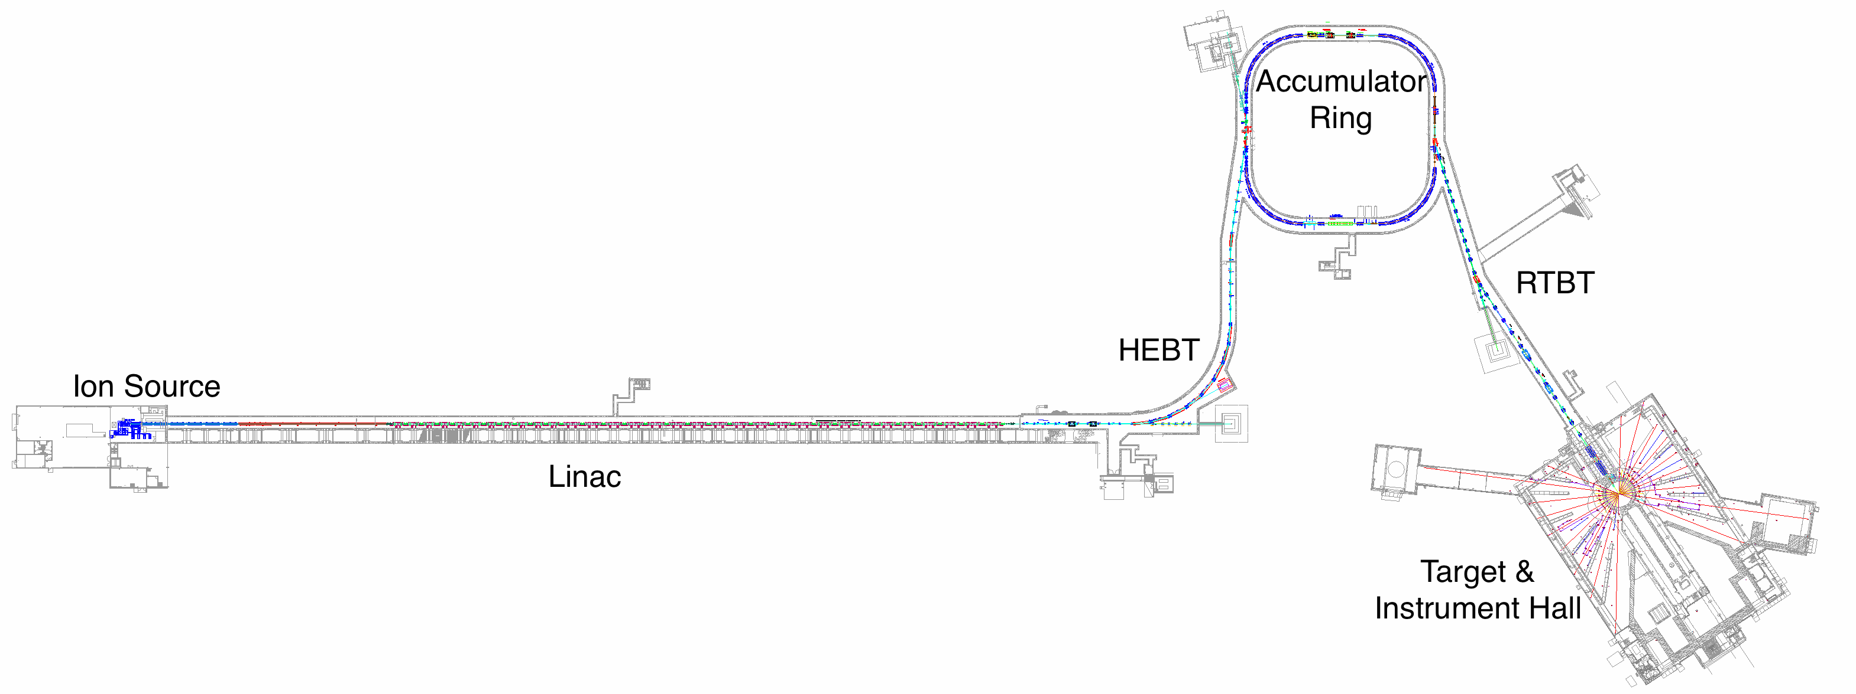

$f(x,p_{x},y,p_{y},z,p_{z})$ = ?
Computational model

Slide 2
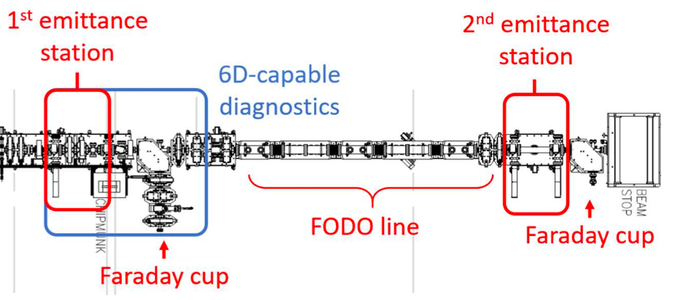








$$p_{x},p_{y},p_{z}$$
$$p_{x},p_{y},p_{z}$$
Predict
$$x,y,z$$
$$x,y,z$$
Reconstruct
Evaluate
$$p_{x}$$
$${10}^{−6}$$
$${10}^{−2}$$
Refine model
$$x$$
High-dimensional measurement
High-dynamic-range measurement

Slide 3




$$p_{x},p_{y},p_{z}$$
$$p_{x},p_{y},p_{z}$$
Predict
$$x,y,z$$
$$x,y,z$$
Reconstruct
Evaluate
$$p_{x}$$
$${10}^{−6}$$
Refine model
$${10}^{−2}$$
$$x$$
High-dimensional measurement
High-dynamic-range measurement

