Slide 1
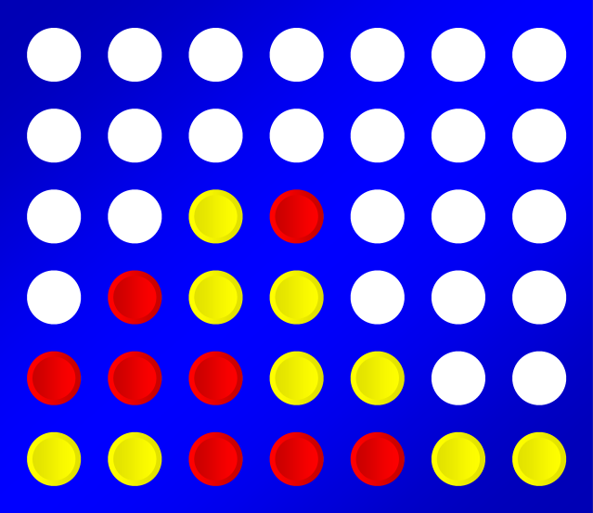
Exploring Object-Oriented Programming with Game Development
Austin Saylor, Kyle Remmenga, Kian Highland

Slide 2
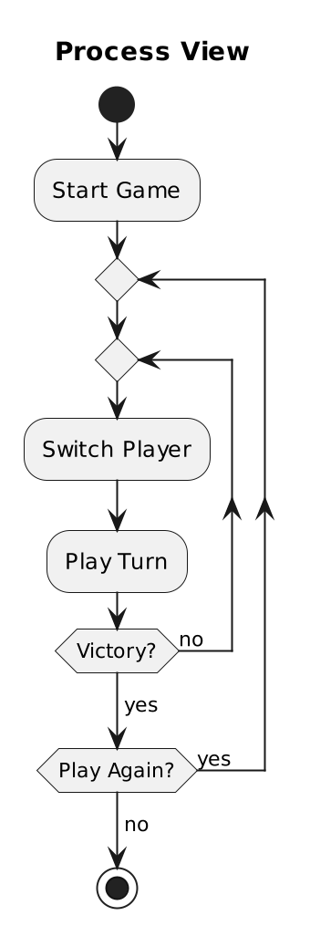
4+1 View (Process View)

Slide 3
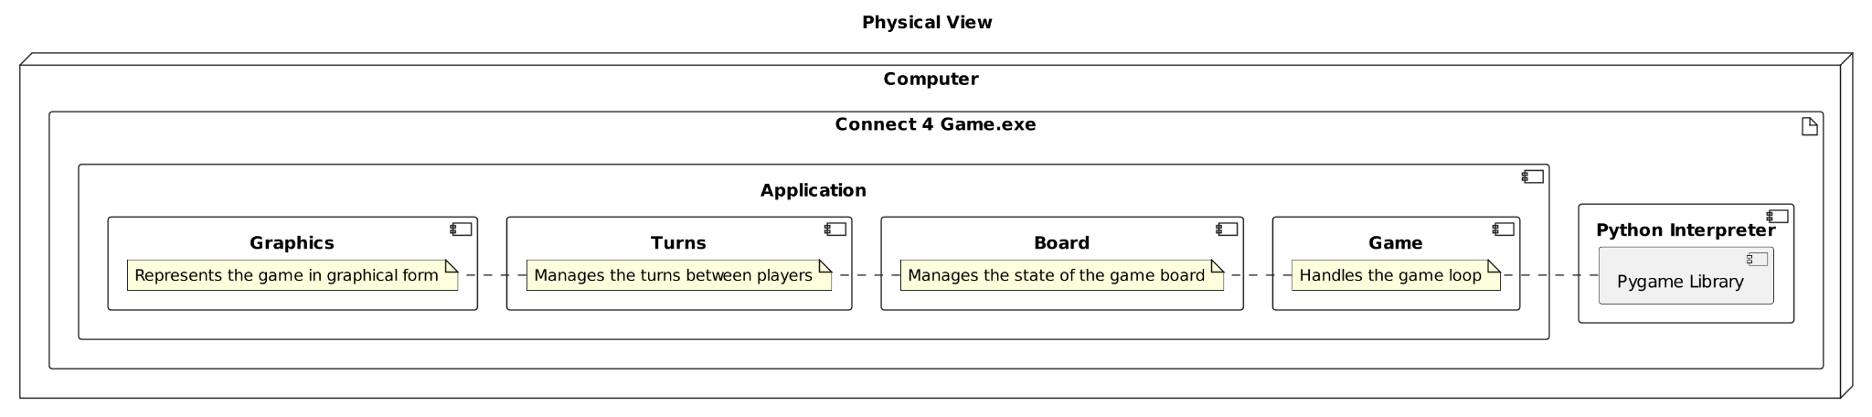
4+1 View (Physical View)

Slide 4
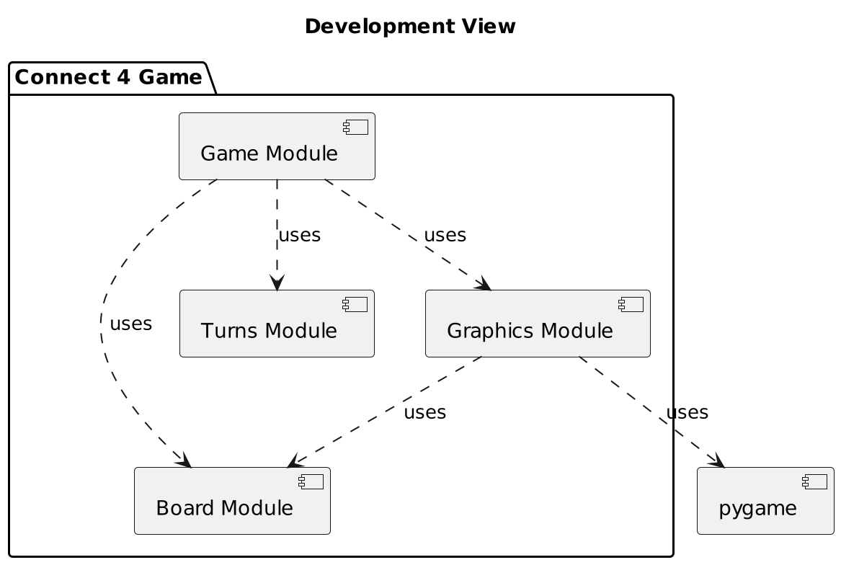
4+1 View (Development View)

Slide 5
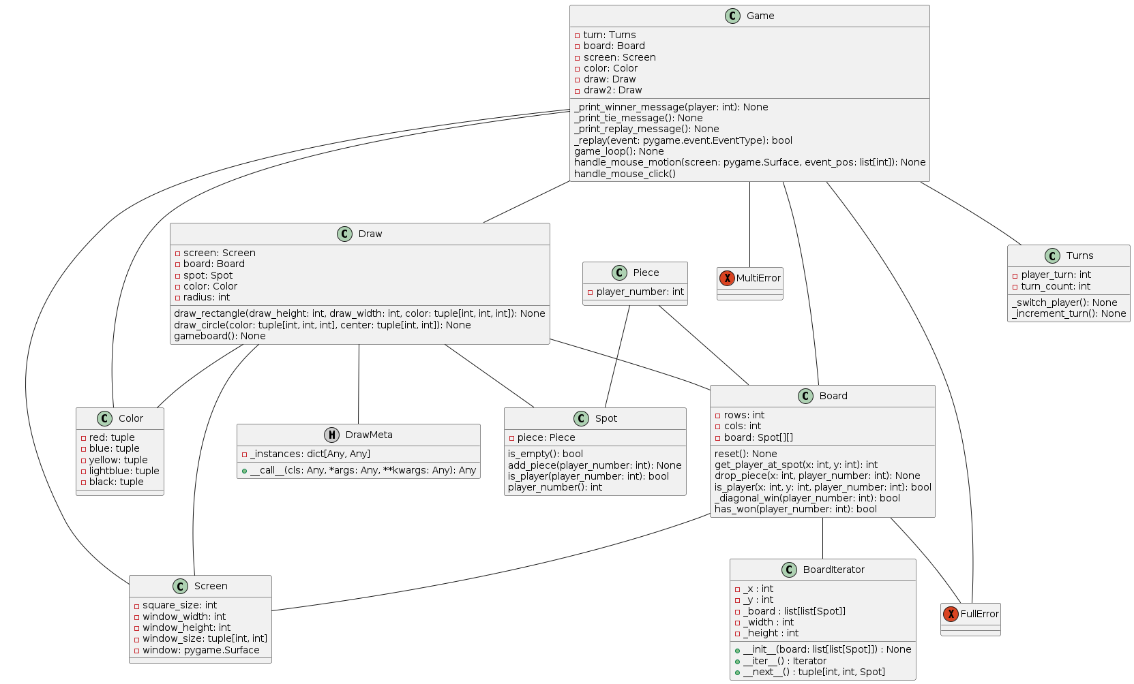
4+1 View (Logical View)

Slide 6
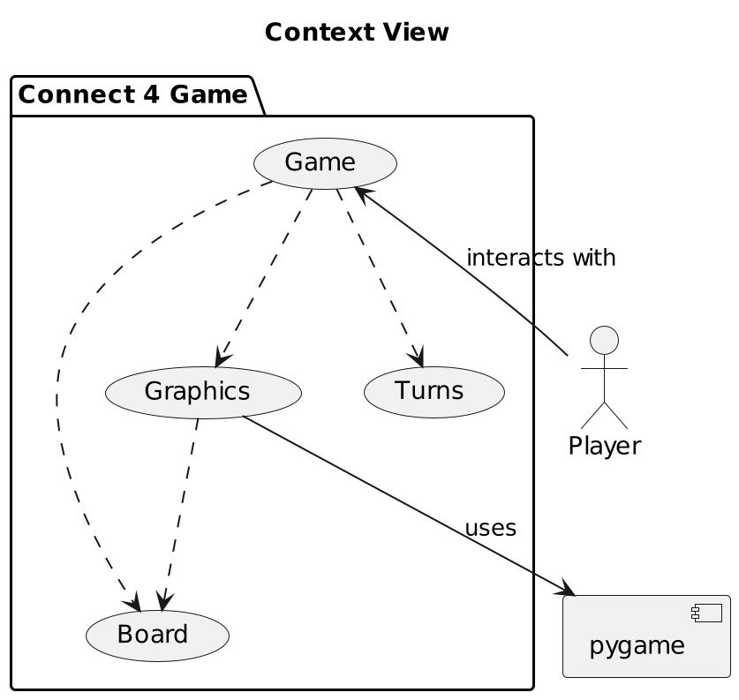
4+1 View (Context View)

Slide 7
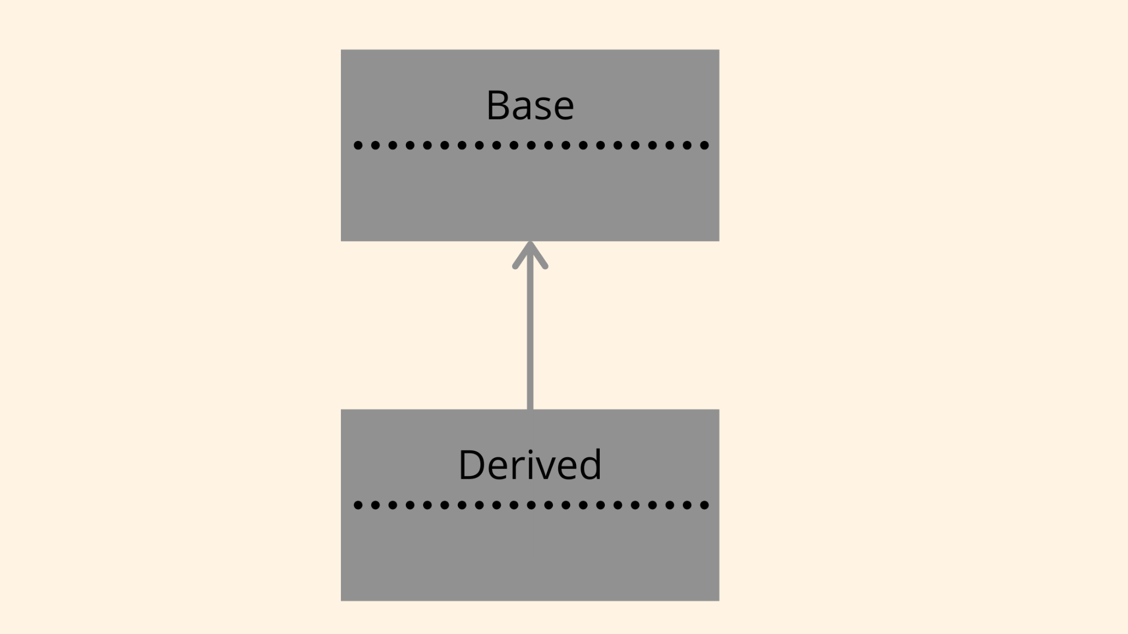
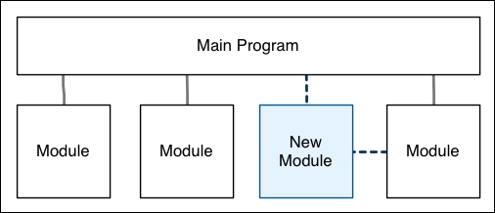
OOD Concepts Used
Inheritance
Attributes
Getters
Methods
Modularity
Overloading

Slide 8
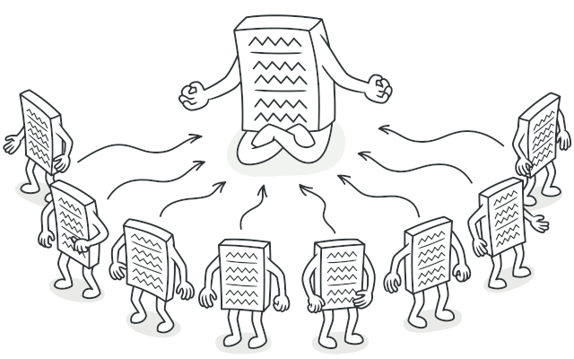
Singleton Design Pattern
Creational Design Pattern
A design style that ensures a class only has one instance
Used to protect resources (databases, file or memory)
Used in Draw from graphics.py
Image: https://refactoring.guru/design-patterns/singleton

Slide 9
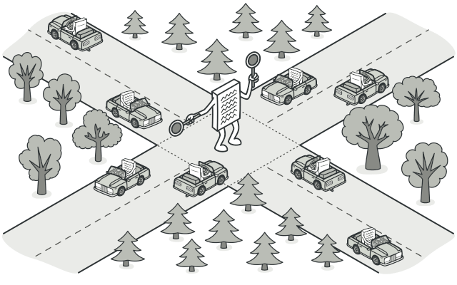
Mediator Design Pattern
Behavioral Design Pattern
Purpose is to reduce chaotic dependencies between objects
Forces objects to interact with each other only via the mediator object
Used in our Game class from game.py
Image: https://refactoring.guru/design-patterns/mediator

Slide 10

Iterator Design Pattern
Behavioral Design Pattern
Allows traversal of a collection without exposing the underlying representation (list, stack, tree, etc.)
Allows access to a data structure while keeping the details of the structure private
Used in Board from board.py
Image: https://refactoring.guru/design-patterns/iterator

Slide 11
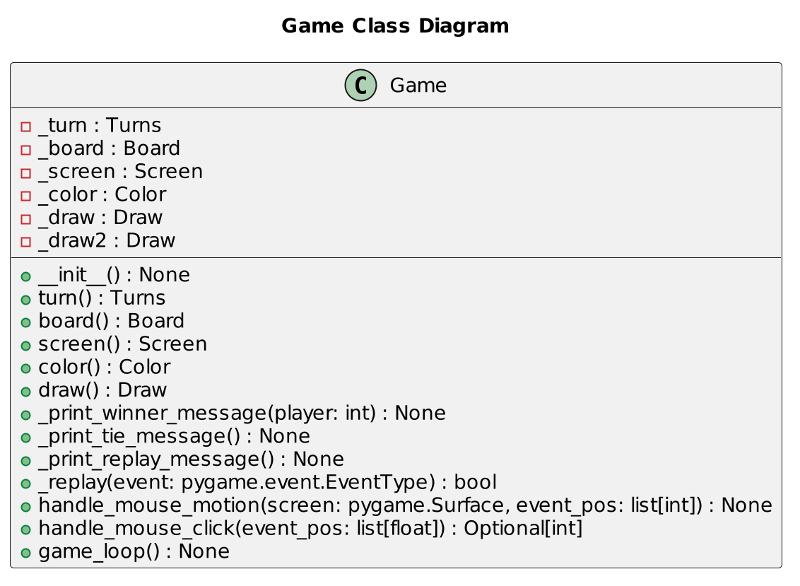
UML Diagram - Game

Slide 12
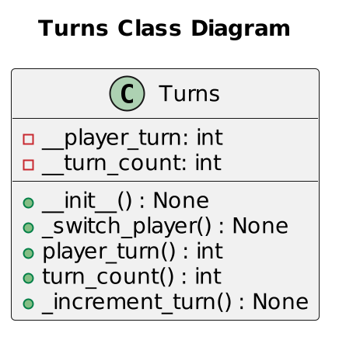
UML Diagram - Turns

Slide 13
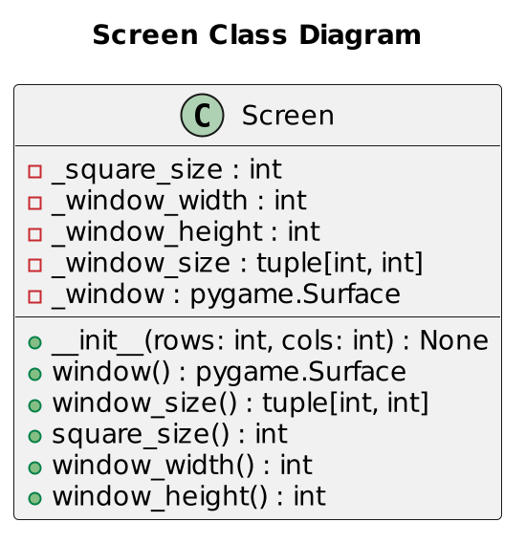
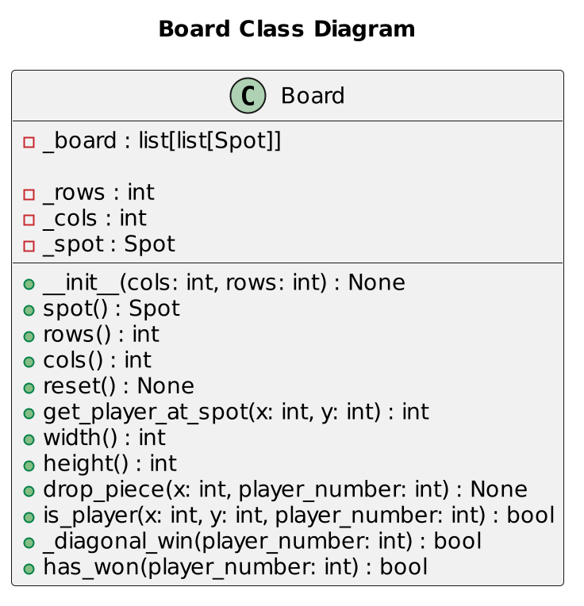
UML Diagrams - Board

Slide 14
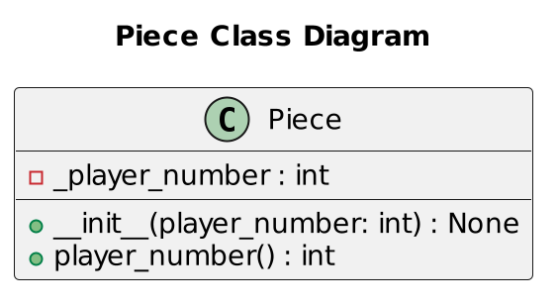
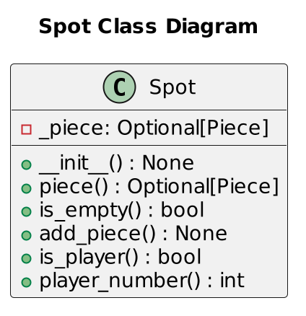
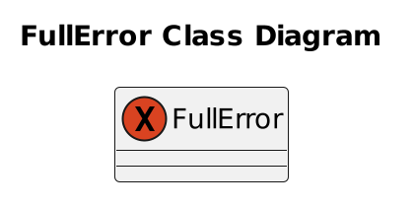
UML Diagrams - Board

Slide 15
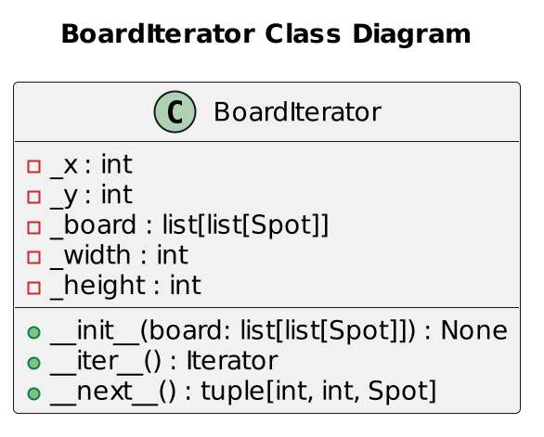
UML Diagrams - Board

Slide 16
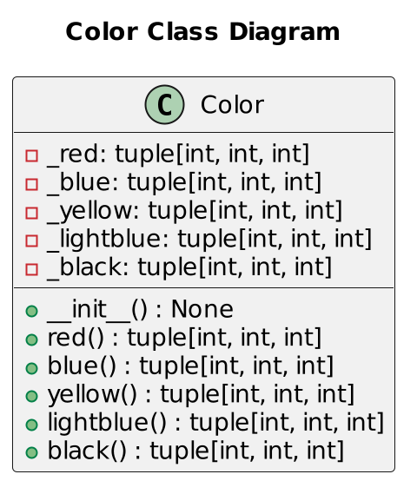
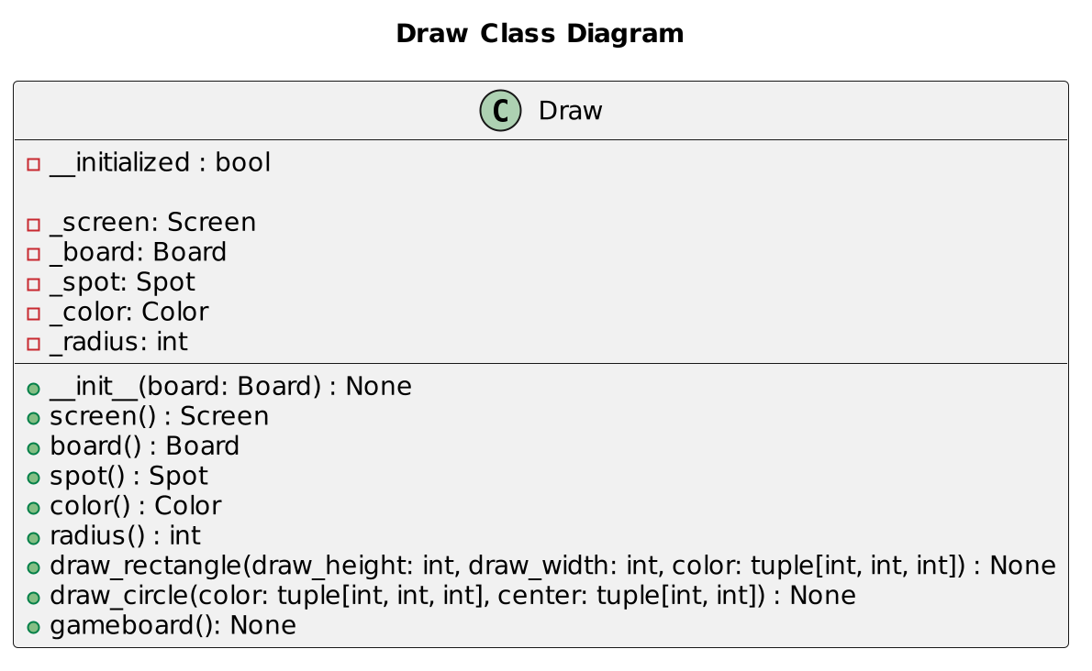
UML Diagrams - Graphics

Slide 17
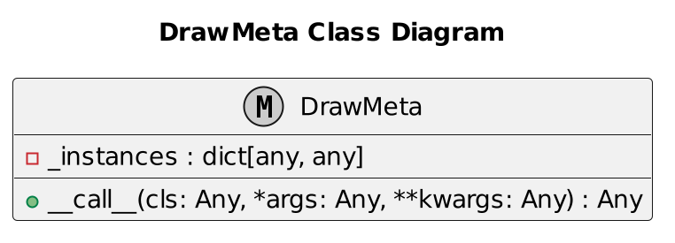
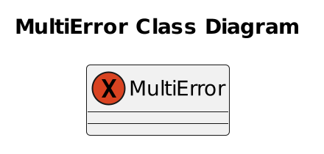
UML Diagrams - Graphics

Slide 18
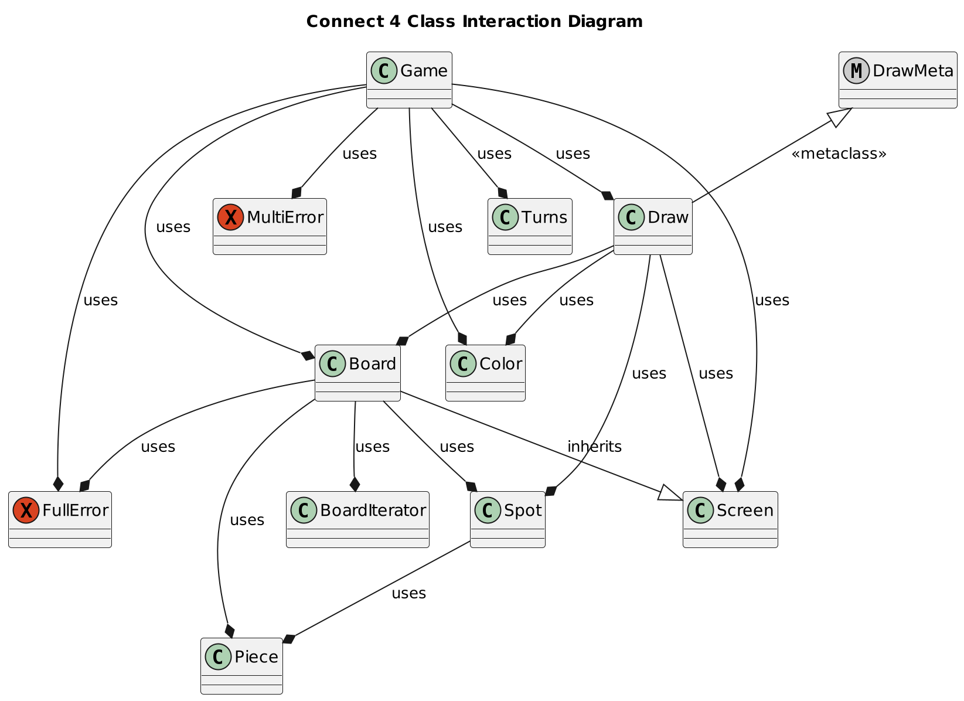
UML Class Interaction Diagram

Slide 19
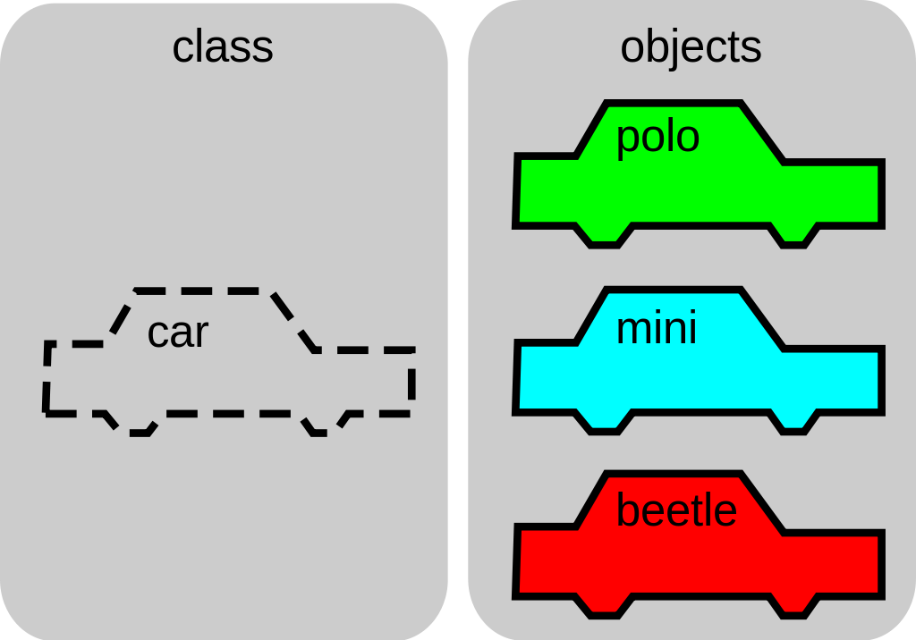
OOD Benefits
Creates reusable, highly modular code
Allows programming in a way that suits humans
Creating objects and categories
Easy and quick to debug

Slide 20

Lessons Learned
Allocating jobs to different team members
Reporting issues formally to ensure that they were fixed and documented
Following a determined schedule to keep us on track

