Slide 1
Multi-Agent Systems Bus Ride-sharing Problem
Chinjung Kuo, Kaiyuan Wei
MAI
Notes:
Wei

Slide 2
Outline
Objectives
Research Question
Hypotheses
MAS Explanation
Video Demo
Experiment-follow U-model setup result analysis
conclusion
Notes:
Kuo

Slide 3
Objectives
Conclusions
Questions
Answers
Hypothesis
Verified
Variables
Results
Data
Notes:
Wei

Slide 4
Objectives
Optimize the pick up and deliver problem in a dynamic environment, by enabling ride-sharing.
Notes:
Wei

Slide 5
Objectives
Conclusions
Questions
Answers
Hypothesis
Verified
Variables
Results
Data
Notes:
Kuo
Before goes to our research question, I will explain the parameters we observe in the experiment.

Slide 6
Definition of Three Parameters
From bus perspective:
Income gain:
Effective delivery route / Total route ≈ Income / Gas cost
From passenger perspective:
Wait time:
average waiting time before pick up.
Passenger loss:
Actual onboard time/Optimal onboard time
Travel time = Wait time + Onboard time
Notes:
Kuo

Slide 7
Research Question
1. Could ride-sharing bring benefits?
2. Is the most efficient plan for bus, at the same time, also efficient for passenger?
3. How many groups of passengers(1~3) are allowed onboard can have a good combination for bus and passenger?
4. Find passenger by nearest N passengers vs. by all passengers in range R. Which one is better?
Notes:
Wei

Slide 8
Objectives
Conclusions
Questions
Answers
Hypothesis
Verified
Variables
Results
Data
Notes:
Kuo

Slide 9
Hypotheses
Question 1:
Could ride-sharing bring benefits?
Hypothesis 1:
The system can be more efficient if we allow the passengers to do ride-sharing.
Notes:
Kuo

Slide 10
Hypotheses
Question 2:
Is this most beneficial plan for bus, at the same time, also beneficial for passenger?
Hypothesis 2:
Comparing a heuristic beneficial for bus with a heuristic beneficial for passengers in the station, the first could have higher Income gain, the second could have lower Wait time and Passenger loss.
Notes:
Wei

Slide 11
Hypotheses
Question 3:
How many groups of passengers(1~3) are allowed onboard can have a good combination for bus and passenger?
Hypothesis 3:
The higher the limitation of passengers allowed on ride-sharing, the better for bus and passengers.
Notes:
Kuo

Slide 12
Hypotheses
Question 4:
Find passenger by N-nearest passengers vs. by all passengers in radius R. Which one is better?
Hypothesis 4:
The two methods to find passengers are equally efficient.
Notes:
Wei

Slide 13
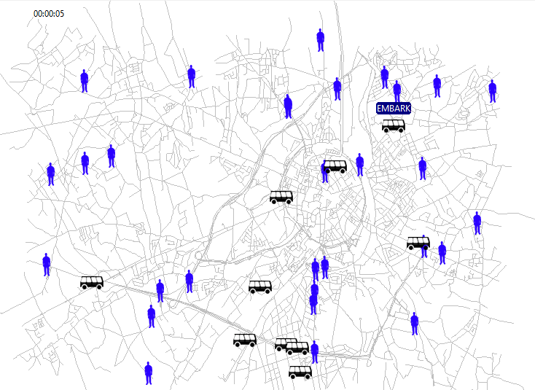
System Design
Notes:
Wei

Slide 14
System Design
Rinsim - TaxiExample
Bus: mobile unit
Fixed number.
Group of passengers: tasks
Randomly generated on map with time. Fixed total number.
Station: communication between agents
~Intention ants + Exploration ants.
Notes:
Wei
indirect communication within the agents, task allocation and relocation by gradient field

Slide 15
Task: Group of passengers
Pickup location: Randomly generated
Delivery location: Randomly generated
Size: 1~3 passengers. Randomly chosen
Notes:
Kuo

Slide 16
BDI Agent: Bus
Capacity: Maximum 8 people
Limitation on group of passengers onboard: 1~3
Agent’s logic:
Find groups of passengers as candidates.
Calculate benefit on candidate.
Send estimated benefit to station.
Accept or decline task depends on feedback of station.
Notes:
Wei
Travel salesman problem. Send ants on each path to calculate the sum. IN calculate benefit on candidate.(more than one passengers onboard)
Since we only have 3 packs maximum, so 8 path in total. we don’t use searching heuristic. We do a complete search and compare.
BDI agents

Slide 17
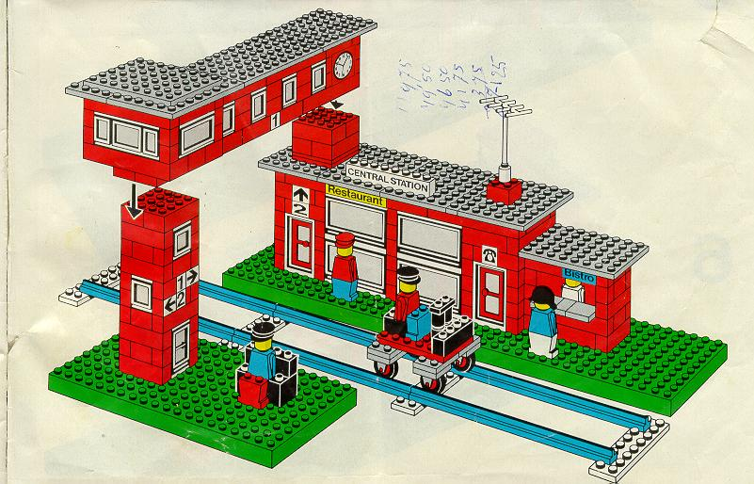
BDI Agent: Bus
Belief: agent has the road information, could ask passenger information from station.
Desire: pick up and deliver passenger to achieve higher income gain.
Intention: commit the task of pick up and deliver based on algorithm.
Notes:
Kuo

Slide 18
Communication Center: Station
Register new group of passengers to the database.
Maintain all the necessary information for each group of passengers.
Task:
1. Receive estimated benefit from bus.
2. Compare new estimated benefit with stored one, choose the best one according to different heuristic H0, H1, H2.
3. Store the best one in the database.
4. Send feedback to bus as a confirmation or rejection.
Notes:
Wei
Station use delegate MAS to exploit the environment and relief the task agents -- bus.
So: buses are bidders and station as auctioneer. Buses compete to get task.
Task distribution and redistribution are in same step. We use a monotonic concession protocol.(Station compare bits, give to the highest bidder bus)
Negotiation set: represents the space of possible proposals that agents can make
Protocol: defines the legal proposals that agents can make
Collection of strategies: (one for each agent) determines what proposals the agent will make
Rule: to determine when an agreement has been reached

Slide 19
Communication Center: Station
These ants are virtually applied in Station.
Exploration ants:
Find the information about passengers around:
1. bus location 2. first destination
Sort the passengers by distance and store the result as candidate list.
Notes:
Kuo
Exploration ants: radius + nearest Very important:(after , sort by cost)

Slide 20
Communication Center: Station
Intention ants:
Bus sends its estimated benefit to Station
The Station sends two intention ants.
The faster ant informs the passenger its intention.
Notes:
Wei
Intention ants: types of Heuristic gives ant different initial position.
Can also act as bidders.
Station (H): B – Distance(Agent to candidate)(t)

Slide 21
Program Flow in Bus
Process 1 Ask for candidates, calculate benefit and send to station.
Process 2 Confirm task with station.
Process 3 Move to pick up location or pick up
Process 4 Move to delivery location or deliver
Notes:
Kuo

Slide 22
Video Demo
Notes:
Wei

Slide 23
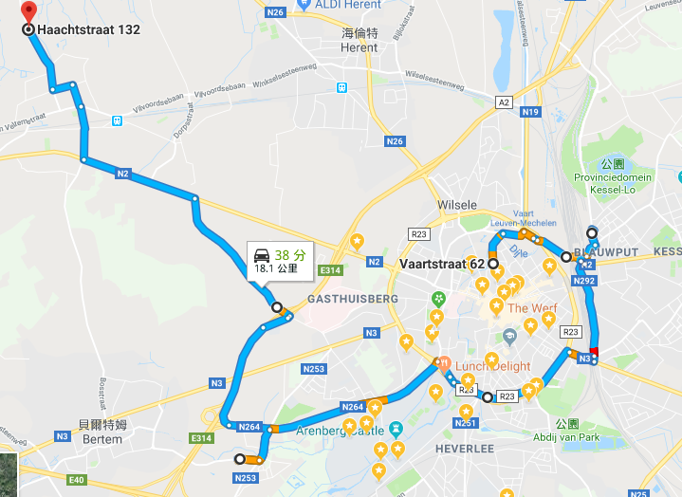
L=3, H=0

Slide 24
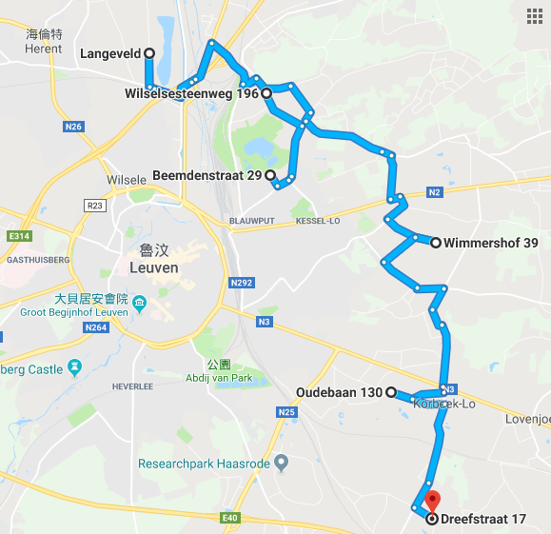

L=3, H=0
3
2
1
Notes:
Kuo

Slide 25
Objectives
Conclusions
Questions
Answers
Hypothesis
Verified
Variables
Results
Data
Notes:
Wei

Slide 26
Variables
Independent variables:
Different Heuristic implemented in station: H0, H1, H2
Limitation on groups of passengers allowed onboard: 1~3
Dependent variables: (observed in the experiment)
Bus perspective: Income gain
Passenger perspective: Wait time, Passenger loss
Total Travel time
Notes:
Kuo

Slide 27
Variables
Other variables:
bus number, initial position of bus, speed of bus.
initial number and position of group of passengers, groups’ pickup location and destination, group size.
map size….
Notes:
Kuo

Slide 28
Experiment- Default Setting
Stress test
Bus: 10
Passengers: randomly generate until the 200th passenger is arrived.
Bus capacity: Max 8.
Ride-sharing: Max 3.
Notes:
Wei

Slide 29
Experiment 1
Hypothesis 1:
The system can be more efficient if we allow the passengers to do ride-sharing.
Setup:
Under same condition, the limitation on group of passengers onboard is set to 1, 2, 3.
Notes:
Kuo
The amount of group allowed onboard will be 1 ,2 and 3.

Slide 30
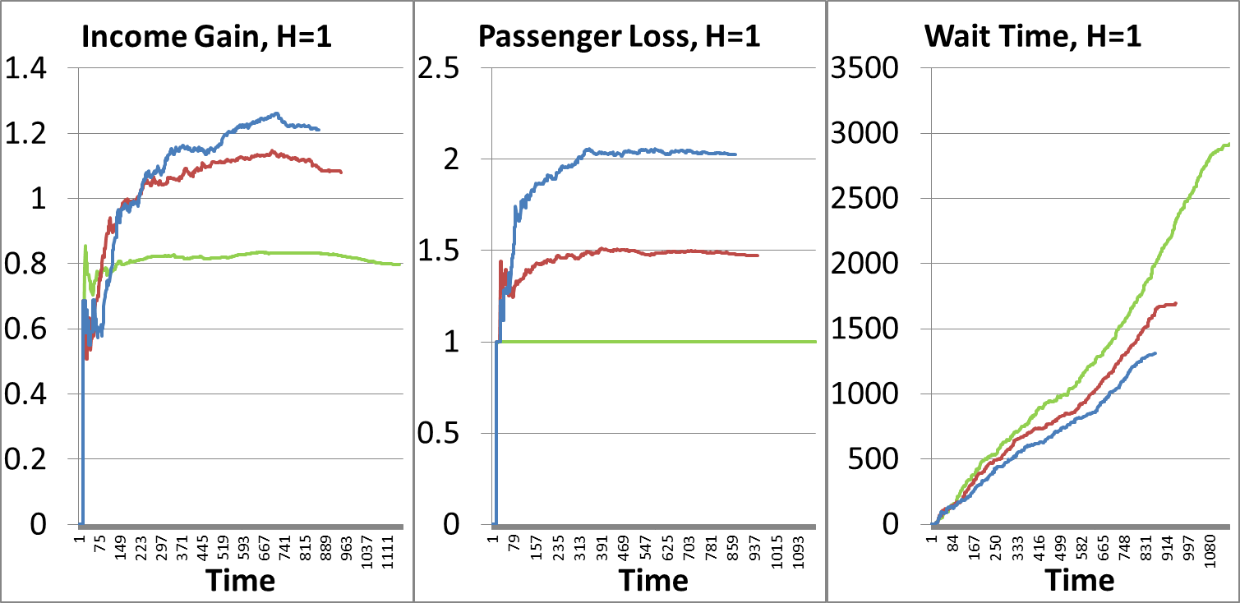
Experiment 1- H1
L=1
L=2
L=3
The bus can earn more income after enable ride-sharing.
The passenger loss 50%/100% after ride-sharing.
The Wait time could decrease after ride-sharing
Notes:
Kuo
For Bus, enabling ride-sharing could have higher income.
For the passengers, although they might spend more time on the bus, they will save waiting time
The total time in the system to deliver all 200 passenger could be optimized after ride-sharing
#########
Heuristic is based on Bus, hence in this experiment there is no best heuristic for passenger.
Passenger are willing to do ride-sharing when there are two groups only.

Slide 31
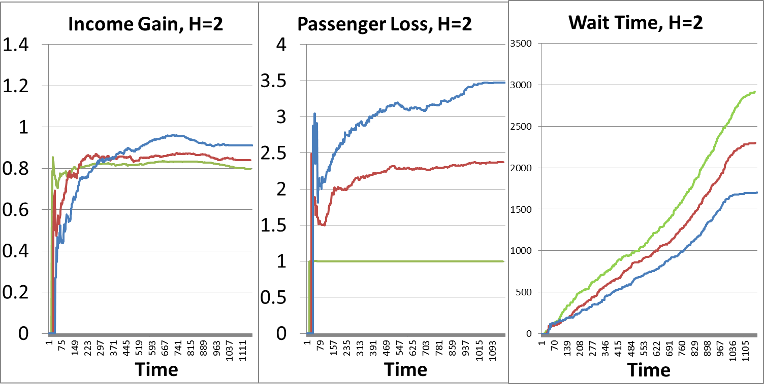
Experiment 1- H2
L=1
L=2
L=3
Notes:
Kuo
For Bus, enabling ride-sharing , the income gain by naïve pick up method did not increase as much as implement heuristic
For passenger, the passenger loss has huge increase in naïve way.
Even though they have less waiting time, but they all spend longer on the bus, in the end the bus finish the task in the same time step.

Slide 32
Verification on Hypothesis 1
Hypothesis 1 is true.
After enabling ride-sharing…
The passenger could have better travel time, less waiting time.
The system could deliver 200 passengers in shorter time.
However, a good heuristic is needed.
Notes:
Kuo
A good heuristic is needed to improve the efficiency on the algorithm.

Slide 33
Experiment 2
Hypothesis 2:
Comparing the heuristic beneficial for bus with the heuristic beneficial for passengers, the first could have higher Income gain, the second could have lower Wait time and Passenger loss.
Setup:
Under same condition, apply different heuristics in station.
H0: Good for passengers;
H1: Good for bus;
H2: Naive heuristic, always pickup the nearest one.
Notes:
Wei

Slide 34
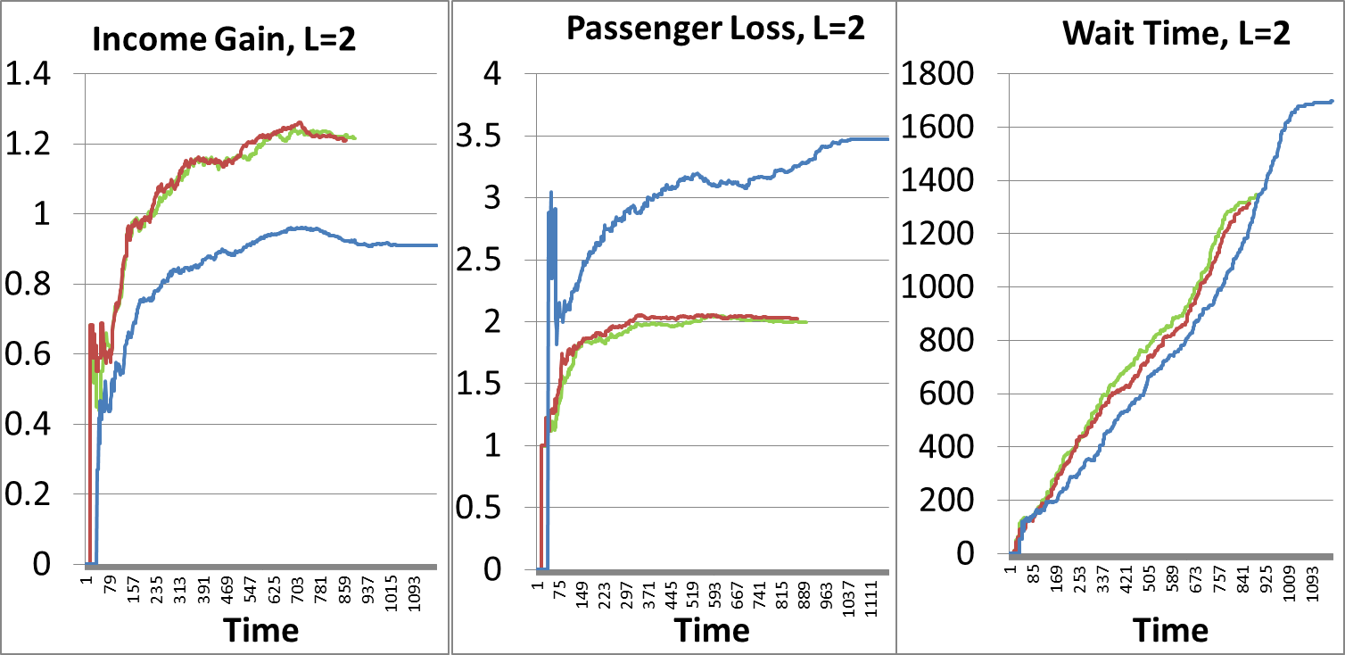
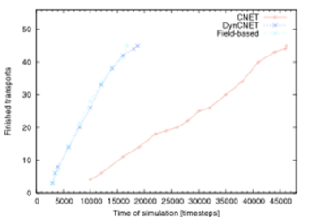
Experiment 2
H=0
H=1
H=2
There is no difference in L1. L2 and L3 would be similar. Hence, L2 are shown.
Notes:
Kuo
Our system implement as gradient, thats why when good heuristic implement its behaviour is like the figure we see in the lecture.
Gradient field/Contract net

Slide 35
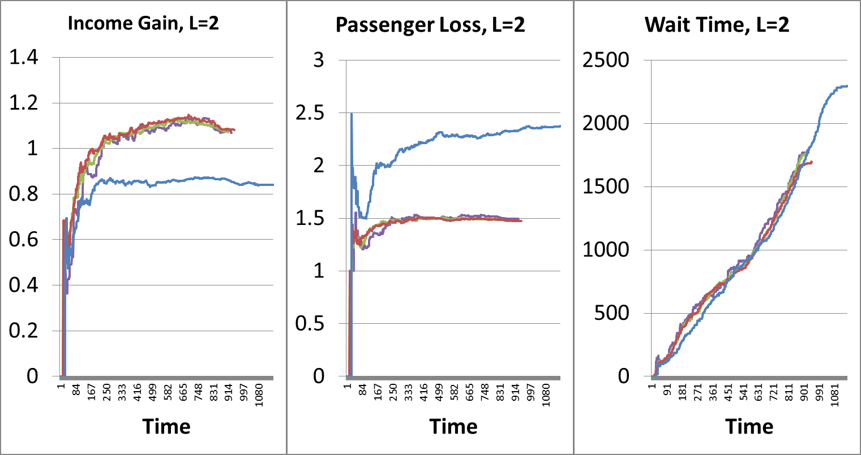
Experiment 2 - extra
H=0
H=1
H=2
H* with 10*cost
Notes:
Wei
So we try something extra. We increase the distance coefficient in heuristic, which is design to assign the task to the nearer bus, in H0 to 10 instead of 1, and we expect it behave same with Naïve. Turn out it still the same with the H1 and H0.
This is because, we give the bus an algorithm to calculate the benefit, only benefit > 0 the bus send the benefit an intention. The distance already involved in this benefit. So in most case, this benefit is correlated to the distance. So the coefficient did not change the result obviously.

Slide 36
Verification on Hypothesis 2
Hypothesis 2 is false.
If we insist the algorithm to calculate the benefits of ride-sharing on bus, and bus only do ride-sharing when there is a benefit, then the beneficial for bus becomes a premise.
In this premise, there is no heuristic to compare intention to achieve the most beneficial scenario for passengers.
Notes:
Kuo
Like the google map we see before, In bus perspective, bus will only pick passenger up if this passenger has similar delivery path in common with the passenger on board. So, in this situation, there is no scenario most beneficial for passengers.

Slide 37
Experiment 3
Hypothesis 3:
The higher the limitation of passengers allowed on ride-sharing, the better for bus and passengers.
Setup:
Use the same setup as experiment 1.
Notes:
Kuo

Slide 38
Experiment 3- H1
L=1
L=2
L=3
10%
40%
The system could be optimal for bus and passenger when L=2
Notes:
Kuo
There are three different limitation on the bus, green=1, red=2. blue=3.
The optimal situation happen in L=2, the system could have good combination of travel time and bus income.

Slide 39
Experiment 3- H2
L=1
L=2
L=3
Notes:
Kuo

Slide 40
Verification on Hypothesis 3
Hypothesis 3 cannot be verified.
The optimal situation happen in L=2, the system could have good combination of travel time and bus income.
Again a good heuristic is needed.
Notes:
Kuo

Slide 41
Experiment
Hypothesis 4:
The two methods to find passengers are equally efficient.
Setup:
Apply different methods to find passengers.
Find N nearest passengers.(N nearest)
Find nearest passengers by radius. (Radius R)
Find nearest passengers by radius + the passenger wait longest. (Radius R +1)
Notes:
Wei

Slide 42
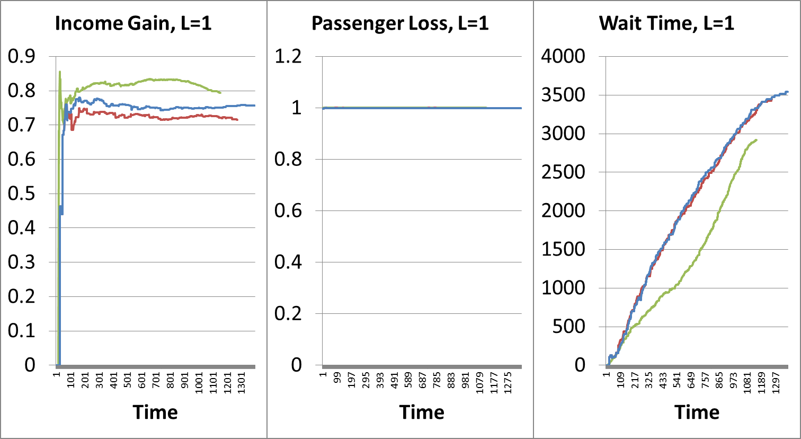
Experiment 4 L=1
N nearest
Radius R
Radius R+1
Notes:
Wei
When no ride-sharing, the find N nearest has a best performance.

Slide 43
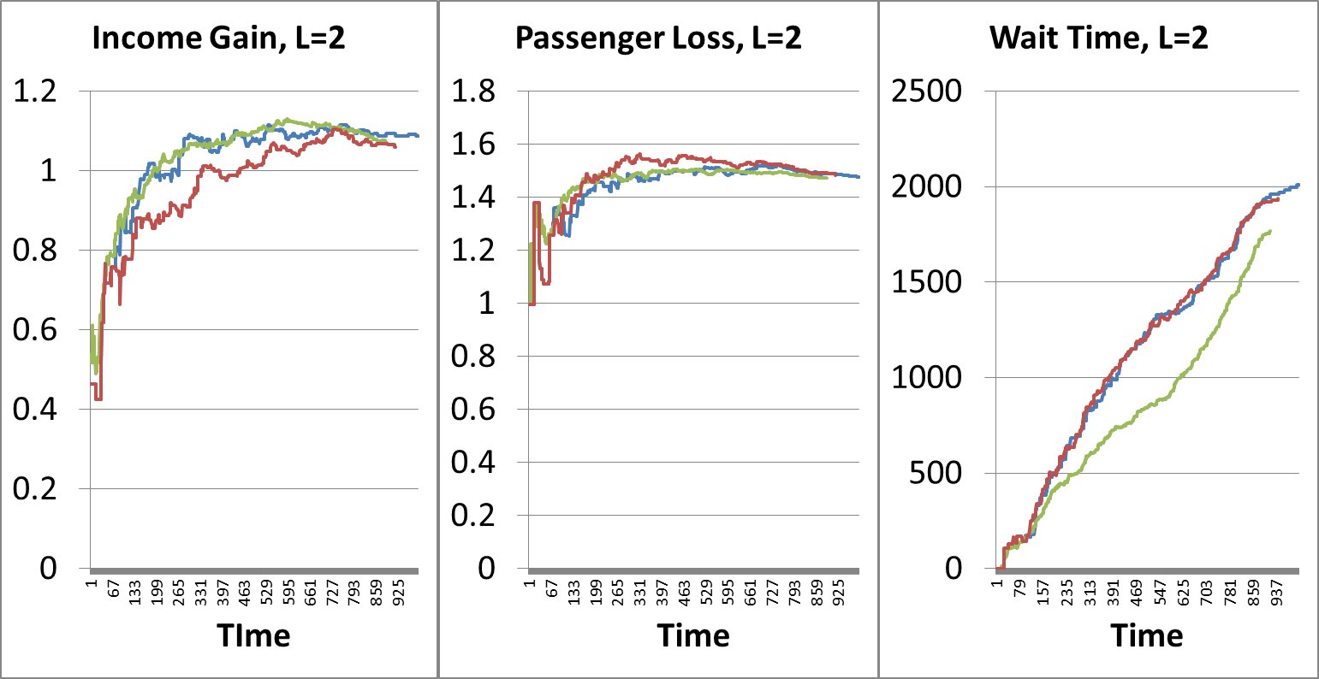
Experiment 4 L=2
N nearest
Radius R
Radius R+1
Notes:
Wei
Allow 1 ride-sharing, the find N nearest has a best performance.

Slide 44
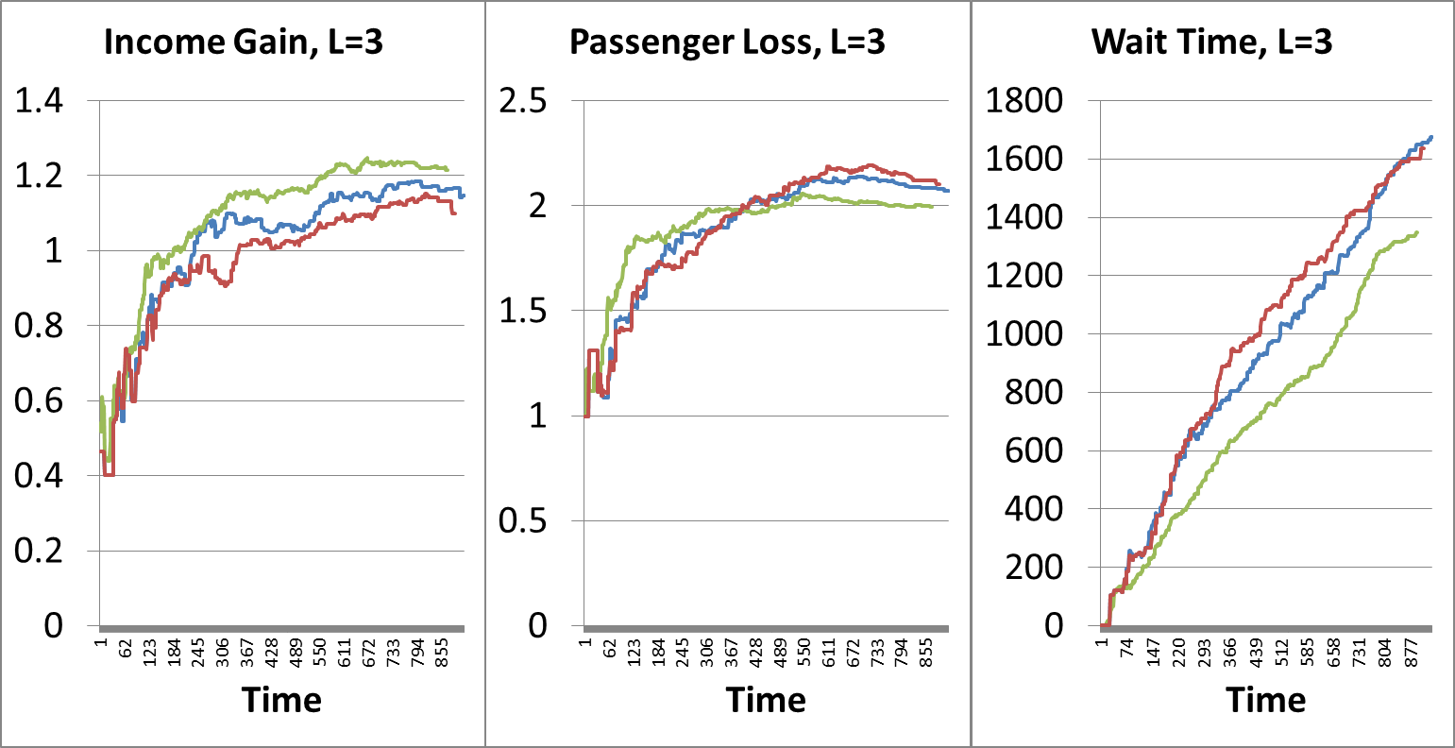
Experiment 4 L=3
N nearest
Radius R
Radius R+1
Notes:
Wei
3 ride-sharing, the find N nearest still has a best performance.

Slide 45
Verification on Hypothesis 4
Hypothesis 4 is false.
The find N nearest passengers has a better performance than find all passengers in radius R.
Notes:
Wei
Due to the find N nearest is a optimal function to find candidate. Always return N passengers on the map. But find within radius has uncertainty on the number. Very crowd give more candidate, more important is when no people around, the bus stops and waste some time. But compare Radius to Radius +1, the radius have higher income gain: It do not go very far to pick up people

Slide 46
Conclusion
By knowing passenger’s location and destination, with proper heuristic, implemented by BDI agent and delegate MAS, the PDP could benefit from ride-sharing.
Notes:
Kuo
Due to the fact Bus calculate heuristic based on earning money, even we give higher weighting for pick up the closer passenger first, the passenger could not optimize waiting time and travel time at same time with limit number of bus.

Slide 47
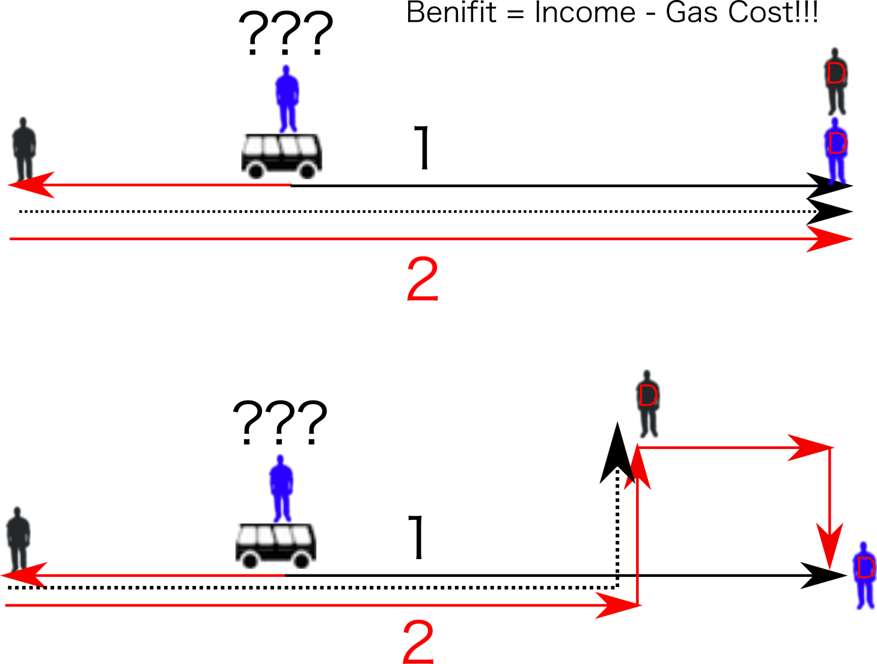
Algorithm
Notes:
Wei

Slide 48
Heuristic
B is the benefit to pick up the passengers.
D is the distance from passenger when receive benefit.
L(t) is the distance bus already drive toward passengers.
Station | Bus
H0 | B-D+L(t)
H1 | B+L(t)
H2 | -D+L(t)
H* | B-10*D+L(t)
Passenger
Bus
Naive
Notes:
Kuo

Slide 49
Thank you for your attention!

