Slide 1
LING 573 Deliverable 2
April 24, 2018
Austin Almond, Corey Moore, Arun Sen

Slide 2
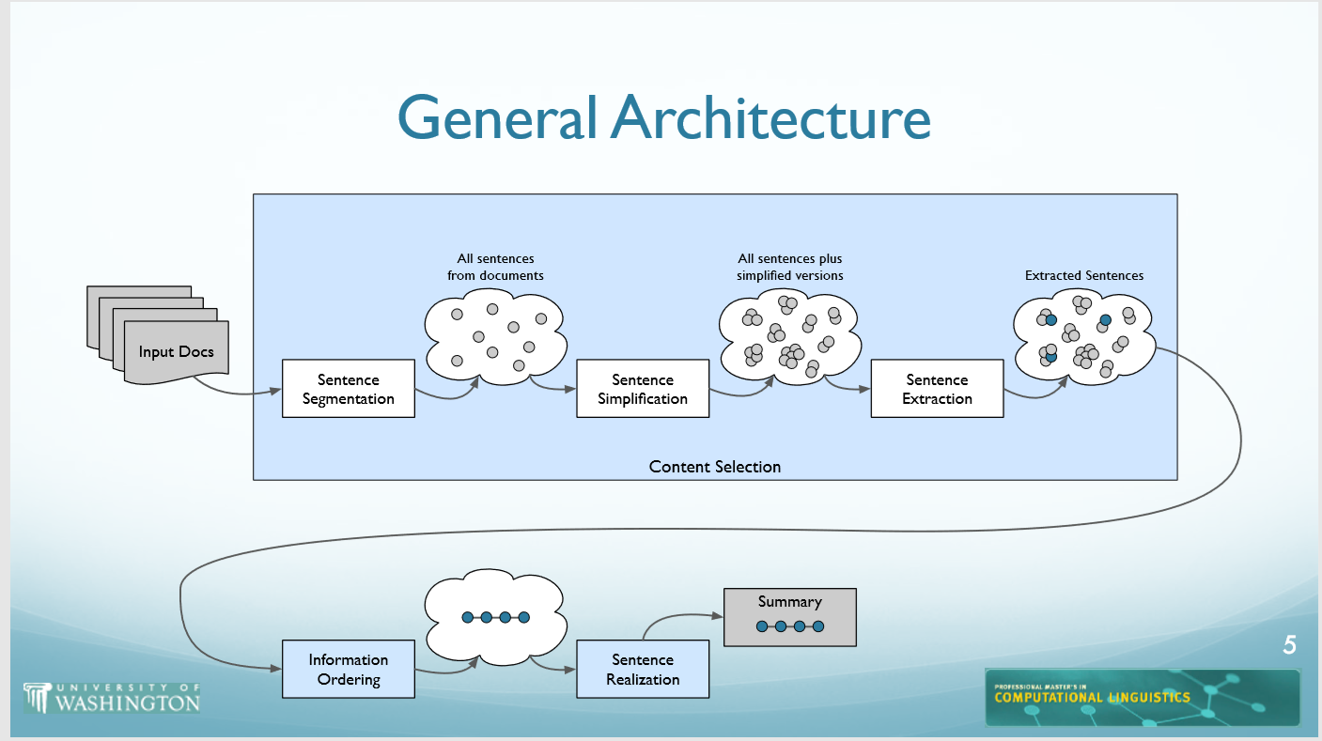
System Architecture

Slide 3
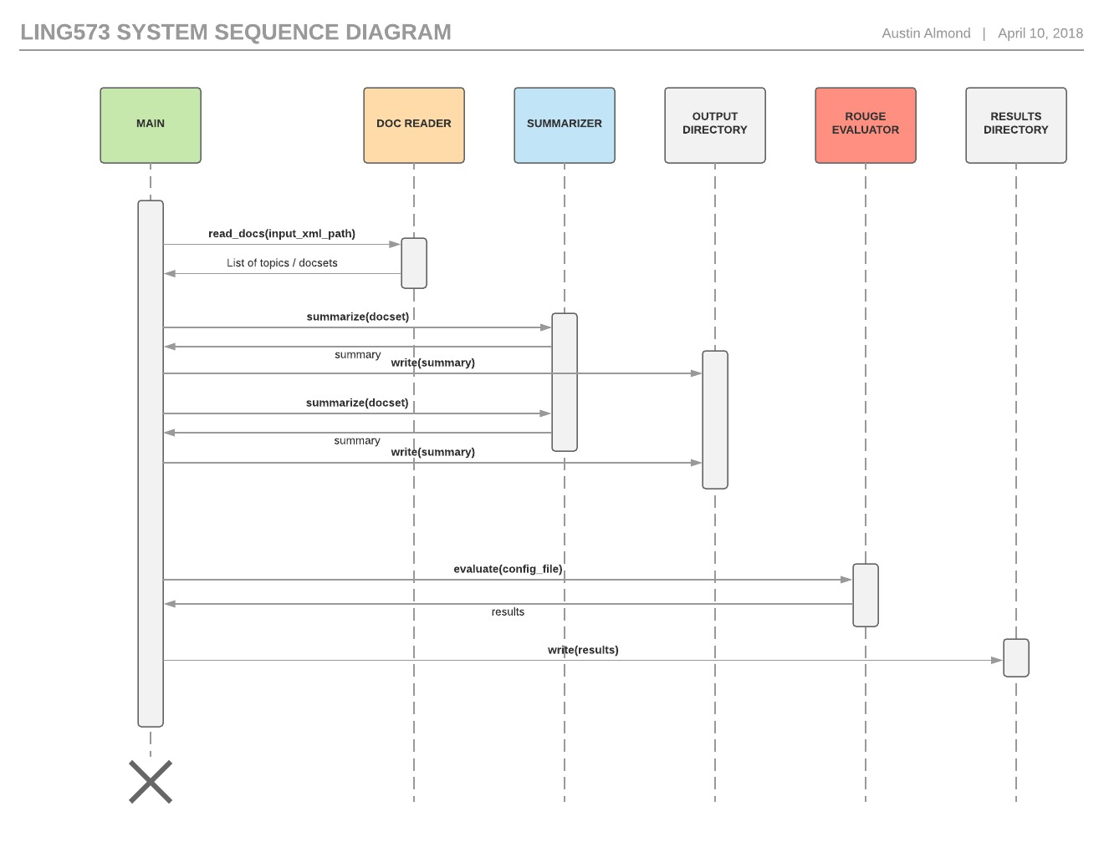
System Architecture

Slide 4
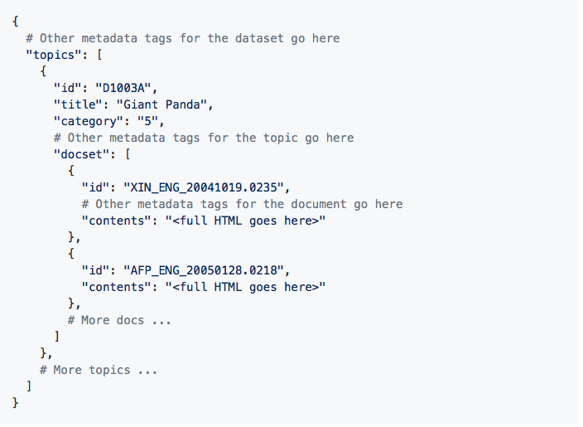
Document Reader (Austin)
Input: XML document identifying the set of topics and their corresponding documents
Output: Python dictionary

Slide 5
Content selection-Sentence segmentation (Corey)
The goal of sentence segmentation is to convert a block of text into a list of sentences.
The sentence segmentation is based on NLTK's sent_tokenize.
http://www.nltk.org/api/nltk.tokenize.html

Slide 6
Content selection-Sentence Simplification (Corey)
The goal of sentence simplification is to simplify a single sentence and returns the same text stemmed, and without punctuation or stop words.
1. Line feeds are stripped
2. Punctuation is removed (based on NLTK's string.punctuation)
3. Sentences are tokenized using NLTK's word_tokenize
4. Stops are removed
5. Sentences are stemmed using NLTK snowball stemmer
http://www.nltk.org/_modules/nltk/stem/snowball.html

Slide 7
Content selection-Sentence Extraction (Corey)
The Extractor uses MEAD to examine a cluster and find the list of X (=max_sent) best sentences.

Slide 8
Information Ordering (Arun)
Information ordering uses a chronological ordering approach.
Dates are extracted using the <DATETIME> </DATETIME> flags in the Content Selection module and then passed to the Information Ordering module.

Slide 9
Sentence Realization
This is currently outputting the sentences from the Information Ordering module.
We plan to further develop the functionality of this module in D3.

Slide 10
Issues and successes
MEAD inputs

Slide 11
Related reading
Radev et al, 2000, 2001, 2004 (MEAD)
Jurafsky, D. & Martin, James H., 2009. Speech and language processing : an introduction to natural language processing, computational linguistics, and speech recognition 2nd ed., Upper Saddle River, N.J.: Pearson Prentice Hall. Section 23.5.2 (Information Ordering)

Slide 12
Strategies for coordinating groupwork
All group members are remote, and we are in different timezones, thus we opted to use Slack for asynchronous communication.
Commenting on specific points of implementation is done within GitHub.

