Slide 1
Summarizer with MEAD:
Final Release
Team 7: Austin Almond, Arun Sen, Corbett Moore

Slide 2
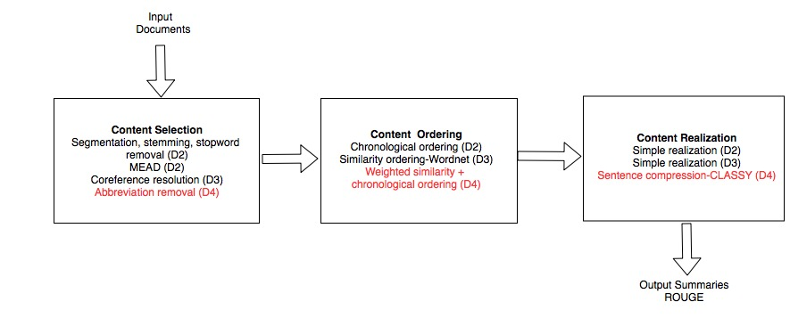
Stage 4 Architecture
D4: improve content ordering, implement content realization
Type to enter a caption.

Slide 3
Improvement 1: Abbreviation remover
The main motivation for removal of abbreviations was to deal with the segmentation issue we discovered in the previous iteration.
<Reference?>

Slide 4
Improvement 2: Information ordering weights
Information ordering now uses a weighed approach with two different methods.
This approach was inspired by the Bollegala et al, 2012 paper which mentions different experts which can be consulted during the reordering process.
Our approach utilizes the following experts:
1. Chronological expert
2. Topical-closeness expert (based on WordNet).
Bollegala, D., Okazaki, N., and Ishizuka, M. (2012) A preference learning approach to sentence ordering for multi-document summarization.

Slide 5
Improvement 3: Sentence Compression
Content realization is now fully implemented, using the CLASSY sentence compression approach discussed in Conroy, et. al, 2006. The older Dunlavy et. al, 2003 paper was also consulted in the course of designing this component.
Conroy, J. M., Schlesinger, J. D., and Goldstein, J. (2006). Classy tasked based summarization: Back to basics.
M Dunlavy, Daniel & Conroy, John & Schlesinger, Judith & A Goodman, Sarah & Ellen Okurowski, Mary & O'leary, Dianne & Halteren, Hans. (2003). Performance of a three-stage system for multi-document summarization. IEEE Intelligent Systems & Their Applications - IEEE INTELL SYST APPL.

Slide 6
ROUGE Scores: Test Data
 | D3 R | D3 P | D3 F | D4 R | D4 P | D4 F
ROUGE-1
ROUGE-2
ROUGE-3

Slide 7
ROUGE Scores: Evaluation Data
 | D3 R | D3 P | D3 F | D4 R | D4 P | D4 F
ROUGE-1
ROUGE-2
ROUGE-3

Slide 8
Error Analysis

Slide 9
Conclusion
Key points we learned from this project:
1. Using off the shelf components/packages appeared to be easy at first; the real challenge was combining them in a multi-component system.
2. Sometimes enhancements to the system did not actually improve the ROUGE scores (D3). Fine tuning (D4) was necessary to get optimal results.
3. Working remotely with partners in different parts of the world can be challenging due to time and schedule differences. Communication was absolutely vital to seeing the project through to successful completion.

Slide 10
References
Bollegala, D., Okazaki, N., and Ishizuka, M. (2012) A preference learning approach to sentence ordering for multi-document summarization.
Conroy, J. M., Schlesinger, J. D., and Goldstein, J. (2006). Classy tasked based summarization: Back to basics.
M Dunlavy, Daniel & Conroy, John & Schlesinger, Judith & A Goodman, Sarah & Ellen Okurowski, Mary & O'leary, Dianne & Halteren, Hans. (2003). Performance of a three-stage system for multi-document summarization. IEEE Intelligent Systems & Their Applications - IEEE INTELL SYST APPL.

