Slide 1

Starting Out with C++ Early Objects
Tenth Edition
Chapter 7
Introduction to Classes and Objects

Slide 2
Topics 1 of 2
7.1 Abstract Data Types
7.2 Object-Oriented Programming
7.3 Introduction to Classes
7.4 Creating and Using Objects
7.5 Defining Member Functions
7.6 Constructors
7.7 Destructors
7.8 Private Member Functions

Slide 3
Topics 2 of 2
7.9 Passing Objects to Functions
7.10 Object Composition
7.11 Separating Class Specification, Implementation, and Client Code
7.12 Structures
7.13 More About Enumerated Data Types
7.15 Introduction to Object-Oriented Analysis and Design
7.16 Screen Control

Slide 4
7.1 Abstract Data Types
Are programmer-created data types that specify
the legal values that can be stored
the operations that can be done on the values
The user of an abstract data type (ADT) does not need to know any implementation details (e.g., how the data is stored or how the operations on it are carried out)

Slide 5
Abstraction in Software Development
Abstraction allows a programmer to design a solution to a problem and to use data items without concern for how the data items are implemented
This has already been encountered in the book:
To use the pow function, you need to know what inputs it expects and what kind of results it produces
You do not need to know how it works

Slide 6
Abstraction and Data Types
Abstraction: a definition that captures general characteristics without details
ex: An abstract triangle is a 3-sided polygon. A specific triangle may be scalene, isosceles, or equilateral
Data Type: defines the kind of values that can be stored and the operations that can be performed on the values

Slide 7
7.2 Object-Oriented Programming
Procedural programming uses variables to store data, and focuses on the processes/ functions that occur in a program. Data and functions are separate and distinct.
Object-oriented programming is based on objects that encapsulate the data and the functions that operate with and on the data.

Slide 8
Object-Oriented Programming Terminology 1 of 2
object: software entity that combines data and functions that act on the data in a single unit
attributes: the data items of an object, stored in member variables
member functions (methods): procedures/ functions that act on the attributes of the class

Slide 9
Object-Oriented Programming Terminology 2 of 2
data hiding: restricting data access to certain members of an object. The intent is to allow only member functions to directly access and modify the object’s data
encapsulation: the bundling of an object’s data and procedures into a single entity

Slide 10
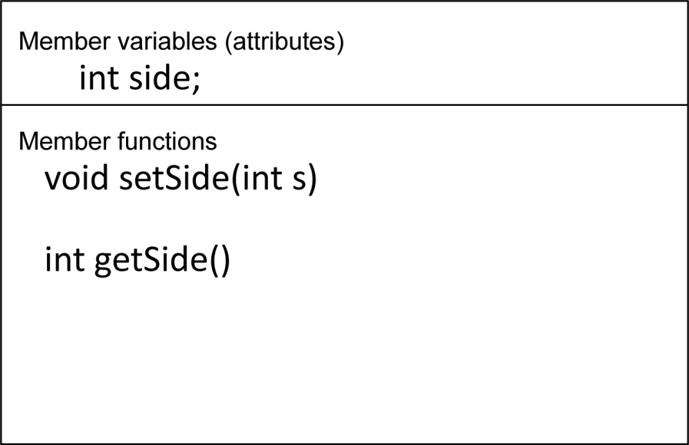
Object Example
Square
Square object’s data item: side
Square object’s functions: setSide - set the size of the side of the square, getSide - return the size of the side of the square

Slide 11
Why Hide Data?
Protection – Member functions provide a layer of protection against inadvertent or deliberate data corruption
Need-to-know – A programmer can use the data via the provided member functions. As long as the member functions return correct information, the programmer needn’t worry about implementation details.

Slide 12
7.3 Introduction to Classes 1 of 2
Class: a programmer-defined data type used to define objects
It is a pattern for creating objects
ex:
string fName, lName;
This creates two objects of the string class

Slide 13
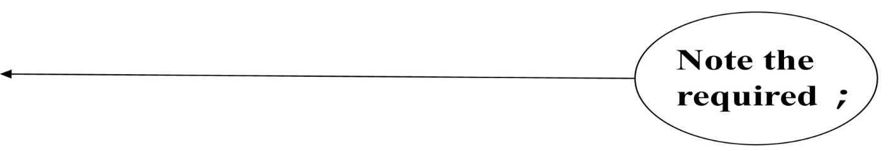
Introduction to Classes 2 of 2
Class declaration format:
class className
{
declaration;
declaration;
};

Slide 14
Access Specifiers
Used to control access to members of the class.
Each member is declared to be either
public: can be accessed by functions
outside of the class
or
private: can only be called by or accessed
by functions that are members of
the class

Slide 15
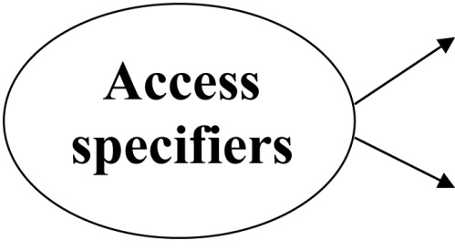
Class Example
class Square
{
private:
int side;
public:
void setSide(int s)
{ side = s; }
int getSide()
{ return side; }
};

Slide 16
More on Access Specifiers
Can be listed in any order in a class
Can appear multiple times in a class
If not specified, the default is private

Slide 17
7.4 Creating and Using Objects
An object is an instance of a class
It is defined just like other variables
Square sq1, sq2;
It can access members using dot operator
sq1.setSide(5);
cout << sq1.getSide();
Notes:
See pr7-01.cpp

Slide 18
Types of Member Functions
Acessor, get, getter function: uses but does not modify a member variable
ex: getSide
Mutator, set, setter function: modifies a member variable
ex: setSide

Slide 19
7.5 Defining Member Functions
Member functions are part of a class declaration
You can place entire function definition inside the class declaration,
or
You can place just the prototype inside the class declaration and write the function definition after the class

Slide 20
Defining Member Functions Inside the Class Declaration
Member functions defined inside the class declaration are called inline functions
Only very short functions, like the one below, should be inline functions
int getSide()
{ return side; }

Slide 21
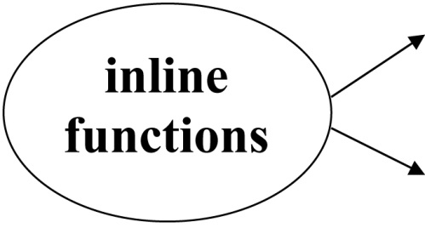
Inline Member Function Example
class Square
{
private:
int side;
public:
void setSide(int s)
{ side = s; }
int getSide()
{ return side; }
};

Slide 22
Defining Member Functions After the Class Declaration
Use a function prototype in the class declaration
In the function definition, precede the function name with the class name and scope resolution operator (::)
int Square::getSide()
{
return side;
}
Notes:
See pr7-02.cpp and pr7-03.cpp

Slide 23
Conventions and a Suggestion
Conventions:
Member variables are usually private
Accessor and mutator functions are usually public
Use ‘get’ in the name of accessor functions, ‘set’ in the name of mutator functions
Suggestion: calculate values to be returned in accessor functions when possible, to minimize the potential for stale data

Slide 24
Tradeoffs of Inline vs. Regular Member Functions
When a regular function is called, control passes to the called function
the compiler stores return address of call, allocates memory for local variables, etc.
Code for an inline function is copied into the program in place of the call when the program is compiled
This makes a larger executable program, but
There is less function call overhead, and possibly faster execution

Slide 25
7.6 Constructors
A constructor is a member function that is automatically called when an object of the class is created
Is can be used to initialize data members
It must be a public member function
It must be named the same as the class
It must have no return type
Notes:
See pr7-04.cpp and pr7-05.cpp

Slide 26
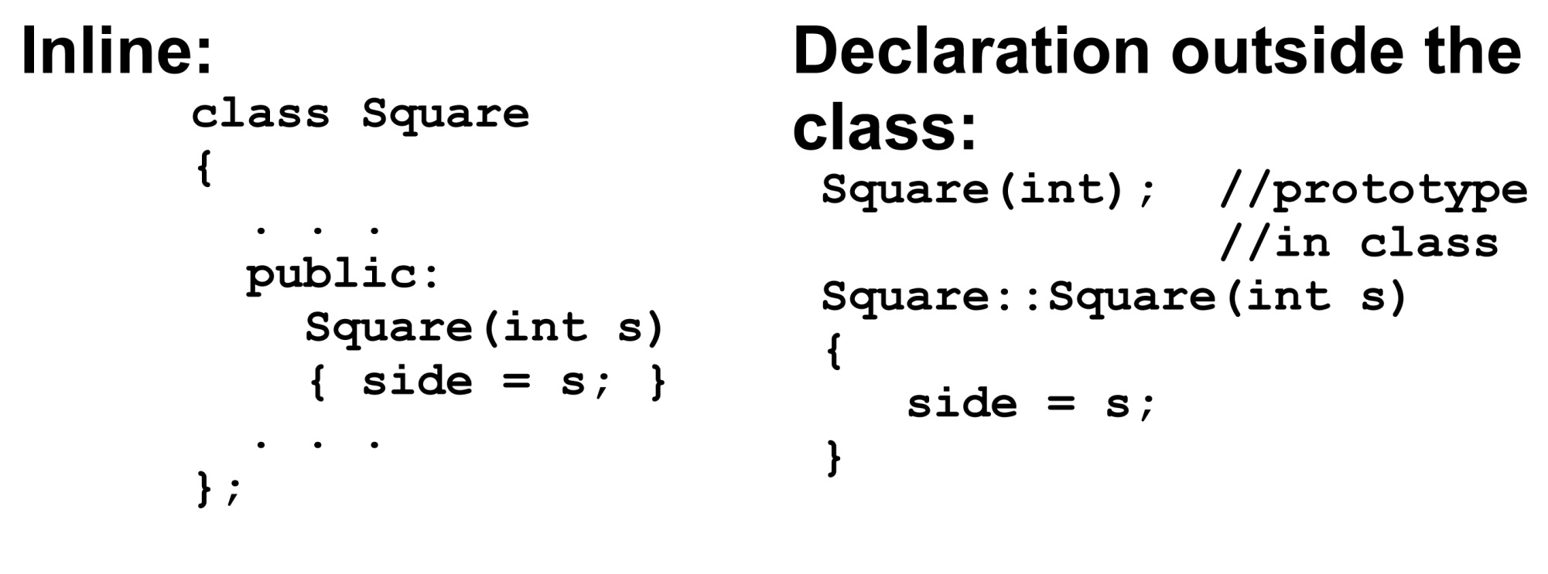
Constructor – 2 Examples

Slide 27
Overloading Constructors
A class can have more than 1 constructor
Overloaded constructors in a class must have different parameter lists
Square();
Square(int);
Notes:
See pr7-06.cpp

Slide 28
The Default Constructor
Constructors can have any number of parameters, including none
A default constructor is one that takes no arguments either due to
No parameters or
All parameters have default values
If a class has any programmer-defined constructors, it should have a programmer - defined default constructor

Slide 29
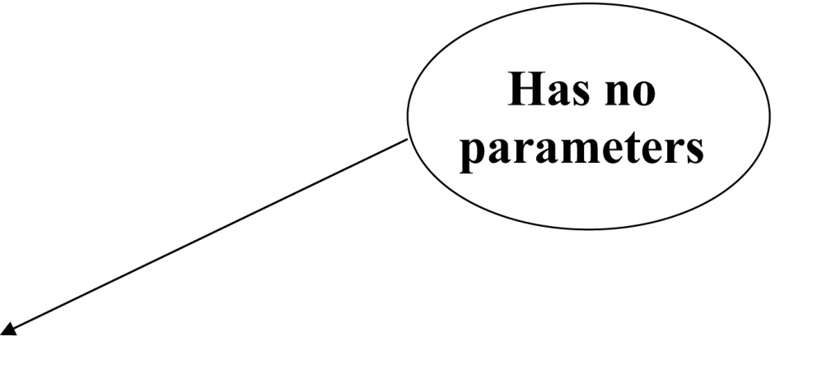
Default Constructor Example
class Square
{
private:
int side;
public:
Square() // default
{ side = 1; } // constructor
// Other member
// functions go here
};

Slide 30
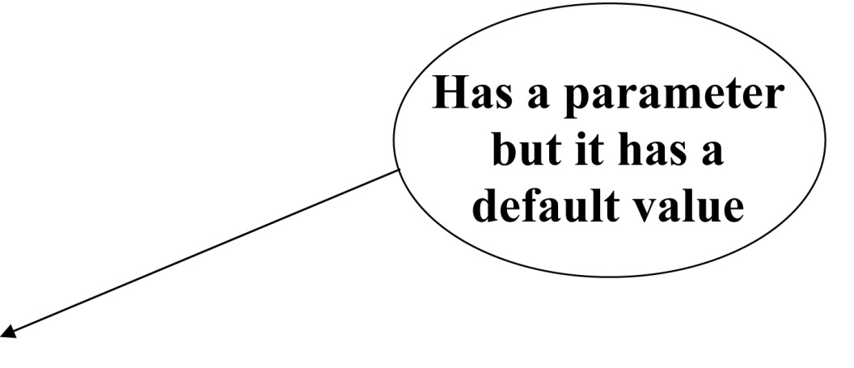
Another Default Constructor Example
class Square
{
private:
int side;
public:
Square(int s = 1) // default
{ side = s; } // constructor
// Other member
// functions go here
};

Slide 31
Invoking a Constructor
To create an object using the default constructor, use no argument list and no ()
Square square1;
To create an object using a constructor that has parameters, include an argument list
Square square2(8);

Slide 32
Member Initialization List 1 of 2
Member variables can be initialized using a member initialization list: a comma-separated list of member variables and initial values following the header of the constructor and before the body.
Examples:
Square() : side(1)
{ }
Square(int size) : side(size)
{ }

Slide 33
Member Initialization List 2 of 2
Notes:
: is required between header and initialization list
no ; at the end of the initialization list
initialization list precedes the function body. It can be on the same or the following line of the header.
The initialization list may accomplish all that is needed in a constructor. In this case, the body of the constructor is empty. The { } are still required.

Slide 34
In-Place Member Initialization List
Starting with C++ 11, member variables can be initialized at the time that they are defined in the class declaration. This provides default values those variables for all objects created from the class.
Default values can be overridden by using a constructor that takes parameters for the variables that have been initialized in-place.

Slide 35
Constructor Delegation
Starting with C++ 11, a constructor in a class can call another constructor in the same class. This is called constructor delegation.
The notation is similar to member initialization list
Example: // default constructor Square(): Square(1)
{ }
Square(int s)
{ side = s; }

Slide 36
Constructor Delegation Notes
The default constructor delegates the work to the constructor that takes one argument.
It calls the non-default constructor and passes the initial value as an argument.
// default constructor Square(): Square(1)
{ }
Square(int s)
{ side = s; }

Slide 37
7.7 Destructors
Is a public member function automatically called when an object is destroyed
The destructor name is ~className, e.g., ~Square
It has no return type
It takes no arguments
Only 1 destructor is allowed per class
(i.e., it cannot be overloaded)
Notes:
See pr7-07.cpp

Slide 38
7. 8 Private Member Functions
A private member function can only be called by another member function of the same class
It is used for internal processing by the class, not for use outside of the class
Notes:
See pr7-08.cpp

Slide 39
7.9 Passing Objects to Functions
A class object can be passed as an argument to a function.
When it is passed by value, the function makes a local copy of the object. The original object in the calling environment is unaffected by actions in the function.
When passed by reference, the function can use ‘set’ functions to modify the object in the calling environment.
Notes:
See pr7-09.cpp

Slide 40
Notes on Passing Objects 1 of 2
Using a value parameter for an object can slow down a program and waste space
Using a reference parameter speeds up the program. However, it allows the function to modify the data in the parameter, which is the same as the argument in the calling part of the program. This may not be desirable.

Slide 41
Notes on Passing Objects 2 of 2
To save space and time while protecting parameter data that should not be changed, use a const reference parameter in the header and the prototype:
void showData(const Square &s)
// header
In order to for the showData function to call Square member functions, those functions must use const in their prototype and header:
int Square::getSide() const;

Slide 42
Returning an Object from a Function
A function can return an object
Square initSquare(); // prototype
Square s1 = initSquare();// call
The function must create an object
for internal use
to use with the return statement

Slide 43
Returning an Object Example
Square initSquare()
{
Square s; // local object
int inputSize;
cout << "Enter the length of side: ";
cin >> inputSize;
s.setSide(inputSize);
return s;
}
Notes:
See pr7-10.cpp

Slide 44
7.10 Object Composition 1 of 2
This occurs when an object is a member variable of another object.
It is often used to design complex objects whose members are simpler objects
ex. (from book): Define a rectangle class. Then, define a carpet class and use a rectangle object as a member of a carpet object.
Notes:
See pr7-11.cpp

Slide 45
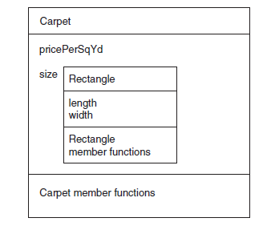
Object Composition 2 of 2

Slide 46
7.11 Separating Class Specification, Implementation, and Client Code
Separating the class declaration, member function definitions, and the program that uses the class into separate files is considered good design.

Slide 47
Using Separate Files
Place class declaration in a header file that serves as the class specification file. Name the file classname.h (for example, Square.h)
Place member function definitions in a class implementation file. Name the file classname.cpp (for example, Square.cpp)This file should #include the class specification file.
A client program (client code) that uses the class must #include the class specification file and be compiled and linked with the class implementation file.
Notes:
See pr7-12.cpp, Rectangle.cpp, and Rectangle.h

Slide 48
Include Guards
Are used to prevent a header file from being included twice
Format: #ifndef symbol_name
#define symbol_name
. . . (normal contents of header file)
#endif
symbol_name is usually the name of the header file, in all capital letters:
#ifndef SQUARE_H
#define SQUARE_H
. . .
#endif

Slide 49
What Should Be Done Inside vs. Outside of the Class
Class should be designed to provide functions to store and retrieve data
In general, input and output (I/O) should be done by functions that use class objects, rather than by class member functions
Notes:
See Rectangle.h, Rectangle.cpp, and pr7-12.cpp

Slide 50
7.12 Structures
Structure: A programmer-defined data type that allows multiple variables to be grouped together
Structure declaration format:
struct structure name
{
type1 field1;
type2 field2;
…
typen fieldn;
};

Slide 51
Example struct Declaration
struct Student // structure name
{
int studentID;// structure
string name; // members
short year;
double gpa;
}; // The ; is required

Slide 52
struct Declaration Notes
struct names commonly begin with an uppercase letter
Multiple fields of same type can be declared in a comma-separated list
string name,
address;
Fields in a structure are all public by default

Slide 53
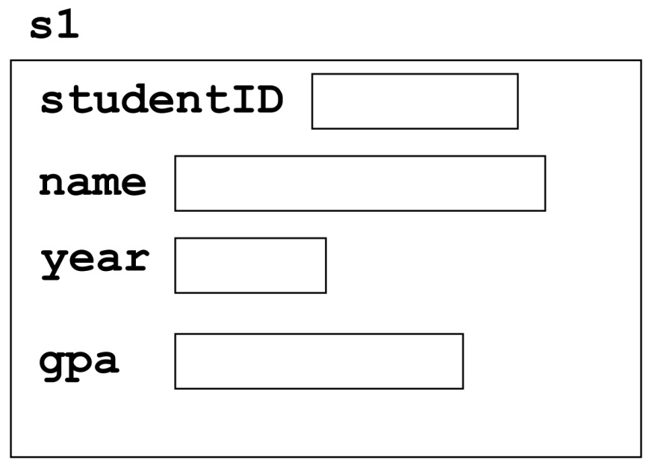
Defining Structure Variables
A struct declaration does not allocate memory or create variables
To define variables, use the structure name as the type name
Student s1;

Slide 54
Accessing Structure Members
Use the dot (.) operator to refer to the data members of struct variables
getline(cin, s1.name);
cin >> s1.studentID;
s1.gpa = 3.75;
The member variables can be used in any manner appropriate for their data type
Notes:
see pr7-13.cpp

Slide 55
Displaying struct Members
To display the contents of a struct variable, you must display each field separately, using the dot operator
Wrong:
cout << s1; // won’t work!
Correct:
cout << s1.studentID << endl;
cout << s1.name << endl;
cout << s1.year << endl;
cout << s1.gpa;

Slide 56
Comparing struct Members
Similar to displaying a struct, you cannot compare two struct variables directly:
if (s1 >= s2) // won’t work!
Instead, compare member variables:
if (s1.gpa >= s2.gpa) // better

Slide 57
Initializing a Structure 1 of 2
Structure members cannot be initialized in the structure declaration, because no memory has been allocated yet
struct Student // Illegal
{ // initialization
int studentID = 1145;
string name = "Alex";
short year = 1;
float gpa = 2.95;
};

Slide 58
Initializing a Structure 2 of 2
Structure members are initialized at the time a structure variable is created
You can initialize a structure variable’s members with either
an initialization list, or
a constructor

Slide 59
Using an Initialization List
An initialization list is an ordered set of values, separated by commas and contained in { }, that provides initial values for a set of data members
{12, 6, 3} // initialization list
// with 3 values

Slide 60
More on Initialization Lists
The order of list elements matters: The first value initializes first data member, second value initializes second data member, etc.
The elements of an initialization list can be constants, variables, or expressions
{12, W, L/W + 1} // initialization list
// with 3 items

Slide 61
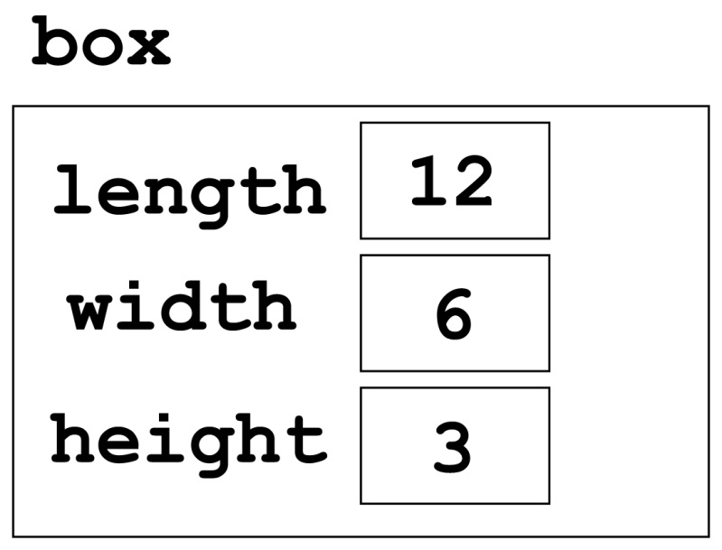
Initialization List Example
Structure Declaration Structure Variable
struct Dimensions
{ int length,
width,
height;
};
Dimensions box = {12,6,3};

Slide 62
Partial Initialization
You can initialize some of the members, but you cannot skip over members
Dimensions box1 = {12,6}; //OK
Dimensions box2 = {12,,3}; //illegal

Slide 63
Problems with Using an Initialization List
You can’t omit a value for a data member without omitting values for all following members
It does not work on most modern compilers if the structure contains objects, e.g., string objects

Slide 64
Using a Constructor to Initialize Structure Members
This is similar to a constructor for a class:
the name is the same as the name of the struct
it has no return type
it is used to initialize data members
It is normally written inside the struct declaration

Slide 65
A Structure with a Constructor
struct Dimensions
{
int length,
width,
height;
// Constructor
Dimensions(int L, int W, int H)
{length = L; width = W; height = H;}
};

Slide 66
Nested Structures
A structure can have another structure as a
member.
struct PersonInfo
{ string name,
address,
city;
};
struct Student
{ int studentID;
PersonInfo pData;
short year;
double gpa;
};

Slide 67
Members of Nested Structures
Use the dot operator multiple times to access fields of nested structures
Student s5;
s5.pData.name = "Joanne";
s5.pData.city = "Tulsa";
Reference the nested structure’s fields by the member variable name, not by the structure name
s5.PersonInfo.name = "Joanne"; //no!
Notes:
See pr7-14.cpp

Slide 68
Structures as Function Arguments
You may pass members of struct variables to functions
computeGPA(s1.gpa);
You may pass entire struct variables to functions
showData(s5);
You can use a reference parameter if the function needs to modify the contents of the structure variable
Notes:
See pr7-15.cpp

Slide 69
Notes on Passing Structures
Using a value parameter for structure can slow down a program and waste space
Using a reference parameter speeds up program execution, but it allows the function to modify data in the structure
To save space and time while protecting structure data that should not be changed, use a const reference parameter
void showData(const Student &s)
// header

Slide 70
Returning a Structure from a Function
A function can return a struct
Student getStuData(); // prototype
s1 = getStuData(); // call
The function must define a local structure variable
for internal use
to use with return statement

Slide 71
Returning a Structure Example
Student getStuData()
{ Student s; // local variable
cin >> s.studentID;
cin.ignore();
getline(cin, s.pData.name);
getline(cin, s.pData.address);
getline(cin, s.pData.city);
cin >> s.year;
cin >> s.gpa;
return s;
}
Notes:
See pr7-15B.cpp

Slide 72
7.13 More About Enumerated Data Types
Additional ways that enumerated data types can be used:
Data type declaration and variable definition in a single statement:
enum Tree {ASH, ELM, OAK} tree1, tree2;
Assign an int value to an enum variable:
enum Tree {ASH, ELM, OAK} tree1;
tree1 = static_cast<Tree>(1); // ELM

Slide 73
More About Enumerated Data Types 1 of 4
Assign the value of an enum variable to an int:
enum Tree {ASH, ELM, OAK} tree1;
tree1 = ELM;
int thisTree = tree1; // assigns 1
int thatTree = OAK; // assigns 2

Slide 74
More About Enumerated Data Types 2 of 4
Assign the result of a computation to an enum variable
enum Tree {ASH, ELM, OAK} tree1, tree2;
tree1 = ELM;
tree2 = static_cast<Tree>(tree1 + 1);
// assigns OAK

Slide 75
More About Enumerated Data Types 3 of 4
Using enumerators in a switch statement
enum Tree {ASH, ELM, OAK} tree1;
switch(tree1)
{
case ASH: cout << "Ash";
break;
case ELM: cout << "Elm";
break;
case OAK: cout << "Oak";
break;
}

Slide 76
More About Enumerated Data Types 4 of 4
Using enumerators for loop control:
enum Tree {ASH, ELM, OAK};
for (Tree tree1 = ASH; tree1 <= OAK;
tree1=static_cast<Tree>(tree1+1))
{
.
.
.
}

Slide 77
Strongly Typed enums (C++ 11) 1 of 4
Enumerated values (names) cannot be re-used in different enumerated data types that are in the same scope.
A strongly typed enum (an enum class) allows you to do this
enum class Tree {ASH, ELM, OAK};
enum class Street {RUSH, OAK, STATE};
Note the keyword class in the declaration

Slide 78
Strongly Typed enums (C++ 11) 2 of 4
Because enumerators can be used in multiple enumerated data types, references must include the name of the strongly typed enum followed by : :
enum class Tree : char {ASH, ELM, OAK};
Tree tree1 = Trees::OAK;

Slide 79
Strongly Typed enums (C++ 11) 3 of 4
Strongly typed enumerators are stored as ints by default.
To choose a different integer data type, indicate the type after the enum name and before the enumerator list:
enum class Tree : char {ASH, ELM, OAK};

Slide 80
Strongly Typed enums (C++ 11) 4 of 4
To retrieve the integer value associated with a strongly-typed enumerator, cast it to an int:
enum class Tree : char {ASH, ELM, OAK};
int val = static_cast<int>(Trees::ASH);
Notes:
See pr7-16.cpp

Slide 81
7.15 Introduction to Object-Oriented Analysis and Design
Object-Oriented Analysis: that phase of program development when the program functionality is determined from the requirements
It includes
identification of classes and objects
definition of each class's attributes
definition of each class's behaviors
definition of the relationship between classes

Slide 82
Identify Classes and Objects
Consider the major data elements and the operations on these elements
Candidates include
user-interface components (menus, text boxes, etc.)
I/O devices
physical objects
historical data (employee records, transaction logs, etc.)
the roles of human participants

Slide 83
Define Class Attributes
Attributes are the data elements of an object of the class
They are necessary for the object to work in its role in the program

Slide 84
Define Class Behaviors
For each class,
Identify what an object of a class should do in the program
The behaviors determine some of the member functions of the class

Slide 85
Relationships Between Classes
Possible relationships
Access ("uses-a")
Ownership/Composition ("has-a")
Inheritance ("is-a")

Slide 86
Finding the Classes
Technique:
Write a description of the problem domain (objects, events, etc. related to the problem)
List the nouns, noun phrases, and pronouns. These are all candidate objects
Refine the list to include only those objects that are applicable to the problem

Slide 87
Determine Class Responsibilities
Class responsibilities:
What is the class responsible to know?
What is the class responsible to do?
Use these to define some of the member functions

Slide 88
Object Reuse
A well-defined class can be used to create objects in multiple programs
By re-using an object definition, program development time is shortened
One goal of object-oriented programming is to support object reuse

Slide 89
Object-Based vs. Object-Oriented
A program that uses classes and objects is object-based.
An object-based program that
defines relationships between classes of objects
creates classes from other classes
determines member function behavior based on the object
is more likely to be an object-oriented program

Slide 90
7.16 Screen Control
Programs to date have all displayed output starting at the upper left corner of the computer screen or output window. Output is displayed left-to-right, line-by-line.
Computer operating systems are designed to allow programs to access any part of the computer screen. Such access is operating system-specific.

Slide 91
Screen Control – Concepts
An output screen can be thought of as a grid of 25 rows and 80 columns. Row 0 is at the top of the screen. Column 0 is at the left edge of the screen.
The intersection of a row and a column is a cell. It can display a single character.
A cell is identified by its row and column number. These are its coordinates.

Slide 92
Screen Control – Windows - Specific
#include <windows.h> to access the operating system from a program
Create a handle to reference the output screen:
HANDLE screen = GetStdHandle(STD_OUTPUT_HANDLE);
Create a COORD structure to hold the coordinates of a cell on the screen:
COORD position;

Slide 93
Screen Control – Windows – More Specifics
Assign coordinates where the output should appear:
position.X = 30; // column
position.Y = 12; // row
Set the screen cursor to this cell:
SetConsoleCursorPosition(screen, position);
Send output to the screen:
cout << "Look at me!" << endl;
be sure to end with endl, not '\n' or nothing
Notes:
See pr7-18.cpp and pr7-19.cpp

Slide 94

Copyright

