Slide 1
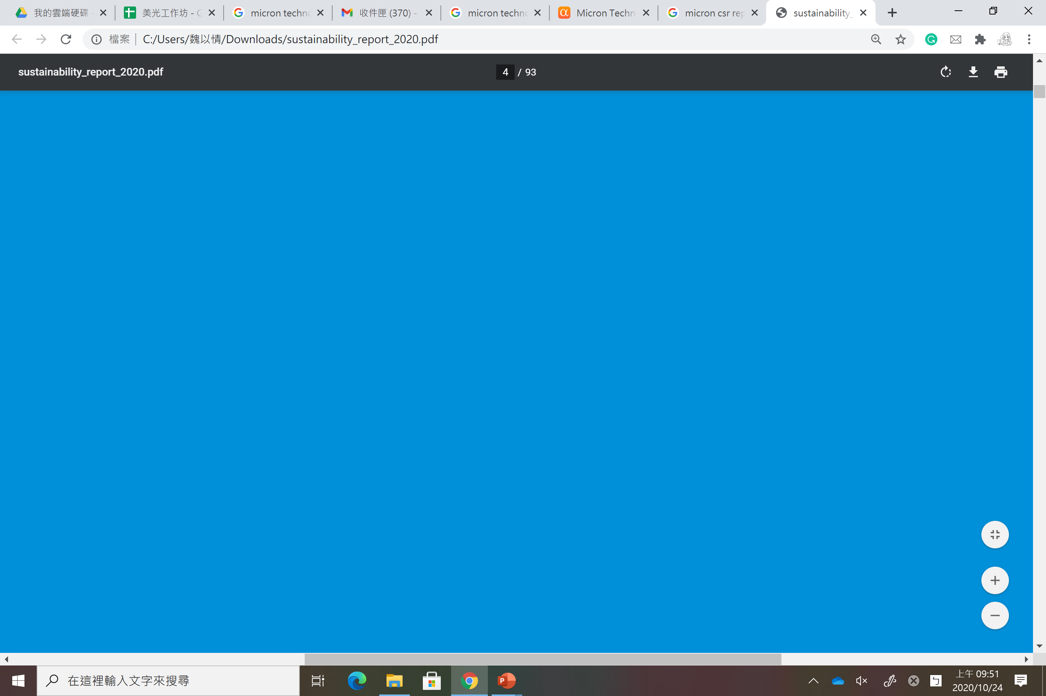
RATA Demo
You are not alone
Micron Technology
Oct. 25, 2020

Slide 2
Agenda
Vision
Product
Value

Slide 3
Revolution
Our
Product is
RATA
Allocation
Time
Working From Home
will never be alone
Achievement

Slide 4
痛點

Slide 5
Product

Slide 6
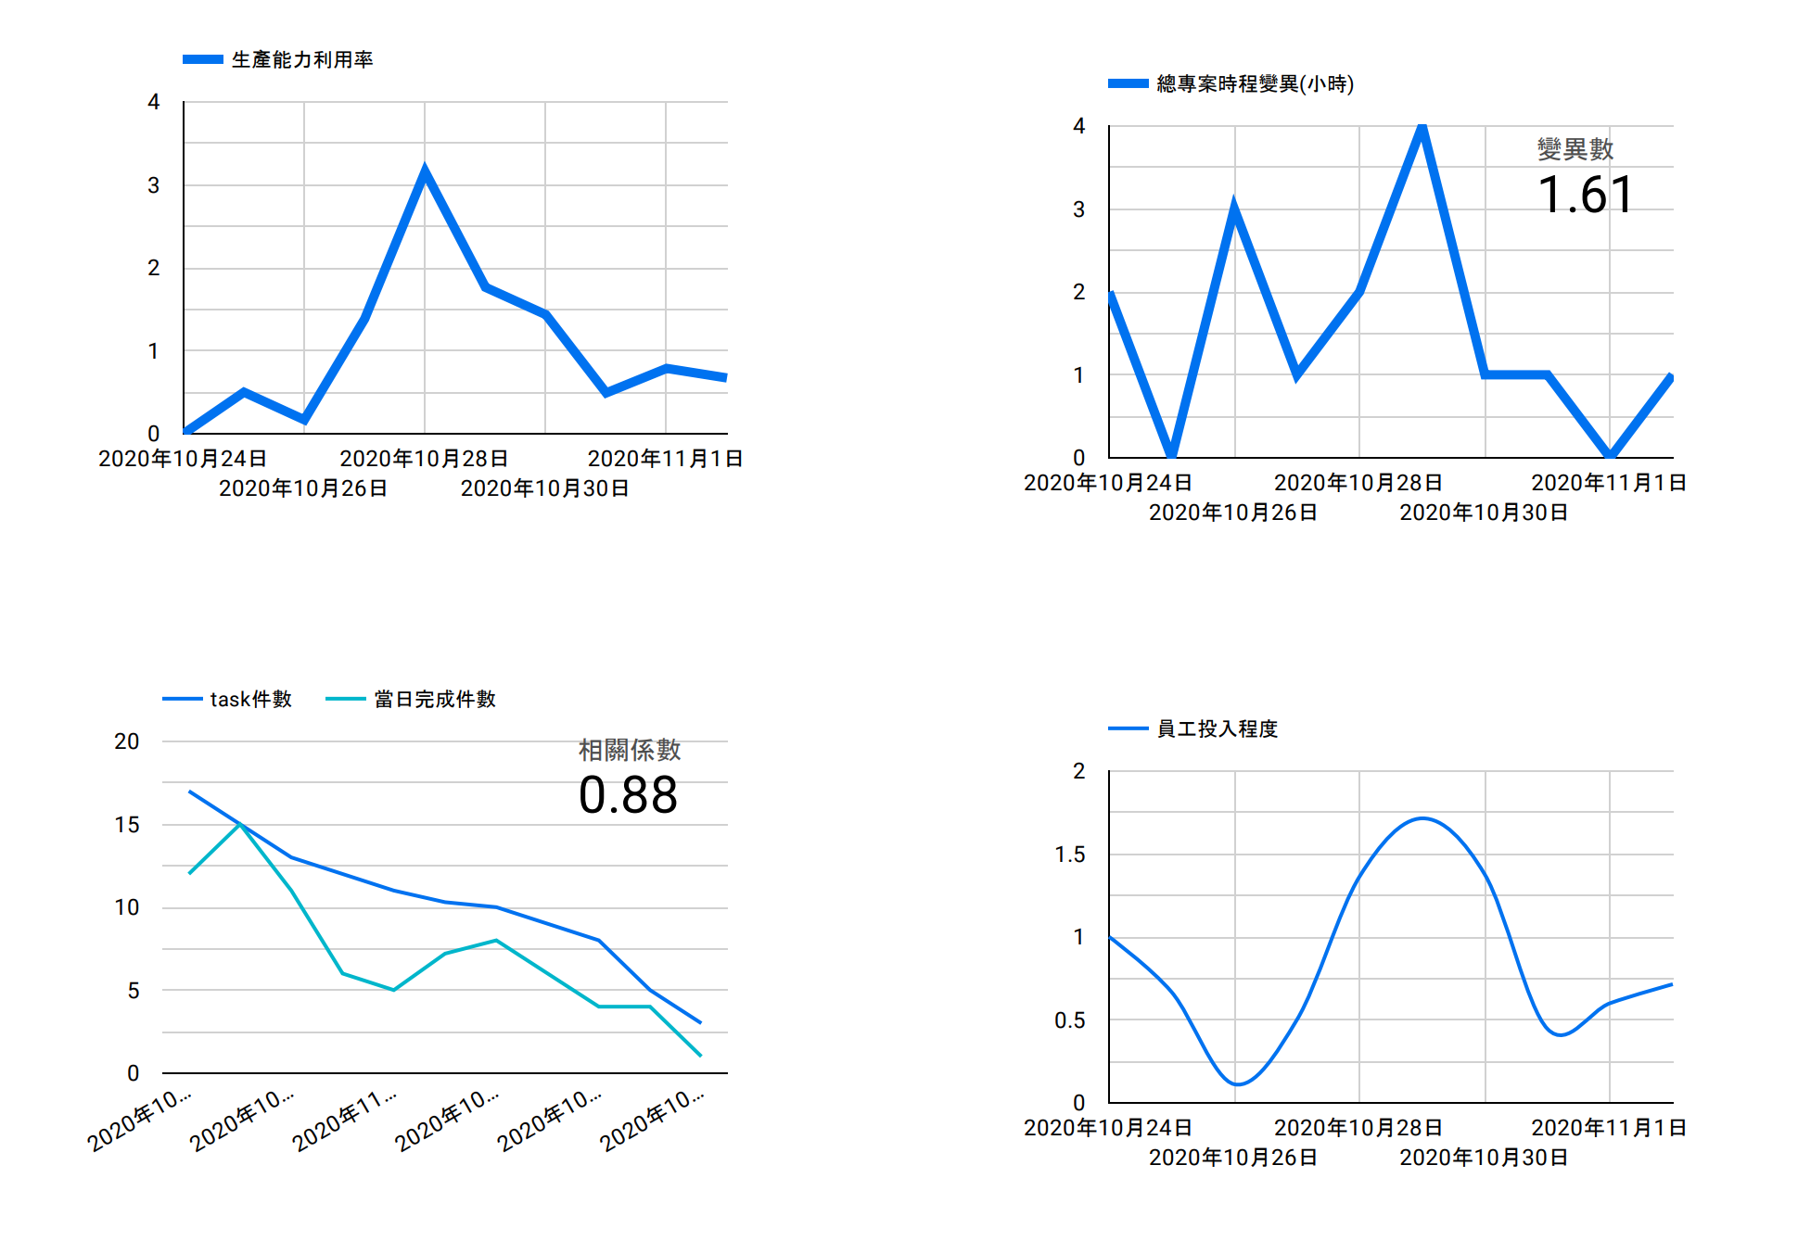
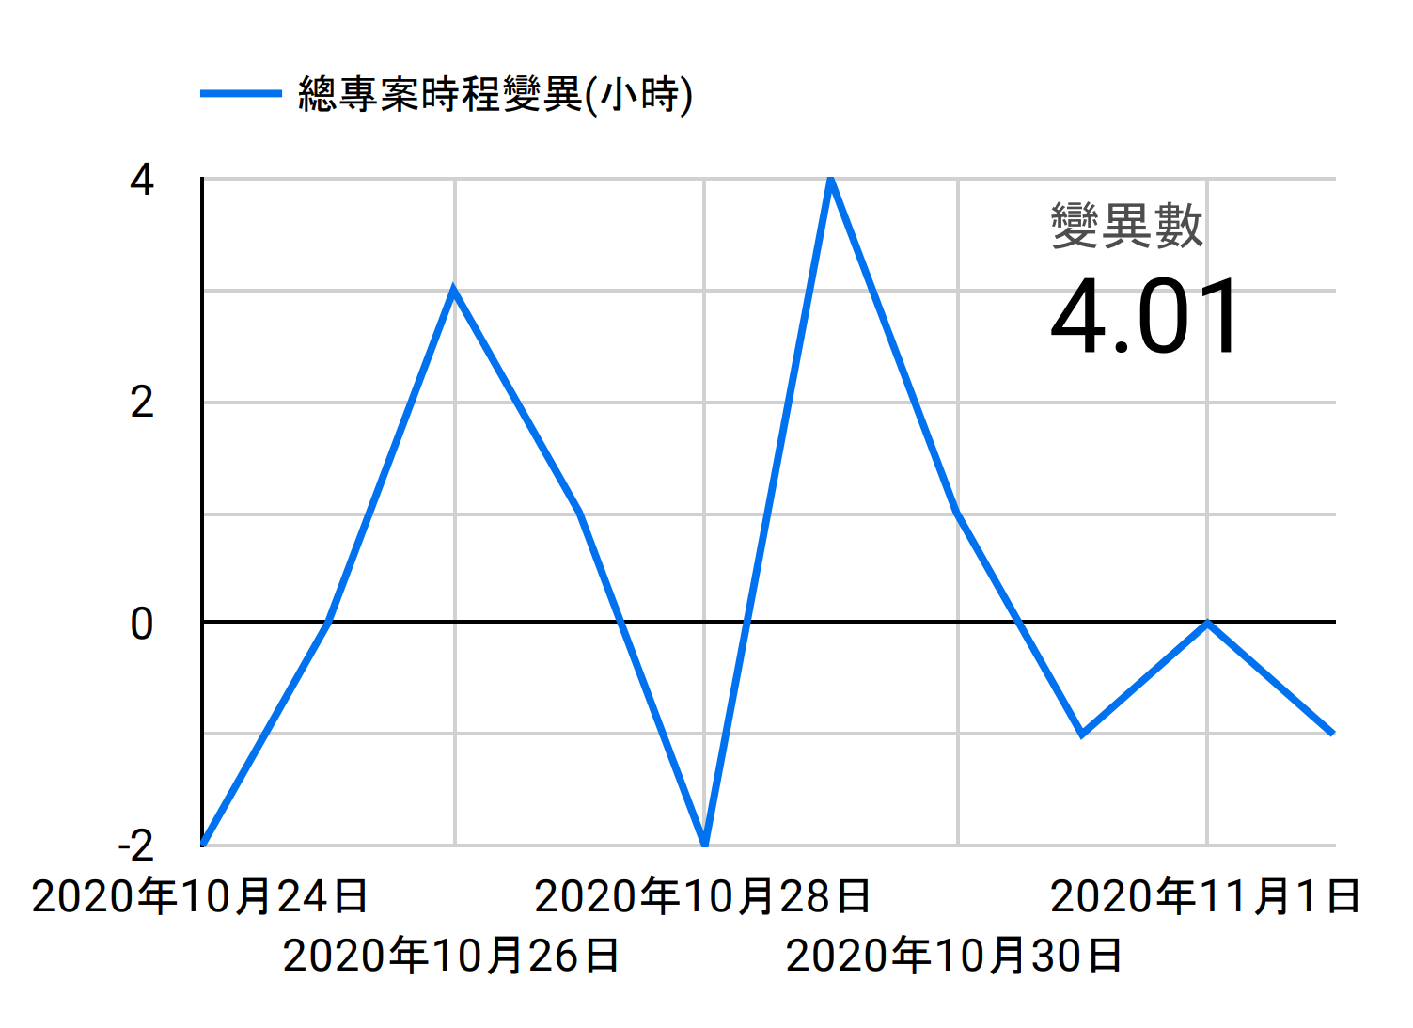
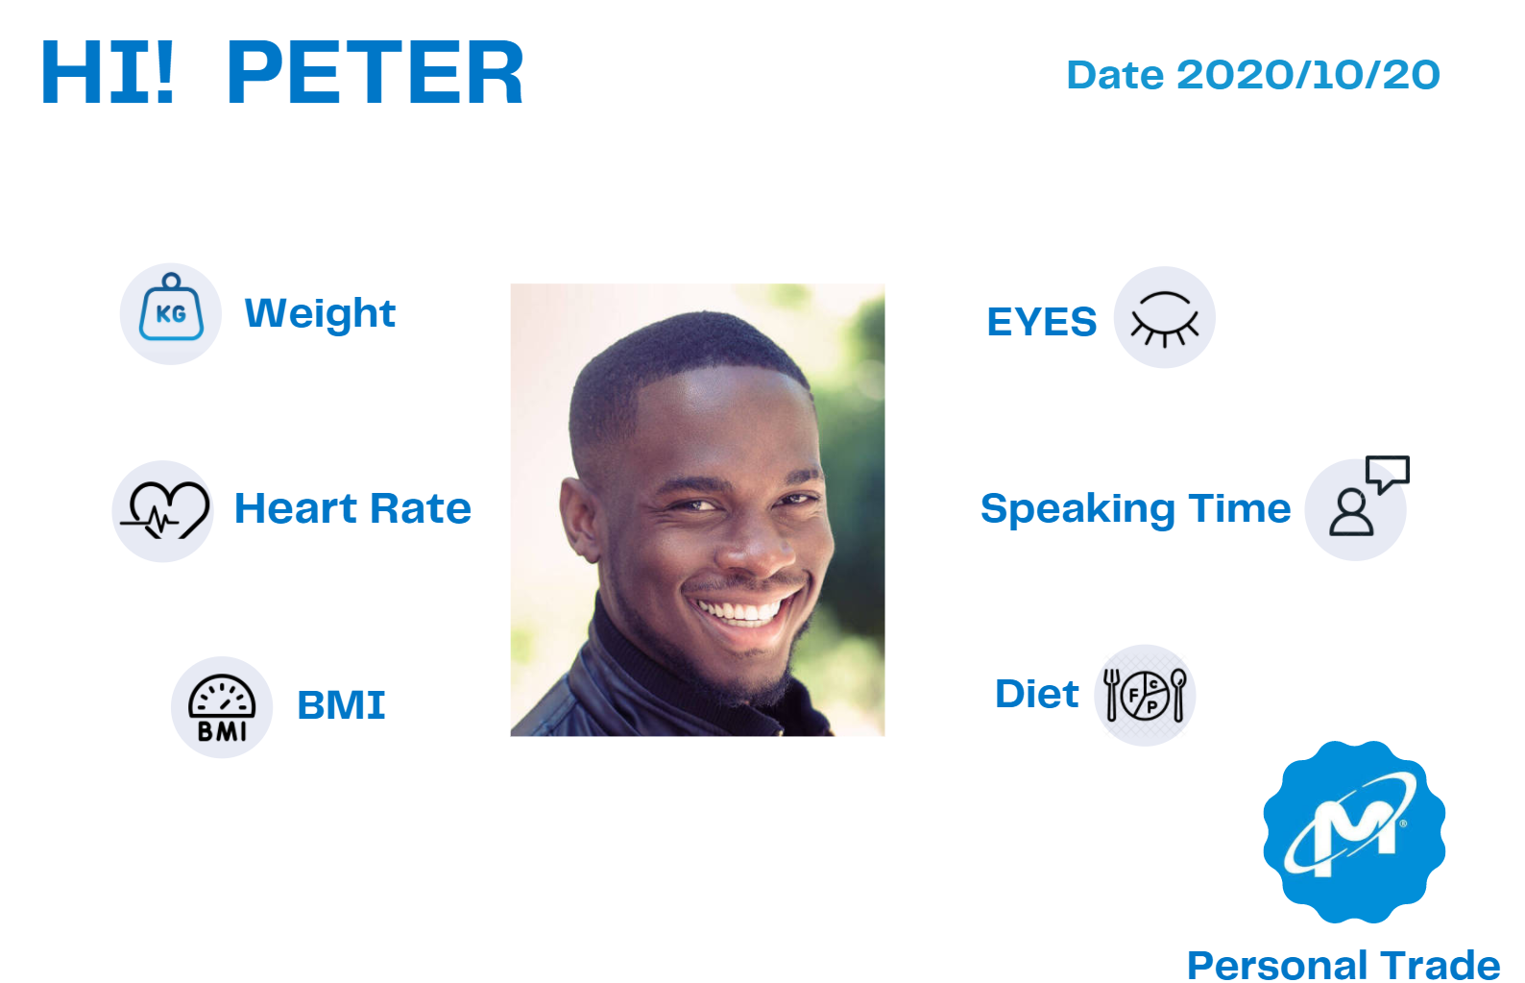
Task Management
Dashboard
Meeting
Health-Care

Slide 7
Function

Slide 8
Task Management
Notes:
讓員工可以兼顧下班後生活品質

Slide 9
Meeting

Slide 10
Dashboard

Slide 11
Health-Care
Personal trait

Slide 12
Our Value
Work From Home is never alone
Efficient Tracking
Time-Saving
Management
Life-Quality

Slide 13
RATA
You are not alone
is with you

Slide 14
Vision
Notes:
新型態工作解決企業wfh的問題

Slide 15
SAAS

Slide 16
HR Management

Slide 17
產品特色
01
解決孤獨感
系統人性化互動性高
內部創業組員配對
02
整合性
系統頁面容易操作
03
解決上下班難以區分問題
以顏色區分任務緊急性
儀錶板紀錄燈熄
04
預約時間功能
燈泡顯示在線與否
解決找不到同事的問題

Slide 18
Revolution
Our
Product is
RATA
Allocation
Time
WFH is never alone
Accomplishment

Slide 19
Expected
Results

Slide 20
Our
Product
is Strong
Integration
Interaction
Collaboration
Efficiency
WFH is never alone

Slide 21
產品特色
整合性
互動性
任務排程與視訊開會整合
以DISC徽章進行分類促進同事參與
1
2
即時性
易操作
會議記錄自動導入排程
視覺化儀表板
人性化排程系統
3
4

Slide 22
Agenda
設計發想
產品特色
功能展示
預期成效

Slide 23
Integration
Integration
Our
Product
is Strong
Interaction
Collaboration
WFH is never alone
Efficiency

Slide 24
Revolution
Allocation
RATA
Time
WFH is never alone
Accomplishment

Slide 25
Revolution
Our
Product
is RATA
Allocation
Time
WFH is never alone
Accomplishment

Slide 26
Revolution
Allocation
Our Product is
RATA
Time
WFH is never alone
Accomplishment

Slide 27
Revolution
Our
Product,
RATA
Allocation
Time
WFH is never alone
Accomplishment

Slide 28
Revolution
Our
Product
RATA
Allocation
Time
WFH is never alone
Accomplishment

Slide 29
Revolution
Allocation
Our Product
RATA
Time
WFH is never alone
Accomplishment

Slide 30
Our
Product
is Strong
Integration
Interaction
Collaboration
Efficiency
WFH is never alone

Slide 31
Value
Notes:
新型態工作解決企業wfh的問題

