Slide 1
The Effect of Walkability on Rent
Austin Coffelt , Tanisha Gauns
May 6th, 2025

Slide 2
Big Picture Of This Project
Research Question: What is the effect of neighborhood walkability on the median rent in that neighborhood? And what effect does crime have on that relationship?
Data:
2019 EPA National Walkability Index for Block Groups
Median Contract Rent from Census
Controls from EPA as well as Census Data
Crime Statistics from individual cities
Broad Findings and Interpretations:
Causal Method: OLS with controls
1 unit increase in standard deviation Walkability causes 1.1% increase in median block group rent, significant at all levels
Possible interesting interaction with crime, limited by our data

Slide 3
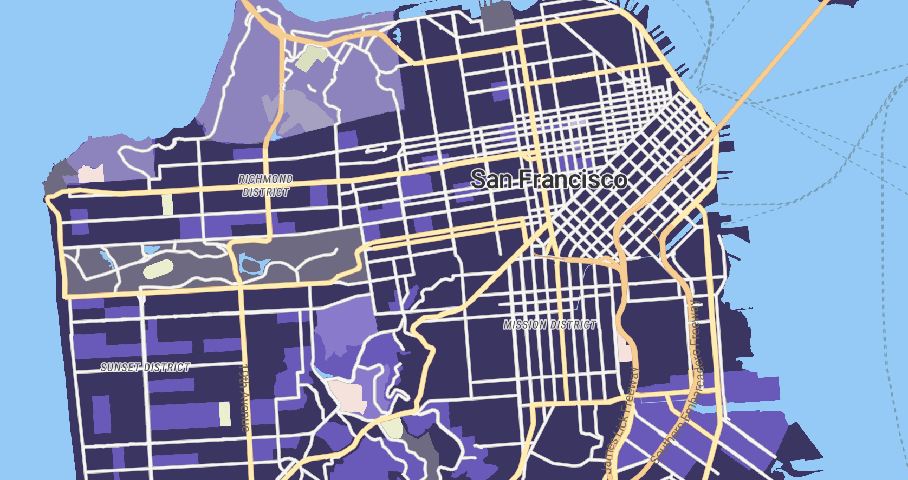
Walkability

Slide 4
Motivation
USA very car dependant
Behind many contemporary economies (Paris, Berlin)
Cars are a large contributor to US emissions
About 25 percent (US EIA, 2023)
Climate change related disasters increasing
US cities have began to address this issue
Changes towards walkability (Congestion Pricing, Removal of Parking Minimums)
Is there demand for these changes?
Does the American Public value walkability?

Slide 5
Literature Review :
Does Walkability Influence Housing Prices? (Austin Boyle, Charles Barrilleaux, and Daniel Scheller, September 2014.)
The Effect of Walkability on House Prices (Ekaterina Chernobai and Zhongming Ma, 18 January 2022.)
Neighborhood Walkability and Crime: Does the Relationship Vary by Crime Type? (Narae Lee and Christopher Contreras, Environment and Behavior, August 2021.)

Slide 6
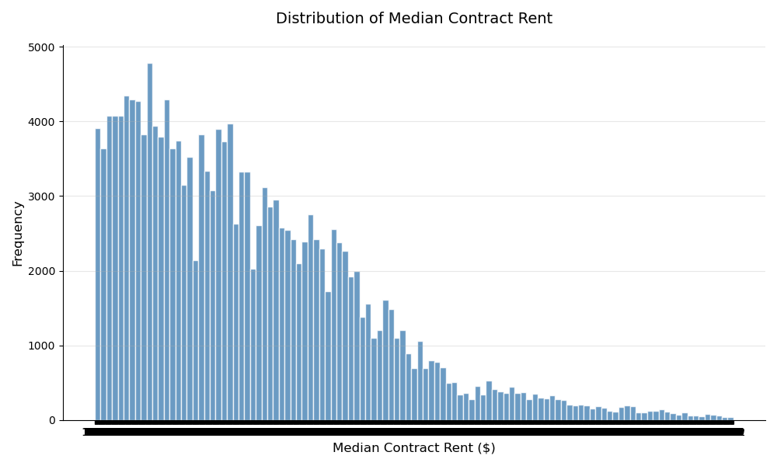

Slide 7
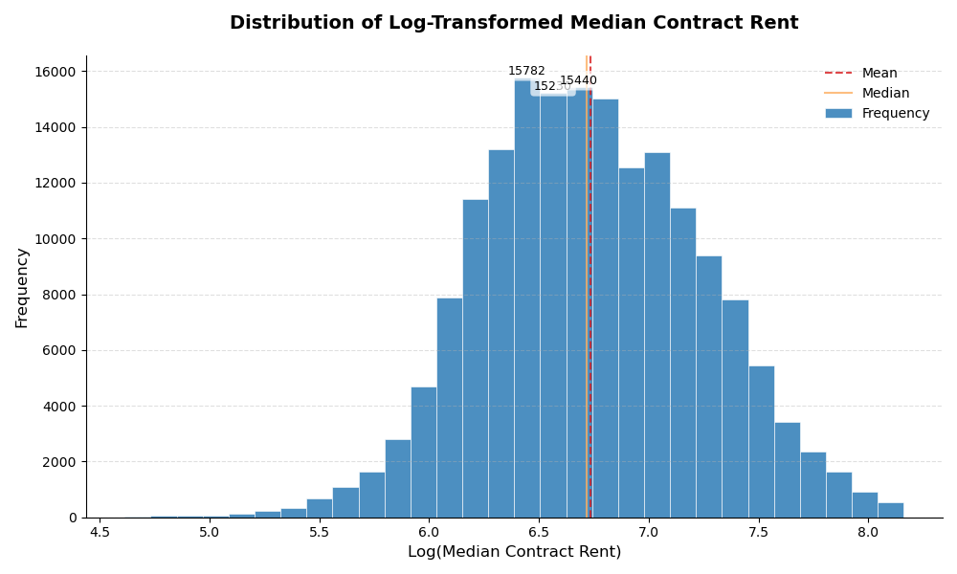

Slide 8
Data
Cities/Counties with Crime data:
Alameda County, CA
Austin, TX
Boston, MA
Buffalo, NY
Cambridge, MA (only all crimes)
Chattanooga, TN
Chicago, IL
Cincinnati, OH
District of Columbia
Detroit, MI
Gainesville, FL
Houston, TX
Johns Creek, GA
Los Angeles, CA
Montgomery County, MD
New Orleans, LA
New York City, NY
Oakland, CA
Omaha, NE
Philadelphia, PA
Raleigh, NC
San Francisco, CA
Tempe, AZ

Slide 9
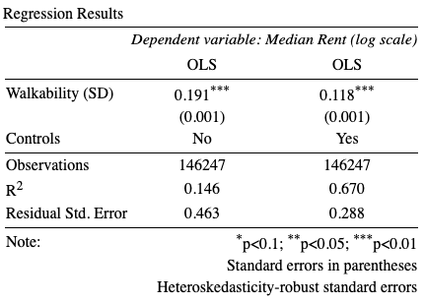
Estimating Equations:
Causal Identification Method
Rent = β₀ + β₁ SD(Walkability) + X Π + Ɣ_{county} + u
Rent = β₀ + β₁ SD(Walkability) + δ₀ High Crime + δ₁(SD(Walkability) * High Crime) + X Π + Ɣ_{county} + u
%ΔRent = 100β₁ Δ SD(Walkability)
Investigating Total Crime, Violent Crime, Property Crime, and Motor Vehicle Thefts
Above 75th percentile (2019 rates) => High Crime = 1
Heteroskedasticity Robust Errors

Slide 10
Causal Identification Method (Controls)
Neighborhood Characteristics: | Characteristics of the Commute: | Characteristics of the rental properties/people in it:
- Race - Income (log scale) - Population Density - Housing Density - Percentage of households that own no cars - Percentage of households that own two cars - Amount and Percentage of people who work for low/high wages | - Jobs within 45 minute drive - Regional Centrality - Percentage of people that drive to work - Percentage of people that take public transportation to work - Percentage of people that walk to work - Percentage of people that start their commute before 6AM - Percentage of people that have less than a 15 minute commute - Percentage of people with longer than a hour commute | - Average household size - Percentage of households with gas/electric/no heating - Percentage of households without Internet - Percentage of people living alone - Median number of rooms - Median year the properties were built - Percentage of people that pay extra for utilities - Median year the tenants moved in

Slide 11
Limitations
Omitted Variables
Measurement for Terrain (Hilliness): Likely Bias Upward
Frequency of Transit: Likely Bias Upward
Average Temperature: Likely Bias Upward
Square Footage: Likely Bias Upward
Selection
Census data has artificial cutoffs
Only have crime data for cities that publish (Increasing SE)
Must have a crime committed in the block group to be included
Measurement Error
Census data comes with margin of error
Crime Geolocating has gotten better with time

Slide 12
Summary Statistics (Walkability and Rent)
 | Walkability (Full Data) | Walkability (With Controls) | Median Rent (With Controls) | Walkability (Crime Data) | Median Rent (Crime Data)
Count | 220472 | 146247 | 146247 | 11573 | 11573
Standard Deviation | 4.37 | 4.26 | 500.18 | 2.82 | 561.03
Minimum | 1.00 | 1.00 | 101 | 1.83 | 172
25th Percentile | 5.83 | 6.17 | 587 | 12.17 | 816
Median | 9.17 | 9.50 | 822 | 14.17 | 1151
75th Percentile | 13.17 | 13.33 | 1188 | 15.83 | 1546
Maximum | 20.00 | 20.00 | 3500 | 20.00 | 3500

Slide 13
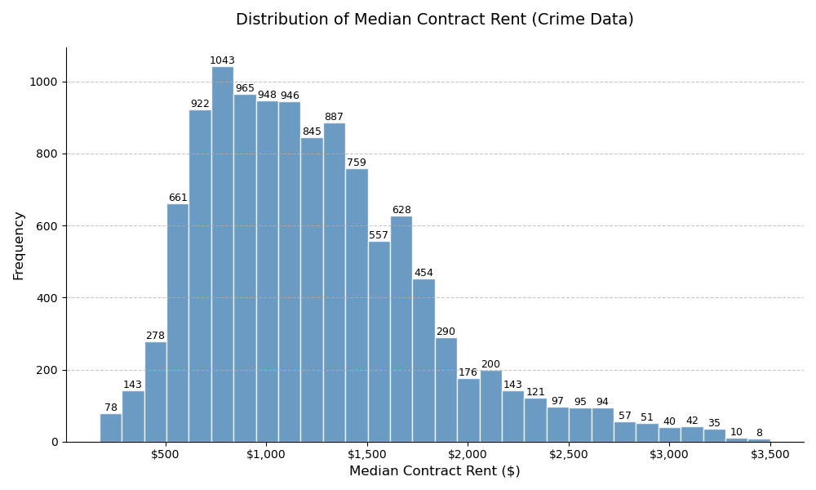

Slide 14
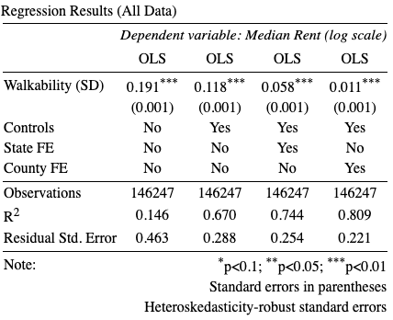
Results

Slide 15
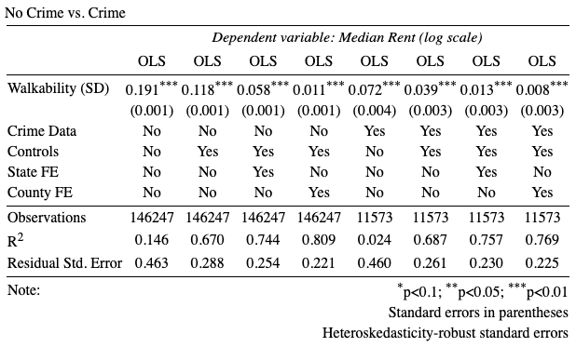
Results

Slide 16
Summary Statistics (Crime)
 | 25th Percentile Rate | Median Rate | 75th Percentile Rate | Percentage of observations above the 75%
All Crime | 1818.85 | 2437.5 | 3020.4 | 30.99%
Violent Crime | 222.3 | 326.8 | 453.4 | 38.88%
Property Crime | 1560.2 | 2124.2 | 2639.7 | 29.47%
Motor Vehicle Theft | 94.3 | 162.75 | 254.55 | 45.23%

Slide 17
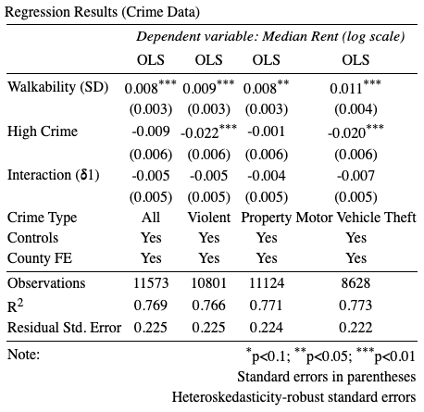
Results

Slide 18
Conclusion
Outcomes:
EPA, Census, and City level data for estimating walkability impact
Causal Identification: OLS with controls
Major selection bias in crime sample
1.1% increase in Rent from 1 SD increase in Walkability
No significant effects from crime, Motor Vehicle the closest
Further Research:
Address Level (Walk Score)
Radius around address for crime results
Find crime sample more representative of general population

