Slide 1
Update on Report on Health Insurance Enrolment
coverage as of Fourth Quarter, 2025
January, 2026

Slide 2
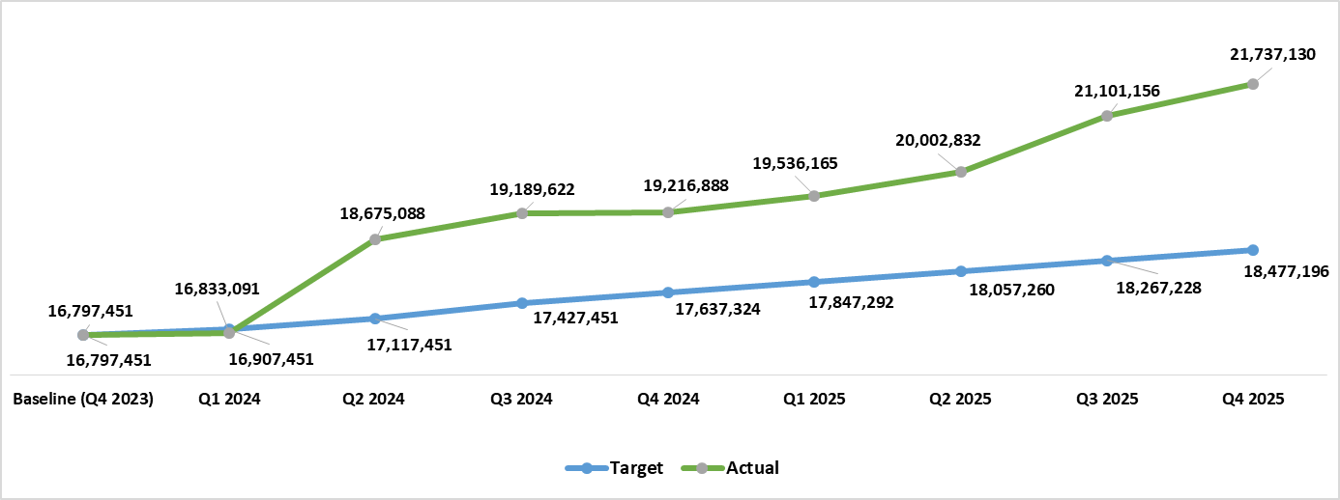

Health Insurance Coverage Quarterly Growth Rate/Targets as of Q4 2025
3.01 %
5.49 %
2.38 %
1.66 %
2.75 %
0.14 %
Covered additional ~4.93M citizens into the Health Insurance from Q4 2023 to Q4 2025 bringing the total enrolment to ~21.73 million and Growth rate of 29.41%.
10.94 %
0.21 %

Slide 3
Health Insurance Coverage Status by State by Program as of Q4 2025

Slide 4
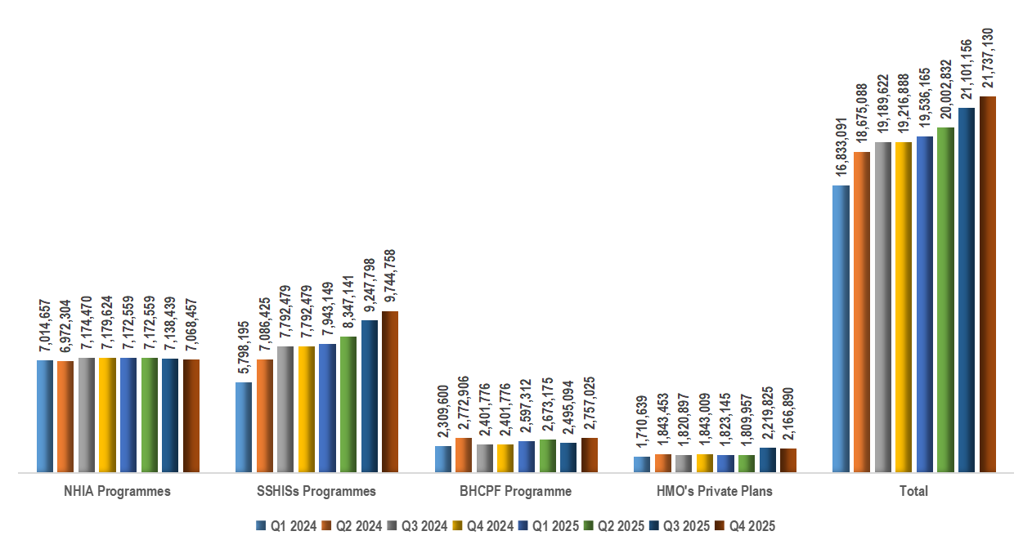
Quarterly Growth in Health Insurance Coverage by Program as of Q4 2025

