Slide 1
Group Assignment

Slide 2
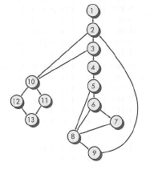
Exercises
What is the difference between black-box and white-box testing ?
Determine the cyclomatic complexity and define the independent paths of the below flow graph :

Slide 3
Exercises
In your own words, describe why the class is the smallest reasonable unit for testing wlthin an OO system
What is the difference between thread-based and use-based strategies for integration testing? How does cluster testing fit in?
Compatibility is an important quality dimension. What must be tested to ensure that compatibility exisis for a WebApp ?
What is the difference between testing for navigation syntax and navigation semantics?
Assume that you're the manager of a small project. What baselines would you define for the project and how would you control them?
Briefly describe the differences between SCM for conventional software and SCM for WebApps

