Slide 1
Progress Project Report
Software Engineering
Group 2 - LM01
Austin Andika Tanujaya (2301860261) : Project Manager
Chandra Steven Harley (2301860375) : Developer
Marcellino Budiman (2301866763) : Analyst
Brian Samuel (2301850424) : Developer
Sesilia Aleria (2301876644) : Analyst

Slide 2
Project - Sinau (School Assistant Unit)
Sinau is an Learning Management System (LMS) application for elementary until high school student especially in Indonesia that provides easy access, simplicity, and integrated features for both teachers and students.
We build this application that follows the school system in Indonesia so that teachers and students will not find any difficulties when they have to use the Sinau application.
First stage, Sinau application will has some main features:
Dashboard for teacher and student
Schedule page
Assignment page
Grade page

Slide 3
Process Model - Waterfall
We agreed to change our process model from agile development to waterfall model, since waterfall model is more suited for this project.
In the waterfall process model, all of the requirements are done at the beginning of the project and meetings with users happen at the beginning of the project (requirement gathering) and after deployment. Considering the scale of this project is quite small, limited deployment time, and limited meeting time with users.

Slide 4
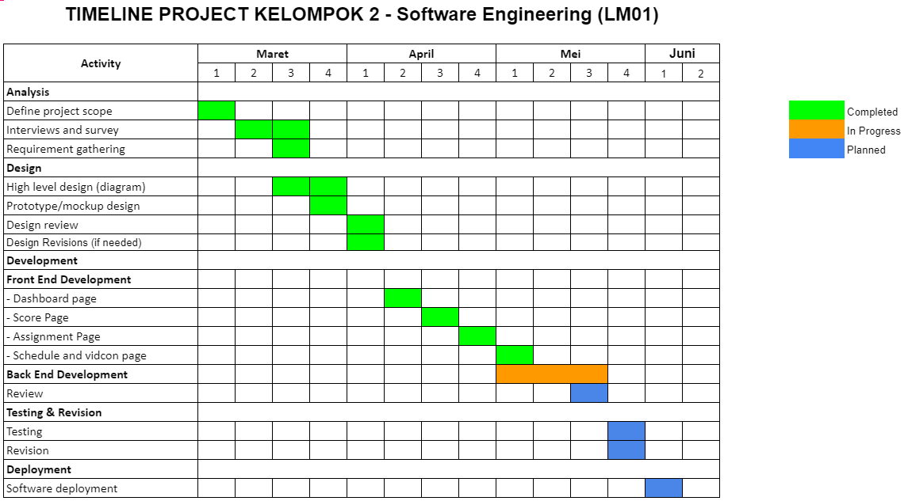
TIMELINE TABLE - WATERFALL PROCESS MODEL
Update: Mei 18, 2021

Slide 5
Team Organization
Project Manager
Austin Andika T
(2301860261)
Developer
Chandra Steven H
(2301860375)
Developer
Brian Samuel
(2301850424)
System Analyst & Design
Marcellino B
(2301866763)
System Analyst & Design
Sesilia Aleria (2301876644)

Slide 6
Table of Contents
Project Explanation Page 2
Process Model Page 3
Timeline Page 4
Team Organization Page 5
Project Report 1 (Mar 28, 2021) Page 7
Project Report 2 (Apr 4, 2021) Page 57
Project Report 3 (Mei 23, 2021) Page 83

Slide 7
Project Report 1
(Mar 28, 2021)

Slide 8
Project Scope
Our project scope:
Build dashboard page to show general information
Schedule page to view upcoming courses and to join video conference
Assignment page to insert the assignment (teacher) and upload the answer of the assignment (student)
Score page to input and edit the student score (teacher) and view the student score (student)

Slide 9
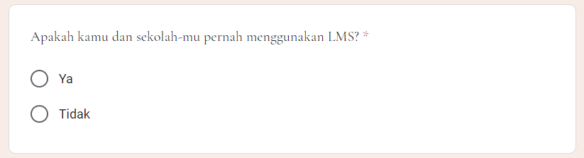
Survey
Link gform: https://forms.gle/Z6Ncp8Qaw93DXswKA

Slide 10
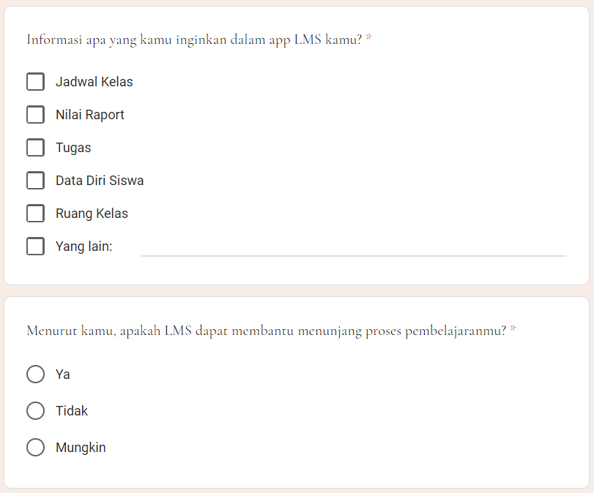

Slide 11
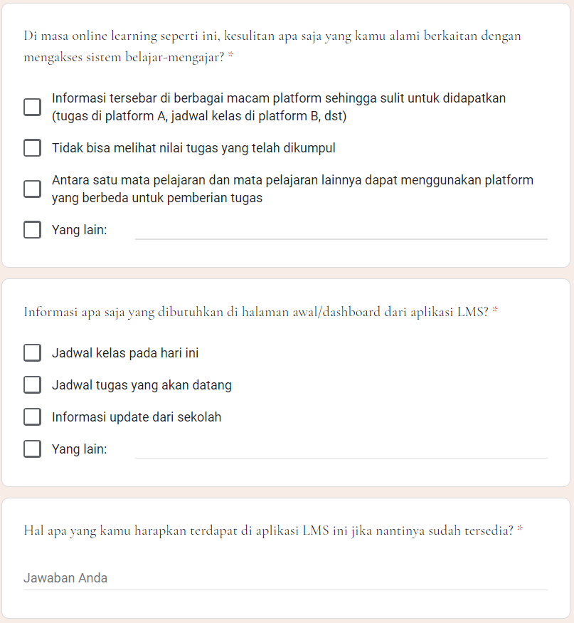

Slide 12
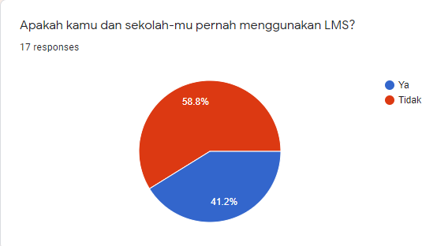
Survey Summary
From 17 Students that answered the form, 10 out of 17 students have never used LMS yet.

Slide 13
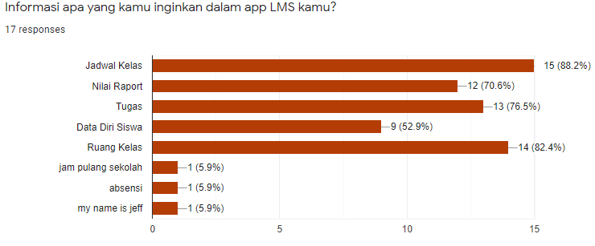
The top 3 information needed by the respondents are : Schedule, Class Number, Assignment

Slide 14
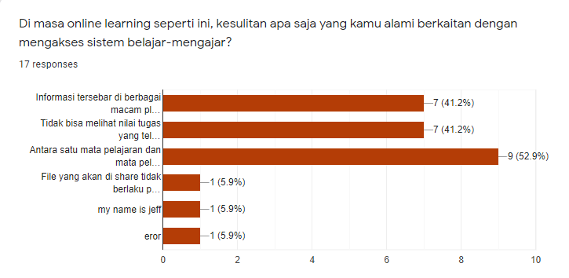
The main problem that the respondents having are, there are no platform that contains all of the information they needed to enhance their education purpose.

Slide 15
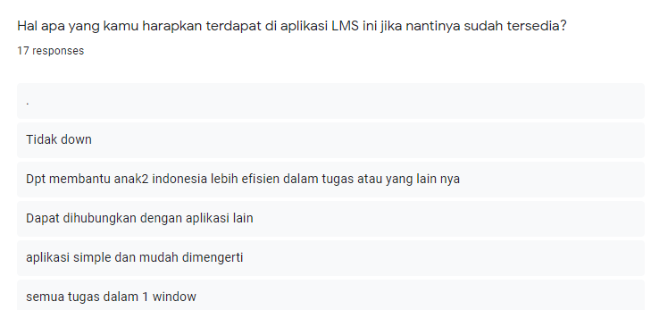
They hope to get application that are simple and integrated. Also, it has to contain all the integral information needed to support learning progress such as : Schedule, Assignment, Class number, Attendance, etc. We need to make a quick guide tour to our LMS and the most important thing is to make sure the app wont go down in any circumstances.

Slide 16
Interview Plan
System: LMS System
Participant: - Endang Wurnyaningsih (High-School Teacher)
Date : Mar 20, 2021 | Time : 14.00 | Duration : 30 minutes | Place : Zoom Meeting
Purpose of Interview : Gathering information about the problem with the current system, the needs of LMS, and the information that needs to be displayed in the LMS application.
Agenda : Current situation for learning management in the school Problems in school activity management Needs of features that should include in the LMS Initial idea from user point of view
Documents to be brought to interview :

Slide 17
Interview Questions
Is there an management application/ software for managing courses in your school environment?
If yes, then please explain how the application works, if possible please show us the application.
If no, then how do you communicate with the students about scoring, assignments, and class schedule?
Is there any difficulties in participating in your current learning system?
What features do you think would be helpful if we were to develop a learning management system?
What essential information that needs to be displayed the first time that you open an LMS app (homepage/dashboard)?
Would you use the application if it were to be developed? Is there any additional ideas?

Slide 18
Interview Summary
System: LMS System
Participant: - Endang Wurnyaningsih (High-School Teacher)
Date : Mar 20, 2021 | Time : 16.00 | Duration : 30 minutes | Place : Zoom Meeting
Purpose of Interview : Gathering information about the problem with the current system, the needs of LMS, and the information that needs to be displayed in the LMS application.
No | Item | Action
1 | Difficulty informing students about schedules and assignments due to unintegrated platforms | Build a system that integrate all features that needed by the school in one platform
2 | Manually input the student score with paper-based that can cause miscalculation, hard to do, and easy to lose if something bad happens (paper lost, wet, or burned) | Make system-base scoring, so teacher only needs to store the student score in the web application and it will automatically calculated the score and store it in the database.

Slide 19
List Of Requirement
No | Item | Action
3 | Difficulty in obtaining the latest information updates from the school | Displays all the latest information from the school on the dashboard of the website
4 | The need for a website that is easy to understand | Build a simple website that including all the features and easy-to-understand
R1 : Make a push notification about Classes, Assignment. (From Questionnaire Number 6)
R2 : Make an automated score calculation system from input. (From Interview with High-School Teacher, Question Number 5)
R3 : Slideshow of information in dashboard page (From Questionnaire Number 7 and
From Interview with High-School Teacher, Question Number 3)
R4 : Simple and commonly used GUI (From Questionnaire Number 8 and From Interview with High-School Teacher,
Question Number 6 and 9)
R5 : Make an integrated platform for education purposes (From Questionnaire Number 8 and From Interview with High-School Teacher,
Question Number 1)

Slide 20
Problem Definition
Client: Students & Teachers (Elementary - High School)
Problems:
Students have difficulty in gathering the latest information from the school
Unintegrated learning platform is still being used
The lack of ease to use learning platform
Conventional Reporting system has higher error probability

Slide 21
Objectives of the new system:
To create an Integrated learning system that can assist Students & Teachers in learning activity
To provide students with the latest information from school
To Create an Easy to use Learning platform that is accessible to both Teachers and Students
To reduce Error in Report making system

Slide 22
Scope of new system :
Dashboard to show all school informations
Class scheduling procedures
Student grade procedures
Student assignment procedures
Preliminary ideas :
Build a system that resembles the current system
Design a user-friendly and easy to use web application
Design a responsive web application
Recommended Action :
Design what student and teacher need based on survey and interview we took

Slide 23
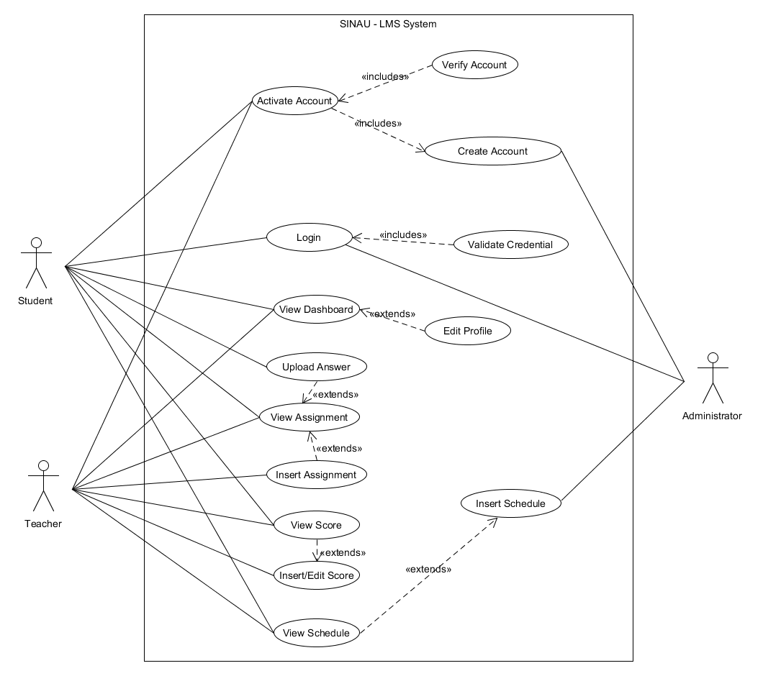
Use Case Diagram

Slide 24
Use Case Description
Use case : Create Account
Preconditions : -
Actors : Administration
Goal : To create student and teacher account
Overview:
When Students and Teachers register at school, then the admin will register it to LMS account.
Cross-reference: R5, R4
Actor action | System response
Student or teacher enroll to school Administrator registers the student and teacher to the system | Insert the data into database

Slide 25
Use Case Description
Use case : Activate Account
Preconditions : ‘Create Account’ must have been executed
Actors : Student, Teacher
Goal : To activate student/teacher account that has been registered
Overview:
After administrator register the account, student and teacher can activate the account and create email, password to login to the lms.
Cross-reference: R4, R5
Actor action | System response
Student/teacher input the ID (NISN/NIGN) Input email and password for login to the LMS | Verify the ID inputted by user Create a user account and store to the database

Slide 26
Use Case Description
Use case : Login
Preconditions : -
Actors : Student, Teacher, Administrator
Goal : Login to the LMS System
Overview:
After student and teacher successfully register and activate the account, user can login to the system. Administrator also can login to the system.
Cross-reference: R5, R4
Actor action | System response
Student/teacher/administrator input email and password | Verify the email and password Create a user session to the system

Slide 27
Use Case Description
Use case : View Dashboard
Preconditions : ‘Login’ must have been executed
Actors : Student, Teacher
Goal : To display all of the dashboard and school informations
Overview:
Dashboard will display latest informations from school, upcoming class schedule, and user information.
Cross-reference: R3, R4
Actor action | System response
 | Request session from Login information Generate all dashboard informations from database

Slide 28
Use Case Description
Use case : View Assignment
Preconditions : ‘Login’ must have been executed
Actors : Student, Teacher
Goal : To display all of the assignments that given by teacher to student
Overview:
Student and teacher can view all of the assignments
Cross-reference: R1, R4
Actor action | System response
User clicked the Assignment tab | 2. Request session from Login information 3. Generate assignment data from database based on the session

Slide 29
Use Case Description
Use case : Insert Assignment
Preconditions : ‘Login’ must have been executed
Actors : Teacher
Goal : To insert the assignment that inserted by teacher
Overview:
Teacher can give assignment to the student
Cross-reference:R1, R4, R5
Actor action | System response
Assign assignment to a specific class | Request session from Login information Insert assignment to database and show in the student assignment

Slide 30
Use Case Description
Use case : Upload Answer
Preconditions : ‘Login’ must have been executed
Actors : Student
Goal : To upload the answer of the assignment
Overview:
Student can upload the answer of the assignment that given by the teacher
Cross-reference: R4, R1, R5
Actor action | System response
Upload the answer of the assignment | Request session from Login information Insert the answer to the system

Slide 31
Use Case Description
Use case : View Score
Preconditions : ‘Login’ must have been executed
Actors : Student, Teacher
Goal : To display the score of specify student
Overview:
Student and teacher can view score
Cross-reference: R4, R2
Actor action | System response
User clicked the score tab | 2. Request session from Login information 3. Generate score data from database based on the session

Slide 32
Use Case Description
Use case : Insert/Edit Score
Preconditions : ‘Login’ must have been executed
Actors : Teacher
Goal : To insert score for specify student
Overview:
Teacher can insert score for specify student
Cross-reference:R2,R4
Actor action | System response
Insert score for specify student | Request session from Login information System insert the score to the database and student can view the score

Slide 33
Use Case Description
Use case : View Schedule
Preconditions : ‘Login’ must have been executed
Actors : Student, Teacher
Goal : To display the class schedule
Overview:
Student and teacher can view the class schedule and video conference link
Cross-reference: R4, R1
Actor action | System response
User clicked the schedule tab | 2. Request session from Login information 3. Generate schedule data for teacher and student from database.

Slide 34
Use Case Description
Use case : Insert Schedule
Preconditions : ‘Login’ must have been executed
Actors : Administrator
Goal : To insert schedule for each class
Overview:
Administrator can insert schedule for each class that enrolled by student
Cross-reference: R4
Actor action | System response
3. Administrator Inserted the schedule for specific class | Request session from Login information Generate schedule data for each school class from database.

Slide 35
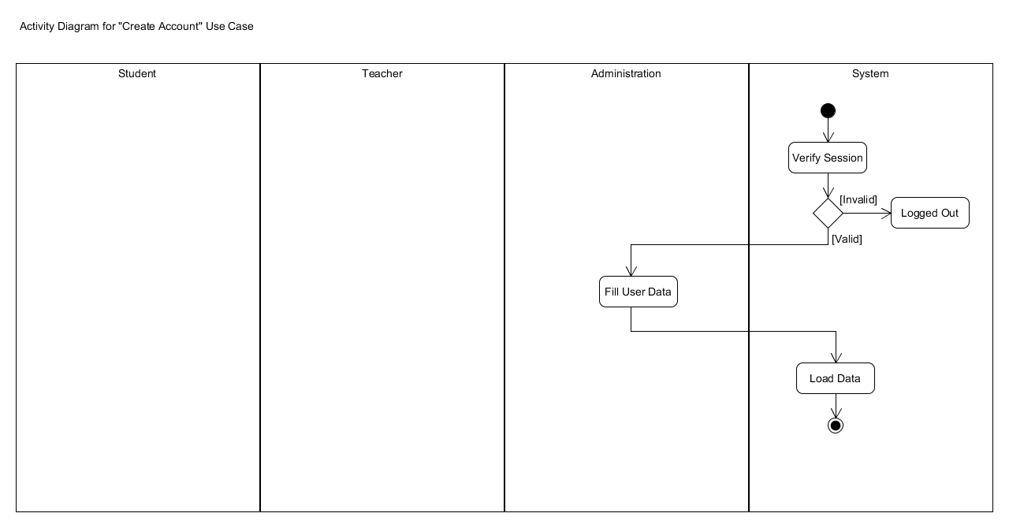
ACTIVITY DIAGRAM

Slide 36
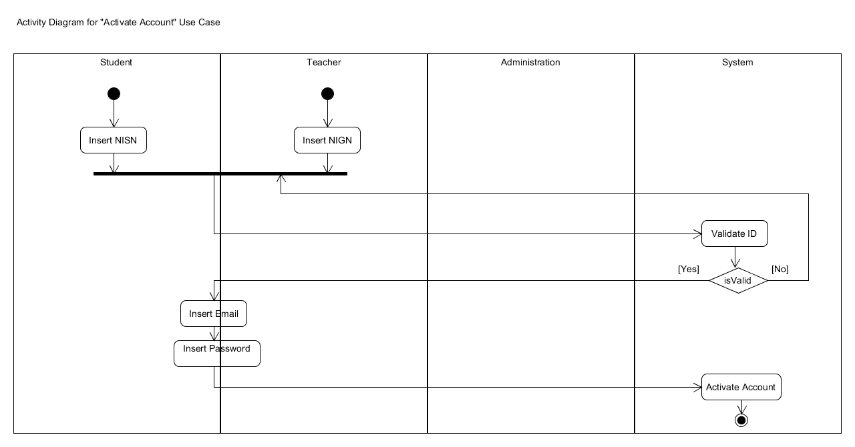
ACTIVITY DIAGRAM

Slide 37
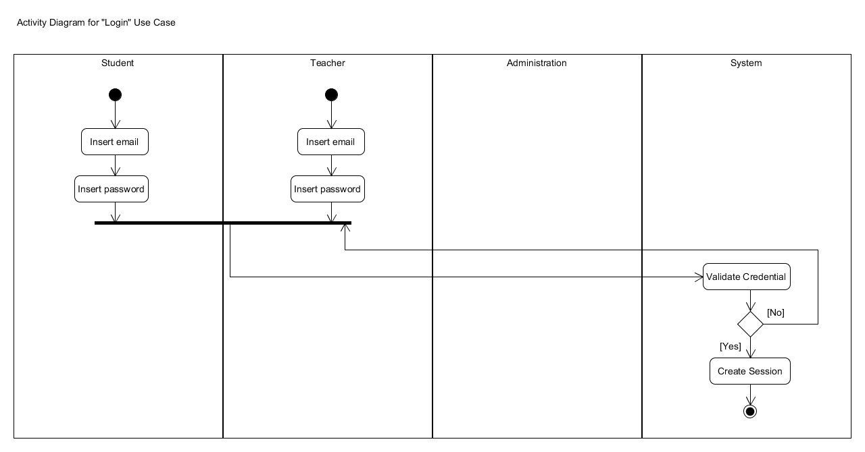
ACTIVITY DIAGRAM

Slide 38
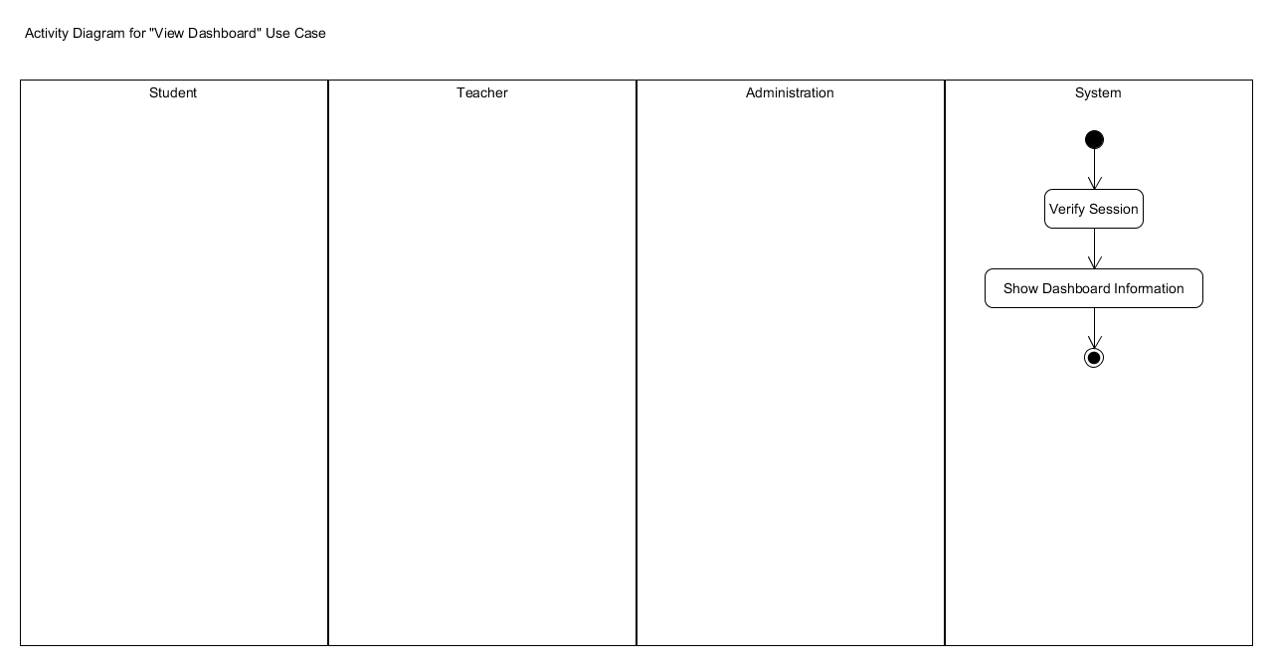
ACTIVITY DIAGRAM

Slide 39
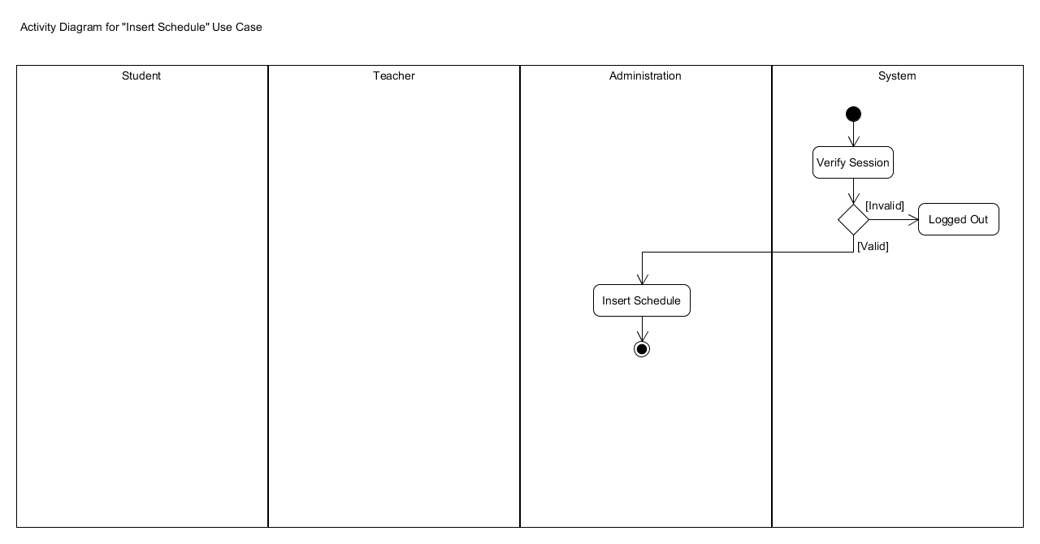
ACTIVITY DIAGRAM

Slide 40
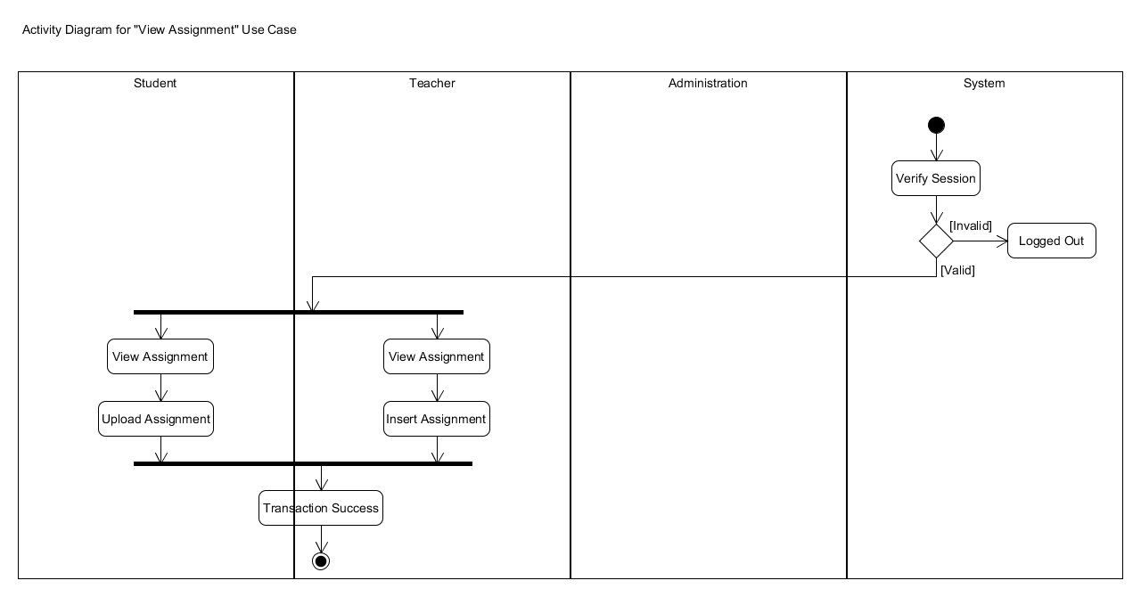
ACTIVITY DIAGRAM

Slide 41
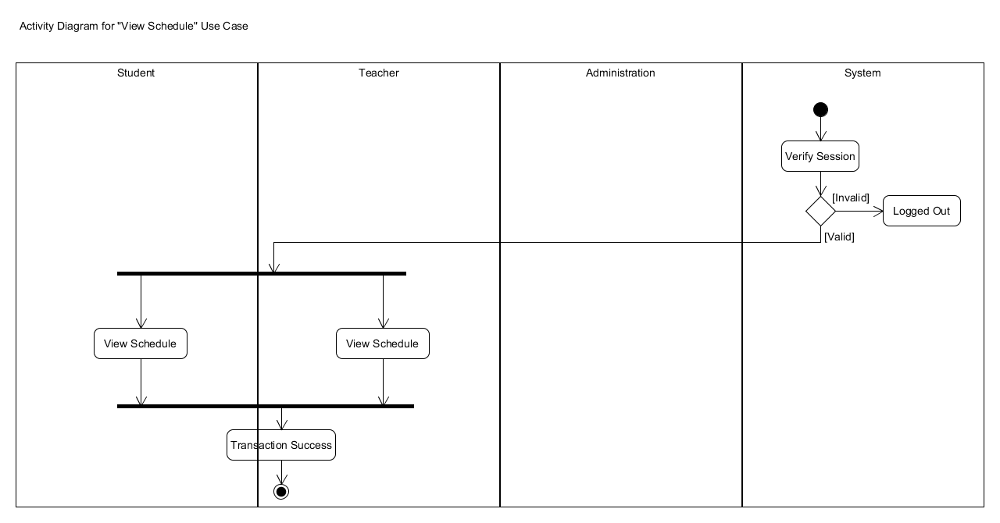
ACTIVITY DIAGRAM

Slide 42

ACTIVITY DIAGRAM

Slide 43
CRC (Class Responsibility Collaboration)
Teacher
Responsibility | Collaborator
Add Assignment | Assignment
Input Score | Score
View Teacher Dashboard | Dashboard
View Student Answer | Assignment
Administrator
Responsibility | Collaborator
Assign Schedule | Schedule
View Admin Dashboard | Dashboard
Create Account
Student
Responsibility | Collaborator
Submit Assignment | Assignment
View Assignment | Assignment
View Student Dashboard | Student
View Score | Score

Slide 44
CRC (Class Responsibility Collaboration)
Dashboard
Responsibility | Collaborator
Print Upcoming Schedule
Print Upcoming Assignment
Display News
User
Responsibility | Collaborator
Get Email
Get Password
View Schedule | Schedule
View Score | Score
Login
Responsibility | Collaborator
Verify Credentials
Create Session

Slide 45
CRC (Class Responsibility Collaboration)
Assignment
Responsibility | Collaborator
Add Assignment
View Assignment
Is Submited
Activate Account
Responsibility | Collaborator
Get ID
Set Email
Set Password
Get Name
Schedule
Responsibility | Collaborator
Add Schedule
Print Schedule

Slide 46
CRC (Class Responsibility Collaboration)
Score
Responsibility | Collaborator
Calculate Total Score
Modify Score
Print Score

Slide 47
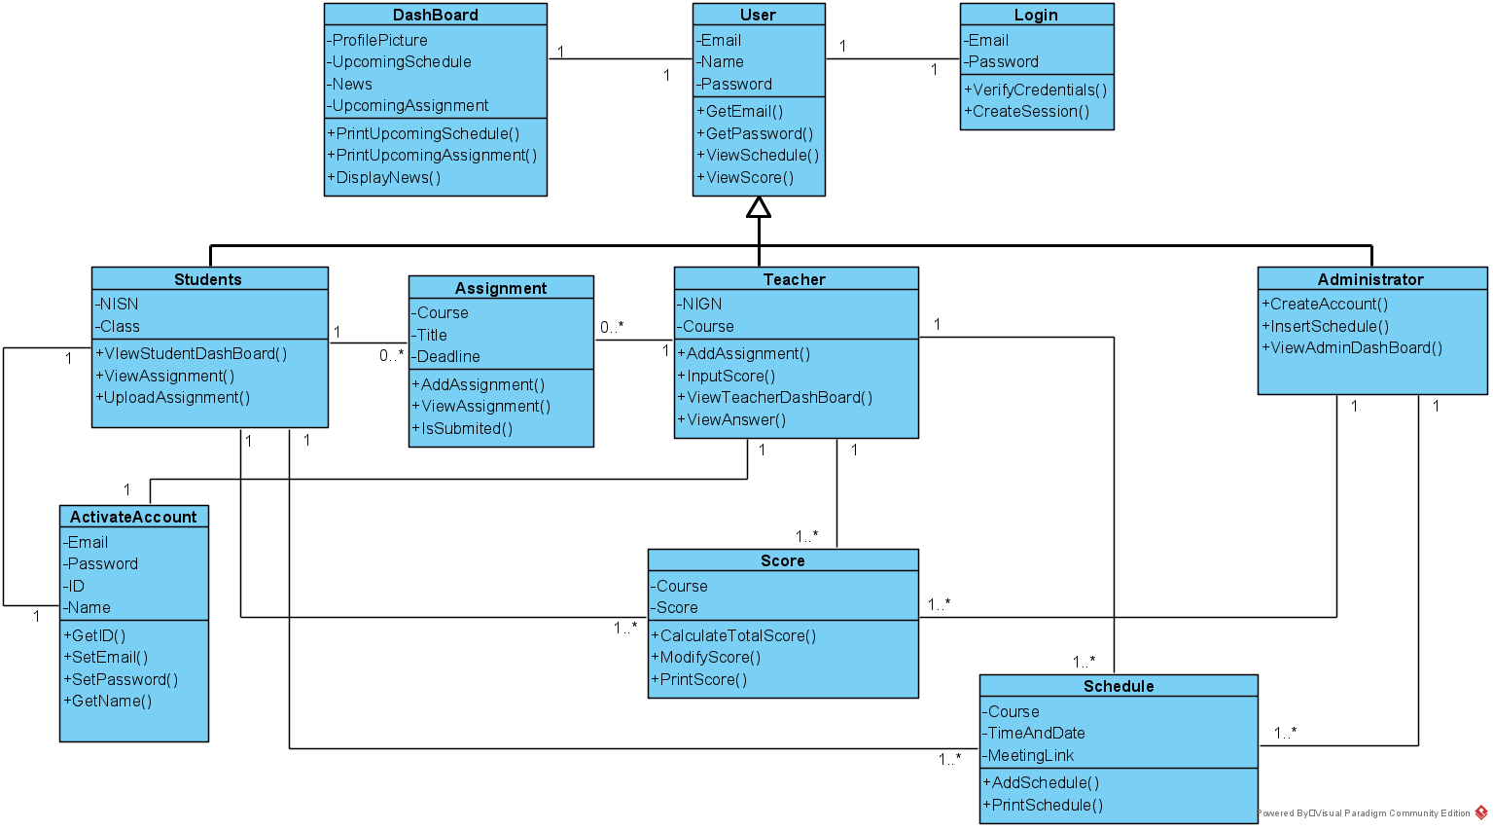
Class Diagram

Slide 48
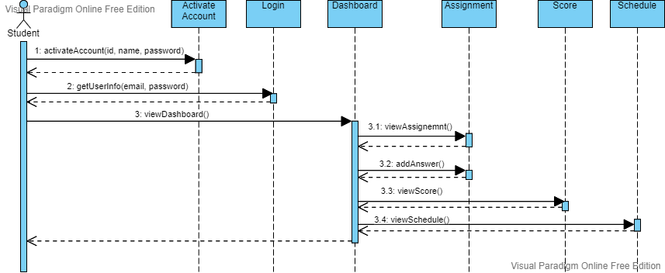
Sequence Diagram

Slide 49
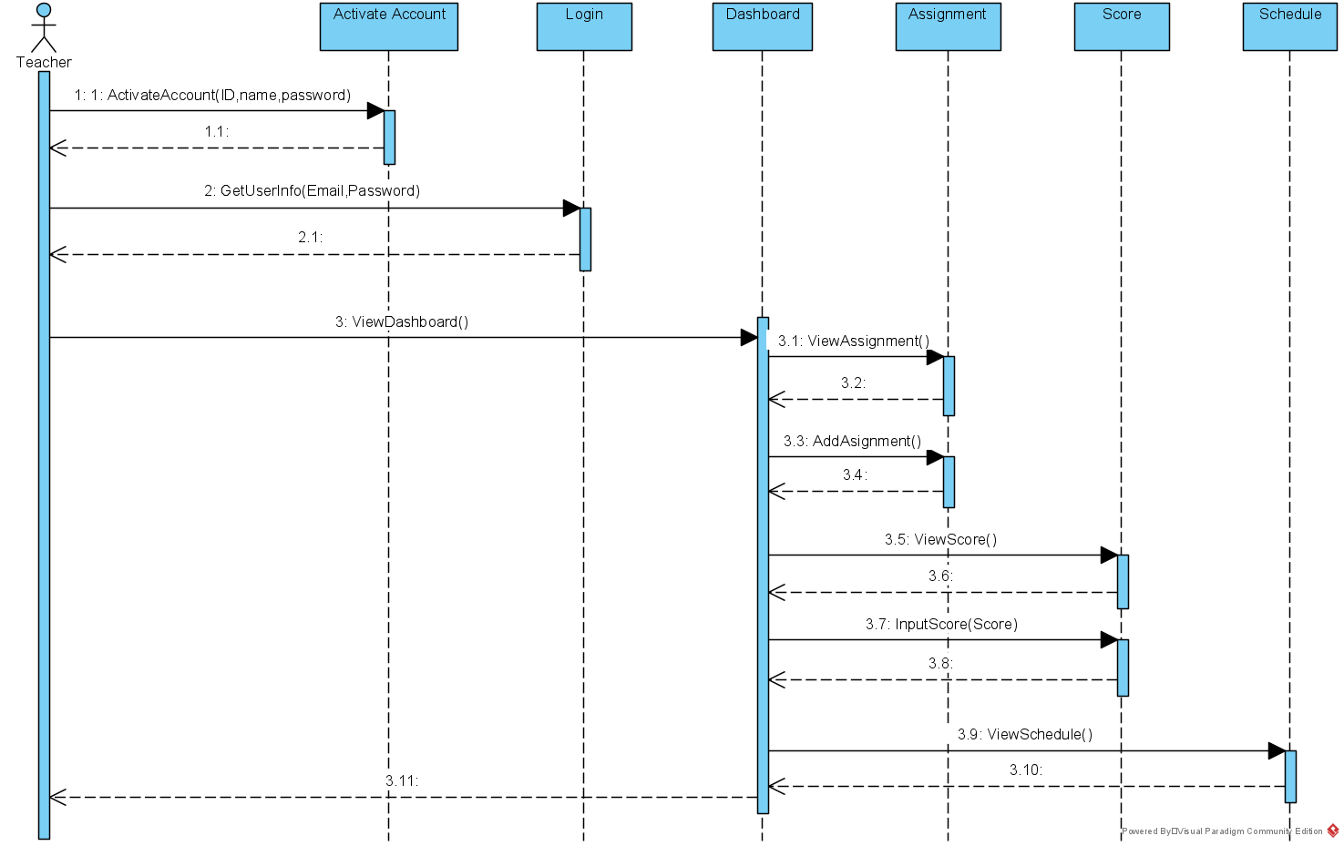
Sequence Diagram

Slide 50
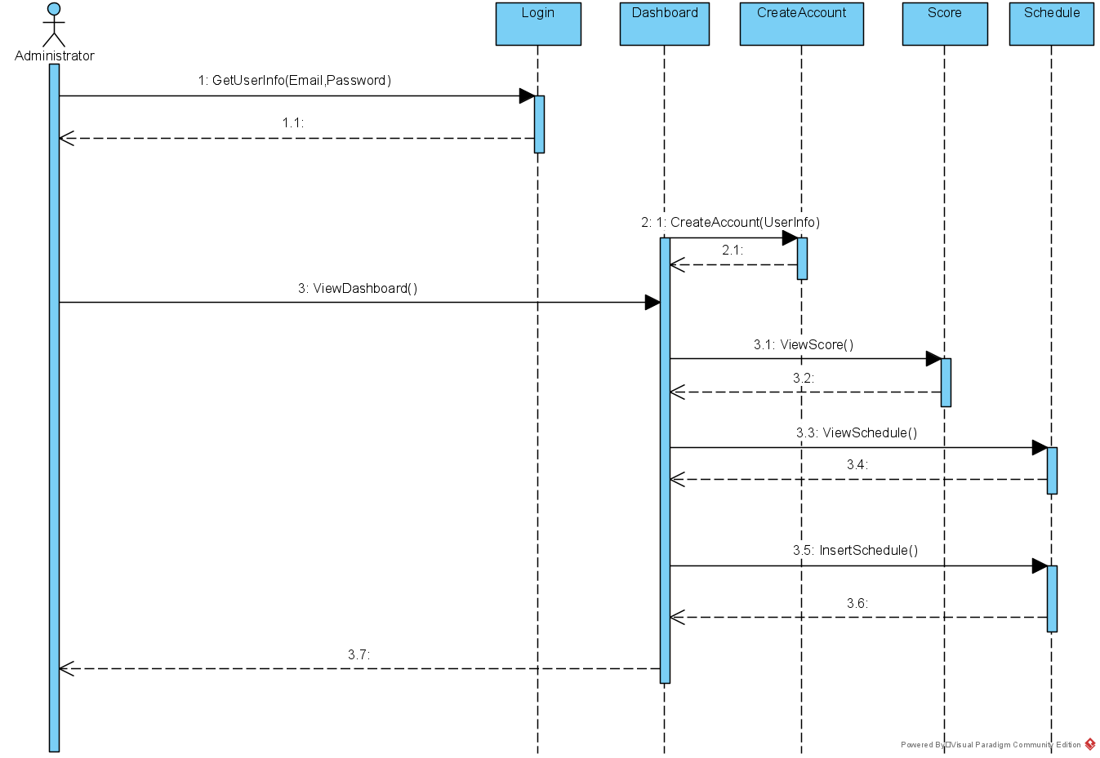
Sequence Diagram

Slide 51
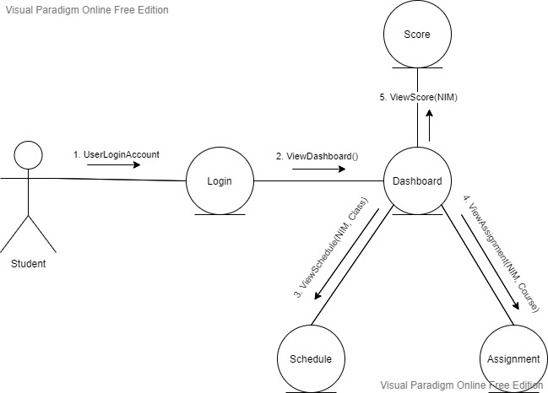
Collaboration Diagram

Slide 52
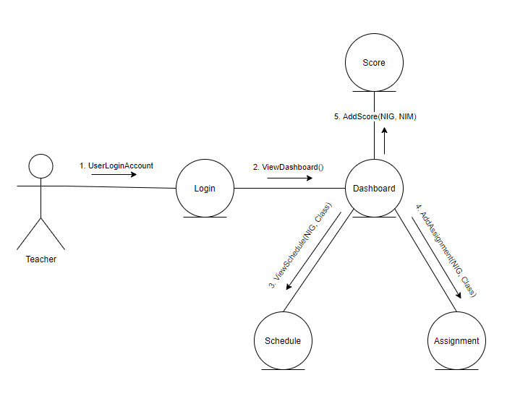
Collaboration Diagram

Slide 53
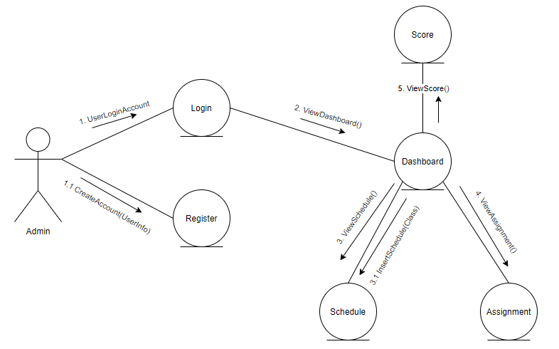
Collaboration Diagram

Slide 54
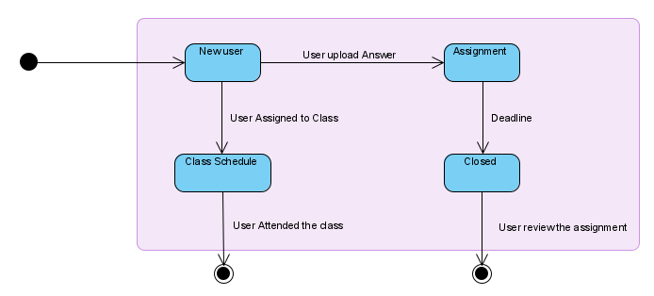
State Diagram Teacher

Slide 55
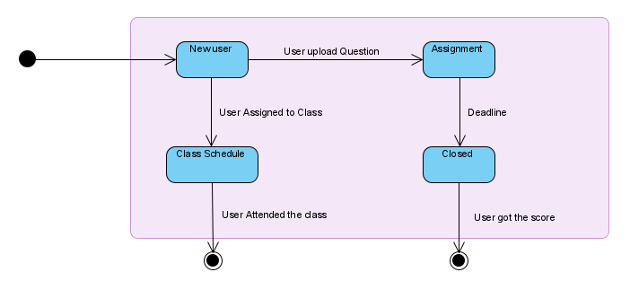
State Diagram Student

Slide 56
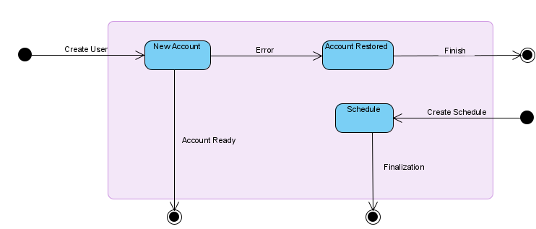
State Diagram Administrator

Slide 57
Project Report 2
(Apr 4, 2021)

Slide 58
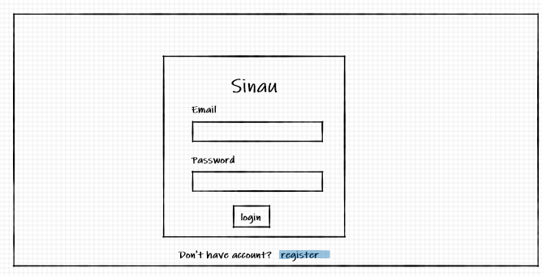
Mockup Design / Wireframe

Slide 59
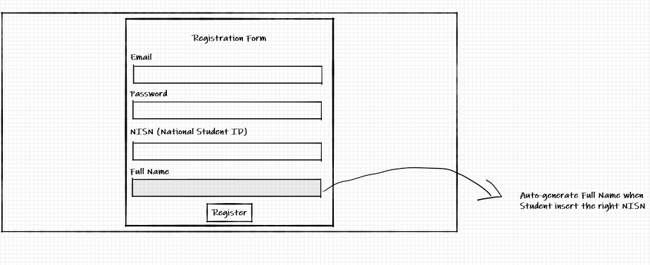
Mockup Design / Wireframe

Slide 60
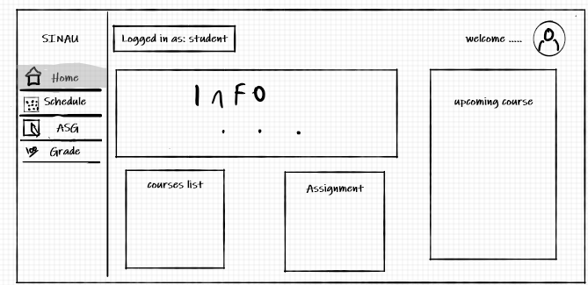
Mockup Design / Wireframe

Slide 61
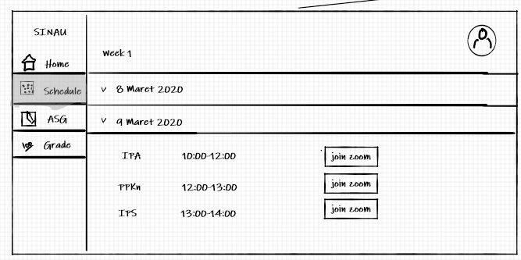
Mockup Design / Wireframe

Slide 62
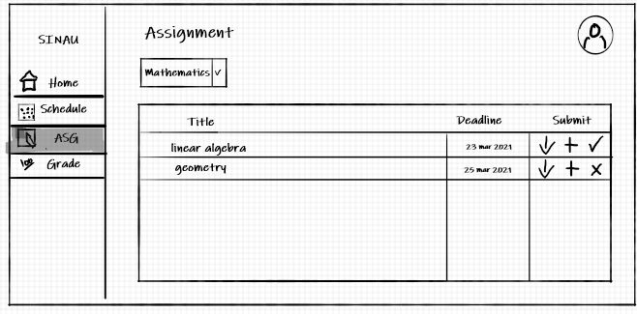
Mockup Design / Wireframe

Slide 63
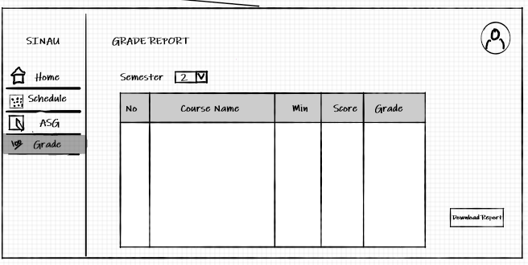
Mockup Design / Wireframe

Slide 64
Prototype
Teacher Page: https://www.figma.com/file/WFYqs1ZwhFJkcO3zP8njr6/prototype?node-id=53%3A544
Student Page: https://www.figma.com/file/WFYqs1ZwhFJkcO3zP8njr6/prototype?node-id=0%3A1
Prototype explanation video:
https://binusianorg-my.sharepoint.com/personal/austin_tanujaya_binus_ac_id/_layouts/15/guestaccess.aspx?docid=0533805491ea0408db88b4a76e81d9292&authkey=Aa9lSWPijRwaY2ijJQfL0fE&e=BoKn7O

Slide 65
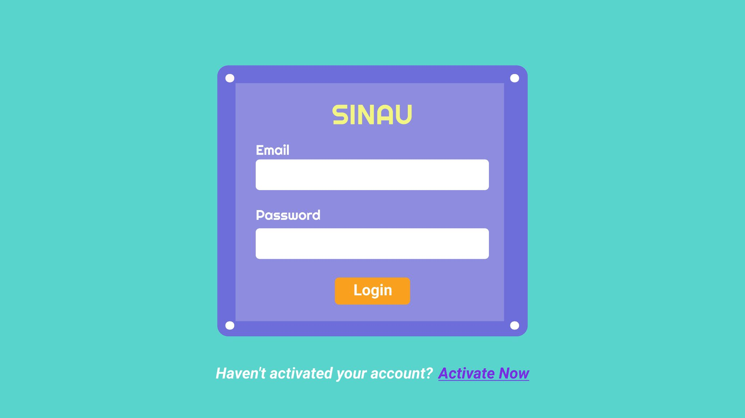
Prototype - Student Page

Slide 66
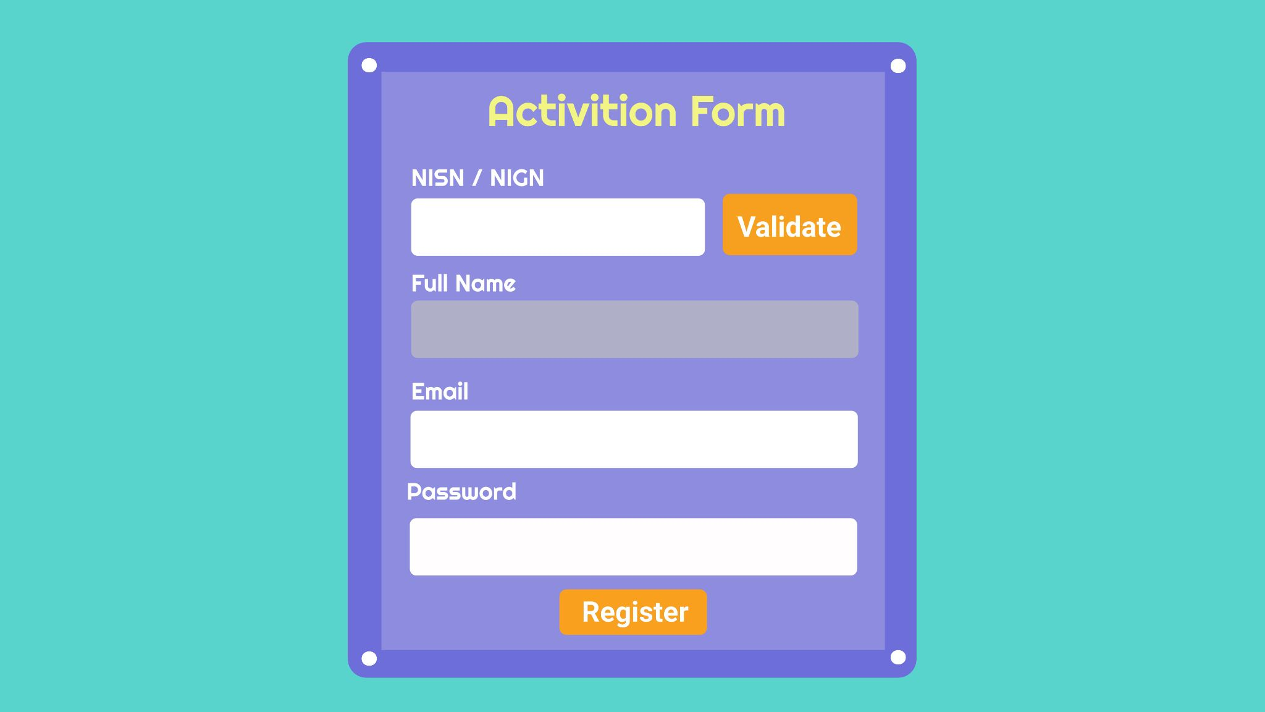
Prototype - Student Page

Slide 67
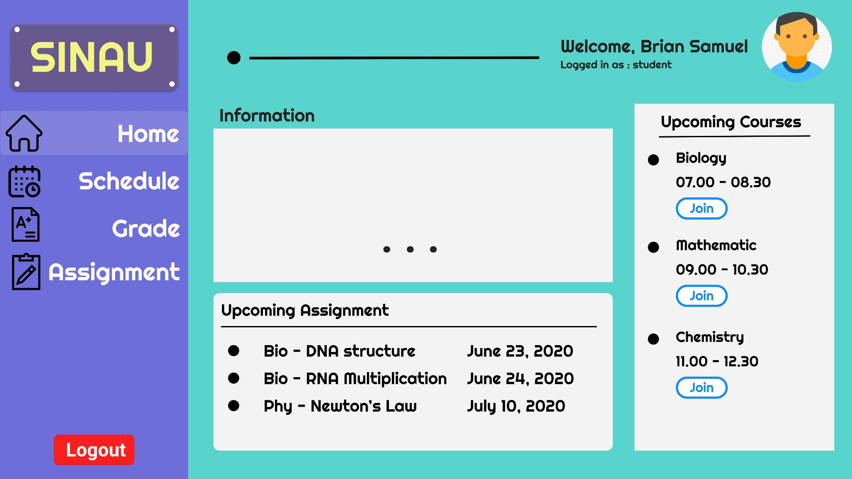
Prototype - Student Page

Slide 68
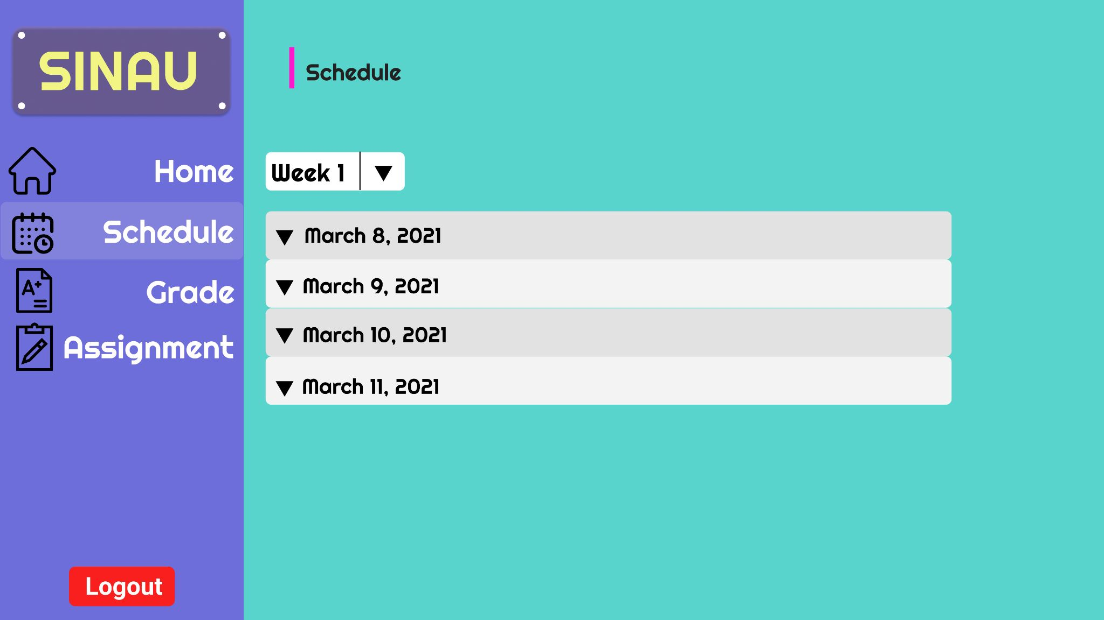
Prototype - Student Page

Slide 69
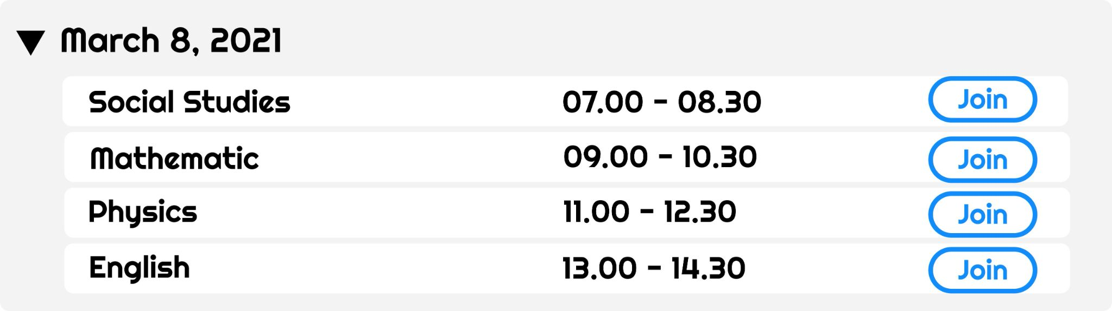
Prototype - Student Page

Slide 70
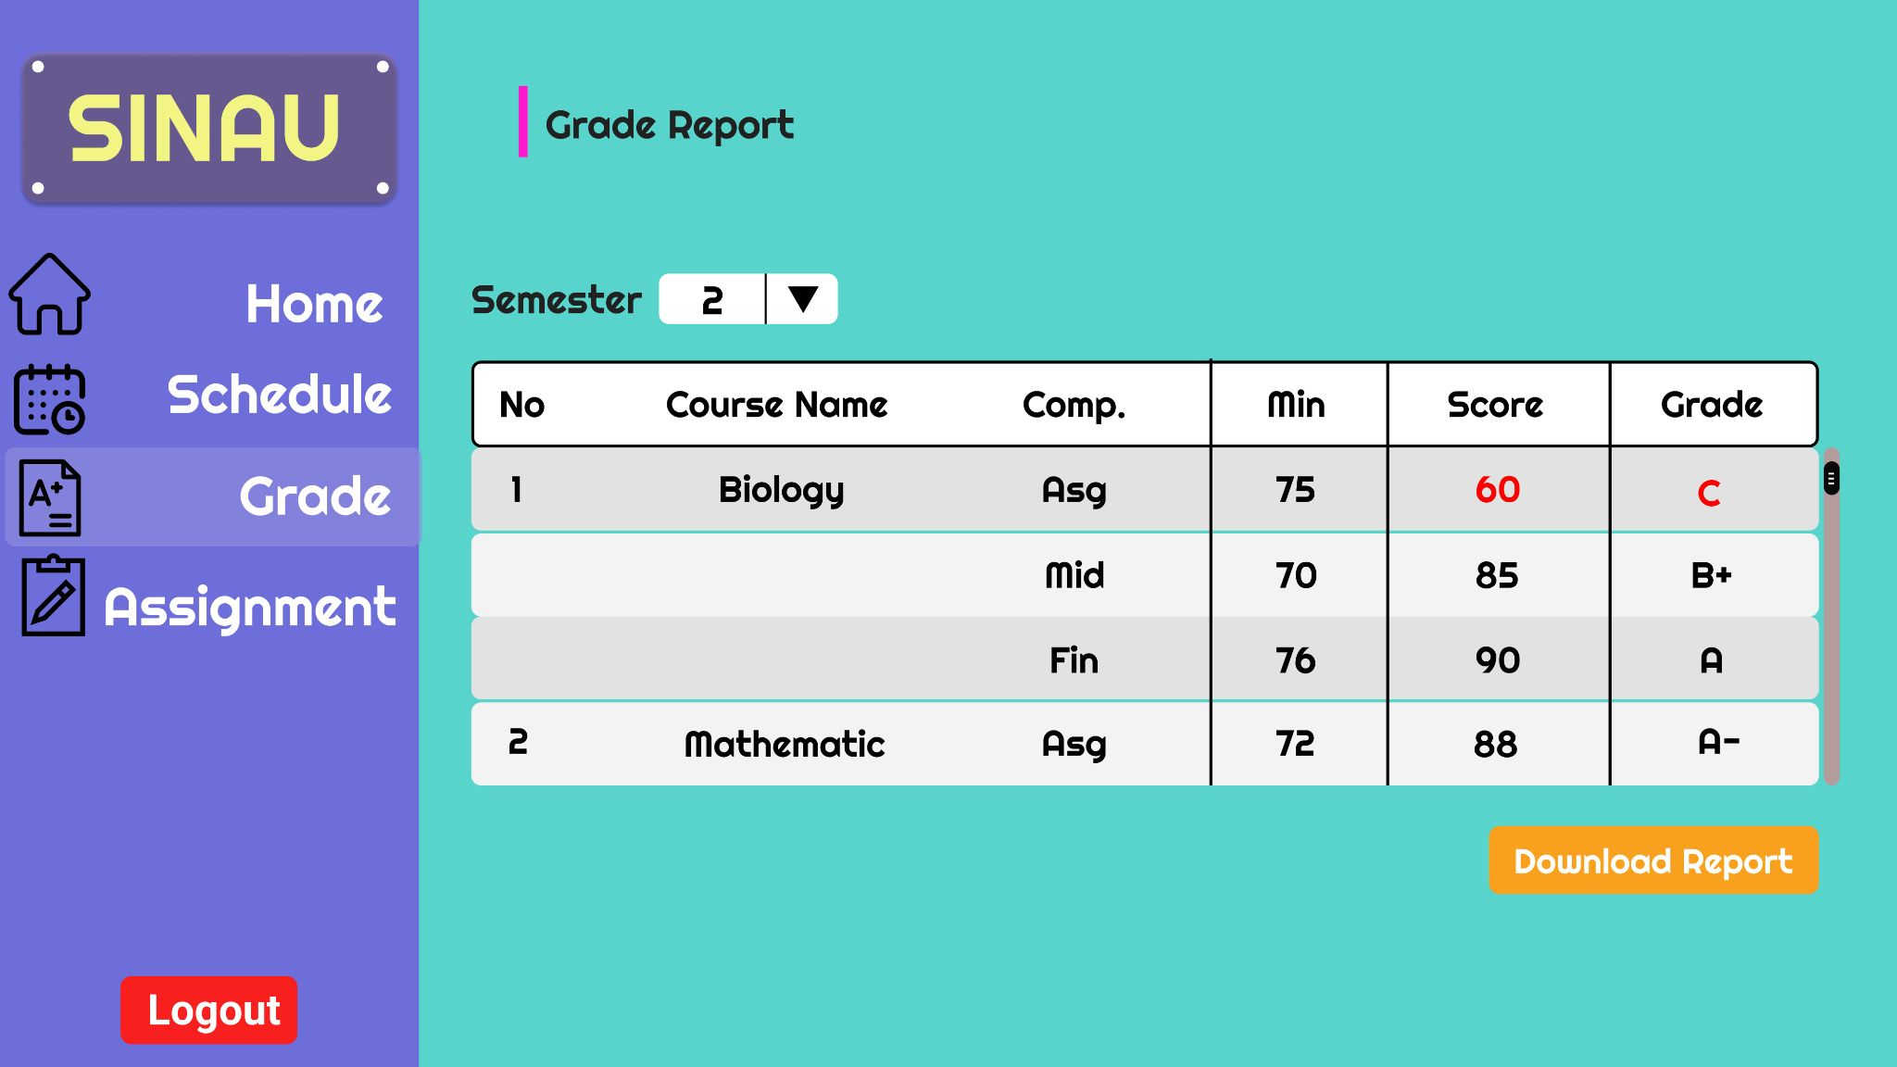
Prototype - Student Page

Slide 71
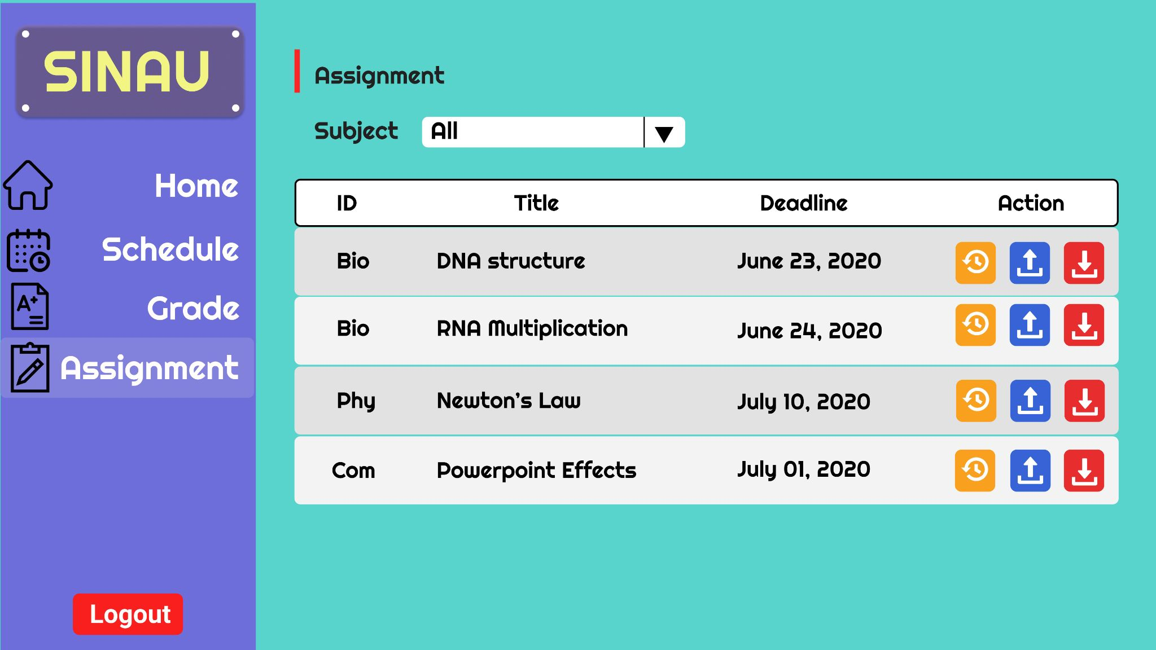
Prototype - Student Page

Slide 72
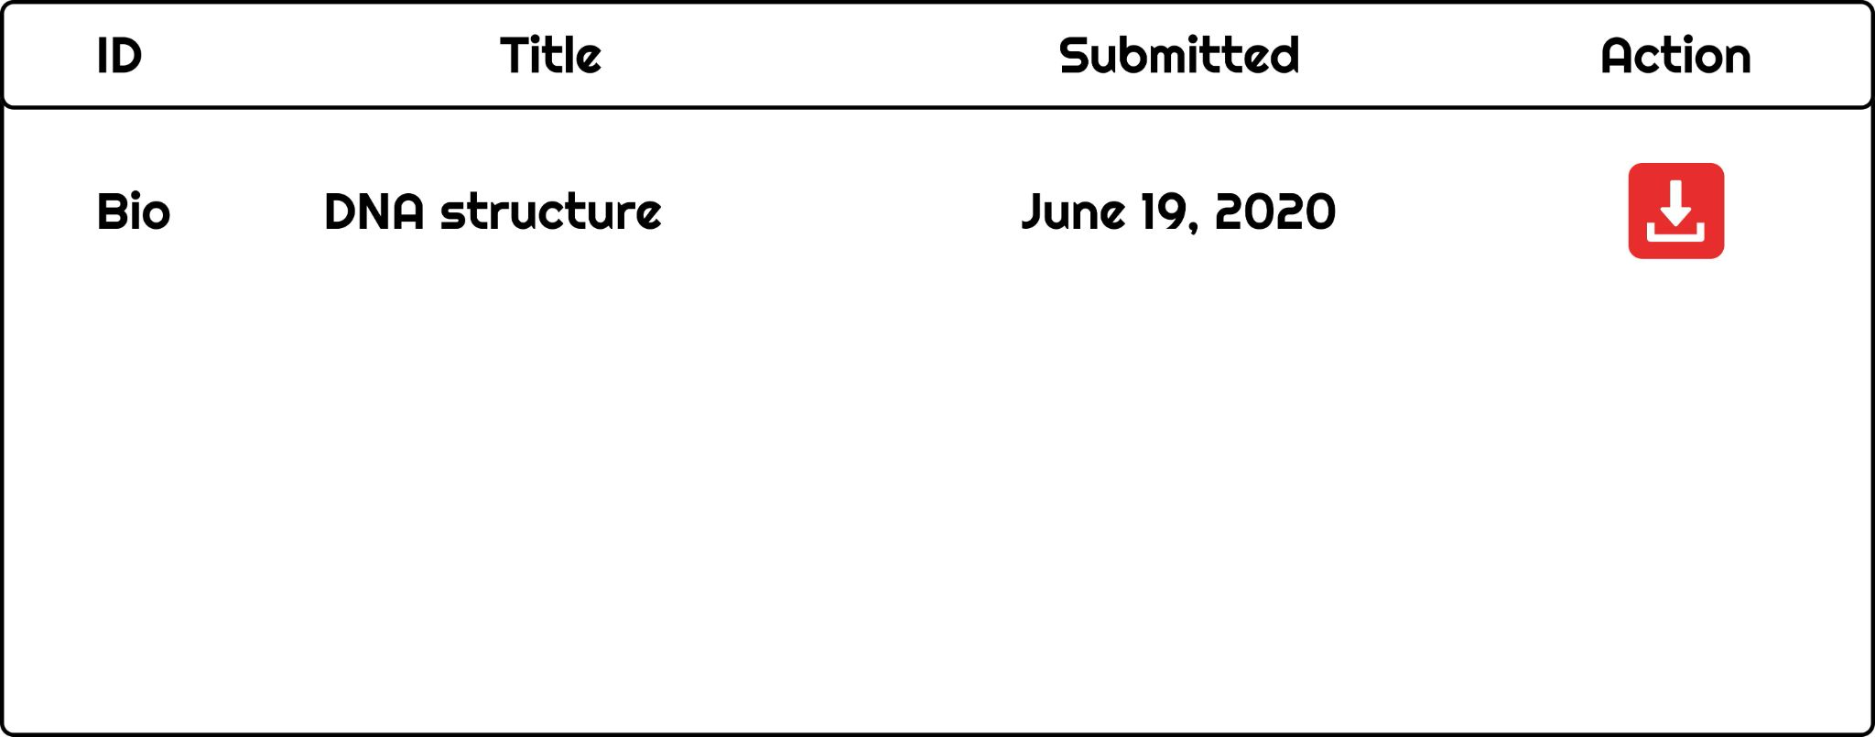
Prototype - Student Page

Slide 73
Prototype - Teacher Page

Slide 74

Prototype - Teacher Page

Slide 75

Prototype - Teacher Page

Slide 76
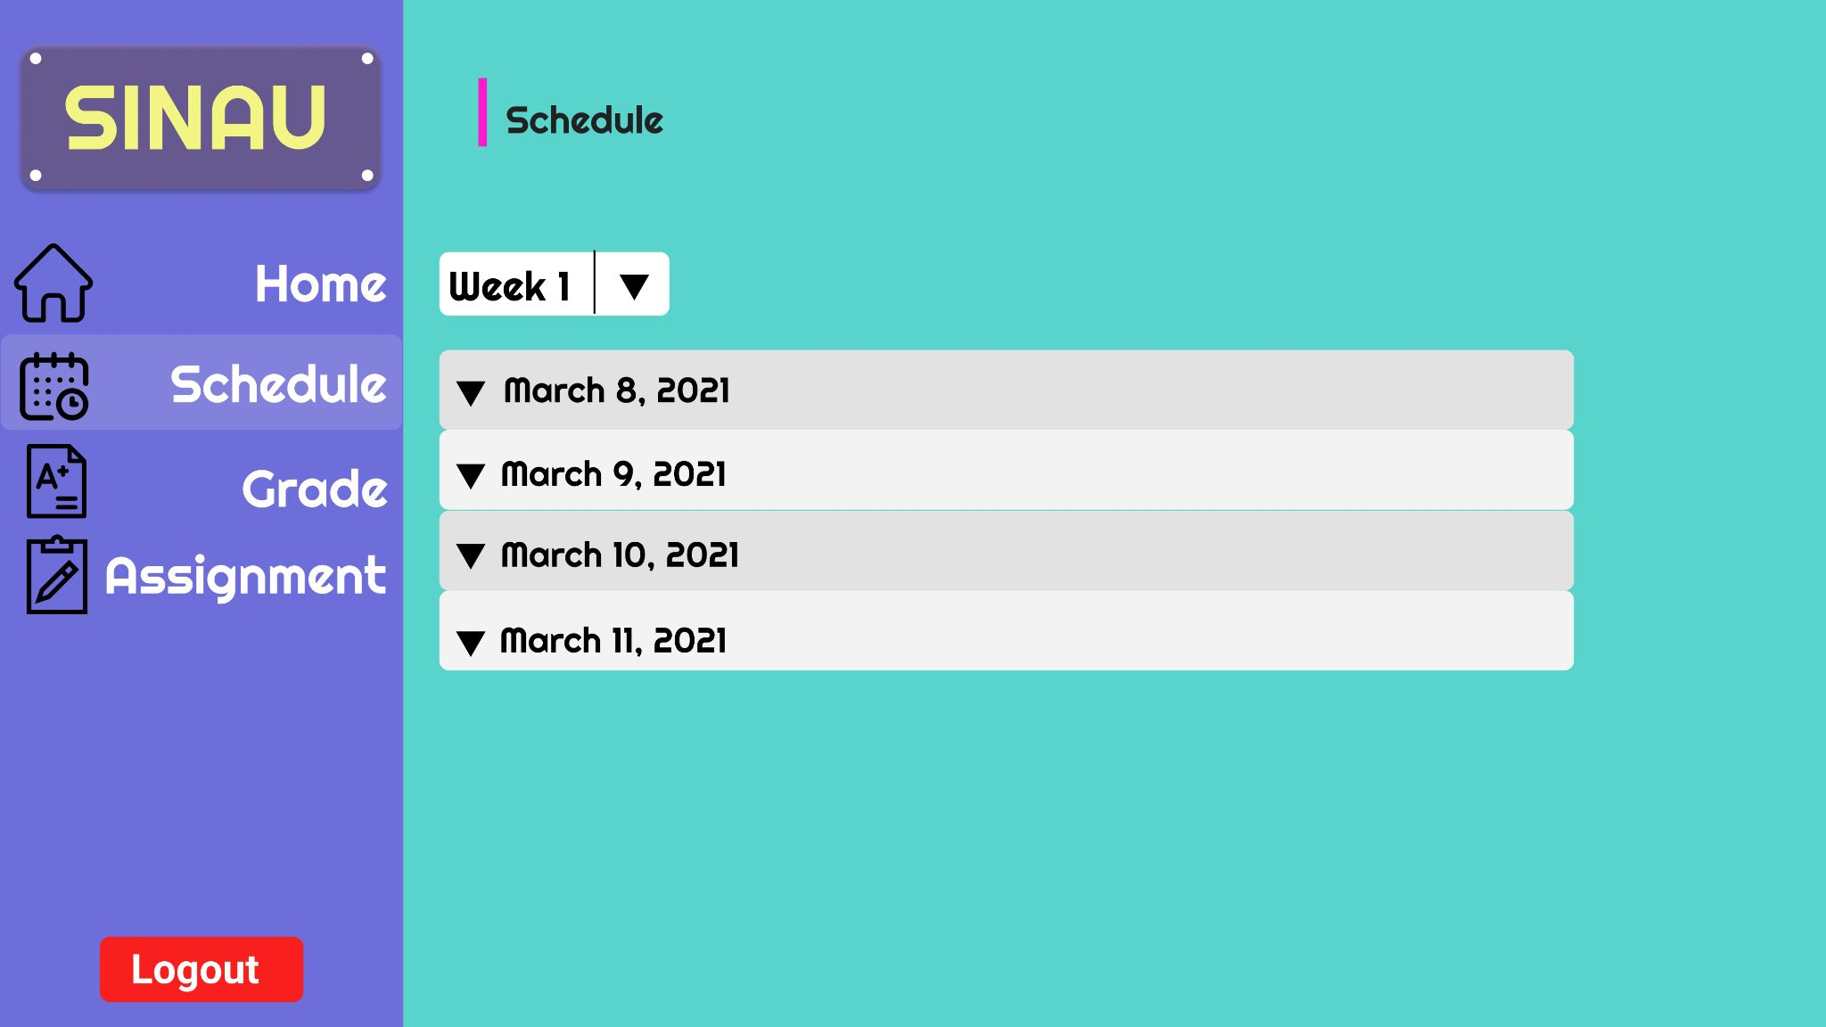
Prototype - Teacher Page

Slide 77
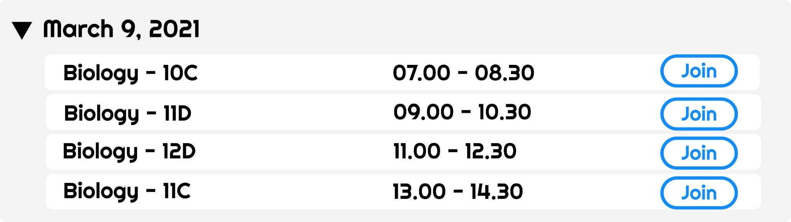
Prototype - Teacher Page

Slide 78
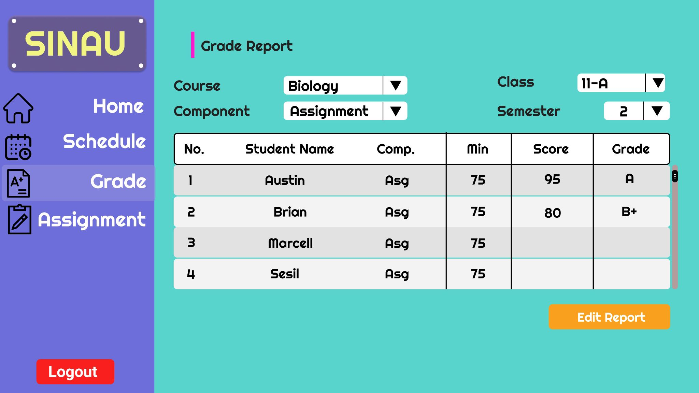
Prototype - Teacher Page

Slide 79
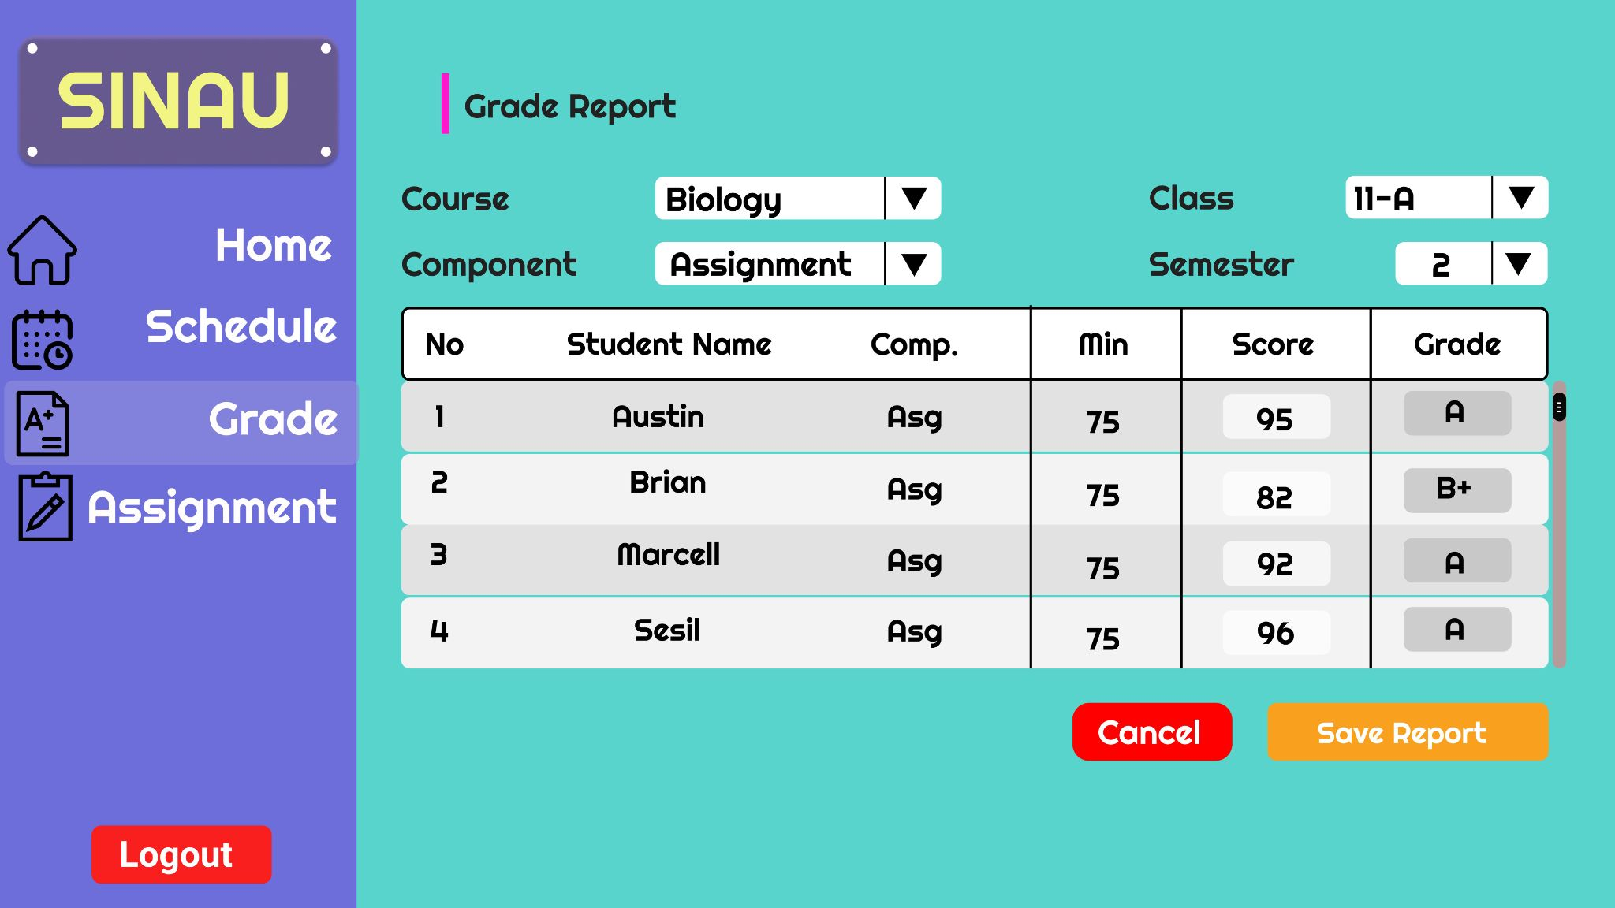
Prototype - Teacher Page

Slide 80
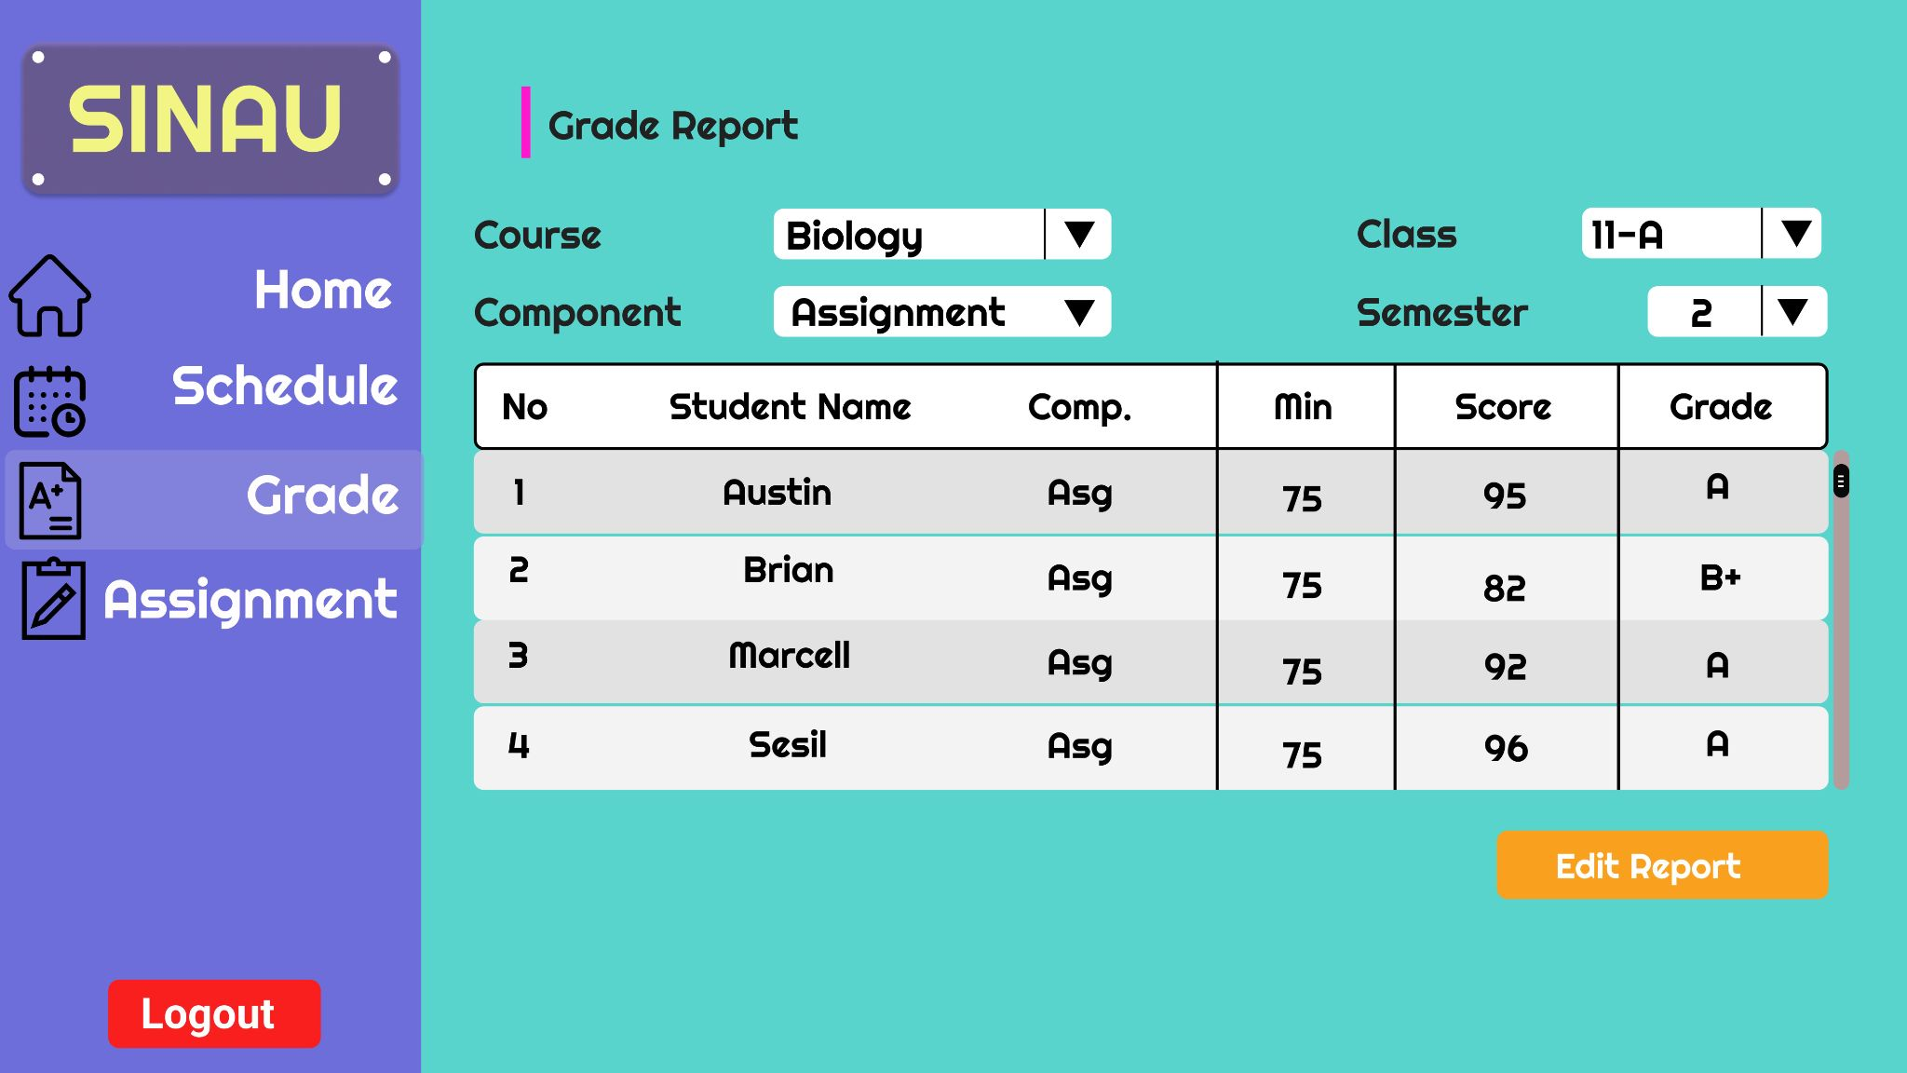
Prototype - Teacher Page

Slide 81
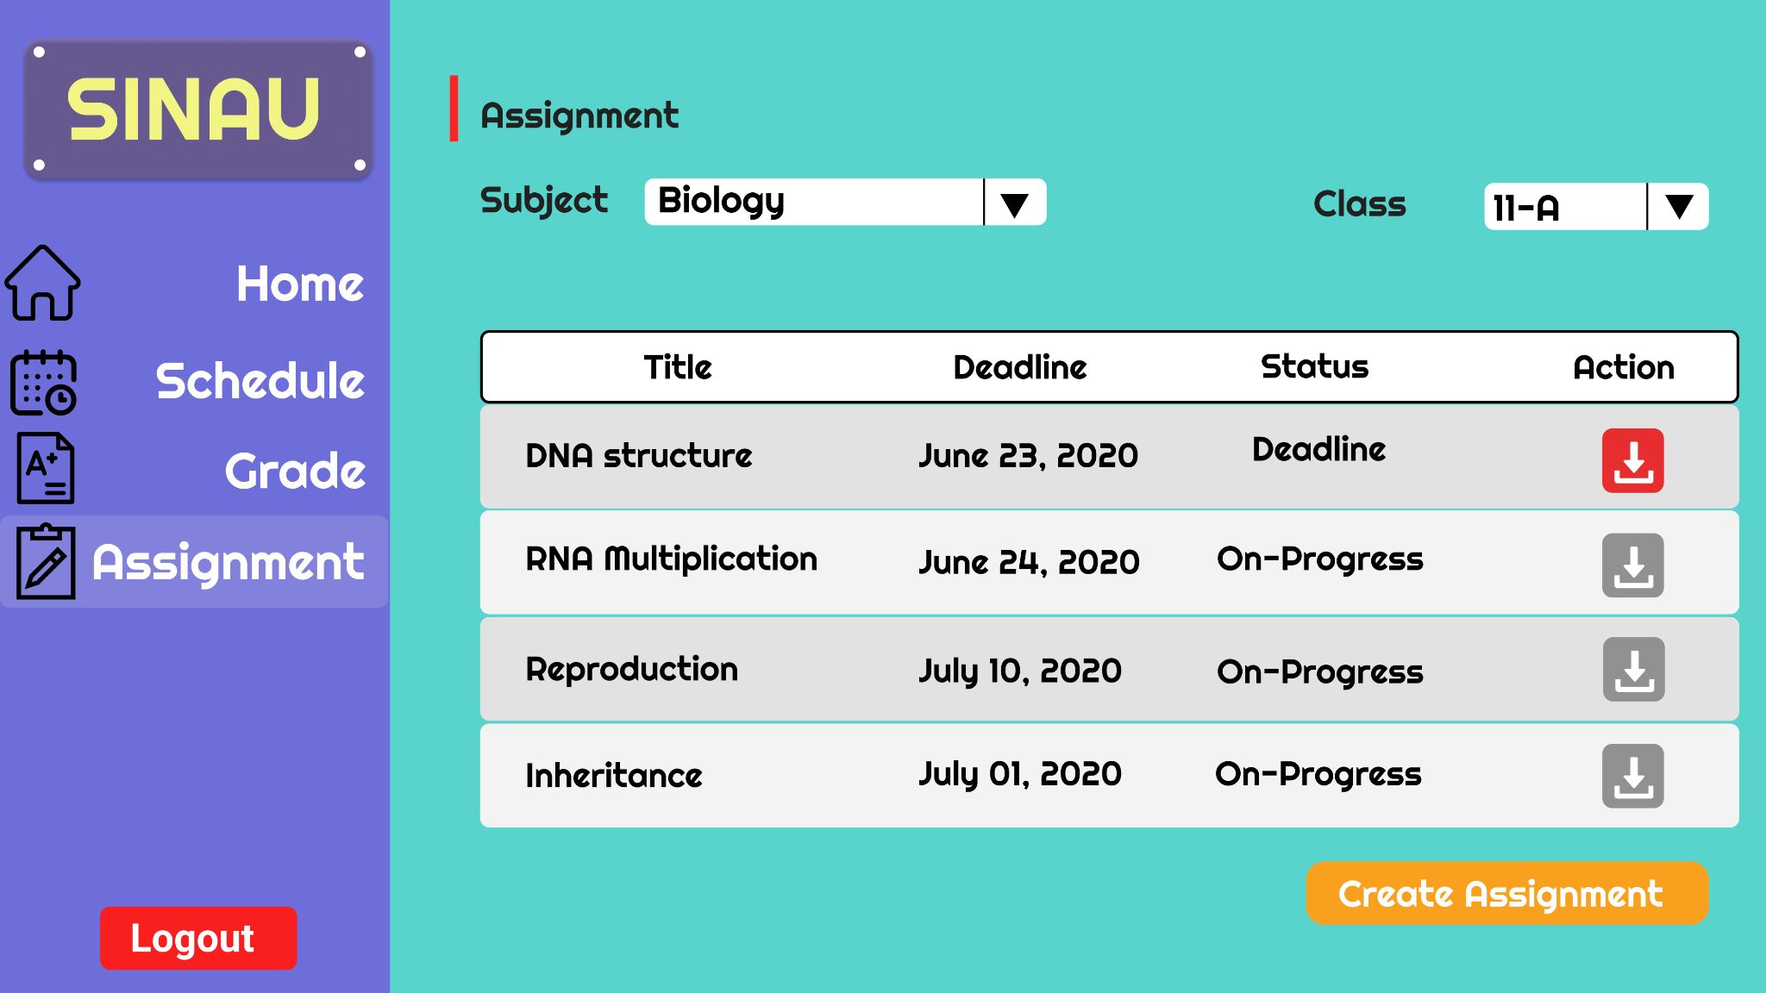
Prototype - Teacher Page

Slide 82
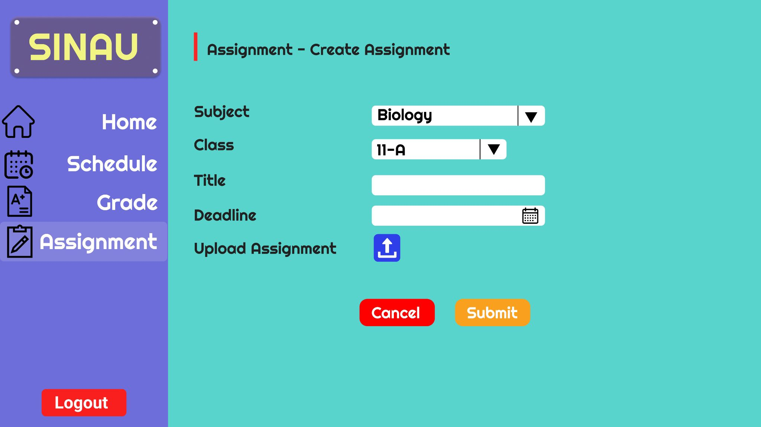
Prototype - Teacher Page

Slide 83
Project Report 3
(Mei 23, 2021)

Slide 84
Prototype Design Revision

Slide 85
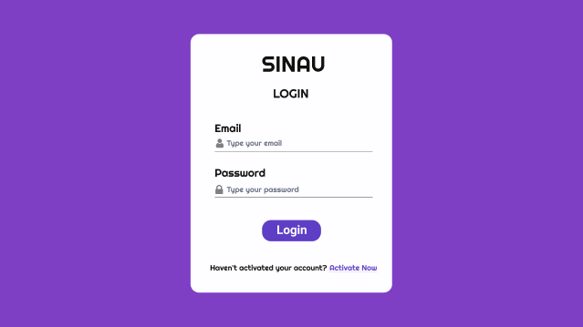
Prototype

Slide 86
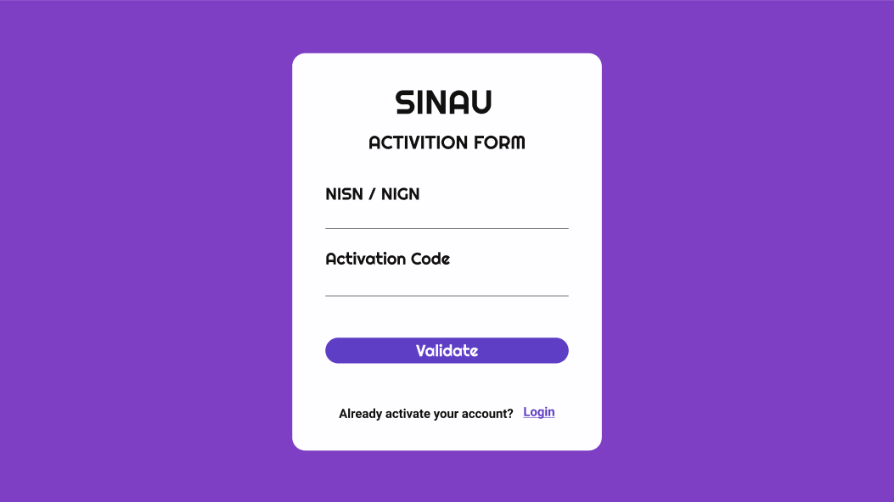
Prototype

Slide 87
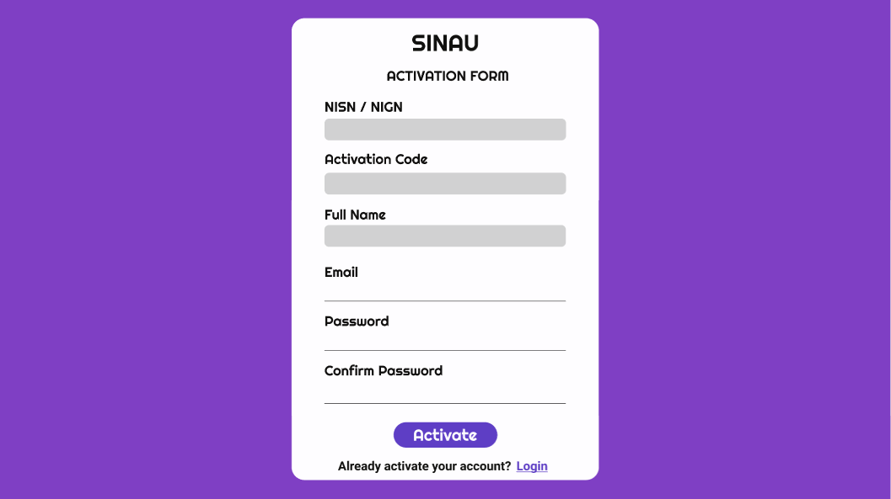
Prototype

Slide 88

Prototype - Student Page

Slide 89

Prototype - Student Page

Slide 90

Prototype - Student Page

Slide 91

Prototype - Student Page

Slide 92

Prototype - Student Page

Slide 93

Prototype - Teacher Page

Slide 94

Prototype - Teacher Page

Slide 95

Prototype - Teacher Page

Slide 96

Prototype - Teacher Page

Slide 97

Prototype - Teacher Page

Slide 98

Prototype - Teacher Page

Slide 99

Prototype - Teacher Page

Slide 100

Prototype - Teacher Page

Slide 101
Development Progress
Link Website : http://sinau.somee.com/
Progress:
We have done the front-end development and all of the features
We are currently still developing the back-end system
The web application has not connected to the database (all information on the website is currently hard-coded)
Steps:
To open the website, just open the link given above (please use desktop/pc for best experience, because this website currently only available for PC/laptop view)
Login as Teacher:
email : teacher@gmail.com
password : teacher1234
Login as Student:
email : student@gmail.com
password : student1234
The other webapps features is ready to use but it is not connected to the database (cannot modify/store data/save the modified data)

