Slide 1
Process control and anomaly detection with classification of optical emission spectra
Austin bock
Springboard Capstone 2 - milestone
oct, 2017

Slide 2
Project overview & Goals
Overview:
Customer has come to me with a dataset that includes optical emission spectra from monitors on a plasma etch tool and the measured Error data from subsequent production runs. (detailed descriptions provided in “Data Dictionary.txt” on Github)
Customer requests exploratory analysis for outlier classification which could be used for process control. 2 methods of using this data will be explored as Key Goals.
The process uses statistical process control in a manufacturing environment to control ‘Error’ on production
The key starting assumption from the customer is that other noise/error sources are not important and this assumption may not be true in that other sources could be present.
Key Goals:
Can classifier be used as UP/DOWN monitor that captures the likelihood of failing with Error outside statistical limits of the population on production
Can classifier be used as monitor the process condition for any shifts that will require investigation.
Advise on next steps to improve modeling capability with other data sources

Slide 3
Data cleaning
Cleaning:
Customer supplied dataset contains a large anonymized dataset of time series sequence through identical toolsets.
Timestamps are removed and converted to sequential runs, thus protecting IP metrics.
Error columns were normalized to zero
Spectra are also included as separate files. These were married to the subsequent ‘Error’ datapt by the following:
Renaming all files with windows creation stamp to allow perfect sort by run order and converting from binary to csv.
Algorithm to search all IDs with ‘Error’ point and then appending the run ID identifier to the end of the monitor that has optical emission data. Ex. 2017-01-06-08-32-45_monitorID_ErrorID.csv
The monitorID spectra file can now be matched to ‘Error’ data pt for ErrorID
The labels are then created for each run based on ‘Error’ according to population limits of
See “Data Dictionary” on Github for more explicit summary

Slide 4
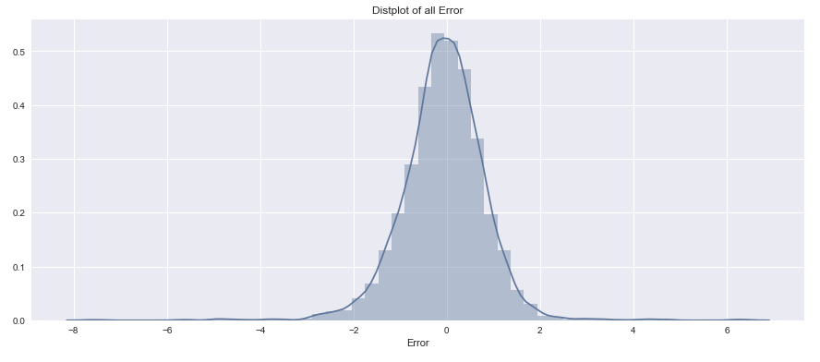
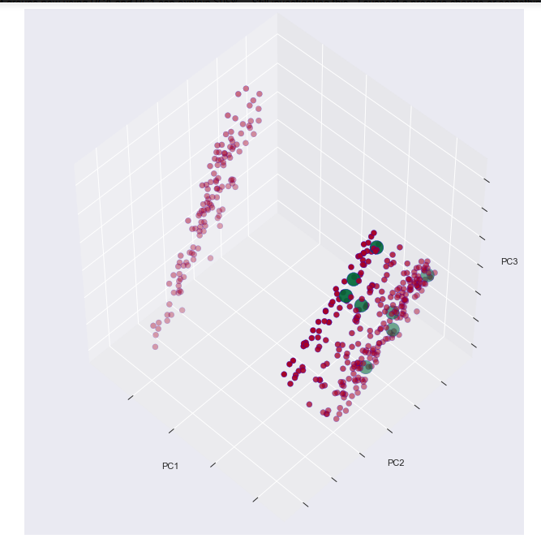
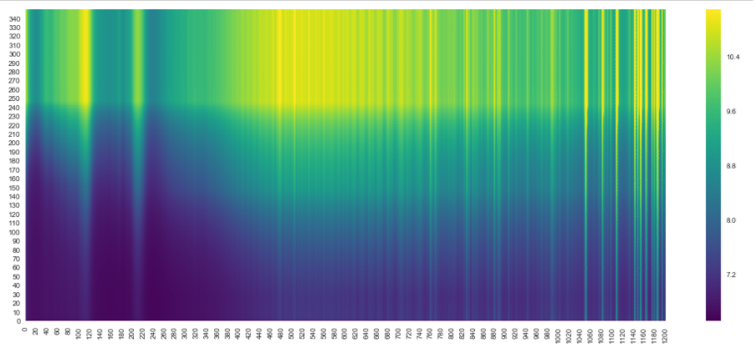
Exploration
PCA successfully found a tool shift – this was confirmed
with process expert who found hardware fix was root
cuase for process shift below
Log scale emission

Slide 5
Mid - Summary
Findings and recommendations:
Spectral information seems to be lost when trying to perform feature reduction on a flat vector for sklearn
Classifaction alg does not classify any outliers doing this – need new methodology for heatmaps
Plan to move to treating the heatmap images as intact images w methods like histogram of oriented gradients
The PCA analysis suggest this will be able to detect hardware shifts, however the shift can dominate the results when trying to perform anomaly detection. Explore a method to normalize the histogram intensities to some base before attempting anomaly classification. This will also help tool to tool hardware mismatches.
Feature reduction will be required in some form by some method that retains the variance

