Slide 1
Biting Mosquitos Back Final Report to the Chicago Dept of Health
Skeeter Patrol, LLC – contracted by the cdc
Mike Sanders, Jeff Rash, Brian Austin
28 April 2017

Slide 2
Agenda
Background
Problem Statement
Data Overview
Hypotheses
Approach
Results
Conclusions

Slide 3
Background on West Nile Virus
West Nile Virus (WNV) is commonly spread when infected mosquitos bite humans. Symptoms of WNV can vary from fever to death in the most extreme cases.
The Chicago Department of Public Health (CDPH) has limited resources and would like to better predict when WNV will be present among the local mosquito population.
Accurate predictions of WNV will help the CDPH in allocating resources to spray of airborne pesticides to control adult mosquito populations.

Slide 4
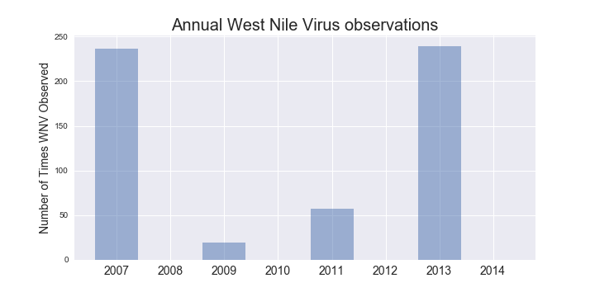
Problem Statement
The purpose of this project is to determine which of the mosquito traps in the city of Chicago had mosquitos with West Nile virus for the years of 2008, 2010, 2012, and 2014.

Slide 5

Notes:
LiveSlide Site
https://public.tableau.com/views/tabMap/TimePlot?:embed=y&:display_count=yes

Slide 6
Information Provided
Results of a weekly survey of mosquito traps 2007, 2009, 2011, and 2013
Trap-level observations include:
A unique trap identifier
The date the test is performed
Street address and block number of the trap
Measure of the accuracy of the street address provided for the trap
The species of mosquito identified
Latitude and longitude associated with the trap address
The number of mosquitos discovered during odd-numbered years
Whether the trap tested positive for West Nile Virus on a given date
Weather data for the months of May-October from 2007 to 2014
A full list of all the species and traps anticipated to be in the even-year data.
The city locations that had been sprayed by a pesticide in 2007, 2011, and 2013

Slide 7
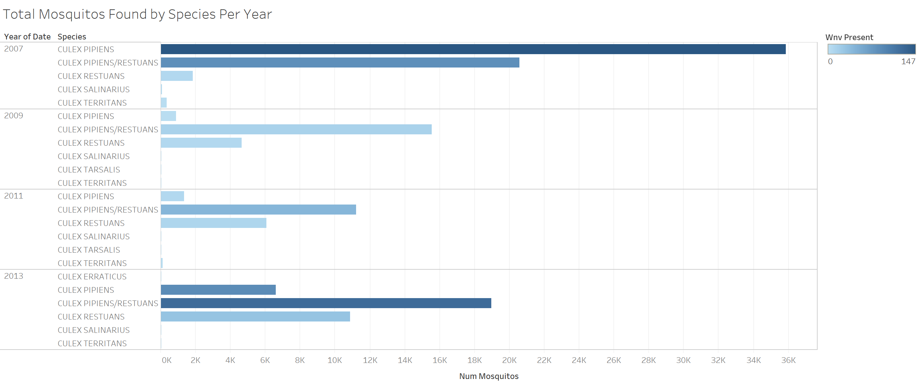
Numbers of each species of mosquito

Slide 8
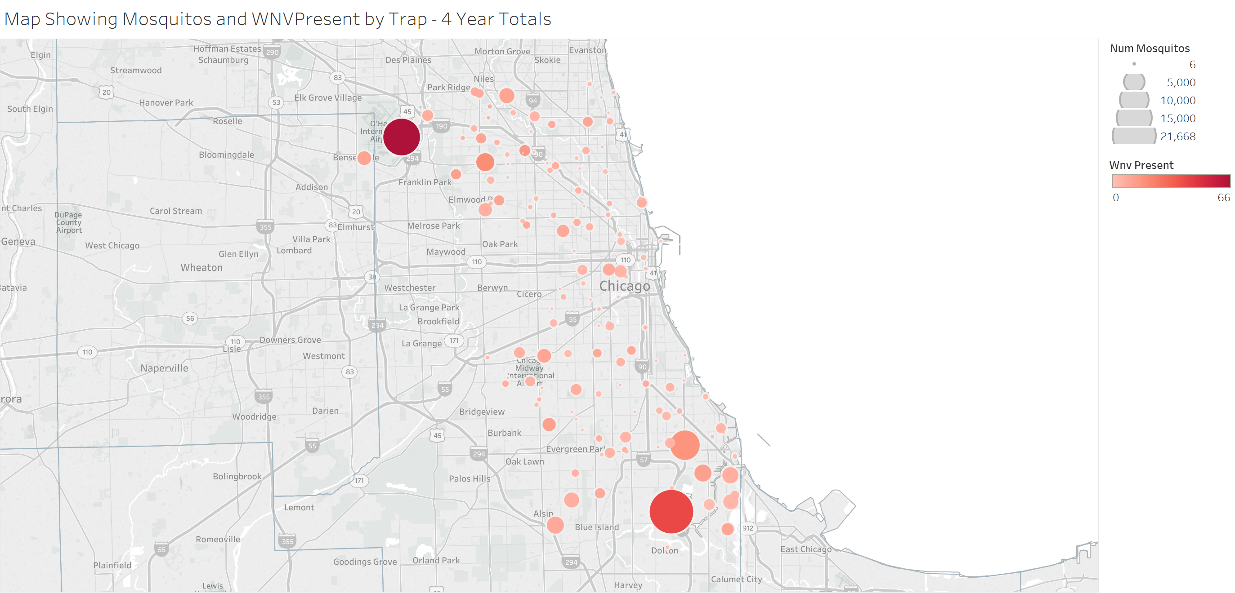
The most frequent WNV is in the northwest of Chicago

Slide 9
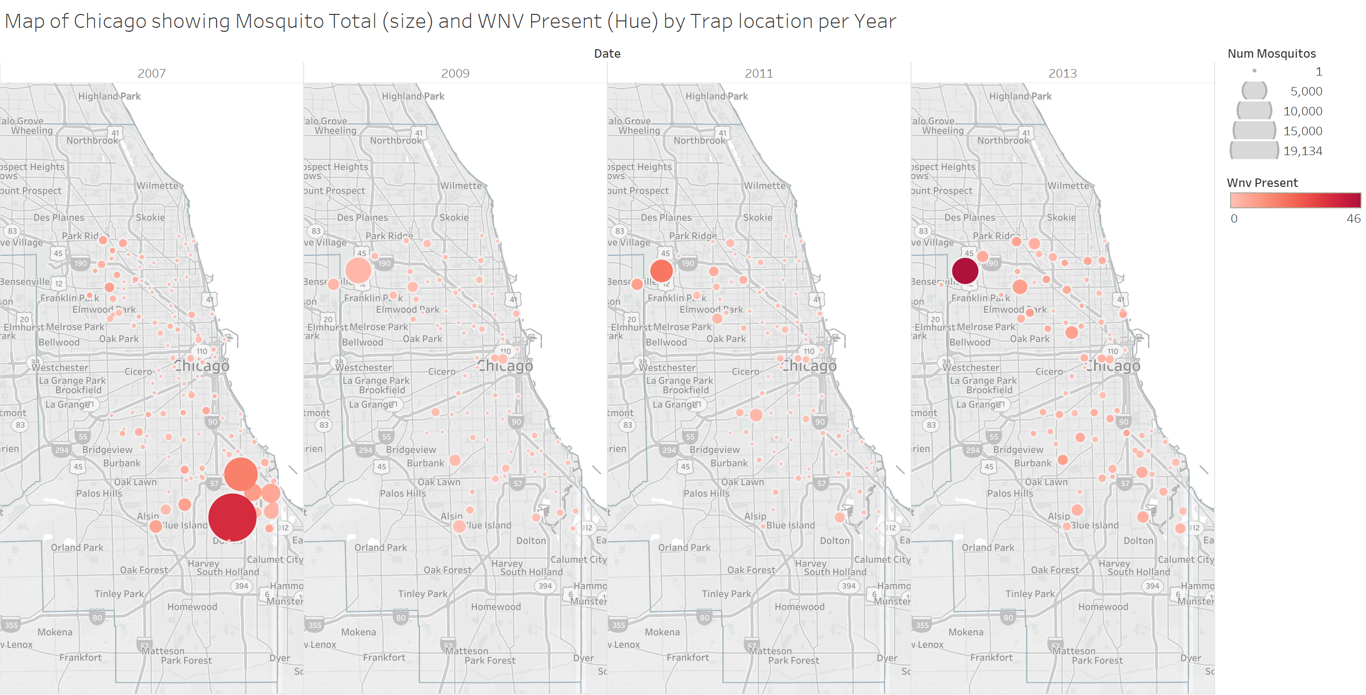
…but this concentration shifted there from the south

Slide 10
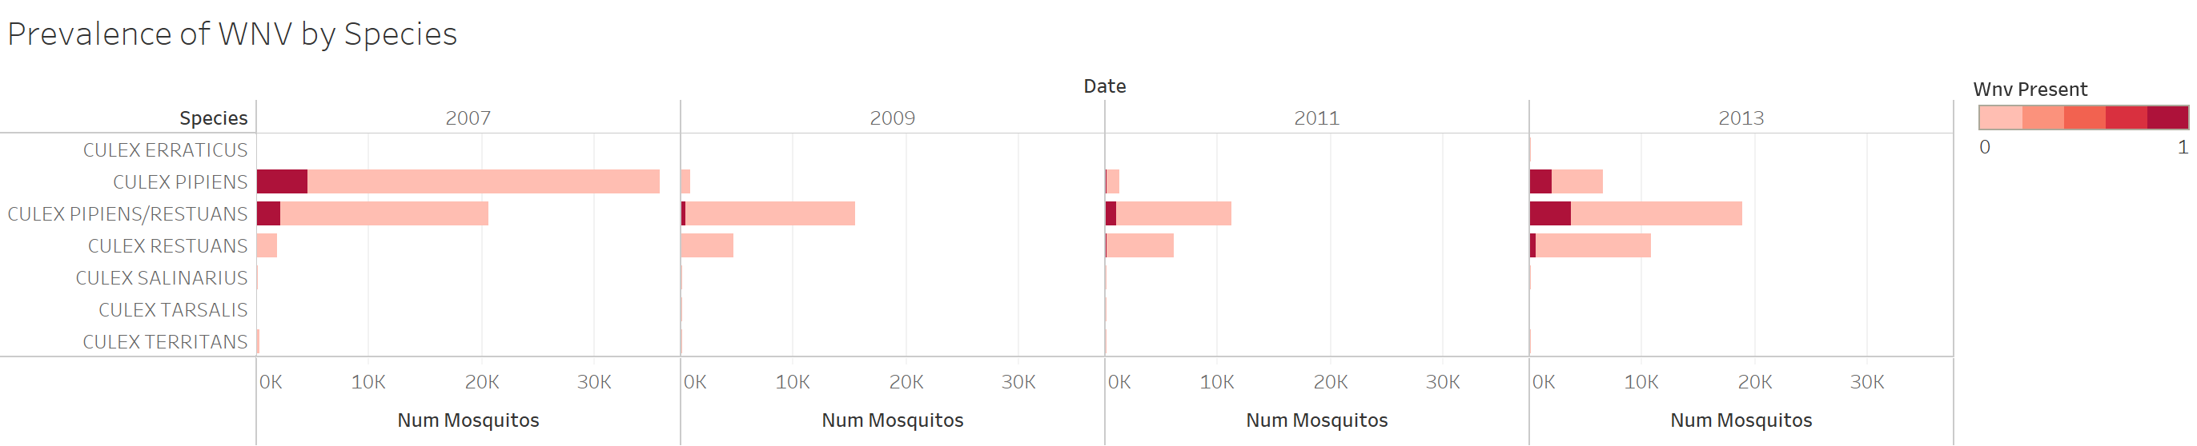
WNV estimates are inconsistent by species

Slide 11
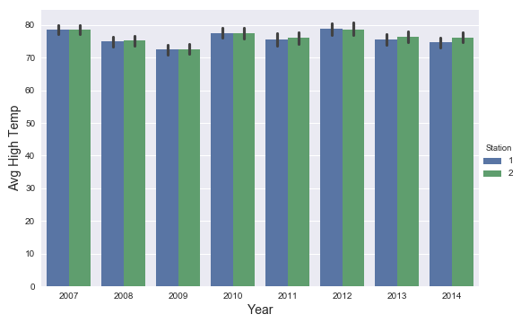
Data Cleaning Decisions
Assigned weather observations to the closest station to each trap
Traps that were listed with multiple locations were given alternate titles
T009 & T035
Combined the total number of mosquitos in each trap per day
Count vectorized the weather observations per day
Imputed missing weather values using average temperature
Changed “T” as 0.05 and ”M” as NaN
Both weather stations exhibit very similar weather

Slide 12
Three primary hypotheses
The primary factors driving West Nile Virus are the trap’s location and weather over the short-term
The actual trap location was somewhat arbitrary, so a trap’s likelihood to test positive for WNV is relative to the locations of other traps
Spray data is irrelevant* because it will not be effective for a year, and so will not predict the number of mosquitos likely to have WNV
* Given that there is no unreleased spray information for predicting even years

Slide 13
Features for distance and bearing
For each trap, we calculated the distance from that trap to every other trap in the dataset. Then we described this distance by calculating the compass bearing between each two points.
For each dated observation, we:
Determined whether a trap was closer to O'Hare Airport and Midway Airport
Using the closer airport, we pulled in the full day's weather for each date observation
We then looked up the date for the prior day's weather and included it as additional observations.
We continued this process until we had built in the weather for all days until n-6.
This resulted in a very long list of features.

Slide 14
Classifiers evaluate West Nile presence
Each of these features were replicated for the testing set as well, since the weather and location information were both included for the years to be predicted
Prior to classification, predicted number of mosquitoes based on variables in the test data using linear regression
Classification tactics included:
Logistic regression
Random forest classification
K-nearest-neighbors classification
Ada-boosted random forest
XGBoost
Support vector machines
HDBSCAN
Because we had such a high number of dimensions, our team decomposed our training data using principal component analysis, and evaluated each of our classifiers using 30 features, which explained ~85% of the variance in our data
We evaluated the performance of our classifier using a test-train split in which 33% of our training data was classified on the fit of a given model, and the area under the Radio Operator Curve was measured

Slide 15
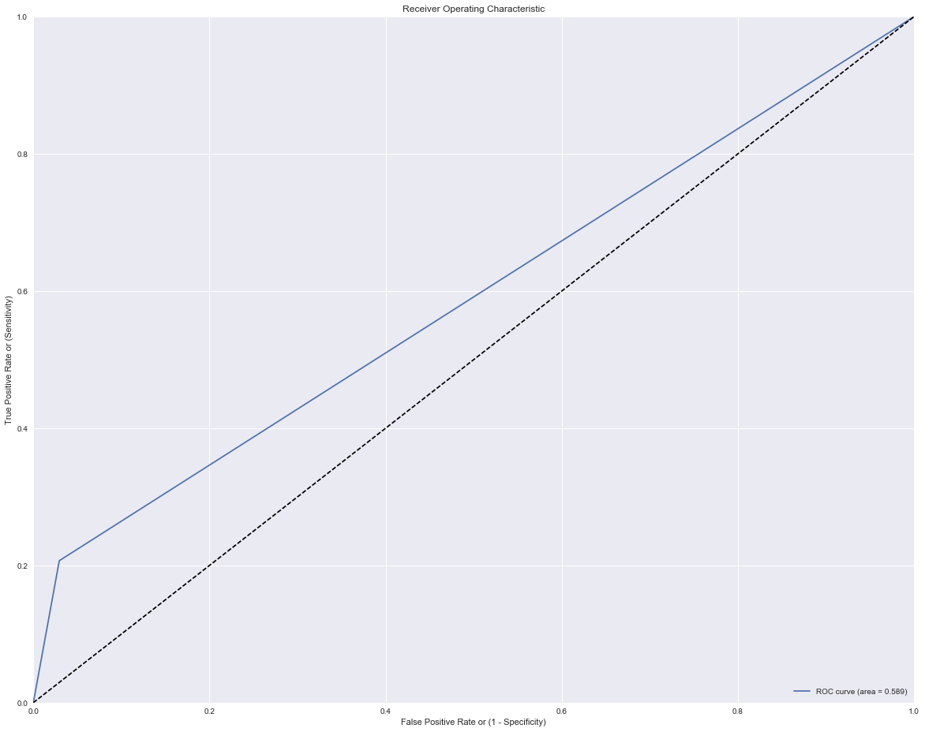
Results
Best-performing training model: AdaBoost with Random Forest base estimator
Conclusion: Not a very good estimator
Area Under ROC Curve: 0.589

Slide 16

Kaggle Scores
AdaBoost: 0.56020
SVMs: 0.50
Gradient Boosting: 0.47825
Random Forest: 0.44662

Slide 17
Questions?

