Slide 1


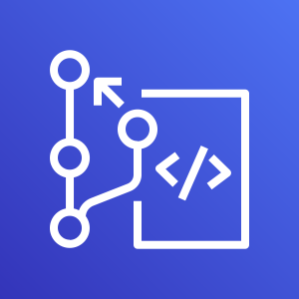
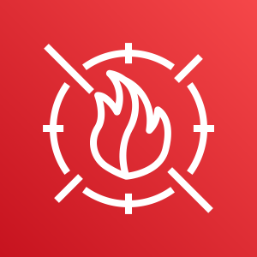


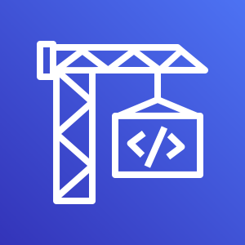


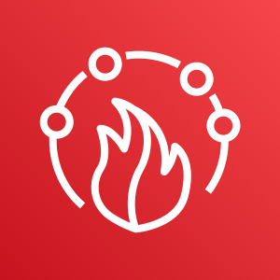




AWS Cloud
Security account
AWS CodeCommit
AWS WAF Web ACLs
Anomali LIMO
MISP
AWS CodeBuild (x2)
Amazon DynamoDB
AWS CodeBuild (x2)
IP Set
AWS Firewall Manager
NOTE: The individual CodeBuild projects are not broken out and the full Sagemaker IP Insights to DDB flow is not shown for conciseness.
MISP Feed Refresh automation
Amazon GuardDuty
Master
Threat List
(*.txt)
Amazon S3
‘n’ member accounts
Amazon GuardDuty
Member
AWS WAF

