Slide 1

QueueFlow
AI-Assisted Smart Queue Monitoring & Management
PROJECT
PRESENTATION
QueueFlow
Abstract & Literature Review
TEAM MEMBERS
QueueFlow Project Team
Academic Project Presentation
September 2026
Notes:
[Sources]
Repository evidence: README.md; docs/architecture/overview.md; backend/app/api/routes/cameras.py; ai/queue/video_pipeline.py; frontend/src/pages/Dashboard.tsx; frontend/src/hooks/useQueueWebSocket.tsx.

Slide 2




Abstract
QueueFlow is a release-verified, AI-assisted queue monitoring system. It converts camera-derived observations into queue state, density, estimated waiting time and meaningful transition alerts. The backend persists each measurement, exposes protected REST APIs and broadcasts real-time updates to a responsive operations dashboard.
Camera / observation ingestion
Persistent queue history
Authenticated live updates
The design separates video analysis from business rules: detection/tracking provide measurements; FastAPI owns validation, thresholds, persistence, analytics and WebSocket delivery. React presents live status with HTTP polling fallback. Production Compose packages PostgreSQL, FastAPI and Nginx.
Analytics, alerts & RBAC
QueueFlow — AI-Based Crowd & Queue Monitoring System
02
Notes:
[Sources]
Repository evidence: README.md; docs/architecture/overview.md; backend/app/api/routes/cameras.py; ai/queue/video_pipeline.py; frontend/src/pages/Dashboard.tsx; frontend/src/hooks/useQueueWebSocket.tsx.

Slide 3

Problem Statement
Queues are often monitored manually, giving operators delayed and incomplete visibility of crowding, queue length and expected wait. QueueFlow addresses this operational gap by turning camera observations into durable, role-protected queue intelligence—without coupling dashboard logic to a specific vision model.
QueueFlow — AI-Based Crowd & Queue Monitoring System
04
Notes:
[Sources]
Repository evidence: README.md; docs/architecture/overview.md; backend/app/api/routes/cameras.py; ai/queue/video_pipeline.py; frontend/src/pages/Dashboard.tsx; frontend/src/hooks/useQueueWebSocket.tsx.

Slide 4


Project Objectives
Measure queues
Persist state
Update live
Ingest person count and density from configured cameras.
Store queue history for analytics and wait estimates.
Broadcast authenticated queue and alert events.
Support decisions
Protect access
Operate reliably
Show queue status, wait and alerts on the dashboard.
Apply JWT authentication and role-based permissions.
Expose health, readiness, metrics and secure deployment.
QueueFlow — AI-Based Crowd & Queue Monitoring System
06
Notes:
[Sources]
Repository evidence: README.md; docs/architecture/overview.md; backend/app/api/routes/cameras.py; ai/queue/video_pipeline.py; frontend/src/pages/Dashboard.tsx; frontend/src/hooks/useQueueWebSocket.tsx.

Slide 5



Literature Review: Research Landscape
The reviewed work clusters into perception, tracking, crowd estimation and operational queue intelligence.
Detection
Tracking
Crowd counting
Queue intelligence
Haar, HOG and one-stage detectors establish the person-observation layer.
Online association preserves identities as people move through queue regions.
CNN and density-map methods address scale and occlusion in dense scenes.
Queue-time studies connect observations to waiting-time and service decisions.
QueueFlow — AI-Based Crowd & Queue Monitoring System
03
Notes:
[Sources]
[1]–[10] as listed in slides 6–7 speaker notes.

Slide 6
Literature Review I — Detection & Tracking
1. Viola–Jones (2001)
2. Dalal–Triggs (2005)
3. Redmon et al. (2016)
Haar cascade. + Fast. − Face-focused; weak for occluded people.
HOG person detector. + Strong classical baseline. − Hand-crafted features.
YOLO detector. + One-pass speed. − Small / overlapped people remain hard.
4. Wojke et al. (2017)
5. Zhang et al. (2016)
What QueueFlow uses
DeepSORT tracker. + Persistent tracks. − Association can drift.
MCNN counting. + Multi-scale counts. − Image-only, no lifecycle.
A replaceable detector + tracker + queue-region boundary.
QueueFlow — AI-Based Crowd & Queue Monitoring System
06
Notes:
[Sources]
[1] Viola & Jones (2001), https://doi.org/10.1109/CVPR.2001.990517
[2] Dalal & Triggs (2005), https://doi.org/10.1109/CVPR.2005.177
[3] Redmon et al. (2016), https://doi.org/10.1109/CVPR.2016.91
[4] Wojke et al. (2017), https://arxiv.org/abs/1703.07402
[5] Zhang et al. (2016), https://doi.org/10.1109/CVPR.2016.70
Repository evidence: README.md; docs/architecture/overview.md; backend/app/api/routes/cameras.py; ai/queue/video_pipeline.py; frontend/src/pages/Dashboard.tsx; frontend/src/hooks/useQueueWebSocket.tsx.

Slide 7
Literature Review II — Counting & Queue Operations
6. Li et al. (2018)
7. Sindagi–Patel (2018)
8. Khan et al. (2023)
CSRNet density map. + Dense-scene focus. − Needs annotated training data.
CNN survey. + Clear taxonomy. − Highlights unresolved generalisation.
Crowd-counting review. + Trends & metrics. − Deployment complexity remains.
9. Zhang et al. (2017)
10. Mohammad et al. (2021)
Implication for QueueFlow
CrowdQTE sensing. + Camera-free alternative. − Depends on participant signals.
Video queue estimate. + Existing cameras. − Weather/view sensitivity.
Use vision as measurement input; keep queue rules transparent and replaceable.
QueueFlow — AI-Based Crowd & Queue Monitoring System
06
Notes:
[Sources]
[6] Li et al. (2018), https://doi.org/10.1109/CVPR.2018.00120
[7] Sindagi & Patel (2018), https://doi.org/10.1016/j.patcog.2017.07.007
[8] Khan, Menouar & Hamila (2023), https://doi.org/10.1016/j.imavis.2022.104597
[9] Zhang et al. (2017), https://doi.org/10.1007/s11704-016-5553-z
[10] Mohammad et al. (2021), https://doi.org/10.3390/pr9101786
Repository evidence: README.md; docs/architecture/overview.md; backend/app/api/routes/cameras.py; ai/queue/video_pipeline.py; frontend/src/pages/Dashboard.tsx; frontend/src/hooks/useQueueWebSocket.tsx.

Slide 8


Research Gap & QueueFlow Response
Gap identified
QueueFlow response
Most work optimises a perception task—detection, tracking or counting—or models queues in isolation. Operational concerns such as authenticated delivery, persistence, alert lifecycle, observability and dashboard fallback are frequently outside a single research prototype.
QueueFlow integrates replaceable AI measurements with a production-oriented queue core: FastAPI validation, PostgreSQL history, status thresholds, history-informed wait estimates, WebSocket events, RBAC, metrics and a React operations dashboard.
QueueFlow — AI-Based Crowd & Queue Monitoring System
05
Notes:
[Sources]
[1]–[10] listed in slides 6–7.
Repository evidence: README.md; docs/architecture/overview.md; backend/app/api/routes/cameras.py; ai/queue/video_pipeline.py; frontend/src/pages/Dashboard.tsx; frontend/src/hooks/useQueueWebSocket.tsx.

Slide 9



Implemented Methodology
A modular, traceable path from camera frame to operator decision.
1. Detect people
2. Track identity
3. Apply queue region
Video adapter provides person detections from each sampled frame.
Centroid tracking associates nearby detections over time.
Only tracked people inside the configured region contribute.
4. Persist measurement
5. Publish real time
6. Operate dashboard
Camera endpoint validates and records count, density and wait.
Backend broadcasts queue updates and transition alerts.
React merges live events while HTTP polling remains a fallback.
QueueFlow — AI-Based Crowd & Queue Monitoring System
07
Notes:
[Sources]
Repository evidence: README.md; docs/architecture/overview.md; backend/app/api/routes/cameras.py; ai/queue/video_pipeline.py; frontend/src/pages/Dashboard.tsx; frontend/src/hooks/useQueueWebSocket.tsx.

Slide 10
System Architecture
The backend is the source of truth; vision is deliberately replaceable.
Camera / video
Detector + tracker
Queue-region count
Measurement service
Status & wait estimate
FastAPI + PostgreSQL · validation · alert lifecycle · metrics · RBAC
Analytics
Alerts
React dashboard
QueueFlow — AI-Based Crowd & Queue Monitoring System
08
Notes:
[Sources]
Repository evidence: README.md; docs/architecture/overview.md; backend/app/api/routes/cameras.py; ai/queue/video_pipeline.py; frontend/src/pages/Dashboard.tsx; frontend/src/hooks/useQueueWebSocket.tsx.

Slide 11
Technology Stack
Application Core
AI & User Experience
FastAPI + Pydantic
SQLAlchemy + Alembic
PostgreSQL
JWT + Argon2 authentication
WebSocket queue events
Prometheus-compatible metrics
Python video-analysis boundary
OpenCV-ready detector adapter
Centroid tracking + queue regions
React + TypeScript + Vite
Tailwind CSS + Recharts
Docker Compose + Nginx
QueueFlow — AI-Based Crowd & Queue Monitoring System
09
Notes:
[Sources]
Repository evidence: README.md; docs/architecture/overview.md; backend/app/api/routes/cameras.py; ai/queue/video_pipeline.py; frontend/src/pages/Dashboard.tsx; frontend/src/hooks/useQueueWebSocket.tsx.

Slide 12
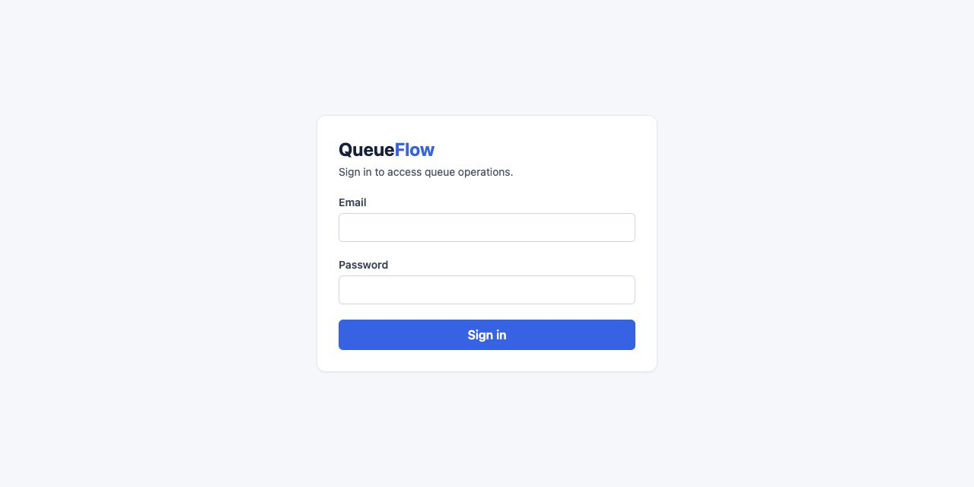
Project Screenshot & Release Evidence
Actual QueueFlow interface
Verified release evidence
The locally running QueueFlow frontend exposes a secure sign-in screen before any operational route becomes available.
• Backend / AI suite: 50 passed
• Frontend suite: 8 passed
• Lint and production build passed
• Fresh Compose: PostgreSQL health, FastAPI health/readiness/metrics and Nginx startup verified
• Authenticated WebSocket and RBAC regression checks verified
QueueFlow — AI-Based Crowd & Queue Monitoring System
05
Notes:
[Sources]
Repository evidence: README.md; docs/architecture/overview.md; backend/app/api/routes/cameras.py; ai/queue/video_pipeline.py; frontend/src/pages/Dashboard.tsx; frontend/src/hooks/useQueueWebSocket.tsx.
Screenshot: locally captured from http://127.0.0.1:4174/ on 2026-09-03.

Slide 13
How the Code Implements the Design
AI pipeline
Ingestion & live publish
video_pipeline.py
tracks = tracker.update(detector.detect(frame))
count = region.count(tracks)
return QueueObservation(region.name, count, density_for_count(count, capacity), observed_at)
cameras.py
record = record_measurement(session, queue, payload, settings)
log("camera_observation_recorded", camera_id=camera.id, queue_id=queue.id)
await publish_measurement(record, manager)
This keeps AI measurement, persistence and broadcast separate.
QueueFlow — AI-Based Crowd & Queue Monitoring System
05
Notes:
[Sources]
Repository evidence: README.md; docs/architecture/overview.md; backend/app/api/routes/cameras.py; ai/queue/video_pipeline.py; frontend/src/pages/Dashboard.tsx; frontend/src/hooks/useQueueWebSocket.tsx.

Slide 14

Verified Outcomes
Evidence from the completed QueueFlow release verification.
Secure operations
Live resilience
Operational visibility
REST endpoints and WebSocket delivery enforce JWT/RBAC.
Authenticated multi-client broadcasts and reconnection behaviour are tested.
Health, readiness, JSON logs and metrics support diagnosis.
History-backed analytics
Deployment verified
Known limitation
Persisted measurement windows power analytics and wait estimation.
Compose packages PostgreSQL, FastAPI and Nginx behind same-origin routes.
Performance baselines are regression indicators, not capacity guarantees.
QueueFlow — AI-Based Crowd & Queue Monitoring System
10
Notes:
[Sources]
Repository evidence: README.md; docs/architecture/overview.md; backend/app/api/routes/cameras.py; ai/queue/video_pipeline.py; frontend/src/pages/Dashboard.tsx; frontend/src/hooks/useQueueWebSocket.tsx.
Release evidence: AGENTS.md Milestone 13 final handoff.

Slide 15

Conclusion
QueueFlow demonstrates a practical pattern for smart queue management: use AI where it adds measurement value, then rely on transparent backend rules for persistence, queue status, wait estimates and alerts. The completed system connects these layers to a secured, observable, production-verified dashboard—while keeping the vision adapter replaceable for future deployment conditions.
QueueFlow — AI-Based Crowd & Queue Monitoring System
13
Notes:
[Sources]
Repository evidence: README.md; docs/architecture/overview.md; backend/app/api/routes/cameras.py; ai/queue/video_pipeline.py; frontend/src/pages/Dashboard.tsx; frontend/src/hooks/useQueueWebSocket.tsx.
Literature synthesis: [1]–[10] listed in slides 6–7.

