Slide 1
QUEUEFLOW
AI-assisted queue
monitoring & management
Abstract Presentation
Project presentation • Team Members
Austine Roy U2409018
Ciril Sajive U2409024
Ishan Jophy Kunnath U2409033
Karthik S Prakash U2409037
2026
Notes:
[Sources]
QueueFlow project repository README and architecture overview (local project documentation).

Slide 2
QUEUEFLOW • LITERATURE REVIEW
02
Queues are operational problems, not just counts
QueueFlow turns visual observations into actions for operators and visitors.
01
02
03
Observe
Interpret
Respond
Camera/video inputs
identify people and queue regions.
Counts, density, wait estimates
and status form a live queue state.
Dashboard alerts and analytics
help staff act before congestion worsens.
QueueFlow | 2025–2026 literature review
02
Notes:
[Sources]
QueueFlow README.md; docs/architecture/overview.md (local project documentation).

Slide 3
QUEUEFLOW • LITERATURE REVIEW
03
QueueFlow keeps vision, operations, and presentation separate
The literature informs the vision layer while the backend remains the source of truth for queue state.
Camera / video
AI pipeline
Backend API
Dashboard
→
→
→
frames & queue region
detection • tracking • density
validate • persist • estimate
REST • WebSocket • alerts
QueueFlow | 2024–2025 literature review
03
Notes:
[Sources]
QueueFlow docs/architecture/overview.md (local project documentation).

Slide 4
QUEUEFLOW • LITERATURE REVIEW
04
Review scope: papers that can shape a deployable queue system
Inclusion
Reading lens
Published 2024 or later
Crowd counting, detection, management, privacy, or training methods
Clear implication for QueueFlow
What problem is addressed?
What technique is used?
What changes for a real queue-monitoring workflow?
10 papers reviewed
5 technical methods + 5 surveys, learning, privacy, and operations studies
QueueFlow | 2024–2025 literature review
04
Notes:
[Sources]
Literature selection compiled from publisher / proceedings pages cited on slides 5–6.

Slide 5
QUEUEFLOW • LITERATURE REVIEW
05
Literature review (1–5): counting methods and learning strategies
Paper
Main contribution
QueueFlow relevance
01
Deng et al. (2024)
Deep learning in crowd counting: a survey
Maps datasets, architectures, and real-world challenges for crowd counting.
Benchmark both sparse queues and dense scenes; do not assume one model fits all.
02
Wang et al. (2024)
Supervised, unsupervised & semi-supervised approaches
Compares annotation regimes and their accuracy/cost trade-offs.
Start with observed labels; add semi-supervision only when data collection becomes limiting.
03
Zhang et al. (2024)
CrowdGraph
Uses graph neural networks for weakly supervised count estimation.
Candidate research path when queue labels are coarse and distributions are uneven.
04
Guo et al. (2024)
CrowdTrans
Transformer density estimation handles perspective-driven scale variation.
Calibrate camera views; prioritize scale robustness near the back of a queue.
05
Khan et al. (2024)
Curriculum for Crowd Counting
Tests curriculum learning across eight crowd models and six settings.
Train/evaluate from easier to harder camera scenes; measure convergence and error.
QueueFlow | 2024–2025 literature review
05
Notes:
[Sources]
[1] Deng et al. (2024), https://doi.org/10.1049/cit2.12241
[2] Wang et al. (2024), “A Survey on Supervised, Unsupervised, and Semi-Supervised Approaches in Crowd Counting,” Computers, Materials & Continua 81(3), 3561–3582.
[3] Zhang et al. (2024), https://doi.org/10.1145/3638774
[4] Guo et al. (2024), https://doi.org/10.1016/j.neucom.2024.127650
[5] Khan et al. (2024), https://arxiv.org/abs/2401.07586

Slide 6
QUEUEFLOW • LITERATURE REVIEW
06
Literature review (6–10): operations, privacy, and current synthesis
Paper
Main contribution
QueueFlow relevance
06
Chen et al. (2024)
Privacy-aware crowd counting
Decentralized learning with parallel transformers reduces data-sharing pressure.
Keep raw video local where possible; plan privacy as an architectural constraint.
07
Alasmari et al. (2024)
Recent trends in crowd management
Systematic review connects counting, flow organization, and public safety.
Operational value comes from alerts and staffing decisions—not count accuracy alone.
08
Ganga (2024)
Object detection and crowd analysis
Reviews detector families and their crowd-analysis deployment role.
Use detection + tracking for low/medium density and preserve an adapter boundary.
09
Gao et al. (2025)
Density estimation & crowd counting survey
Reviews 300+ works, datasets, metrics, and under-explored research directions.
Report MAE/RMSE plus operational error: missed alerts, stale updates, and latency.
10
Yang et al. (2024)
Efficient density estimation with edge intelligence
Pairs a lightweight CNN with reparameterization and knowledge transfer; tests on Jetson Nano.
Consider edge inference where bandwidth, latency, or privacy makes centralized video impractical.
QueueFlow | 2024–2025 literature review
06
Notes:
[Sources]
[6] Chen et al. (2024), https://doi.org/10.1016/j.iot.2024.101167
[7] Alasmari, Farooqi & Alotaibi (2024), https://doi.org/10.1007/s43995-024-00071-3
[8] Ganga (2024), https://doi.org/10.1016/j.neucom.2024.127932
[9] Gao et al. (2025), https://doi.org/10.1007/s44336-024-00011-8
[10] Yang et al. (2024), https://doi.org/10.1016/j.asoc.2024.111366

Slide 7
QUEUEFLOW • LITERATURE REVIEW
07
Synthesis: accurate counting is necessary but insufficient
01
Robust vision
Perspective, occlusion, and scene shift remain central technical risks.
02
Data efficiency
Weak/semi-supervision can lower labeling costs, but accuracy must be validated locally.
03
Privacy by design
Edge or decentralized learning can reduce unnecessary raw-video sharing.
04
Operational loop
Measurements must arrive quickly, persist reliably, and trigger meaningful alerts.
For QueueFlow: retain replaceable AI adapters and judge success at the level of decisions, not only model scores.
QueueFlow | 2024–2025 literature review
07
Notes:
[Sources]
Synthesis inferred from papers cited on slides 5–6.

Slide 8
QUEUEFLOW • LITERATURE REVIEW
08
What the literature suggests for QueueFlow
Vision adapter
Benchmark detection/tracking and density estimation by camera density.
Data & evaluation
Create a small, local validation set; track MAE/RMSE plus alert precision.
Privacy & governance
Limit retention, protect access, and evaluate edge/decentralized options.
Live operations
Preserve WebSocket resilience, persistence, status thresholds, and alert lifecycle.
QueueFlow | 2024–2025 literature review
08
Notes:
[Sources]
QueueFlow project architecture documentation; synthesis inferred from papers cited on slides 5–6.

Slide 9
QUEUEFLOW • LITERATURE REVIEW
09
Team responsibilities
Replace bracketed placeholders with the four team members’ names.
Team member
Role
Key Responsibilities
Austine Roy
Computer Vision Lead
Review papers 1–3; evaluate detection / tracking / density methods; prepare AI pipeline evidence.
Ciril Sajive
Backend & Data Lead
Review papers 4–5; validate ingestion, persistence, queue-state logic, and metrics.
Ishan Jophy Kunnath
Frontend & Operations Lead
Review papers 6–7; demonstrate dashboard, WebSocket updates, alerts, and usability.
Karthik S Prakash
Research & QA Lead
Review papers 8–10; consolidate literature, testing evidence, privacy, documentation, and final delivery.
QueueFlow | 2024–2025 literature review
09
Notes:
[Sources]
Team allocation is a proposed project plan; names intentionally left as placeholders at the user’s request.

Slide 10
QUEUEFLOW • LITERATURE REVIEW
10
Conclusion
QueueFlow can turn visual observations into timely queue decisions—if it is built around reliable measurements, accountable operations, and privacy-aware deployment.
—
Use a replaceable vision layer so that models evolve without breaking operations.
—
Validate with local camera data and operational measures, not benchmark scores alone.
—
Treat real-time delivery, alert quality, and data protection as first-class requirements.
QueueFlow | 2024–2025 literature review
10
Notes:
[Sources]
Conclusion synthesizes local QueueFlow architecture documentation and papers cited on slides 5–6.

Slide 11
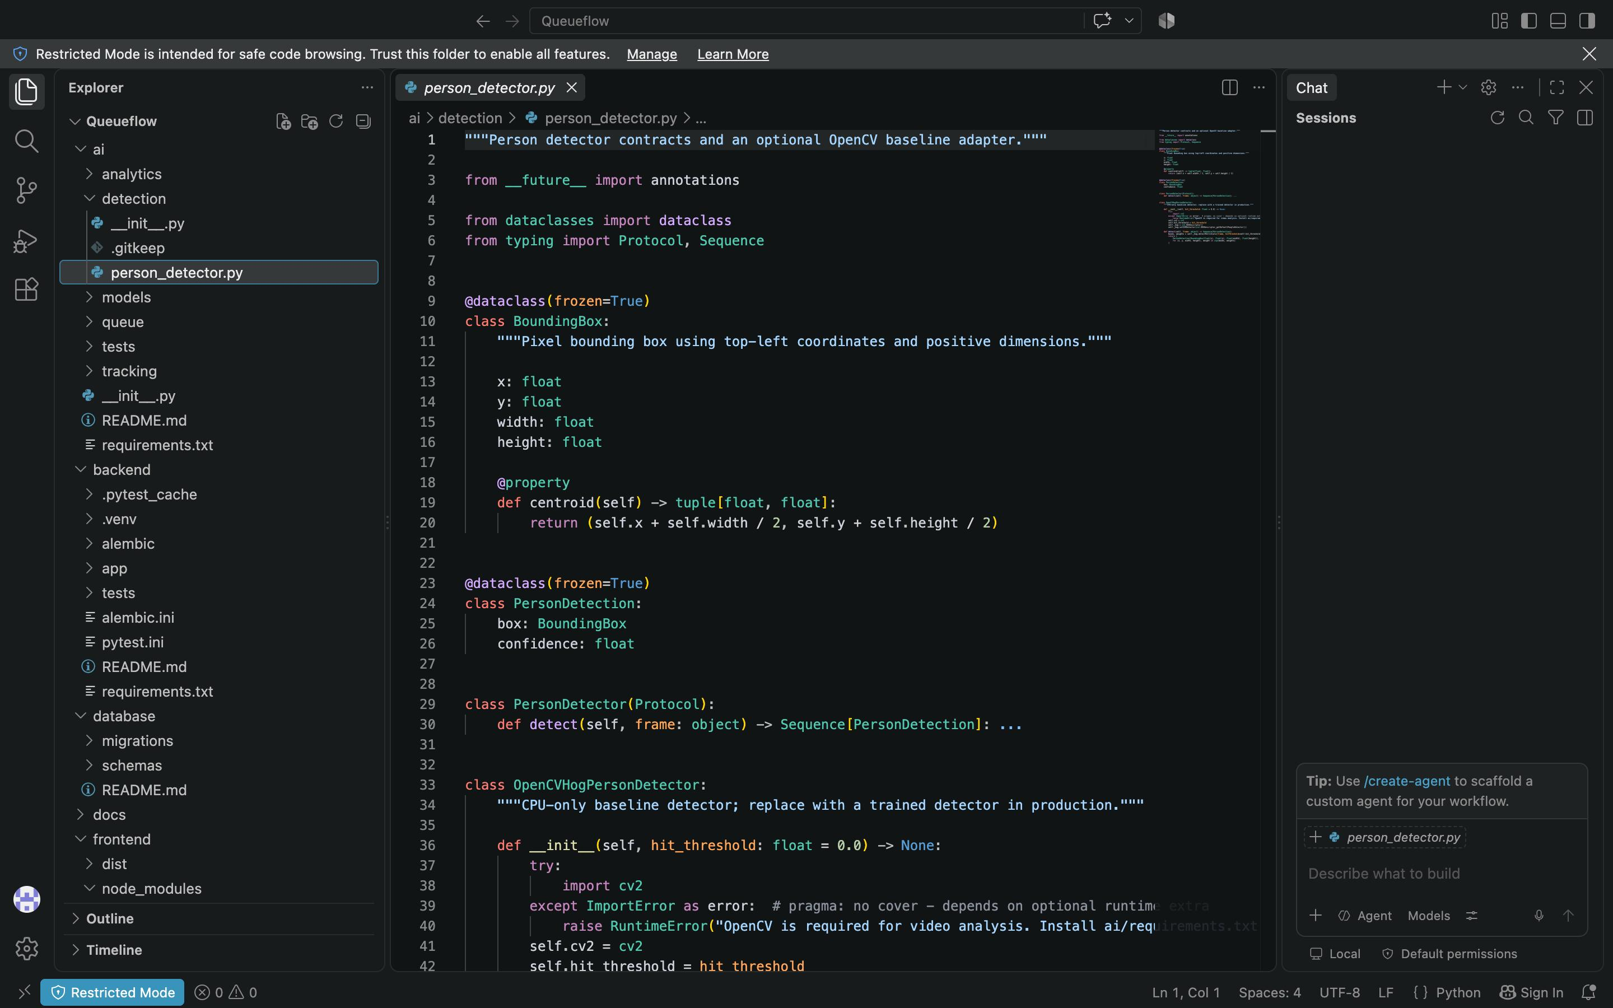
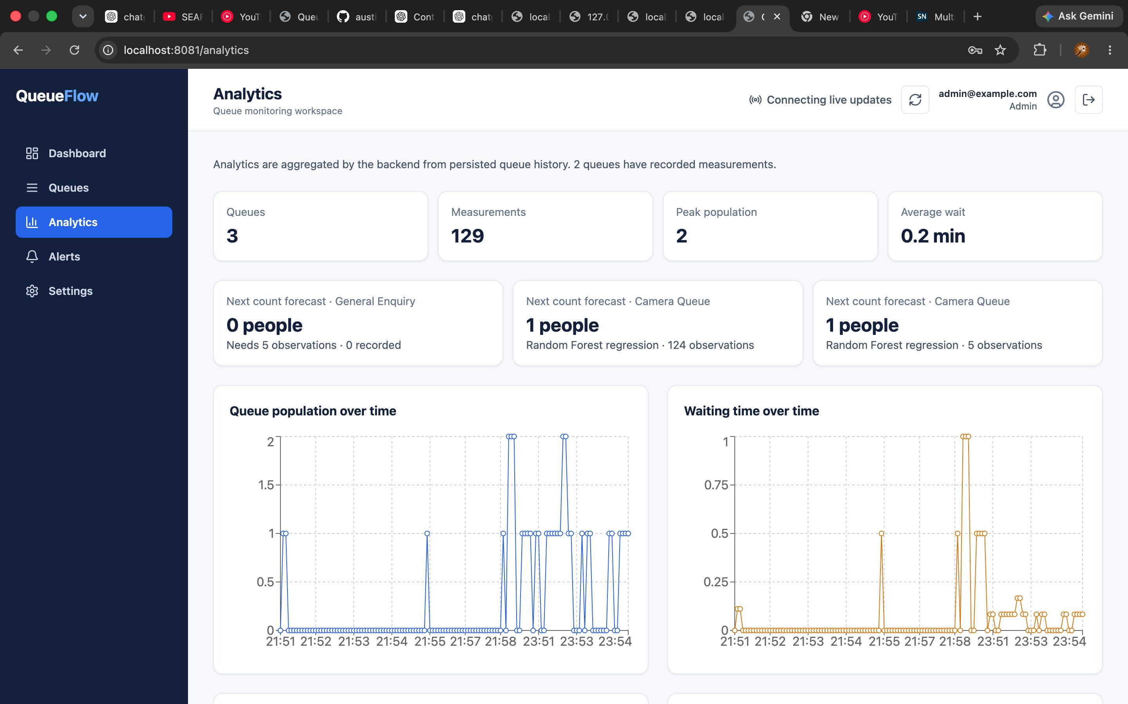
QUEUEFLOW • LITERATURE REVIEW
11
Code snippets/ Screenshots
Evidence slide — replace the reserved area with your own dashboard or camera screenshot before presenting.
Backend: application wiring
app.include_router(cameras.router, prefix="/api")
app.include_router(measurements.router, prefix="/api")
app.include_router(alerts.router, prefix="/api")
app.include_router(analytics.router, prefix="/api")
app.include_router(realtime.router)
SCREENSHOT AREA
Paste a QueueFlow dashboard,
live queue table, camera feed,
or WebSocket status screenshot here.
Suggested caption: Live queue status and alert updates.
Source: backend/app/main.py
QueueFlow | 2024–2025 literature review
11
Notes:
[Sources]
Code excerpt adapted from QueueFlow backend/app/main.py (local project source). Screenshot region intentionally reserved for user-provided project evidence.

Slide 12
QUEUEFLOW • LITERATURE REVIEW
12
Motivation
Queues create uncertainty for visitors and operational pressure for staff.
01
02
03
Visitor experience
Operational visibility
Safety & service
Unclear wait times and crowded spaces make a service visit frustrating.
Manual observation is inconsistent, delayed, and difficult to scale across locations.
Early congestion signals help teams react before the queue becomes critical.
QueueFlow | 2025–2026 literature review
12
Notes:
[Sources]
QueueFlow README.md and docs/architecture/overview.md (local project documentation).

Slide 13
QUEUEFLOW • LITERATURE REVIEW
13
Problem Statement
Queue operators need timely, trustworthy insight into queue size, congestion, and likely wait.
01
02
03
Fragmented inputs
Late intervention
Limited evidence
Camera observations, staff reports, and queue records are often disconnected.
Without live status, staffing and alerting decisions arrive after conditions worsen.
Operators need a clear history of measurements, alerts, and queue transitions.
QueueFlow | 2025–2026 literature review
13
Notes:
[Sources]
QueueFlow README.md and docs/architecture/overview.md (local project documentation).

Slide 14
QUEUEFLOW • LITERATURE REVIEW
14
Goals and Objectives
Build a practical, privacy-aware workflow that turns observations into queue-management actions.
01
02
03
Detect
Estimate
Inform
Measure people and density within defined queue regions from camera or video inputs.
Calculate status and waiting time from capacity, service rate, and queue history.
Deliver dashboard updates, analytics, and transition-based alerts to operators.
QueueFlow | 2025–2026 literature review
14
Notes:
[Sources]
QueueFlow README.md and docs/architecture/overview.md (local project documentation).

Slide 15
QUEUEFLOW • LITERATURE REVIEW
15
Assumptions and Risks
QueueFlow balances useful live visibility with reliable operation and responsible data handling.
01
02
03
Assumptions
Vision risks
Operational risks
Cameras have a usable queue view, capacity is configured, and network access is available.
Occlusion, lighting, perspective, and dense scenes can affect person-count accuracy.
Stale data, unavailable services, and privacy misuse require safeguards and fallbacks.
QueueFlow | 2025–2026 literature review
15
Notes:
[Sources]
QueueFlow README.md and docs/architecture/overview.md (local project documentation).

Slide 16
QUEUEFLOW • LITERATURE REVIEW
16
Project Scope and Target Group
The project focuses on live queue operations while keeping the AI layer replaceable.
01
02
03
In scope
Target group
Out of scope
Queue measurements, status, wait estimates, alerts, analytics, and live dashboard updates.
Operations managers, queue staff, administrators, and visitors who need queue information.
Identity recognition, automatic staffing decisions, and vendor-specific camera lock-in.
QueueFlow | 2025–2026 literature review
16
Notes:
[Sources]
QueueFlow README.md and docs/architecture/overview.md (local project documentation).

Slide 17
QUEUEFLOW • LITERATURE REVIEW
17
Resources Needed
QueueFlow combines standard software components with camera access and operational ownership.
01
02
03
Hardware
Software
People & data
Camera or video source, development machine, and optional edge/GPU capability for inference.
Python, FastAPI, PostgreSQL, React, Docker, OpenCV, YOLOv8, and browser tools.
Four project members, test footage, queue configuration, and operator feedback.
QueueFlow | 2025–2026 literature review
17
Notes:
[Sources]
QueueFlow README.md and docs/architecture/overview.md (local project documentation).

Slide 18
QUEUEFLOW • LITERATURE REVIEW
18
Algorithms Used (1/2)
Algorithm family
QueueFlow function
Proper algorithm name
01
Computer vision
Person detection
YOLOv8 Object Detection
02
Computer vision
Video baseline detection
Histogram of Oriented Gradients (HOG) + Linear SVM People Detector
03
Tracking
Identity tracking
Centroid Tracking with Greedy Nearest-Neighbour Data Association
04
Geometry
Queue-area inclusion
Ray-Casting Point-in-Polygon Algorithm
05
Analytics
Queue density
Capacity-Normalized Density Estimation
QueueFlow | 2024–2025 literature review
18
Notes:
[Sources]
QueueFlow ai/README.md; ai/detection/person_detector.py; ai/tracking/centroid_tracker.py; ai/queue/region.py; ai/analytics/measurements.py; backend/app/services/queue_service.py; backend/app/services/prediction_service.py; backend/app/realtime/simulator.py (local project source).

Slide 19
QUEUEFLOW • LITERATURE REVIEW
19
Algorithms Used (2/2)
Algorithm family
QueueFlow function
Proper algorithm name
01
Rules
Queue-status classification
Threshold-Based Rule Classification
02
Estimation
Wait-time calculation
Throughput / Service-Rate Queueing Estimate
03
Estimation
Wait-time refinement
Historical Departure-Rate Averaging
04
Prediction
Next-count prediction
Random Forest Regression
05
Simulation
Test-data generation
Bounded Random-Walk Queue Simulation
QueueFlow | 2024–2025 literature review
19
Notes:
[Sources]
QueueFlow ai/README.md; ai/detection/person_detector.py; ai/tracking/centroid_tracker.py; ai/queue/region.py; ai/analytics/measurements.py; backend/app/services/queue_service.py; backend/app/services/prediction_service.py; backend/app/realtime/simulator.py (local project source).

Slide 20
QUEUEFLOW • LITERATURE REVIEW
20
Project Timeline
01
Foundation
Set up the backend, database, API, and dashboard baseline.
02
Live queue layer
Add simulated/ingested observations, WebSocket updates, and alerts.
03
AI & integration
Connect detection, tracking, queue regions, cameras, and analytics.
04
Release readiness
Verify security, performance, Docker deployment, documentation, and demo flow.
Milestones 1–13 are complete; Milestone 14 is reserved for post-release maintenance.
QueueFlow | 2024–2025 literature review
20
Notes:
[Sources]
QueueFlow docs/development/roadmap.md and AGENTS.md (local project documentation).

