Slide 1
Cloud Computing : Plagiarism Detection Software
Austin Agbo
MSc Information Systems

Slide 2
Achievements
All three cloud services are being utilized for system
System allows user to build an index
It is possible to create a new index while previous request is running
Results can be viewed from S3 via webpage
Scale Analysis (performance/cost) for full set of source was the focus in test phase

Slide 3
Improvements
Open Stack Instance should be programmed to start up only when required
A restful A.P.I. should get a JSON file each time a form is filled on front end.
In which file contains variables expected to launch indexing and matching processes
System Logs should be stored on a database to efficiently track a job process.

Slide 4
Improvement 2
This database should post job progress to front end each step of the way.
So final results aggregate would be posted back to front end as well.
This database which stored on Open Stack, a bash script should collect final results aggregate and email this to the user.

Slide 5
Project Improvement
Drawing out properly descriptive System design before beginning the build phase.
A more spaced out time of build phase where System was submitted in parts and then put together after which much thought had been put to it.
Consulting Users of the system(Students), in what ways they would prefer the service and putting their opinions into consideration.

Slide 6
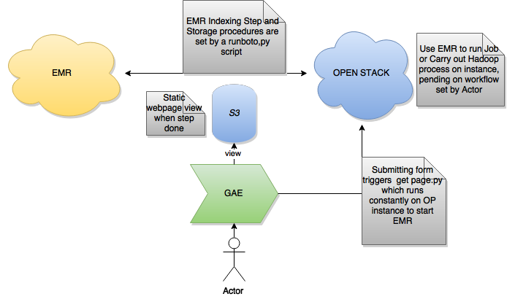
Architecture

