Slide 1
Speech Recognition Final Project
William Gay

Slide 2
The project
Goal: Make a program that recognizes who is speaking
Program takes a live input from microphone and classifies the speaker
Idea was to have a ‘keyword’ that would have to be said.
Keyword is “Enter”
Extended the project to identify different words being said
“Bicycle”
“Guitar”
“Music”
“Water”
“Hello”

Slide 3
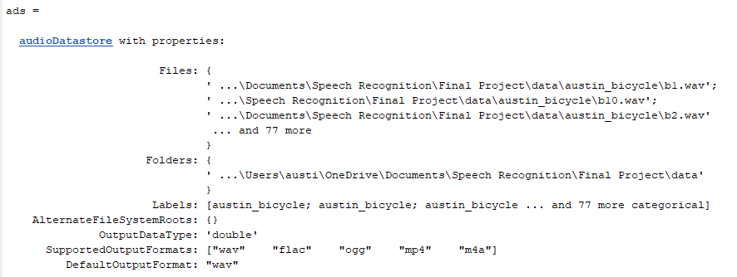
The Data
I created my own data with the help of some friends.
Each of us recorded ourselves saying the word “Enter” numerous times.
All sound was recorded using the same microphone.
Data is split into training and testing by an 80 20 split

Slide 4
Features
Features extracted from the audio include: Zero-Crossing Rate, Short Time Energy, Pitch, and MFCC (Mel-Frequency Cepstral Coefficients)
Zero-Crossing Rate and Short Time Energy used to identify the portions of voiced speech
Pitch and MFCC are used to train the Models
Parameters:
13 MFCC Coefficients
1 Pitch Value

Slide 5
Models Used
K-Nearest-Neighbor
Euclidean Distance
5 Neighbors
Gaussian
Naive Bayes Model

Slide 6
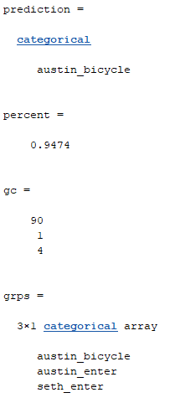
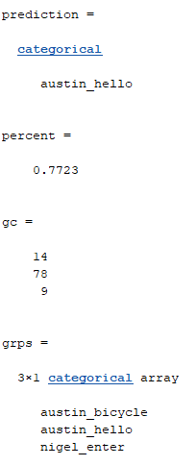
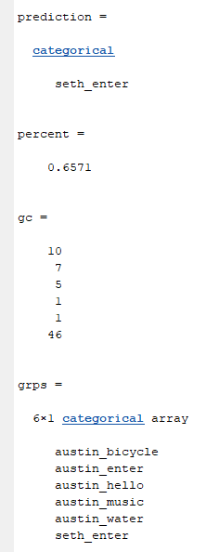
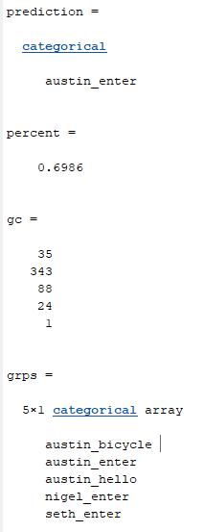
KNN Results
Approximately 97% Validation accuracy

Slide 7
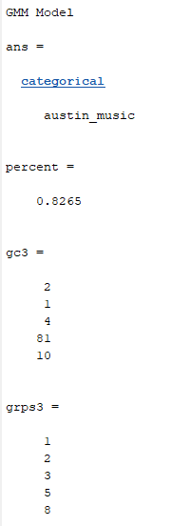
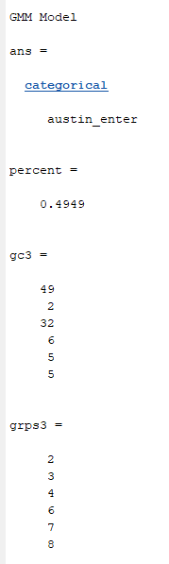
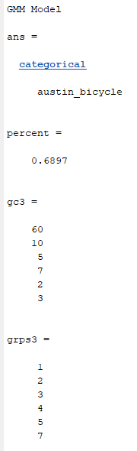
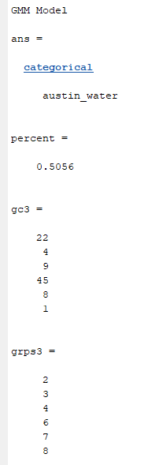
Gaussian Results
Created a Gaussian Model for each Class
Created pdf for each class with input data
Obtained result by taking the greatest likelihood
and assigning the class label of the pdf for each window

Slide 8
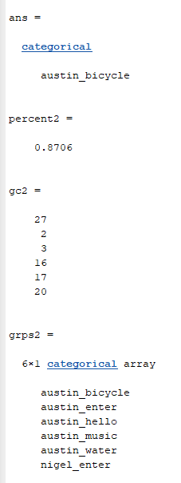
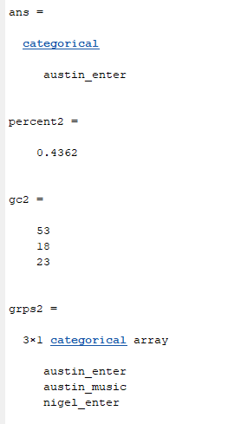
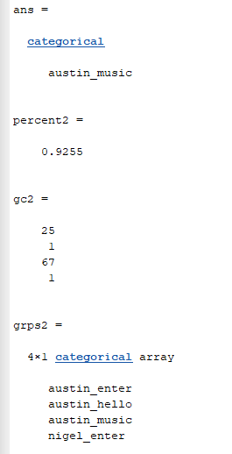
Naïve Bayes Model

Slide 9
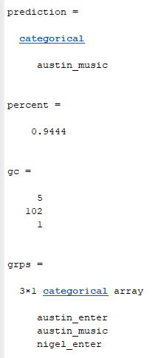
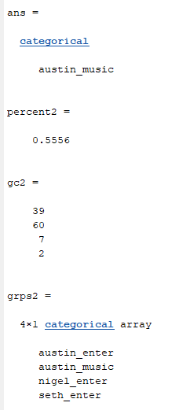
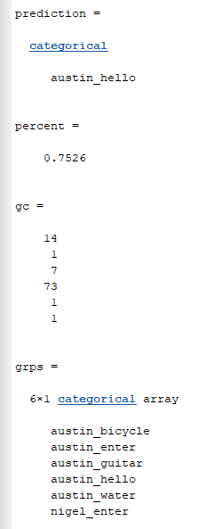
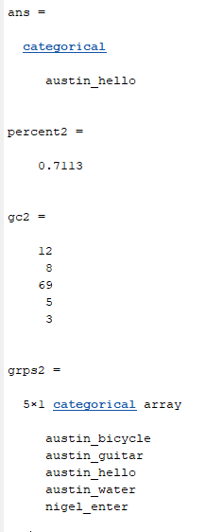
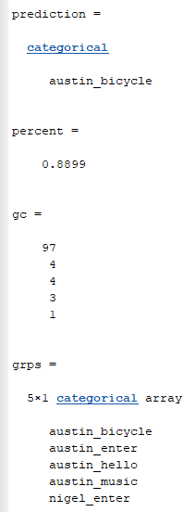
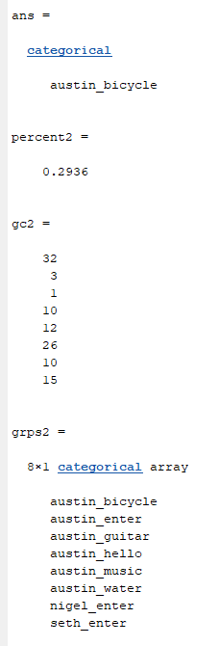
KNN vs Naïve Bayes

Slide 10
Summary
Data was recorded from scratch
Program takes a live audio input and classifies the speaker/word
Features extracted included zero crossing rate, short time energy, pitch, and MFCC
Audio broken into hamming windows where each window is classified to obtain final classification
Supervised Models worked the best for classifying words/speakers
KNN resulted in the greatest accuracy

Slide 11
Continuation
Explore more models
Hidden Markov Model
Clustering?
More data

