Slide 1
The Chinese Military
Explained With Data
By Austin Gae

Slide 2
Table of Contents
Objective
2) Data Analysis
China’s Military Expenditure
China’s Military Branches
China’s Foreign Military Activities
ADIZ intrusions
Overseas Military Base
Overseas Military Operations
3) Summary

Slide 3
Objective
To understand the Chinese military by assessing the following:
Its military expenditure in the present, from 1989 to the present, relative to its economy, and relative to other Asian powers’ spending.
Its military branch capabilities by looking at personnel count and their military equipment count.
Its military foreign activities by looking at ADIZ intrusions, military base, and UN peacekeeping operations.

Slide 4
China’s Military Expenditure
What’s China’s military expenditure? Relative to GDP and gov. spending? Relative to total military spending in Asia? Relative to individual Asian powers?

Slide 5
China’s 2021 Military Expenditure
Military Expenditure: $293 Billion
Military Expenditure Relative to GDP: 1.74%
Military Expenditure Relative to Gov. Spending: 5.03%
Military Spending Relative to Asia’s: 53%¹

Slide 6
Military Spending From 1989 to 2021
Its military spending increased from $11 to $293 billion from 1989 to 2021.⁰

Slide 7
Military Spending Relative to GDP
Its military spending relative to GDP decreased from 2.50% to 1.75%.

Slide 8
Military Spending Relative to Gov. Spending
Its military spending as a share of gov. spending decreased from 14% to 6%.

Slide 9
Spending of China vs Asia Region
China went from 8% to 53% of military spending in Asia.¹

Slide 10
Spending of China vs Asian Powers
China surpassed Japan in 2006, becoming the highest military spender in Asia.
Japan to double military spending, reaching $80 billion by 2027. However, still nothing compared to China.²
India surpassed China only once – in 1990.
Russia surpassed China only from 1994 – 1997.
S. Korea surpassed China only from 1990 – 1996.
Philippines never surpassed China.

Slide 11
Military Expenditure Summary
From 1989 to 2021, China’s military expenditure has increased dramatically from $11 to $293 billion; but its military expenditure relative to GDP and government spending have actually decreased.
The reason for this phenomenon is the increase of its GDP increased government revenue at a higher rate than the increase in military expenditure.
China’s military spending equates to 53% of Asia’s expenditure. It’s currently Asia’s #1 military spender.

Slide 12
China’s Military Branches
This section will only cover army, navy, and air force – not including the strategic missiles forces and strategic support force.

Slide 13
Personnel Count by Military Branch
Total Personnel Count: About 2.5 million.

Slide 14
Personnel Count Among Asian Powers
Among the most powerful states in Asia, China has the most military personnel.³
World’s largest military size.

Slide 15
Navy
Goal: from near seas protection and far seas protection
China has the most submarines, cruisers, destroyers, frigates, and corvettes.⁴
Fun Fact: Japan has 4 aircraft carriers, but the country calls them “helicopter destroyers.” The reason: Japan allows no offensive capability, but aircraft carriers are purposed for offensive operations.

Slide 16
Air Force
Goal: from territorial air defense to “offensive and defensive operations.”
Not China, but Russia seems to top in every category.⁵

Slide 17
Army
Goal: from “regional defense” to trans-theater operations
China has the most armored vehicles, but Russia seems to top in every other category.⁶

Slide 18
Military Branches Summary
China has the most military personnel in Asia and the world.
Navy: China has the most submarines, cruisers, destroyers, frigates, and corvettes.
Air Force: Not China, but Russia seems to top in every category.
Army: China has the most armored vehicles, but Russia seems to top in every other category.
IMPORTANT: Number doesn’t mean everything in assessing military strength, but it does mean something.

Slide 19
China’s Foreign Military Activities
Chinese ADIZ incursions into neighboring states, overseas military base, and UN peacekeeping operations.

Slide 20
Chinese ADIZ Incursions into Neighbors
Since 2013, China has committed more than 4,400 intrusions into the ADIZs of Japan, South Korea, and Taiwan.⁷
China has intruded the most in⁸
2016 for Japan⁹
2018 for S. Korea
2022 for Taiwan¹⁰

Slide 21
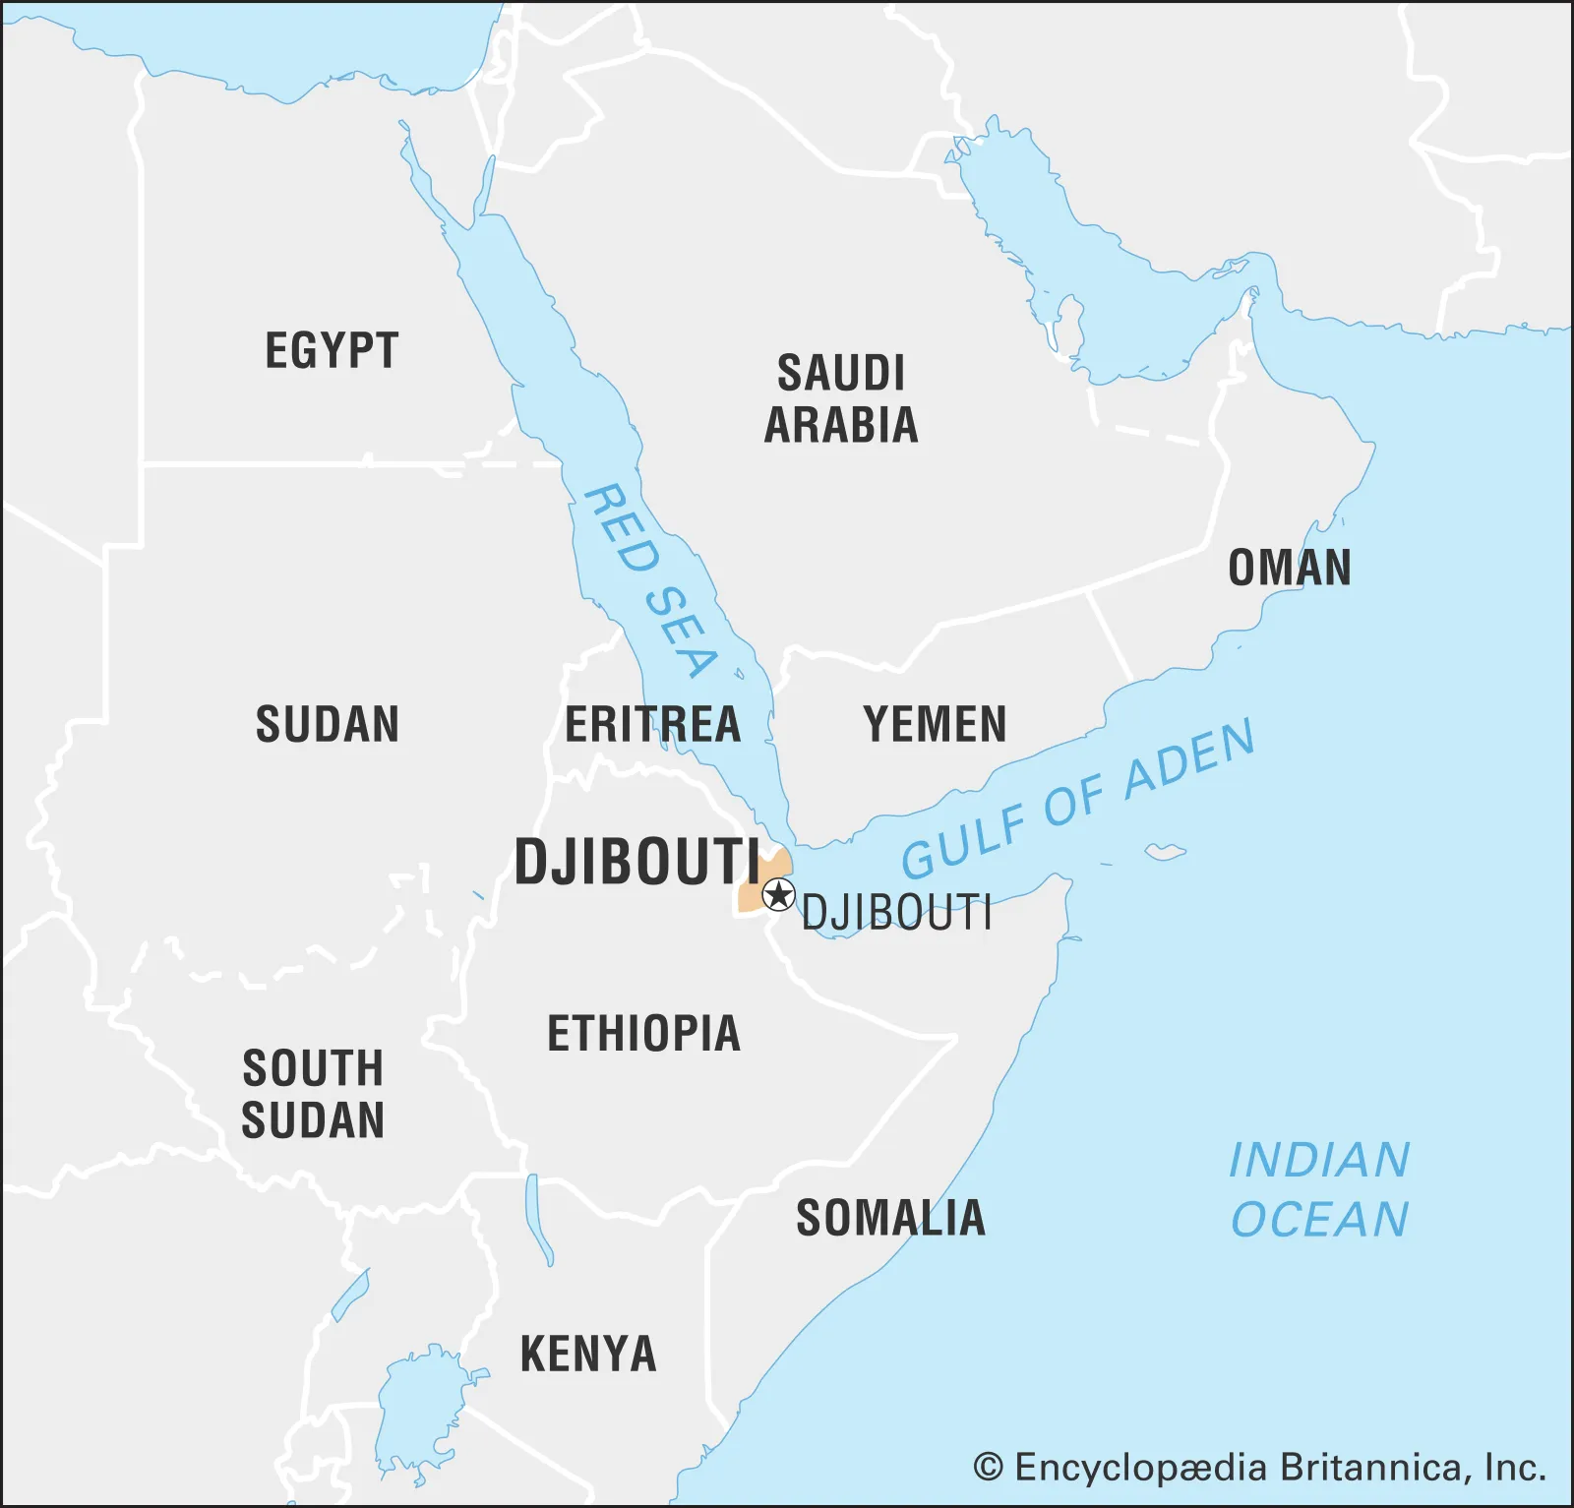
Only One Overseas Military Base
Djibouti in Africa
Purpose: to increase Chinese naval power projection
Strategically located between the Gulf of Aden & Red Sea
Since 2019, China has been planning for a 2nd military base in Equatorial Guinea, on the west coast of Africa.

Slide 22
Overseas Military Bases Among Asian Powers
China only has one, just like Japan and India. Russia has the most, totaling 20.¹¹

Slide 23
China’s UN Peacekeeping Operations
Its military has significantly increased its involvement in peacekeeping.
From 2000 to 2005, nearly 2000% increase. From 2005 to 2010, 200% increase.¹²
Most of its peacekeeping operations have been in Africa.

Slide 24
Foreign Military Activities Summary
What’s most notable of Chinese ADIZ intrusions is its intrusions into Taiwan, which increased 8,635% between 2019 to 2022.
China only has one overseas military base in Africa, but it plans on opening another in the region.
Chinese military has been actively participating in its UN peacekeeping operations.

Slide 25
Summary
From 1989 to 2021, China’s military expenditure has increased dramatically from $11 to $293 billion; but its military expenditure relative to GDP and government spending have actually decreased.
China is the top spender of military in Asia.
China has 2.5 million personnel, the largest military size.
In terms of numbers of naval units, China is the most powerful in Asia.
Its military has been participating actively overseas: it has its overseas base in a strategic location, dramatically increased incursions into Taiwan, and has actively participated in UN peacekeeping operations.

Slide 26
Thank you for listening.

Slide 27
Appendix
0) Chinese military expenditure data from this source: https://www.sipri.org/databases/milex
Data on North Korea, Turkmenistan, and Uzbekistan excluded.
Dooley, B., & Ueno, H. (2022, December 16). Japan moves to double military spending, with a wary eye on China. The New York Times. Retrieved February 18, 2023, from https://www.nytimes.com/2022/12/16/world/asia/japan-national-security-strategy.html
Paramilitary personnel count excluded from the data. If paramilitary is included, India would be number one in military size with a paramilitary size of 1.6 million.
Data for navy units gathered from this source: The International Institute for Strategic Studies. (2022). (rep.). The Military Balance: The Annual Assessment of Global Military Capabilities and Defence Economics 2022. Routledge Taylor & Francis Group. Retrieved from https://www.iwp.edu/wp-content/uploads/2019/05/The-Military-Balance-2022.pdf.
Data for air units gathered from this source: Flight Global. (2022). (rep.). World Air Forces 2022. Retrieved from https://www.flightglobal.com/download?ac=83735.
Data for ground units gathered from this source: Global firepower - 2023 world military strength rankings. Global Firepower - World Military Strength. (n.d.). Retrieved February 18, 2023, from https://www.globalfirepower.com/
ADIZ statement from this source: Mercedes Trent. (2020). (rep.). Over The Line: The Implications of China's ADIZ Intrusions In Northeast Asia. Federation of American Scientists. Retrieved from https://uploads.fas.org/2020/08/ADIZ-Report.pdf.
Chinese ADIZ intrusion data from this source: Mercedes Trent. (2020). (rep.). Over the Line. Federation of American Scientists. Retrieved from https://www.jstor.org/stable/resrep26130.8.
Chinese intrusions into Japan in 2020 and 2021 from this source: Tiwari, S. (2022, January 27). Exhausting Japanese air force, Chinese, Russian incursions forced Tokyo to scramble its fighters over 700 times in 9 months. Latest Asian, Middle-East, EurAsian, Indian News. Retrieved February 18, 2023, from https://eurasiantimes.com/exhausing-japanese-air-force-chinese-russian-incursions-tokyo/
Chinese intrusions into Taiwan in 2020, 2021, and 2022 from this source: Guardian News and Media. (2023, January 2). China's warplane incursions into Taiwan Air Defence Zone doubled in 2022. The Guardian. Retrieved February 18, 2023, from https://www.theguardian.com/world/2023/jan/02/chinas-warplane-incursions-into-taiwan-air-defence-zone-doubled-in-2022#:~:text=Pelosi%20in%20August.-,China%20sent%201%2C727%20planes%20into%20Taiwan's%20air%20defence%20identification%20zone,2021%20and%20380%20in%202020.
Russia overseas base from this source: Bledsoe, E. B. I. am E. (2023, January 4). How many military bases does Russia have overseas? The Soldiers Project. Retrieved February 18, 2023, from https://www.thesoldiersproject.org/how-many-military-bases-does-russia-have/#:~:text=What%20is%20this%3F&text=So%2C%20we%20have%20started%20with,the%20answer%20is%20about%2020.
China’s UN Peacekeeping operations from this source: Is China contributing to the United Nations' Mission? ChinaPower Project. (2021, May 25). Retrieved February 18, 2023, from https://chinapower.csis.org/china-un-mission/

