Slide 1
Authenticate manually
Microsoft Authentication Library (MSAL)
Microsoft Graph

Slide 2







Cloud Apps
Partners & Customers
Employees
Identity
On-premises apps
Devices

Slide 3
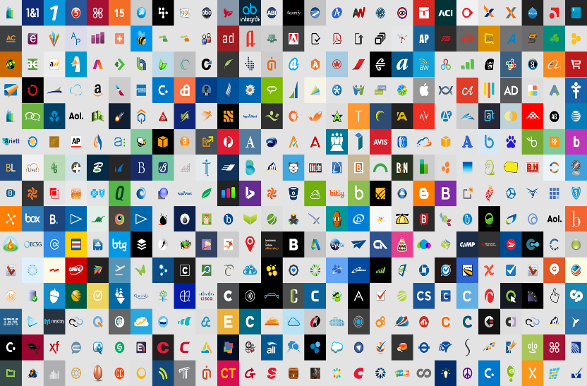





Microsoft Cloud
Cloud SaaS apps
Azure Active Directory
Android
On-premises apps
MacOS
iOS
Windows

Slide 4
Azure AD for developers(v1.0)
App
registrations
Azure AD Authentication Library (ADAL)
Client SDK
Azure AD endpoint (v1.0)
Endpoint
Active Directory
Federation Services
(AD FS)
Your target
audience

Slide 5




Azure AD for developers(v1.0)
Microsoft identity platform (v2.0)
App
registrations
https://portal.azure.com
Azure AD Authentication Library (ADAL)
Client SDK
Microsoft Authentication Library (MSAL)
Azure AD endpoint (v1.0)
Microsoft identity platform
Endpoint (v2.0)
Endpoint
Active Directory
Federation Services
(AD FS)
Work or school
accounts
(Azure AD)
Personal accounts
(Microsoft account)
Social or local
accounts
(Azure AD B2C)
Your target
audience

Slide 6


Browser (SPA)
Web application
Can call many other web APIs
Web API
Includes Graph, API, Office 365, or custom
Native or
Mobile client
Web API
Can call many other web APIs
Daemon or device

