Slide 1
Have you ever wanted to know where a VERY (very) specific plant could be found in TEXAS? Tired of walking around aimlessly?

Slide 2
Personally, when I’m looking for my daily dose of “Juglandaceae”, or by chance, I’m trying to locate the nearest “Polygonaceae”, it can be challenging. Especially in today’s urban world.

Slide 3
In the great state of Texas, in the humble town of Austin, we are on the forefront of solving this problem. No longer will we wonder and look…

Slide 4
Behold…..

Slide 5
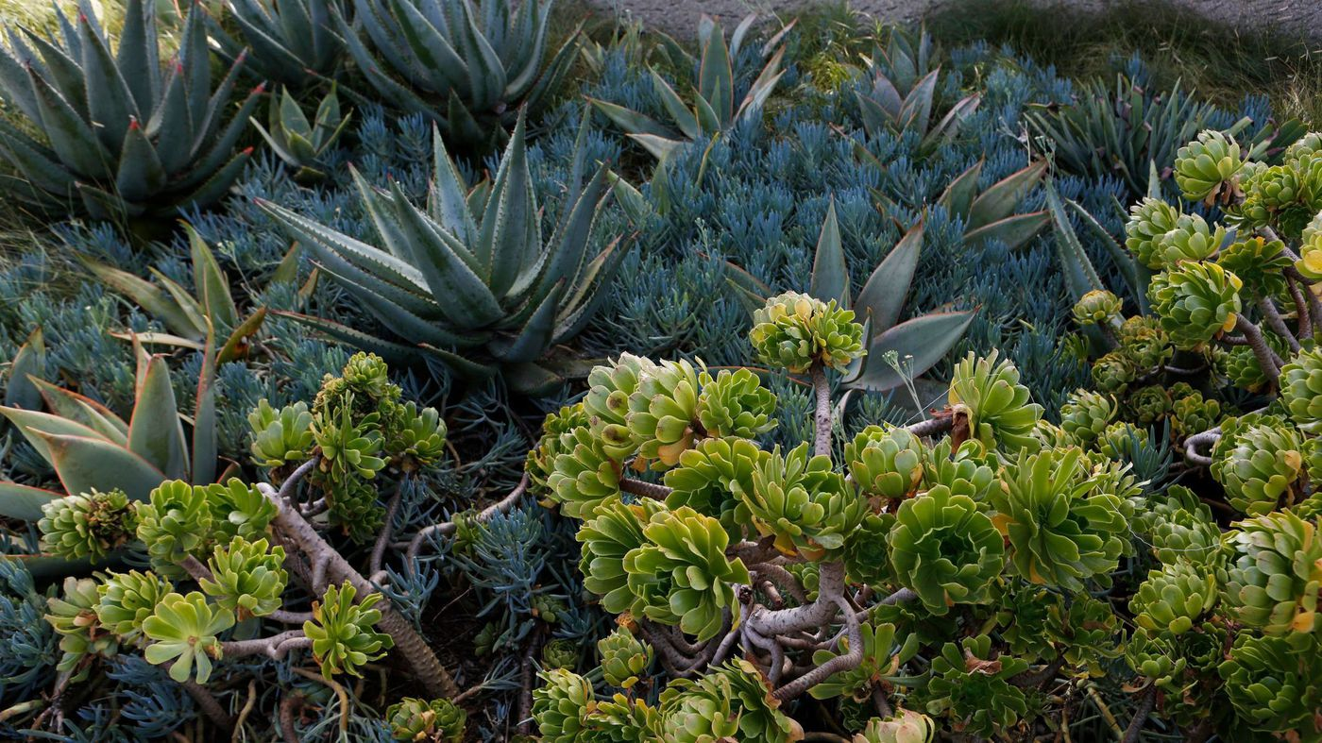
Texas Plant Locator

Slide 6
The app that makes it all easy. Simply find a location, and filter by the plant you’re looking for….

Slide 7
How did we get here? We scraped the Billie L. Turner Plant Resources Center Diversity Portal. If you haven’t had the chance to search this, shall we? click me

Slide 8
So that was fun. Not. John, Michael and Austin wanted … no… NEEDED something better. We partnered, and went to work…

Slide 9
John Swyers scraped the data via Splinter from the PRC website. He then ported the full collection into a Mongo DB. From there, he wrote a PyMongo app to query the DB and render the results on a leaflet map. Mike Raigosa customized the HTML template, and compiled the common names for the plant families. He assisted John in the deployment through HEROKU. John and Mike partnered to design the interface. Austin Gould managed, worked quality control, and pushed the Power Point.

