Slide 1
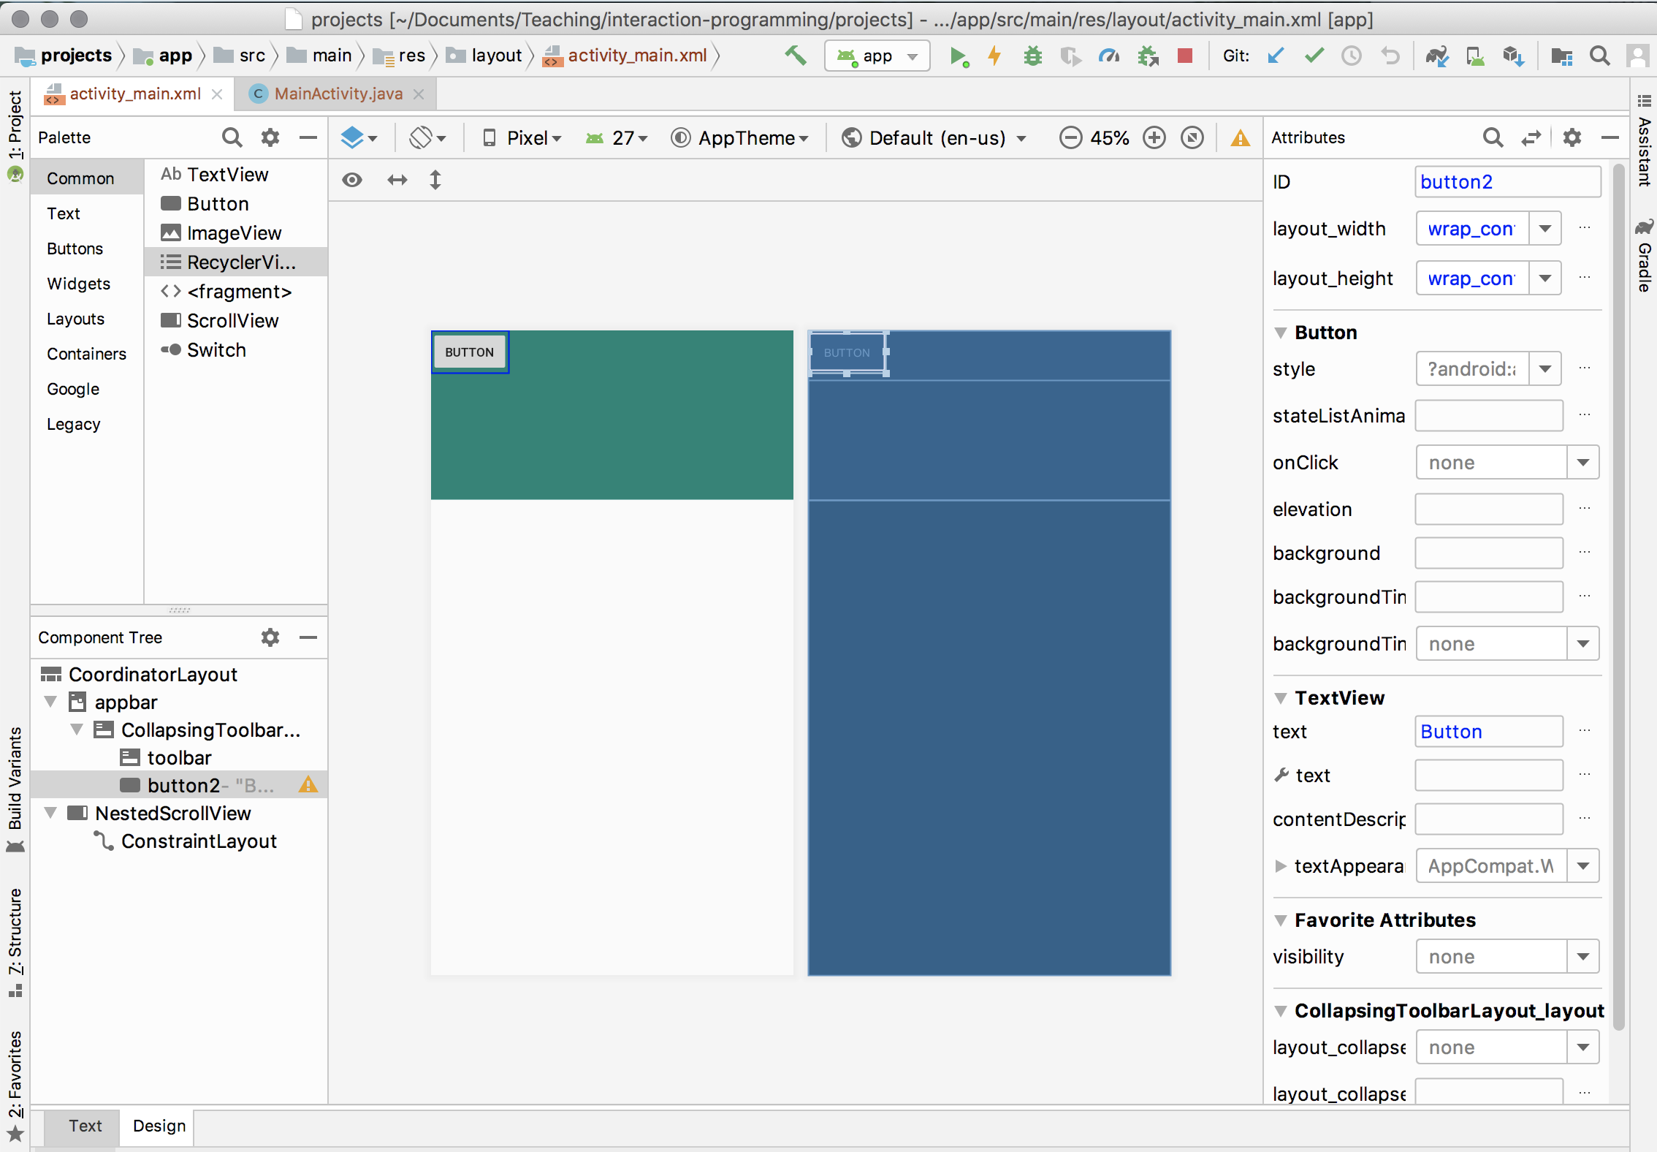
Interactor Toolbox
WYSIWYG Interface
(What you see is what you get)
Layout Editor
Live editor of Interactor Properties
Component Hierarchy
Option to Direct Edit Properties Live

