Slide 1

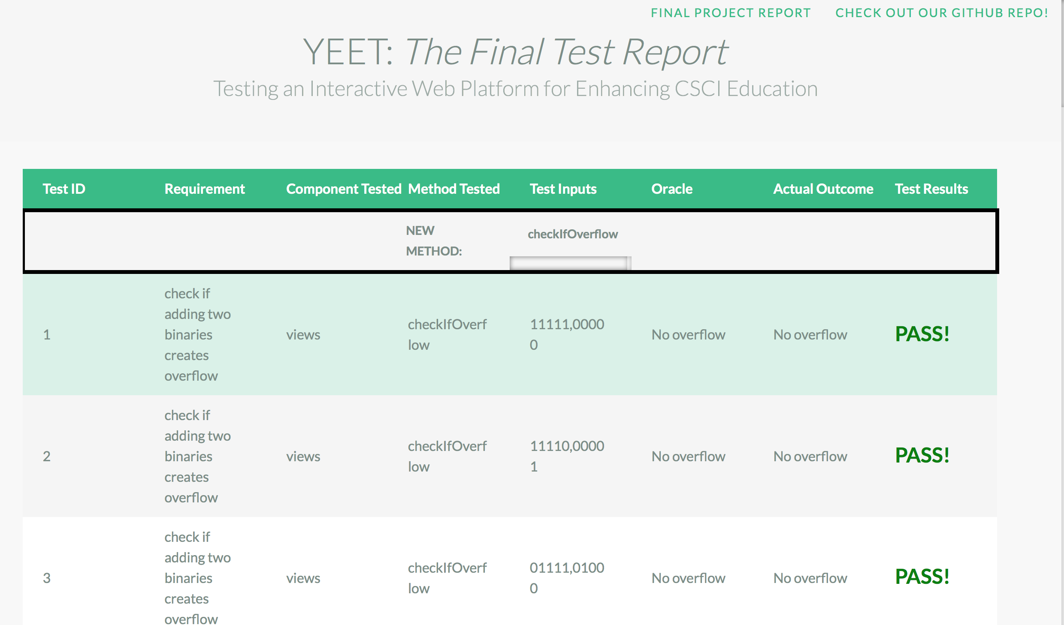

Developing an Automated Testing Framework for a Dynamic Web Platform to Enhance Teaching in The Field of Computer Science
Austin Hunt, Bryce Charydczak
College of Charleston, Department of Computer Science
Abstract
Testing plays a crucial role in the software development process; it allows for the pinpointing of bugs and the minimization of the chance for software failure. Automated test frameworks, like the one we have built, play the role of simplifying the testing process; a couple of concise, well-written scripts can allow not only for software to be tested quickly and automatically, but also for the dynamic creation of test reports that display where problems lie, if any exist at all.
The Django Project: a High-Level View
The Script: Part Two
settings.py
  Contains configuration info, like information about the database to read from and write to
urls.py
  Contains list of URL patterns; when matched by a URL request, corresponding function from views is called that returns a page
views.py
  Contains functions that do thinks like check if users are authenticated, check for AJAX requests, manipulate and read from database, return pages to the user (which are HTML files stored in Templates subdirectory)
models.py
  Contains classes that represent tables in the database; attributes represent fields; change models to add, remove or modify database tables
New Goal: Write a supplementary script to parse the project source code and extract the needed method body. Pre-copied, isolated method bodies are not helpful in unit testing. We need to be testing the up-to-date code.
☑
New script: getMethodBody.sh
How it Works:
1. Cd into project source code
2. cat $1.py | awk "/def $2/,/NEW_FUNCTION/" > tempMethodBody.txt
  Gets file ($1) content, pulls requested method ($2) and outputs to a temporary text file (tempMethodBody.txt)
3. Remove the current method body in driver, replace with tempMethodBody.txt contents
THE FIX: sh getMethodBody.sh $component $unit is run right before executing the driver file within runAllTests.sh to ensure that the up-to-date source code is what is being tested
What are we testing?
We are testing a handful of methods embedded in a website built with Django, which is a high level Python web framework used to make developing web applications both pragmatic and rapid. This particular project is one that we have been helping to develop with Dr. Hajja as part of CSCI 399 throughout the semester; it is designed for his students in CSCI 250, to whom it offers an interactive way to practice material that is covered in class. Prior to starting this project, this Django project did not contain any tests, so we started building from the ground up.
The Test Report
Methods Tested (All co-located in views.py)
checkIfOverflow(value1,value2)
  Checks if two binary numbers cause overflow when added
cofc_convert_decimal_to_sign_magnitude(decimal,numBits)
  Convert an input decimal to sign magnitude representation with given number of bits
cofc_convert_decimal_to_unsigned_binary_with_length(decimal,numBits)
  Convert an input decimal to unsigned binary; also must input number of bits to represent that number with
cofc_decimal_to_ones_complement(decimal,numBits)
  Convert an input decimal to ones complement binary representation
cofc_ones_complement_to_decimal(onesCompBinary)
  Convert input ones complement string to a decimal value
convert_simple_line_c_to_mips(simple_c_exp)
  Convert a simple c expression to MIPS assembly
BIG IDEA: Merge CSCI 399 with CSCI 362 in such a way that their central concepts complement and build upon each other
Test Framework Structure
/YEET – outer framework directory
/250src – Django project being tested (250 website)
/main/views.py – contains all methods being tested
/...
/TestAutomation -
/scripts
/runAllTests.sh – script responsible for running the tests by reading from txt files and executing .py drivers
/getMethodBody.sh – script responsible for pulling live code from views.py into the drivers at runtime
/testCases/… – contains 30 txt files, each of which represent a test case; these are read by the script runAllTests
/testCasesExecutables/… – contains driver files (executable python files); one exists for each method tested
/reports/… – contains the HTML and CSS files used for the generation of the final test report table
/…
The Script: Part One (runAllTests.sh)
Testing the Tests: Fault Injections
cd into testCases subdirectory
Repeat the following for every testCase file
  initialize COUNTER to 1 (to be used to assign names to the lines of the .txt file)
  if current directory is not /testCases, cd into testCases
  Repeat the following for each line of the txt file
    if COUNTER is 1 then testCaseNum is the line, print the test case number
    if COUNTER is 2 then reqToTest is the line, print reqToTest
    if COUNTER is 3 then component is the line, print component
    If COUNTER is 4 then unit is line, print unit
    if COUNTER is 5, then args is the line (to be passed to the function)
    if COUNTER is 6, set oracle = line,
    cd into testCaseExecutables, and execute the $unit.py file while passing in $args and $oracle; output to tempTestOutput.txt
    Compare output, oracle → PASS/FAIL
increment COUNTER
In order to determine how much coverage the test cases we developed actually provided (how sufficient they were for finding bugs), we injected faulty code into each of the methods we tested; each fault belonged to one of the following categories:
Comparison operator modification (< to >, > to <, < to <=, > to >=…)
Reordering of statements/assignments
Changing index values
These faults caused approximately half of the test cases for each method to fail, which shows that our test cases do provide adequate code coverage and should be sufficient for detecting bugs within the selected methods.
Lessons Learned
New skills →
  SCRIPT-WRITING!!
  Executing python drivers with arguments
  HTML
  CSS, styling
  Parsing with awk, sed
  Django
  GITHUB!!
Automation makes testing easy, but creating an automated framework takes time … and patience.
ONE BIG PROBLEM: NOT USING LIVE CODE!

