Slide 1
Fft - fast fourier transform with python
Christopher Pham - EE SJSU

Slide 2
Goals
Practical applications with FFT
Use Python to solve practical applications with FFT

Slide 3
References
But what is the Fourier Transform? A visual introduction.
https://www.youtube.com/watch?v=spUNpyF58BY
Demonstrations: Heart Sounds & Murmurs https://depts.washington.edu/physdx/heart/demo.html
Sample wav file comes from BBC fx sound - http://bbcsfx.acropolis.org.uk/
Computerized Heart Sounds Analysis https://www.intechopen.com/books/discrete-wavelet-transforms-biomedical-applications/computerized-heart-sounds-analysis
Fetal Heart Monitoring
https://www.hopkinsmedicine.org/health/treatment-tests-and-therapies/fetal-heart-monitoring#:~:text=Your%20healthcare%20provider%20may%20do,to%20conditions%20in%20your%20uterus.
Analyzing a Discrete Heart Rate Signal Using Python – Part 1
http://www.paulvangent.com/2016/03/15/analyzing-a-discrete-heart-rate-signal using-python-part-1/
Noise Removal For A Better Fast Fourier Transformation
https://medium.com/swlh/noise-removal-for-a-better-fast-fourier-transformation-284918d4250f
Convert .wav to .csv
https://sendeyo.com/onlineconverter/en/wav/text-csv
https://github.com/Lukious/wav-to-csv
Convert .csv to .wav https://gist.github.com/Pretz/1773870

Slide 4

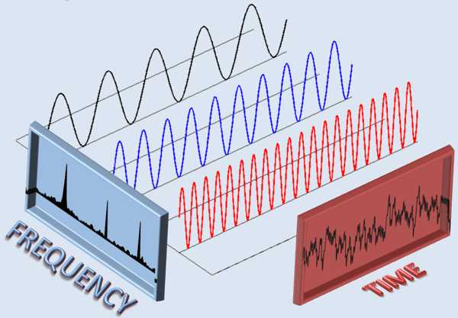

Let’s review FFT

Slide 5
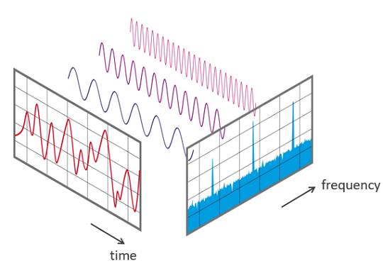
But what is the Fourier Transform? A visual introduction.
https://www.youtube.com/watch?v=spUNpyF58BY

Slide 6
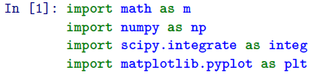
Import libraries

Slide 7
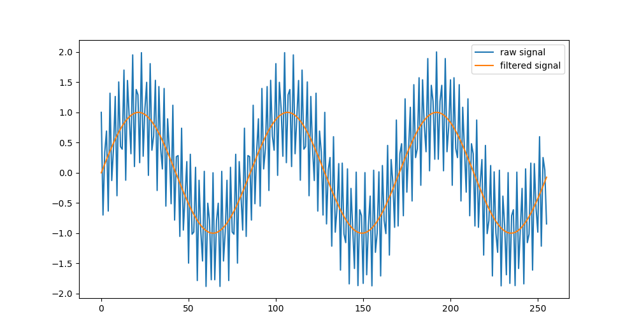
Remove a component of a signal
Example 1

Slide 8
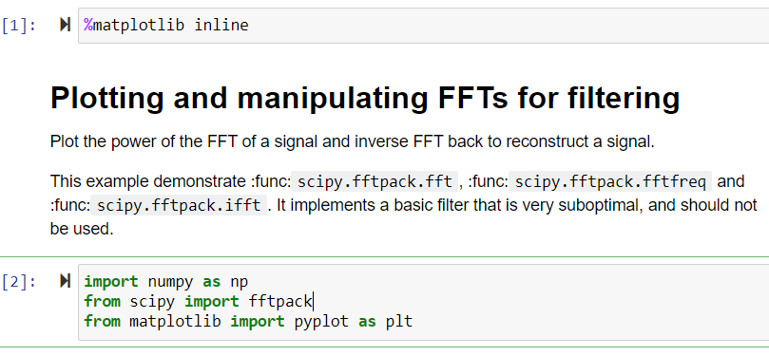
Removing a component of a signal using FFT
https://scipy-lectures.org/intro/scipy/auto_examples/plot_fftpack.html
Code:1_Filter_Frequency_of_a_SumOfSineWaves.ipynb

Slide 9
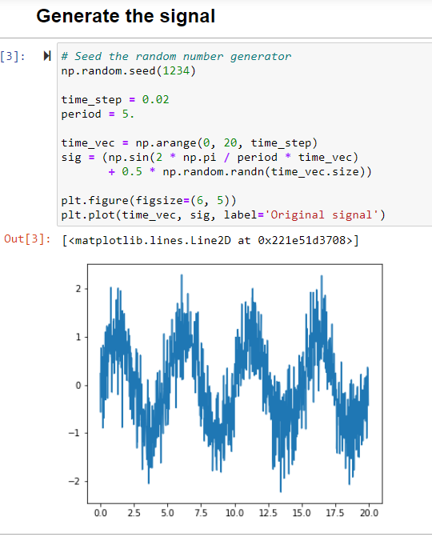

Slide 10
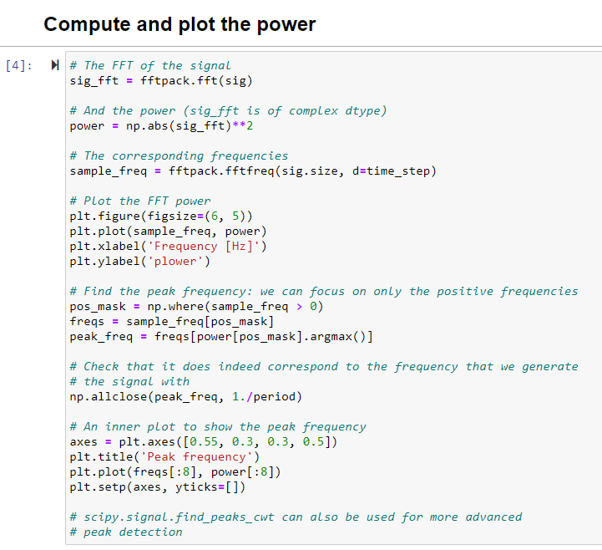
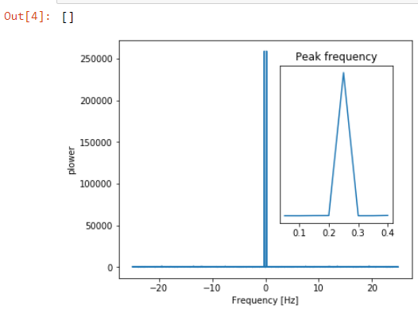

Slide 11
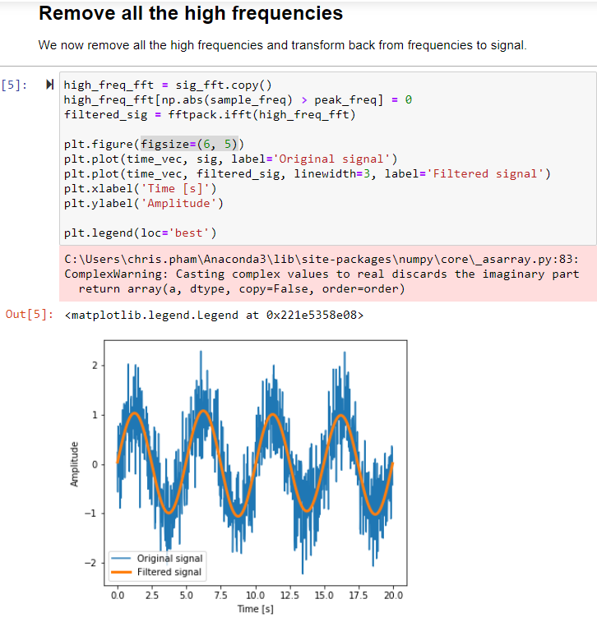
See next slide for how to remove the warnings

Slide 12
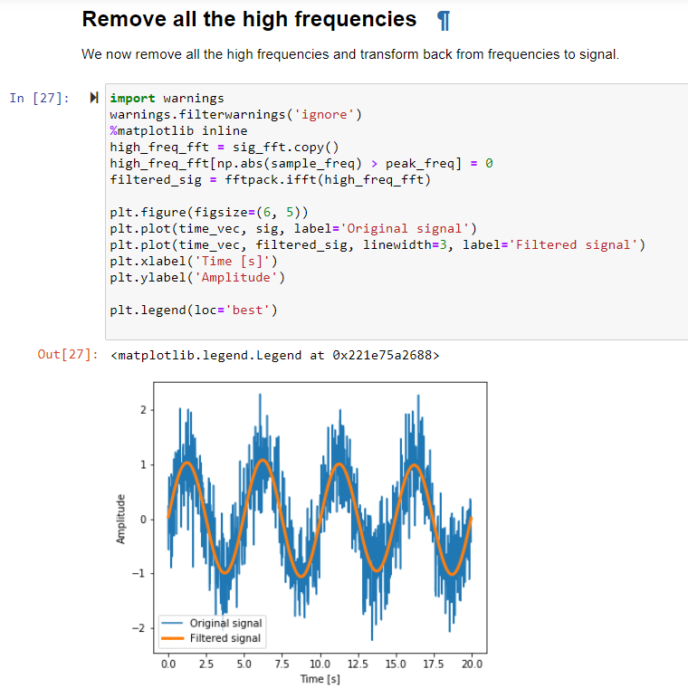
Remove warnings
Actually it is better to use SCIPY FILTER.
See next slides.

Slide 14
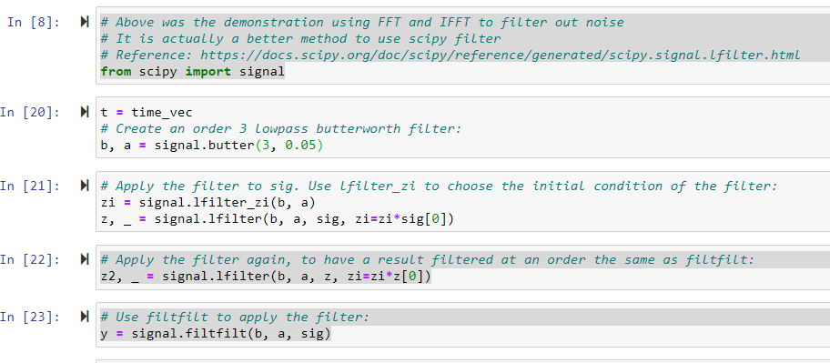
It’s better to use scipy filter

Slide 15
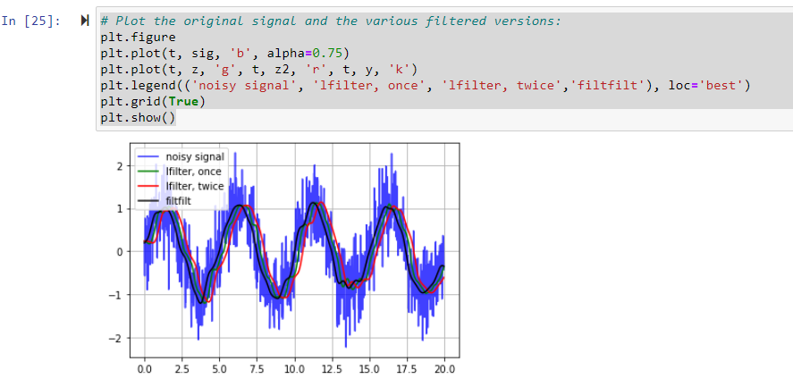

Slide 16
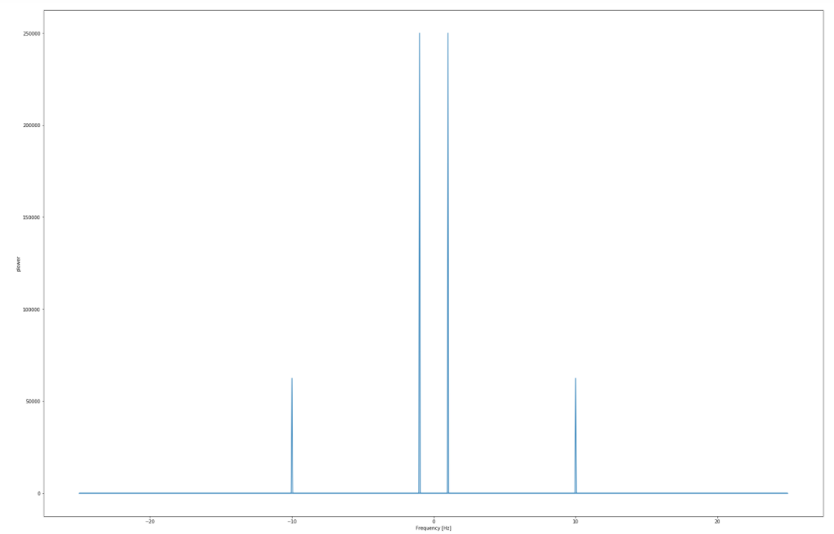
Remove a component of a signal
Example 2

Slide 17
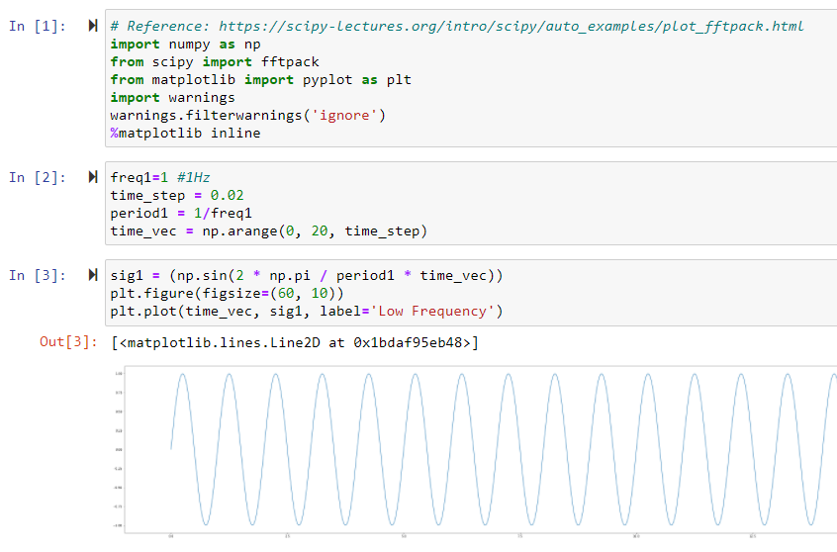
Let’s generate two sine waves and filter out one.
https://docs.scipy.org/doc/scipy/reference/tutorial/fft.html
https://gist.github.com/nipunbatra/0a3c6af8bfe08d3c0bb2a220b9c7a82a
Code: 1_RemoveOneSineWaveFromSumOfTwoSineWaves.ipynb

Slide 18
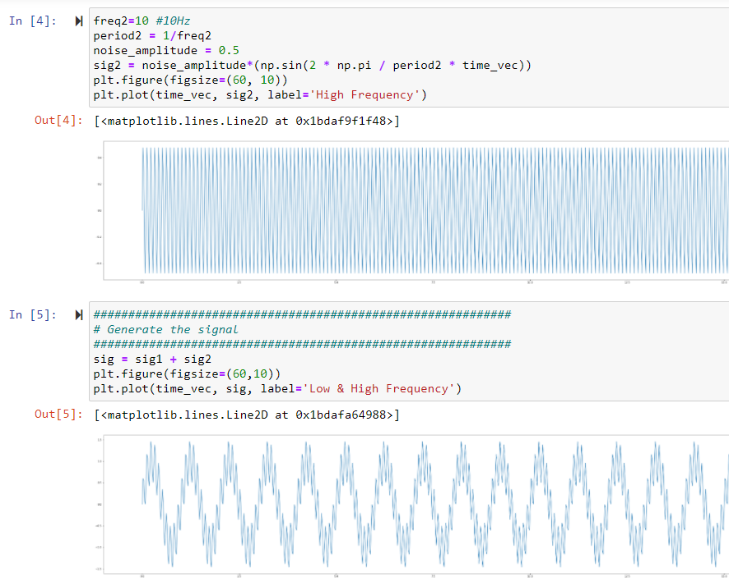

Slide 19
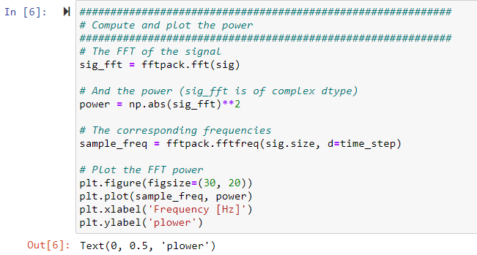
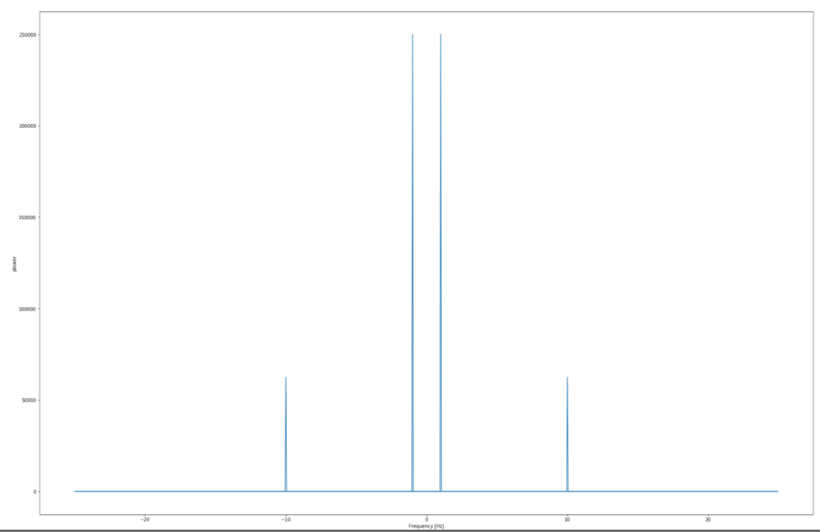

Slide 20
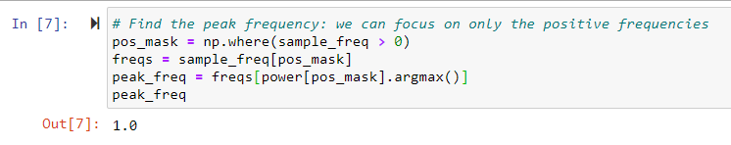

Slide 21
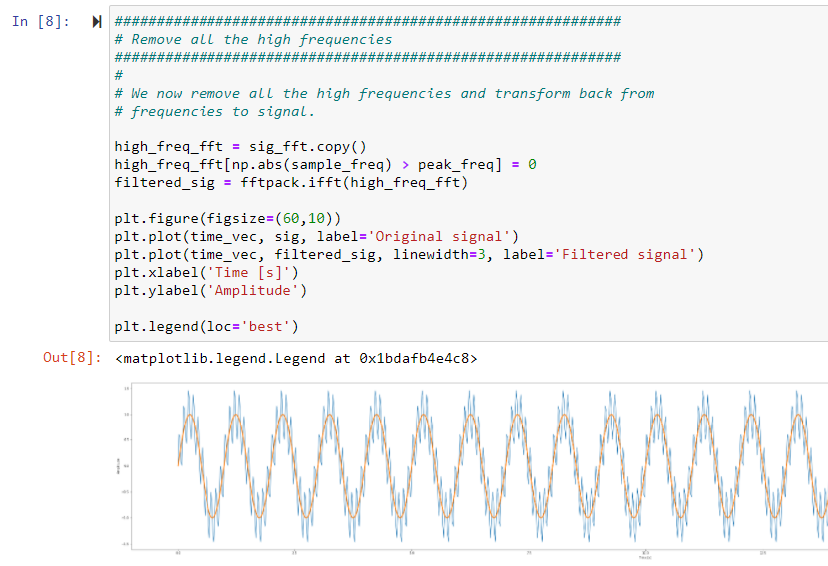

Slide 22
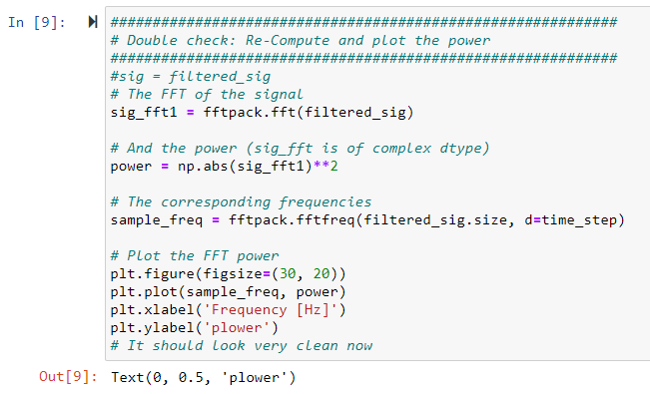
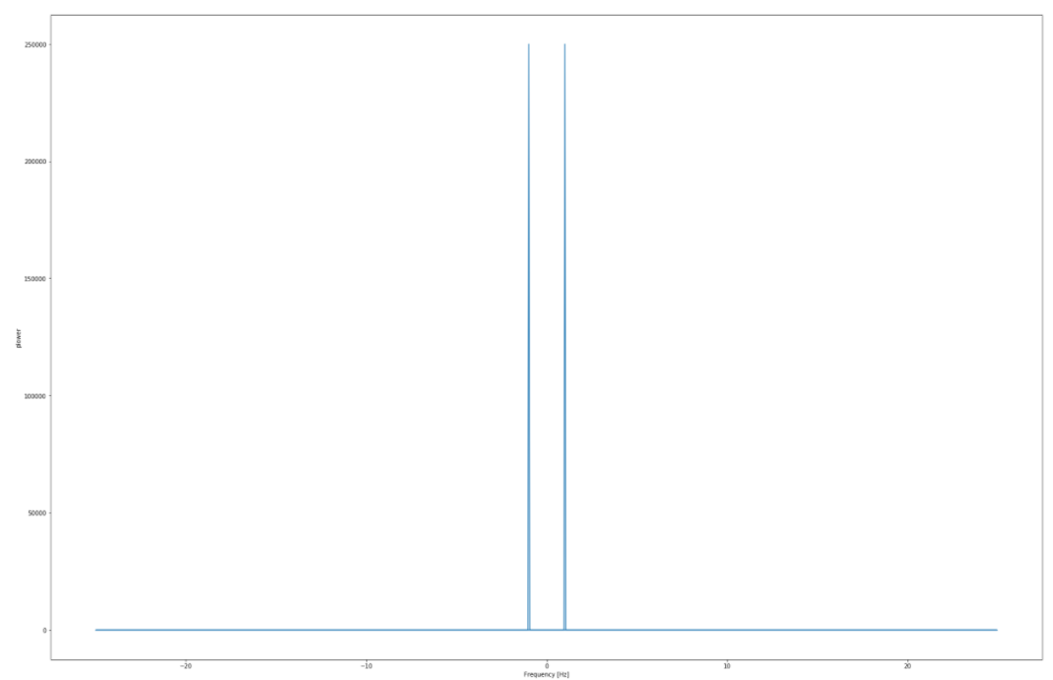
Filtered out!
Filtered out!

Slide 23
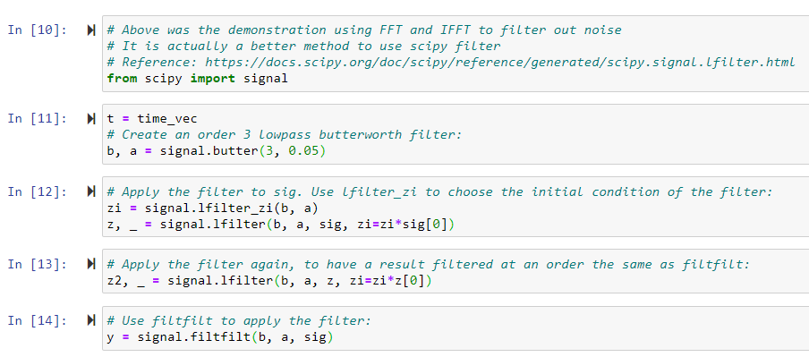
It’s better to use scipy filter

Slide 24
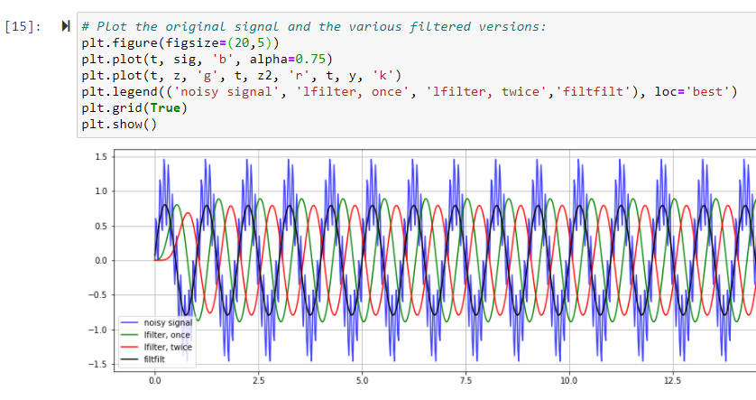

Slide 25
Practical engineering applications

Slide 26
Heart sound analyses
Demonstrations: Heart Sounds & Murmurs
https://depts.washington.edu/physdx/heart/demo.html
Computerized Heart Sounds Analysis https://www.intechopen.com/books/discrete-wavelet-transforms-biomedical-applications/computerized-heart-sounds-analysis
Analyzing a Discrete Heart Rate Signal Using Python – Part 1
http://www.paulvangent.com/2016/03/15/analyzing-a-discrete-heart-rate-signal-using-python-part-1/

Slide 27
Audio editing – removing high frequency noise

Slide 28
Utilities
Convert wav file to csv file https://sendeyo.com/onlineconverter/en/wav/text-csv
https://github.com/Lukious/wav-to-csv
Convert csv file to wav file
https://gist.github.com/Pretz/1773870

Slide 29
resources

Slide 30


