Slide 1
Fft - fast fourier transform with python
Christopher Pham - EE SJSU

Slide 2
Goals
Heart Rate Analysis using Python
Real world application: Let’s look at an HRV Clinical Information Manual.

Slide 3
References
https://github.com/paulvangentcom/heartrate_analysis_python
Demonstrations: Heart Sounds & Murmurs https://depts.washington.edu/physdx/heart/demo.html
Sample wav file comes from BBC fx sound - http://bbcsfx.acropolis.org.uk/
Computerized Heart Sounds Analysis https://www.intechopen.com/books/discrete-wavelet-transforms-biomedical-applications/computerized-heart-sounds-analysis
Fetal Heart Monitoring
https://www.hopkinsmedicine.org/health/treatment-tests-and-therapies/fetal-heart-monitoring#:~:text=Your%20healthcare%20provider%20may%20do,to%20conditions%20in%20your%20uterus.
Analyzing a Discrete Heart Rate Signal Using Python http://www.paulvangent.com/
https://medi-core.com//download/HRV_clinical_manual_ver3.0.pdf
Convert .wav to .csv
https://sendeyo.com/onlineconverter/en/wav/text-csv
https://github.com/Lukious/wav-to-csv
Convert .csv to .wav https://gist.github.com/Pretz/1773870

Slide 4

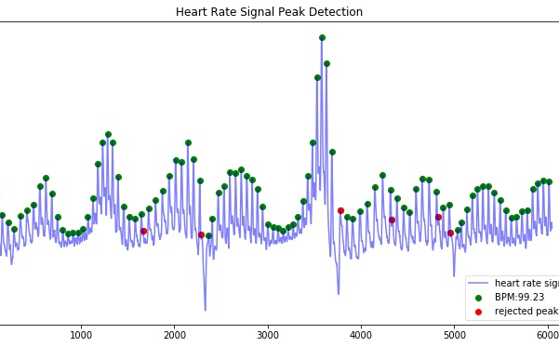

Heart rate analysis

Slide 5
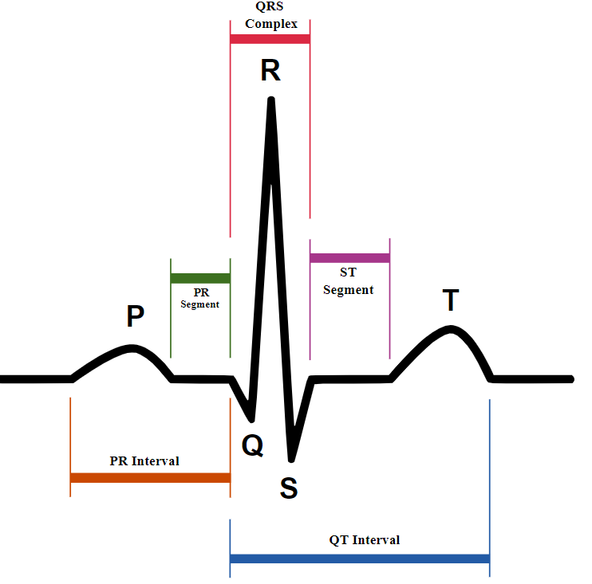
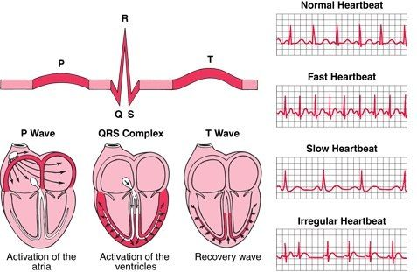
Basic information
https://hubpages.com/education/Heart-Rhythms
https://upload.wikimedia.org/wikipedia/commons/9/9e/SinusRhythmLabels.svg

Slide 6
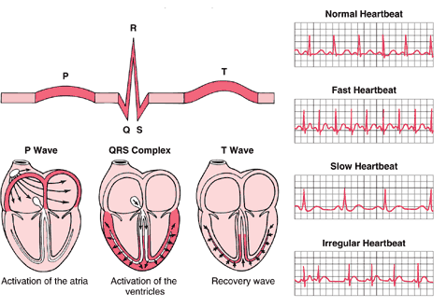
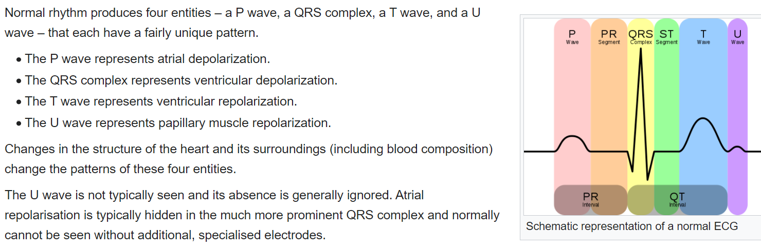
https://en.wikipedia.org/wiki/Electrocardiography

Slide 7
Animation of a normal ECG wave
https://en.wikipedia.org/wiki/File:ECG_principle_slow.gif
By Kalumet - selbst erstellt = Own work, CC BY-SA 3.0, https://commons.wikimedia.org/w/index.php?curid=438140

Slide 8
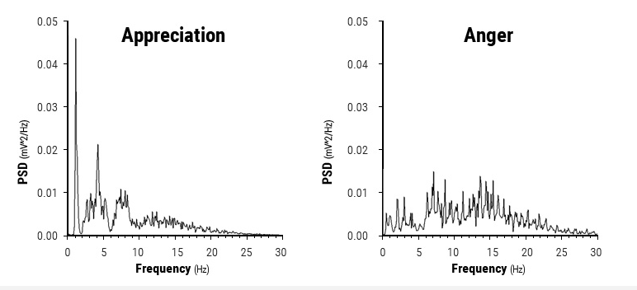
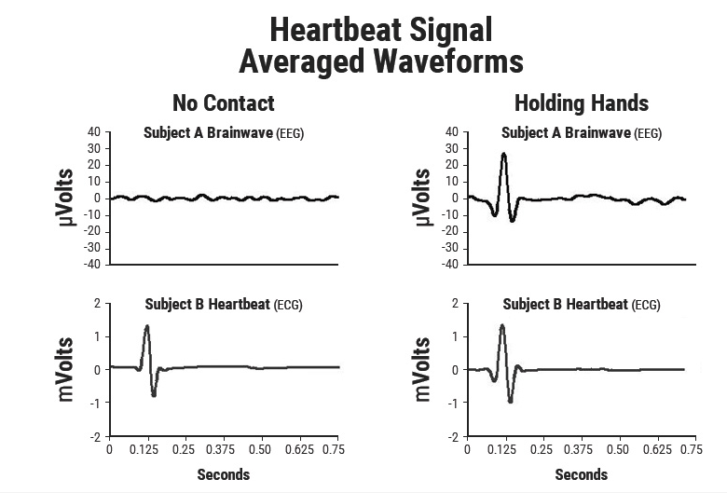
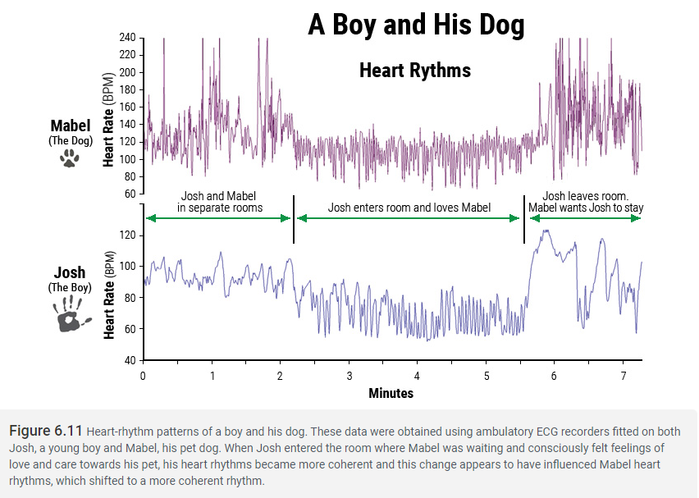
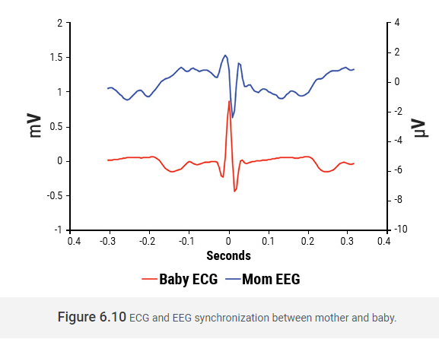
Relationship Synchronization Patterns
https://www.heartmath.org/research/science-of-the-heart/energetic-communication/

Slide 9
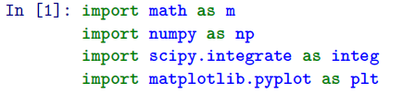
Import libraries
pip install heartpy

Slide 10
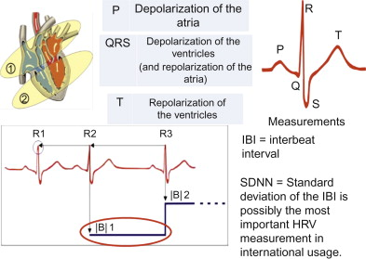
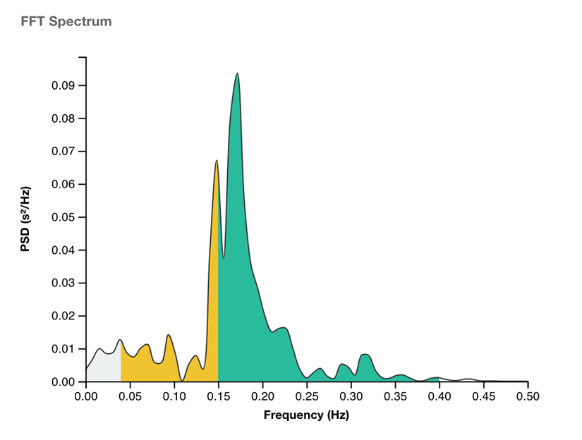
Heart rate Variability - HVR
Time domain:
beats per minute, BPM
interbeat interval, IBI
standard deviation if intervals between adjacent beats, SDNN
standard deviation of successive differences between adjacent R-R intervals, SDSD
root mean square of successive differences between adjacend R-R intervals, RMSSD
proportion of differences between R-R intervals greater than 20ms, 50ms, pNN20, pNN50
median absolute deviation, MAD
Poincare analysis (SD1, SD2, S, SD1/SD1)
Poincare plotting
Frequency domain
low frequency component (0.04-0.15Hz), LF
high frequency component (0.16-0.5Hz), HF
lf/hf ratio, Lf/HF
https://www.sciencedirect.com/topics/psychology/respiratory-sinus-arrhythmia
https://help.elitehrv.com/article/159-hrv-frequency

Slide 11
Supraventricular tachycardia infant heart rate
https://www.rileychildrens.org/health-info/supraventricular-tachycardia
Supraventricular tachycardia is an abnormally rapid heart rate up to 300 beats per minute in infants and 250 beats per minute or faster in older children.
Code: 2_SupraventricularTachycardiaInfantHeartRate.ipynb

Slide 12
Hearpy (hp) documentation
https://readthedocs.org/projects/python-heart-rate-analysis-toolkit/downloads/pdf/latest/
hp.process(dataset, sample_rate, windowsize=0.75, report_time=False, calc_freq=False, freq_method=’welch’, interp_clipping=False, clipping_scale=False, interp_threshold=1020, hampel_correct=False, bpmmin=40, bpmmax=180, reject_segmentwise=False, high_precision=False, high_precision_fs=1000.0, measures = {}, working_data = {}) requires two arguments: • dataset: An 1-dimensional list, numpy array or array-like object containing the heart rate data; • sample_rate: The samplerate of the signal in Hz;
Two dict{} objects are returned: one working data dict wd, and one containing all measures m.

Slide 13
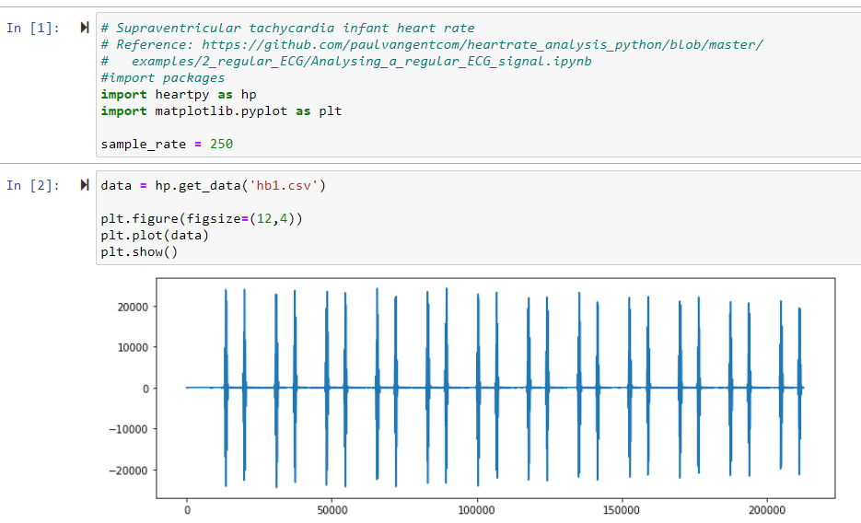

Slide 14
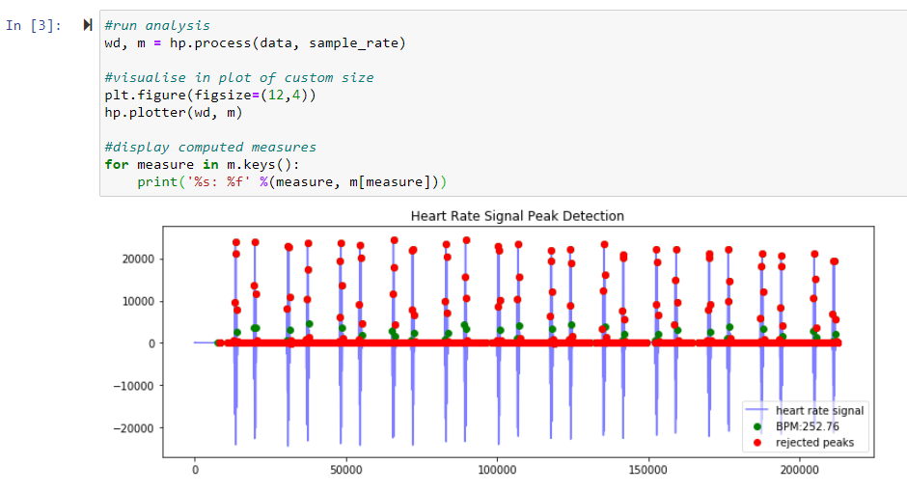
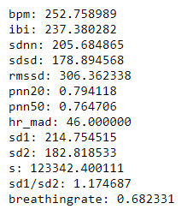

Slide 15

HRV Frequency Measurements (LF, HF, LF/HF)
Heart Rate Variability (HRV) is a term that describes many metrics and analysis techniques, including Time Domain, Frequency Domain, and Non-Linear Analysis.
Frequency Domain Analysis is a complex analysis technique that shows how much of a signal lies within one or more frequency bands (ranges). With regards to Heart Rate Variability, research has identified certain frequency bands that tend to correlate with certain physiological phenomenon, such as Parasympathetic nervous system activity.
Common Frequency Domain HRV metrics include:
High Frequency power (HF): frequency activity in the 0.15 - 0.40Hz range (green in the above chart)
Low Frequency power (LF): frequency activity in the 0.04 - 0.15Hz range (yellow in the above chart)
LF/HF Ratio: A ratio of Low Frequency to High Frequency. Some consider this indicative of Sympathetic to Parasympathetic Autonomic Balance, but that is controversial. Please see this article and this article for more information.
https://help.elitehrv.com/article/159-hrv-frequency

Slide 16
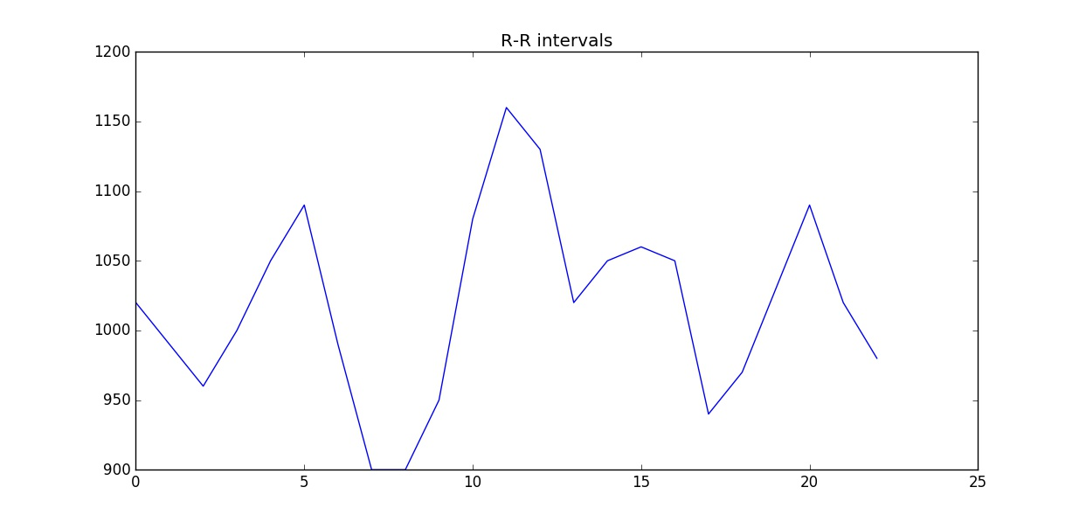
Using fft for heart rate analysis
http://www.paulvangent.com/2016/03/21/analyzing-a-discrete-heart-rate-signal-using-python-part-2/
Frequency Domain Measures – Getting Started
The calculation of the frequency domain measures is a bit trickier than in time domain.
The main reason is that we do not want to transform the heart rate signal to the frequency domain (doing so would only return a strong frequency equal to BPM/60, the heartbeat expressed in Hz).
Rather, we want to transform the R-R intervals to the frequency domain.
Difficult to understand? Think about it like this: your heart rate varies over time as your heart speeds up and slows down in response to the changing demands of your body.
This variation is expressed in the changing distances between heart beats over time (the R-R intervals we calculated earlier).
The distances between R-R peaks vary over time with their own frequency. To visualize, plot the R-R intervals :
R-R intervals do not change abrubtly per heartbeat but vary over time in a sine-wave like pattern (more precisely: a combination of different sine waves). We want to find the frequencies that make up this pattern.

Slide 17
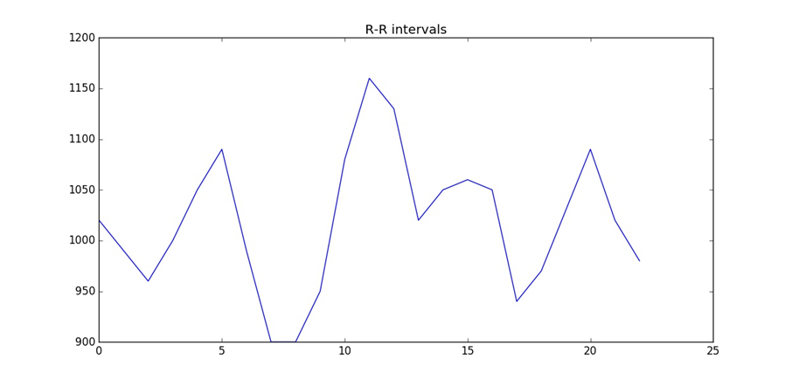
Overcome the fft challenges
Any Fourier transform method depends on evenly spaced data, and our R-R intervals are most certainly not evenly spaced in time. This is because the position in time of the intervals is dependent on their length, which is different for each interval.
To find our measures, we need to:
Create an evenly spaced timeline with the R-R intervals on it;
Interpolate the signal, which serves to both create an evenly spaced time-series and increase the resolution;
This interpolation step is also called re-sampling in some studies.
Transform the signal to the frequency domain;
Integrate the area under the LF and HF portion of the spectrum.

Slide 18
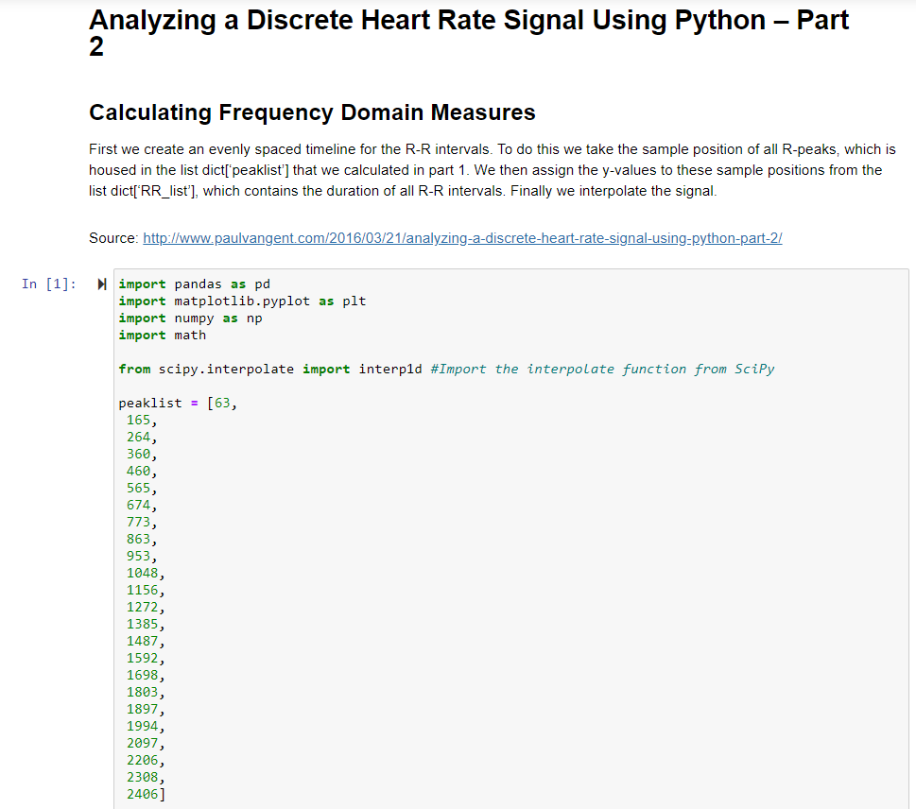
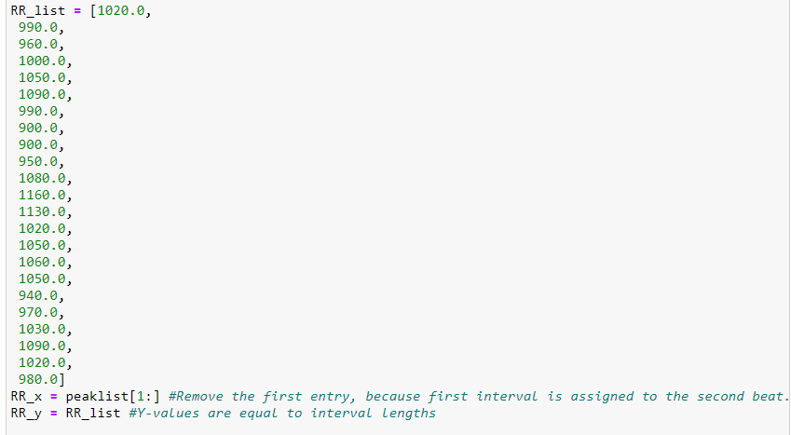
Code: 2_Analyzing a Discrete Heart Rate Signal Using Python – Part 2.ipynb

Slide 19
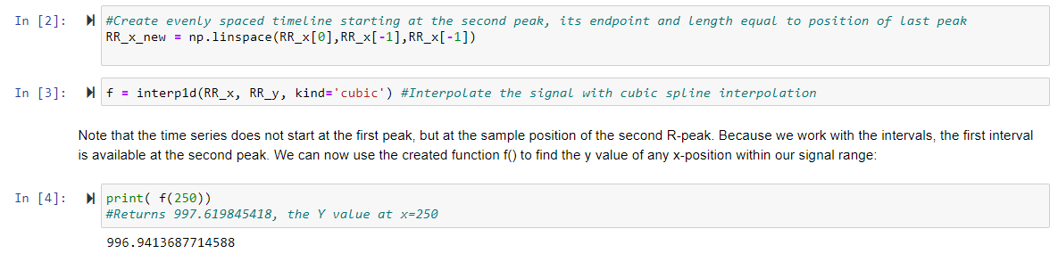

Slide 20
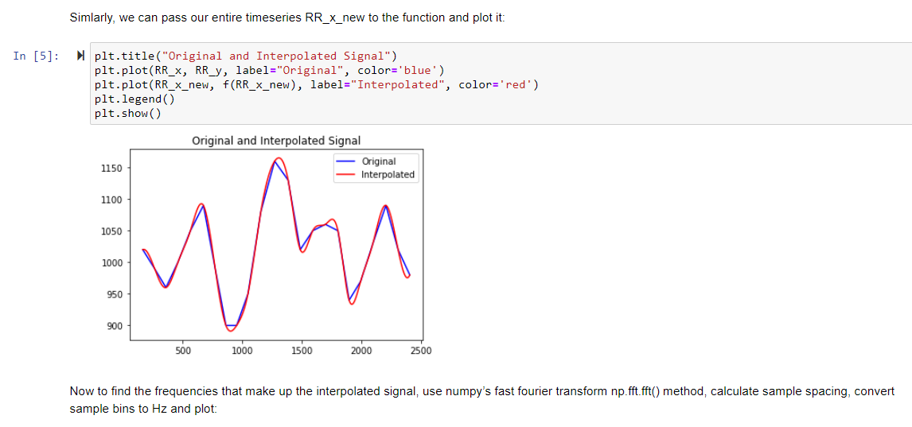

Slide 21
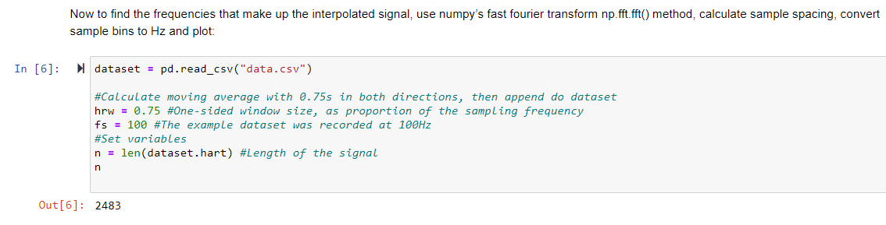

Slide 22
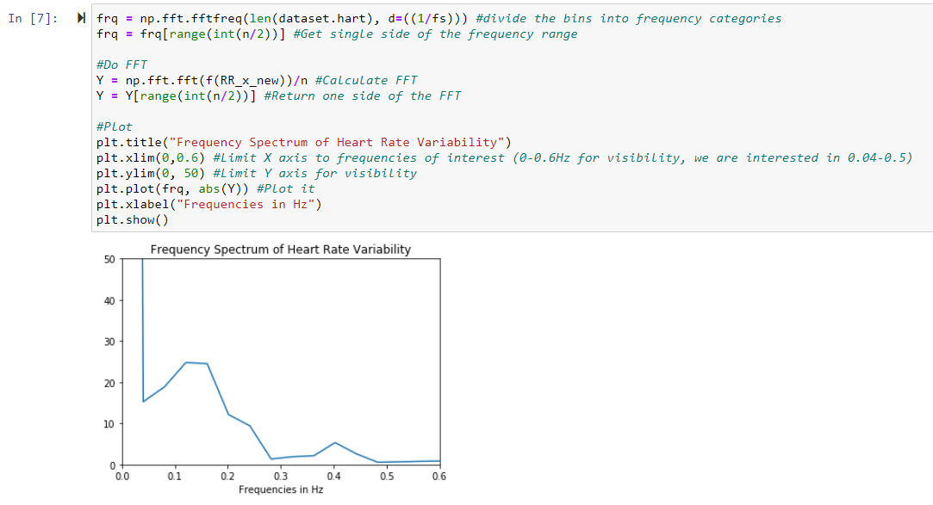
HF (0.16 – 0.5Hz)
LF (0.04 – 0.15Hz)

Slide 23
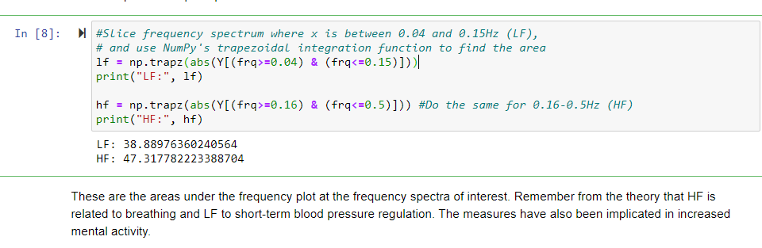
Common Frequency Domain HRV metrics include:
High Frequency power (HF): frequency activity in the 0.15 - 0.40Hz range (green in the above chart)
Low Frequency power (LF): frequency activity in the 0.04 - 0.15Hz range (yellow in the above chart)
LF/HF Ratio: A ratio of Low Frequency to High Frequency. Some consider this indicative of Sympathetic to Parasympathetic Autonomic Balance, but that is controversial. Please see this article and this article for more information.

Slide 24
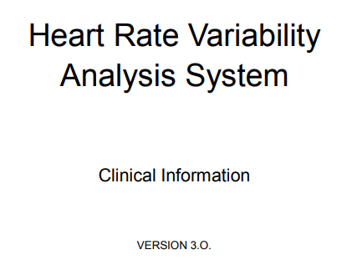
HRV clinical manual
ver 3.0

Slide 25

Heart Rate Variability Analysis System Clinical Information
https://medi-core.com//download/HRV_clinical_manual_ver3.0.pdf

Slide 26
Utilities
Convert wav file to csv file https://sendeyo.com/onlineconverter/en/wav/text-csv
https://github.com/Lukious/wav-to-csv
Convert csv file to wav file
https://gist.github.com/Pretz/1773870

Slide 27
resources
https://readthedocs.org/projects/python-heart-rate-analysis-toolkit/downloads/pdf/stable/

Slide 28


