Slide 1
Predicting Covid Data
Austin Lackey, Chien Lin and Jin Peng

Slide 2
The MonteCarlo Study
In this study by Ignazio Ciufolini and Antonio Paolozzi, they use a Gauss Error to predict future trends of covid data spread.
Add more stuff here…

Slide 3
The Gauss Error function
The Gauss Error function is widely accepted as a good way to model the spread of covid data, especially in China. By using the Gauss Error function, we can predict the spread of covid data in the future for other countries.
$a+b*erf\left(c*x−d\right)$

Slide 4
China Simulation

Slide 5
China Simulation
Add stuff here

Slide 6
Italy Simulation

Slide 7
Italy Simulation
Add stuff here

Slide 8
Australia Simulation

Slide 9
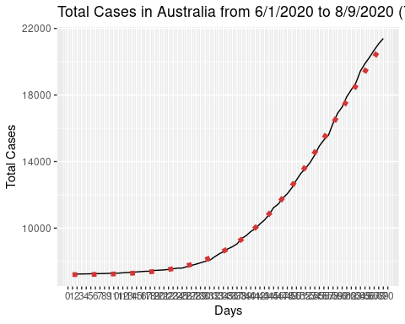
Australia Simulation

Slide 10
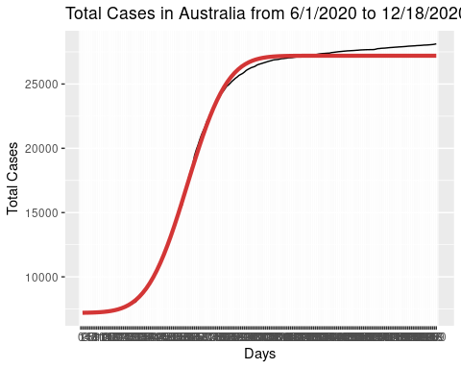
Australia results

Slide 11
Works Cited
Link to study:
I. Ciufolini, A. Paolozzi, Prediction of the time evolution of the Covid-19 Pandemic in Italy by a Gauss Error Function and Monte Carlo simulations. Submitted to BioRxiv on 03.26.2020 and transferred on 03.27.2020 to MedRxiv. https://doi.org/10.1101/2020.03.27.20045104
Link to covid data:
https://covid19.who.int/

