Slide 1
Predicting Covid Data
Austin Lackey, Chien Lin and Jin Peng

Slide 2
Introduction
In this study by Ignazio Ciufolini and Antonio Paolozzi, they use a Gauss Error function that approximates the distribution of the cumulative positive cases of COVID-19 in China
They then use the function to approximate the number of cumulative positive cases in Italy
Then performed 150 Monte Carlo simulations to predict the peak and valley of the number of daily positive cases and fatalities
This study does not take into account factors such as daily nasopharyngeal swabs, medical, social distancing, etc.

Slide 3
The Monte Carlo Study:
Mathematical prediction of the time evolution of the COVID-19 pandemic in Italy by a Gauss error function and Monte Carlo simulations
Author: Ignazio Ciufolini, Antonio Paolozzi

Slide 4
Introduction : Ciufolini and Paolozzi’s Study
In this study by Ignazio Ciufolini and Antonio Paolozzi, they use a Gauss Error function that approximates the distribution of the cumulative positive cases of COVID-19 in China
They have then use the function to approximate the number of cumulative positive cases in Italy
Then performed a 150 Monte Carlo simulations to predict the peak and valley of the number of daily positive cases and fatalities
This study do not take into account factors such as daily nasopharyngeal swabs, medical, social distancing, etc.

Slide 5
Cont.
Mathematical prediction of the time evolution of the COVID-19 pandemic by a Gauss error function and Monte Carlo simulations:
The number of cumulative diagnosed positive cases and fatalities in China approximates a gauss error function: $a+b*erf\left(c*x−d\right)$.
Predicted the potential number of cases in Italy.
Predicted the day in which the peak of the number of daily cases in Italy occurs.

Slide 6
Overview of the Monte Carlo Simulation
create a random matrix : m X n
m = number of random outcomes (chosen to be 150)
n = number of observed days (n = 1,…,j)
each # in the matrix is a Gaussian distribution with mean = 1 and sigma = 0.1
multiply each column (j) by the # of total cases (or deaths) that corresponds to each day j #FIXME#
add more…

Slide 7
China Simulation

Slide 8
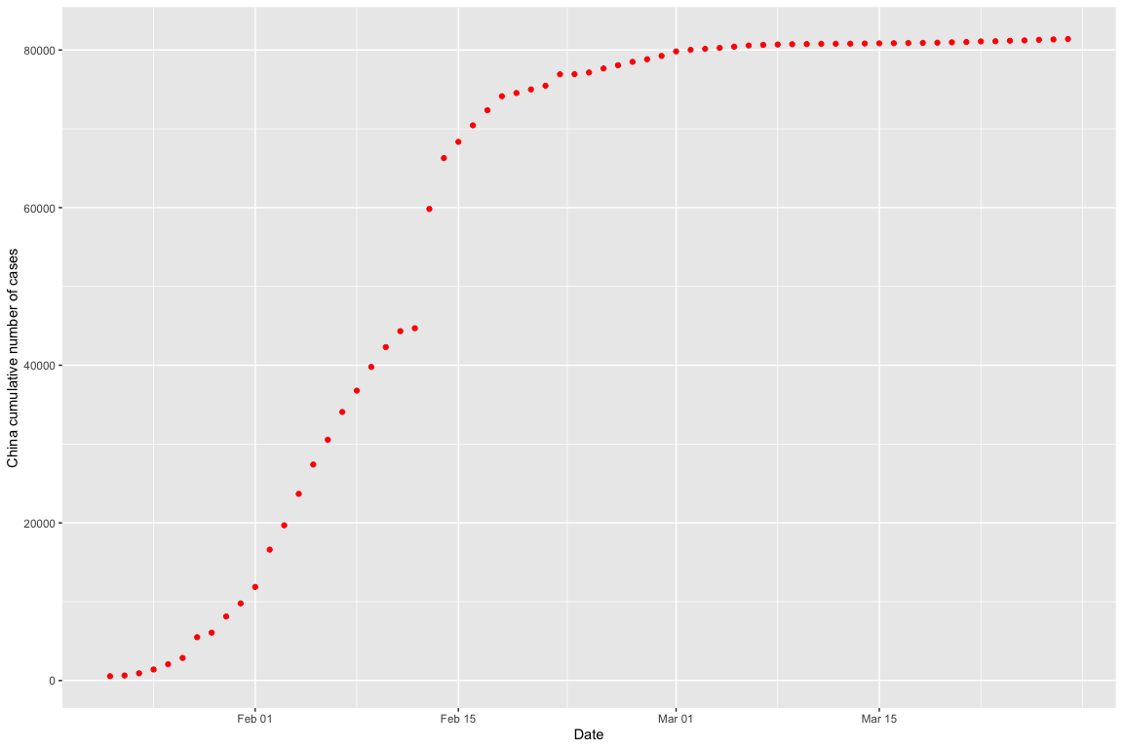
Available Official Data (Positive Cases)

Slide 9
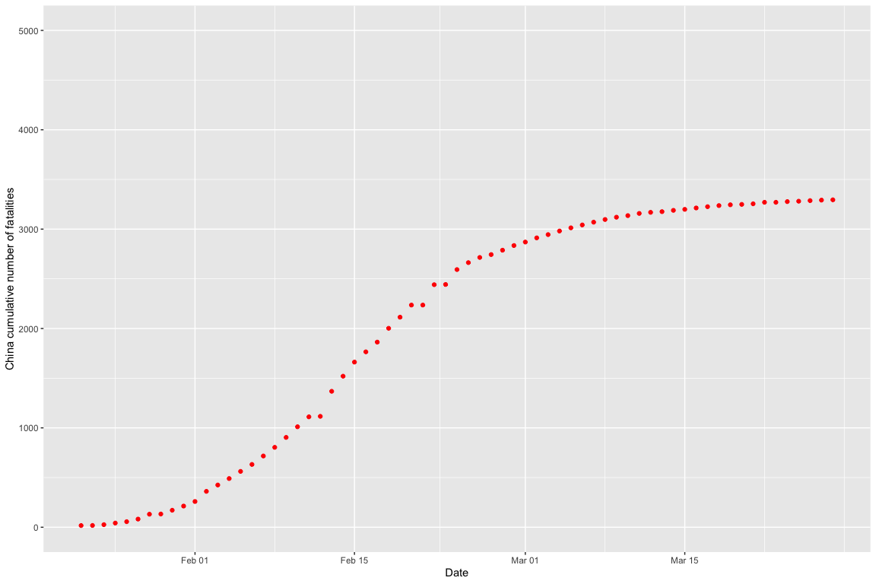
Available Official Data (Fatalities)

Slide 10
Fit by the Gauss Error Function
Apply $nls$ function to determine the nonlinear (weighted) least-squares estimates of the four parameters $a,b,c,d$ of a Gauss error function model: $a+b*erf\left(c*x−d\right)$.
model <- nls(total_cases ~ gauss_fn(days,a,b,c,d), data=china, start=list(a=10000,b=10000,c=0.1,d=1))

Slide 11
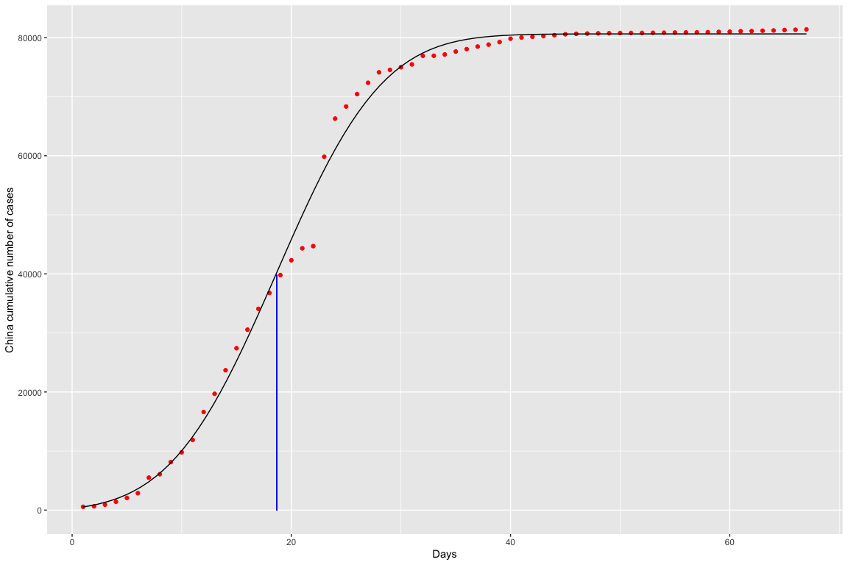
Fit by the Gauss Error Function and Peak Day (Positive Cases)

Slide 12
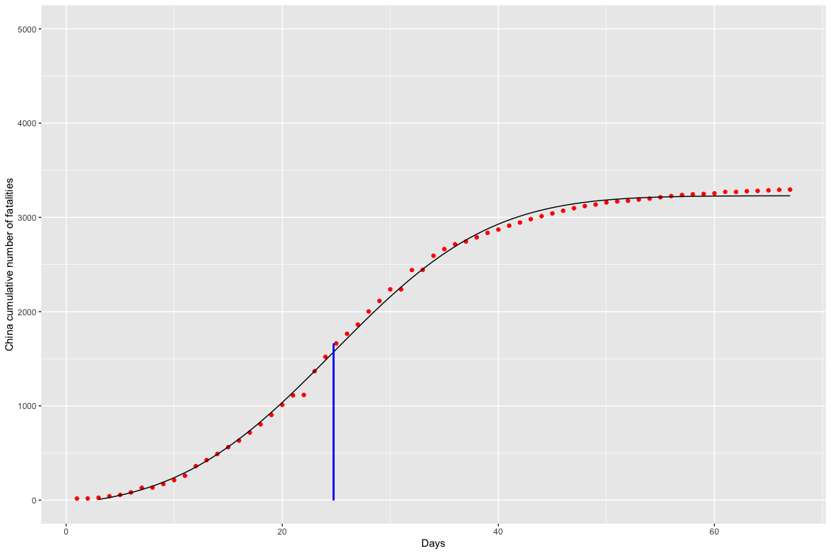
Fit by the Gauss Error Function and Peak Day (Fatalities)

Slide 13
Italy Simulation

Slide 14
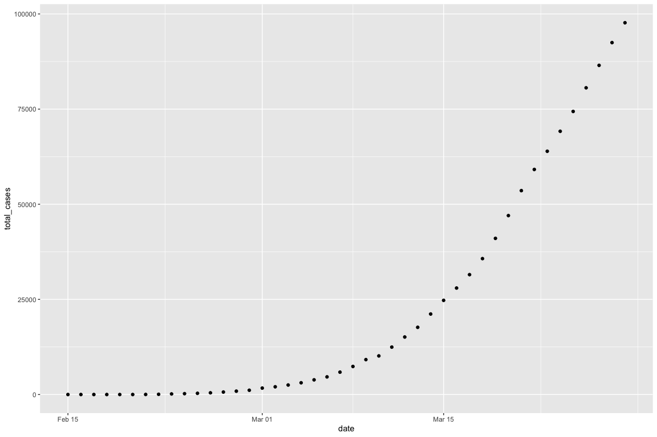
Plot of Diagnosed Positive Cases

Slide 15
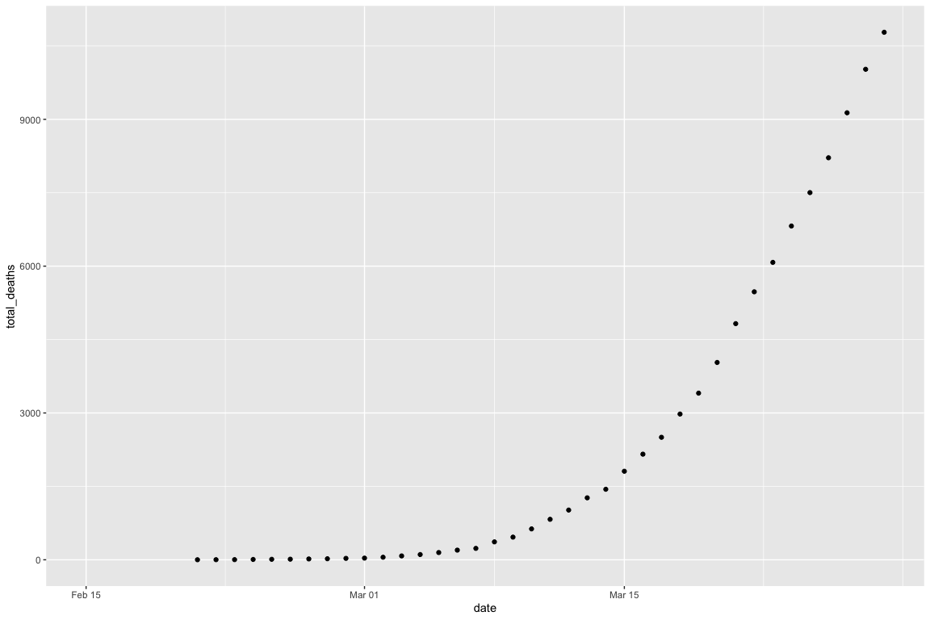
Plot of Fatalities

Slide 16
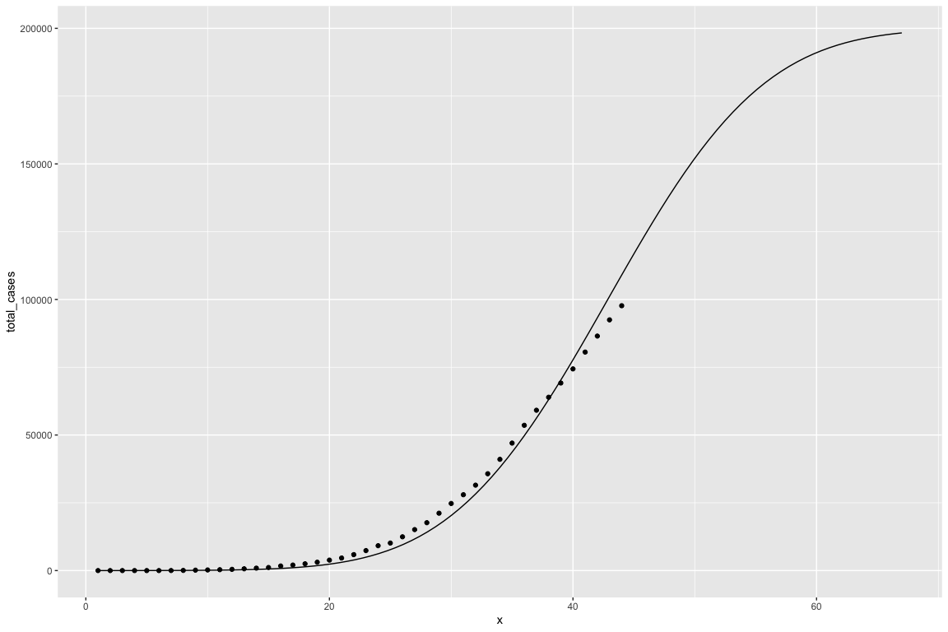
Plot of Diagnosed Positive Cases with Gauss Error Function

Slide 17
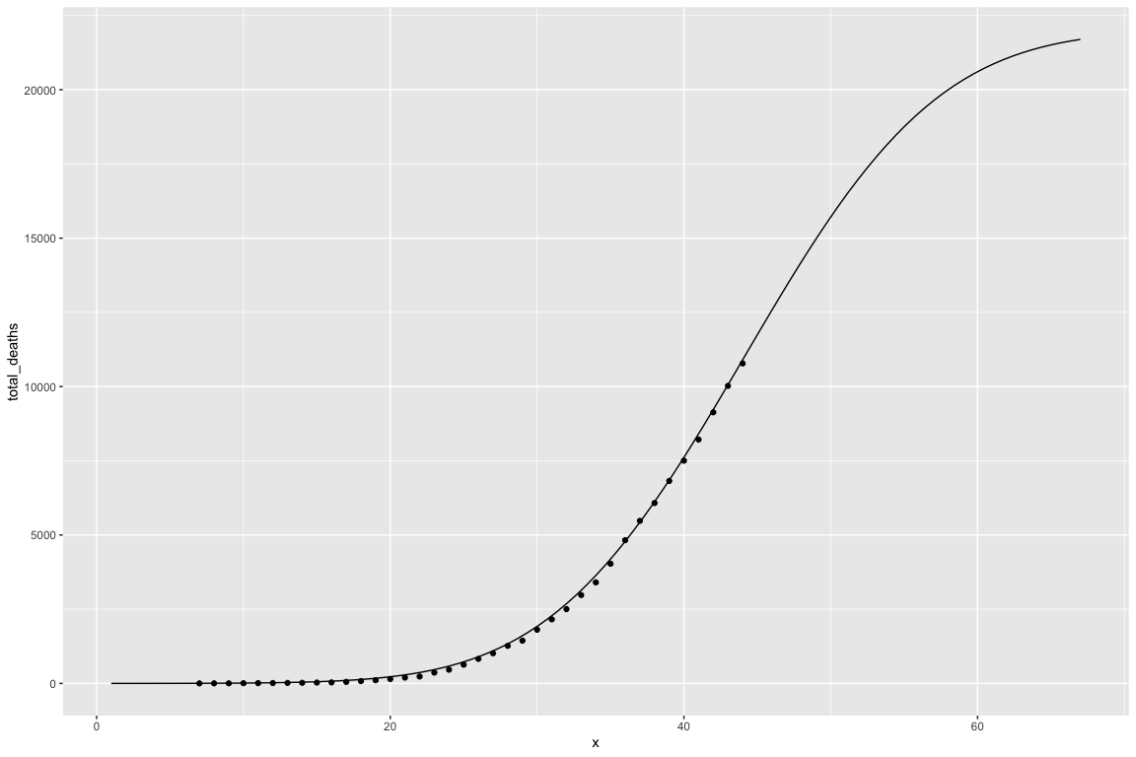
Plot of Fatalities with Gauss Error Function

Slide 18
Australia Simulation

Slide 19
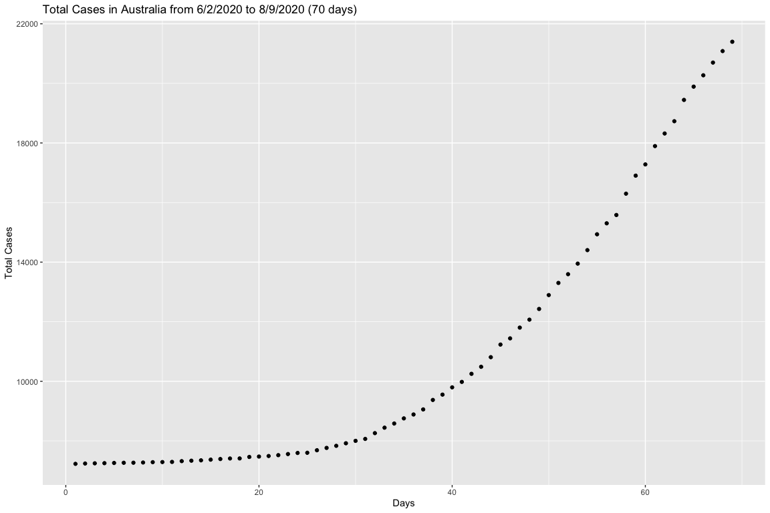
Initial Data for Cases in Australia

Slide 20
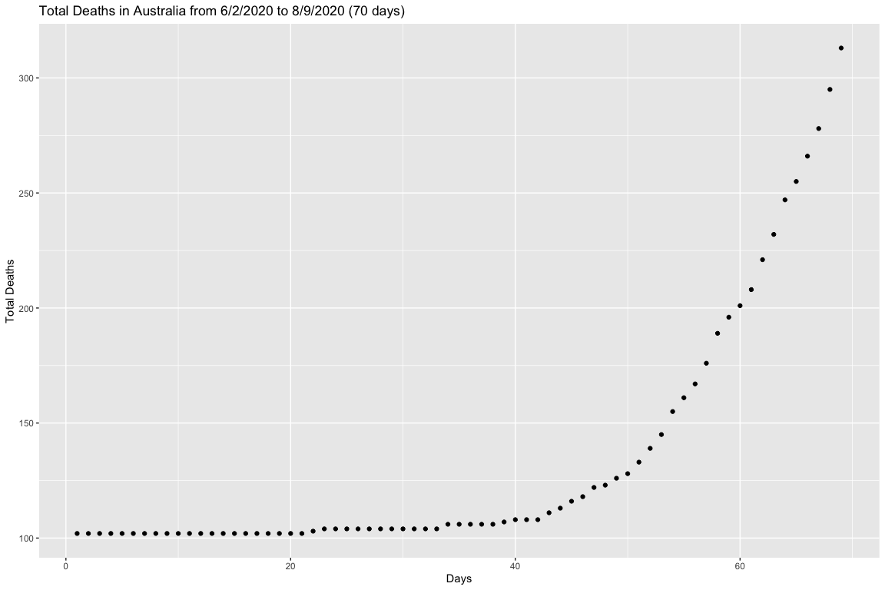
Initial Data for Fatalities in Australia

Slide 21
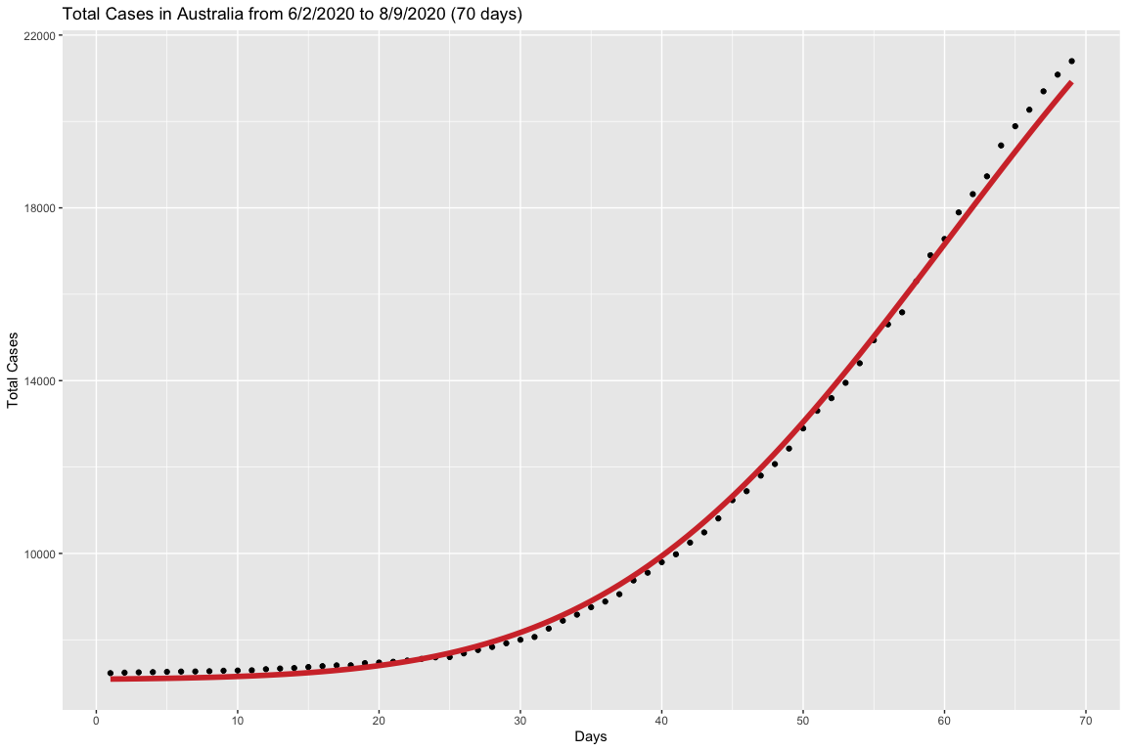
Fitting Gauss Error Function to Cases in Australia

Slide 22
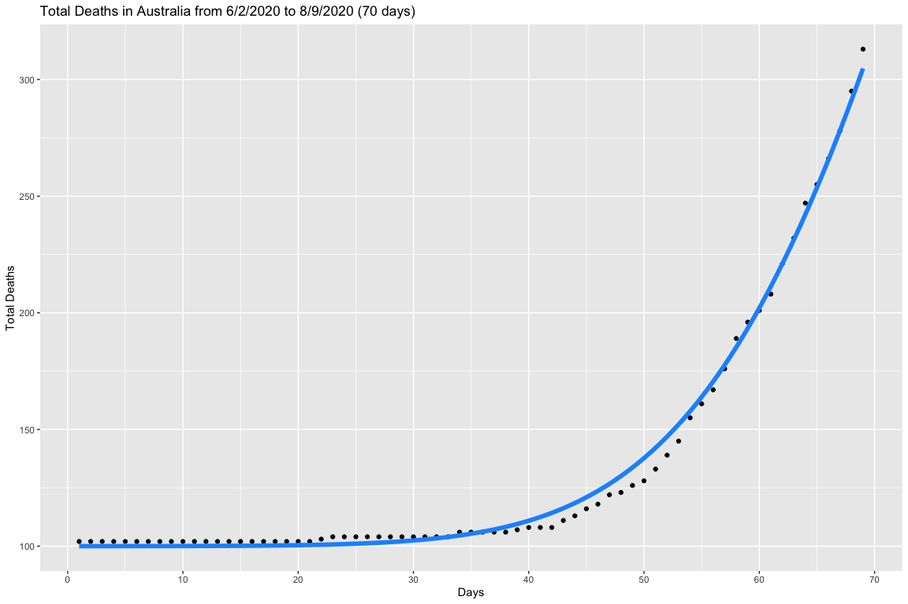
Fitting Gauss Error Function to Fatalities in Australia

Slide 23
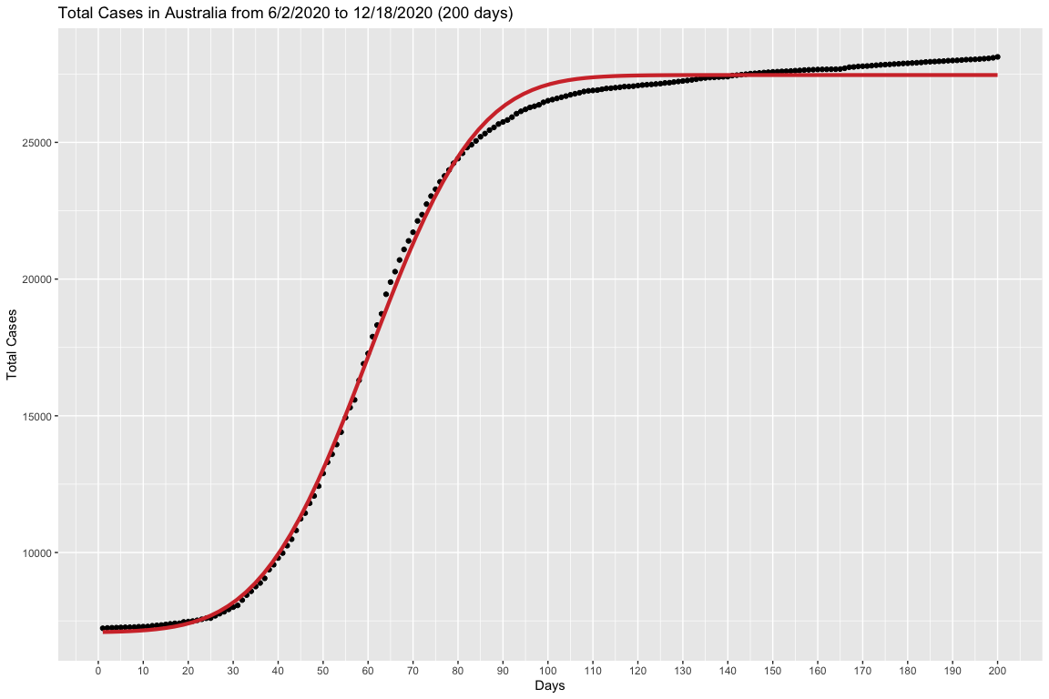
Applying the function to the whole cases dataset

Slide 24
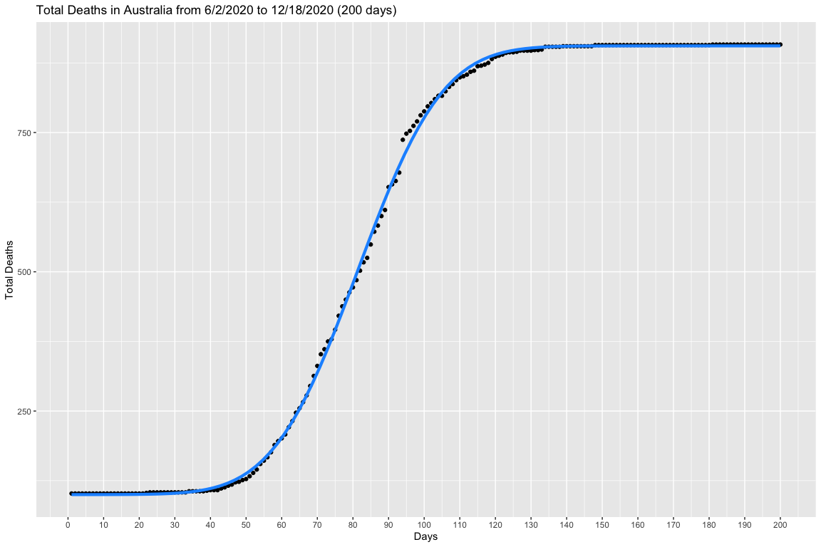
Applying the function to the whole fatalities dataset

Slide 25
Using MonteCarlo Simulation to predict the day of flex
The mean of the day of flex for cases is 60.22 days and the standard deviation is 0.77 days.
The mean of the day of flex for fatalities is 81.4 days and the standard deviation is 0.69 days.

Slide 26

Applying the day of flex indicator to the data (Cases)

Slide 27
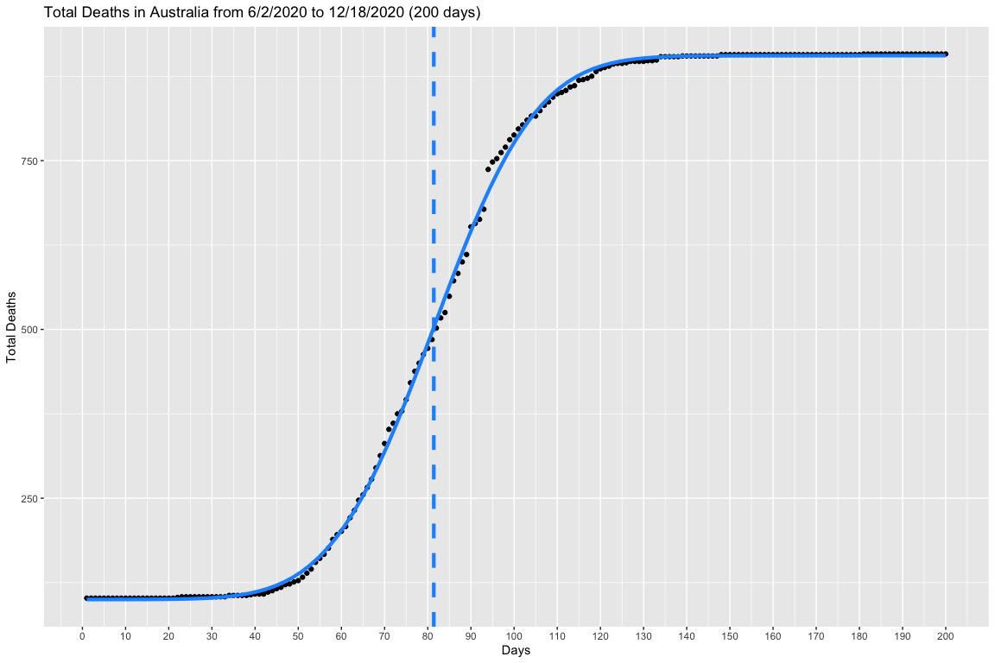
Applying the day of flex indicator to the data (Fatalities)

Slide 28
Monte Carlo Simulations

Slide 29
China

Slide 30
Italy

Slide 31
Australia

Slide 32
Works Cited
Link to study:
I. Ciufolini, A. Paolozzi, Prediction of the time evolution of the Covid-19 Pandemic in Italy by a Gauss Error Function and Monte Carlo simulations. Submitted to BioRxiv on 03.26.2020 and transferred on 03.27.2020 to MedRxiv. https://doi.org/10.1101/2020.03.27.20045104
Link to covid data:
https://covid19.who.int/
source to find the second derivative of fitted function:
https://proofwiki.org/wiki/Derivative_of_Error_Function

