Slide 1
Predicting Covid Data
Austin Lackey, Chien Lin and Jin Peng

Slide 2
The MonteCarlo Study
In this study by Ignazio Ciufolini and Antonio Paolozzi, they use a Gauss Error to predict future trends of covid data spread.
Add more stuff here…

Slide 3
The Gauss Error function
The Gauss Error function is widely accepted as a good way to model the spread of covid data, especially in China. By using the Gauss Error function, we can predict the spread of covid data in the future for other countries.
$a+b*erf\left(c*x−d\right)$

Slide 4
Australia Simulation

Slide 5
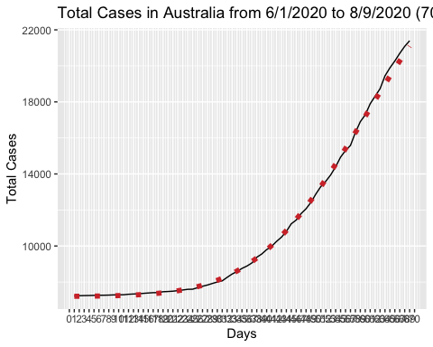
Australia Simulation

Slide 6
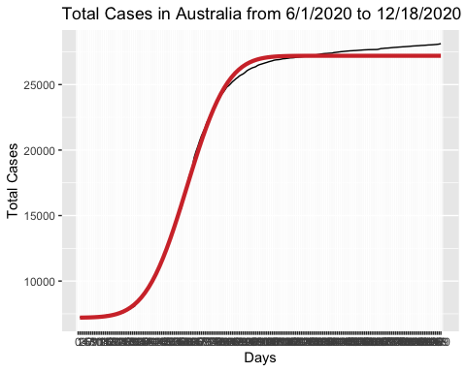
Australia results

Slide 7
Italy Simulation
Add stuff here

Slide 8
(Fill in Here) Simulation
Add stuff here

Slide 9
Works Cited
Add link to study here
Add link to covid data here

