Slide 1
Predicting Covid Data
Austin Lackey, Chien Lin and Jin Peng

Slide 2
Introduction
In this study by Ignazio Ciufolini and Antonio Paolozzi, they use a Gauss Error function that approximates the distribution of the cumulative positive cases of COVID-19 in China
They have then use the function to approximate the number of cumulative positive cases in Italy
Then performed a 150 Monte Carlo simulations to predict the peak and valley of the number of daily positive cases and fatalities
This study do not take into account factors such as daily nasopharyngeal swabs, medical, social distancing, etc.

Slide 3
Ciufolini and Paolozzi’s Study
Mathematical prediction of the time evolution of the COVID-19 pandemic by a Gauss error function and Monte Carlo simulations:
The number of cumulative diagnosed positive cases and fatalities in China approximates a gauss error function: $a+b*erf\left(c*x−d\right)$.
Predicted the potential number of cases in Italy.
Predicted the day in which the peak of the number of daily cases in Italy occurs.

Slide 4
Overview of the Monte Carlo Simulation
add more…

Slide 5
China Simulation

Slide 6
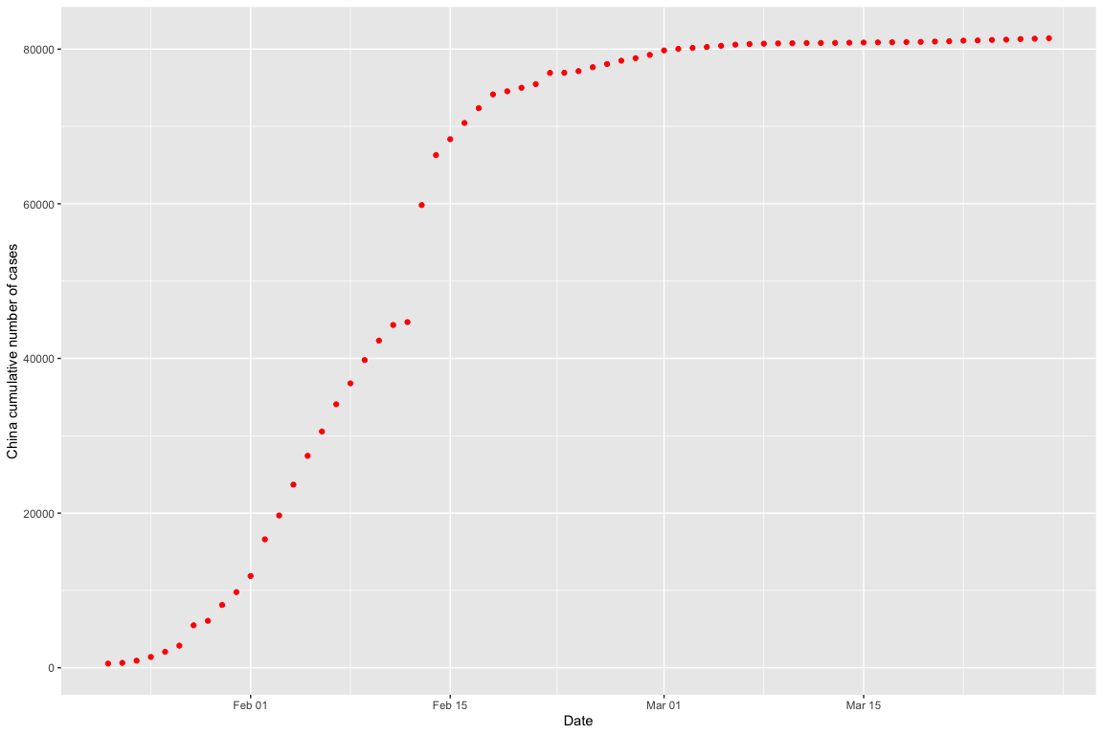
Available Official Data (Positive Cases)

Slide 7
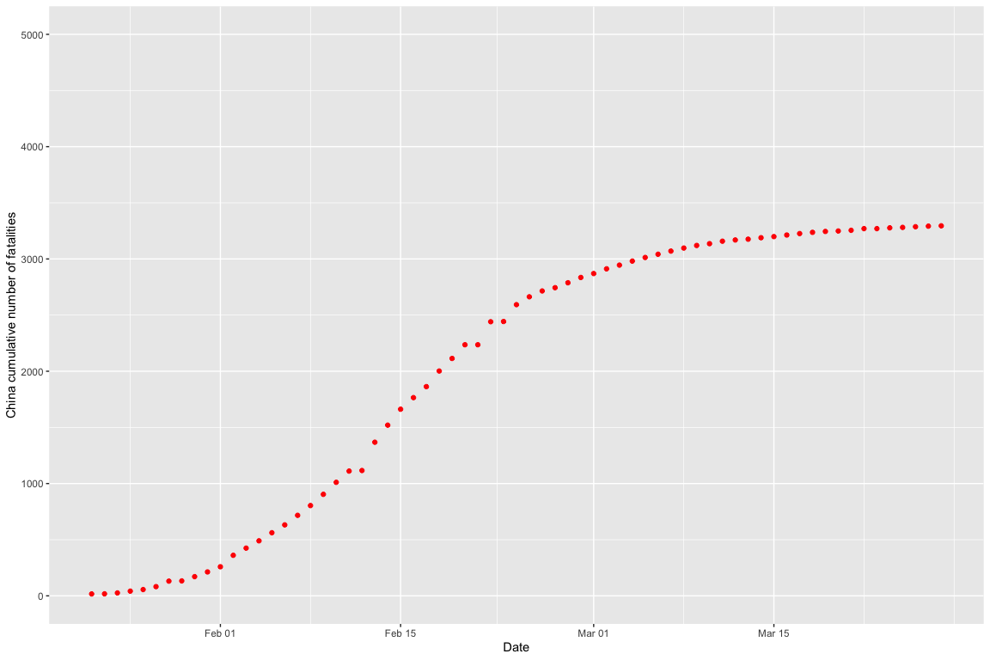
Available Official Data (Fatalities)

Slide 8
Fit by the Gauss Error Function
Apply $nls$ function to determine the nonlinear (weighted) least-squares estimates of the four parameters $a,b,c,d$ of a Gauss error function model: $a+b*erf\left(c*x−d\right)$.
model <- nls(total_cases ~ gauss_fn(days,a,b,c,d), data=china, start=list(a=10000,b=10000,c=0.1,d=1))

Slide 9
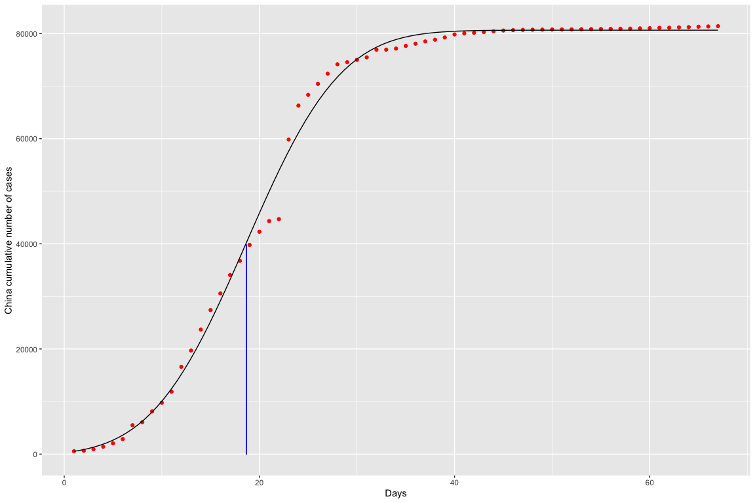
Fit by the Gauss Error Function and Peak Day (Positive Cases)

Slide 10
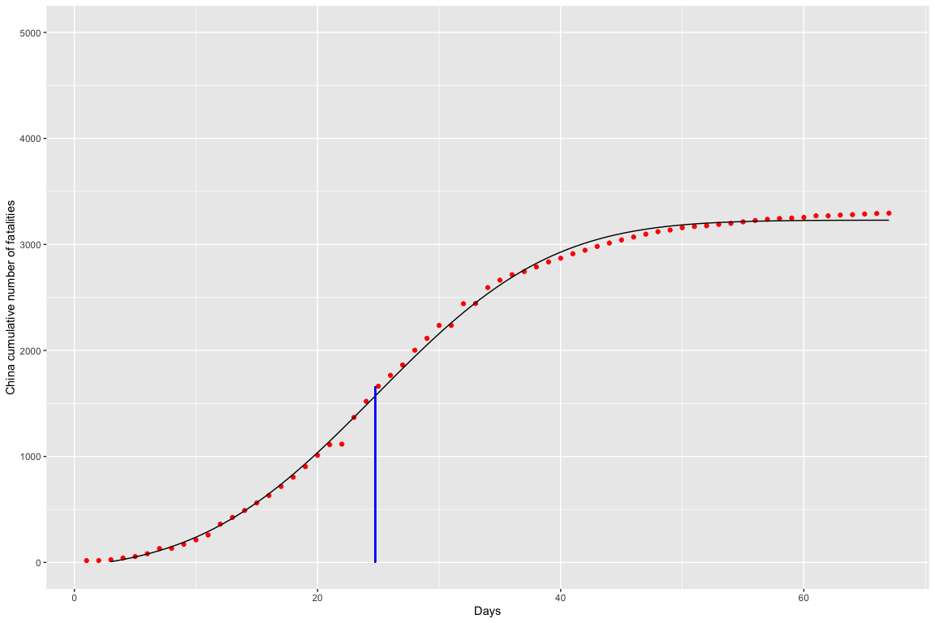
Fit by the Gauss Error Function and Peak Day (Fatalities)

Slide 11
Italy Simulation

Slide 12
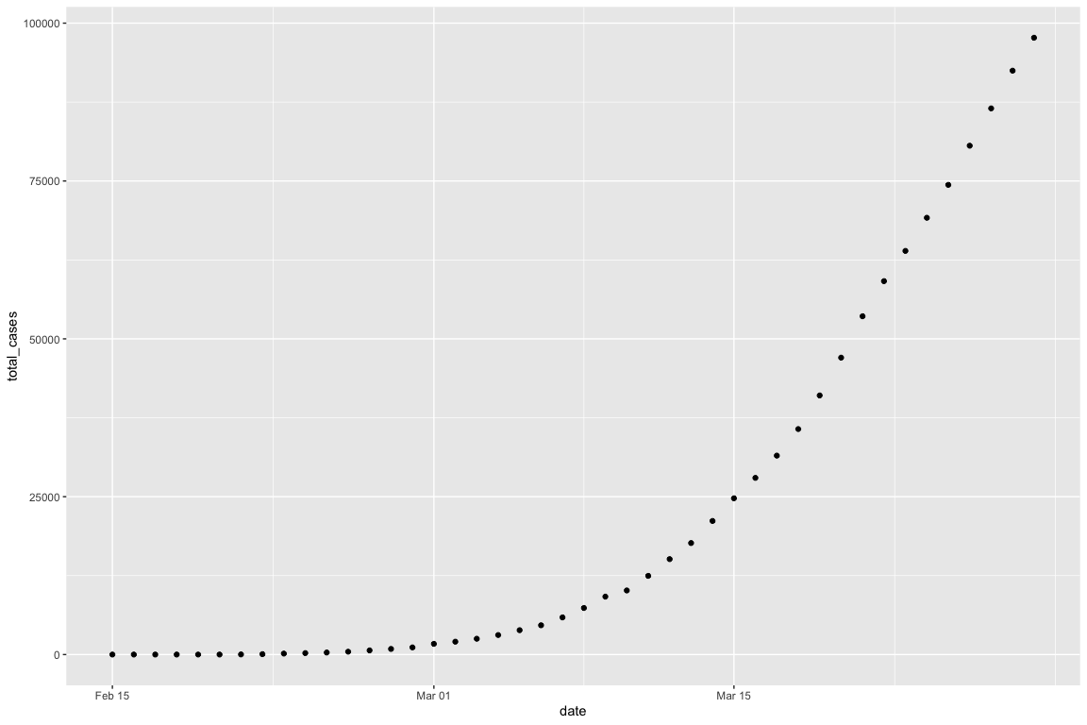
Plot of Diagnosed Positive Cases

Slide 13
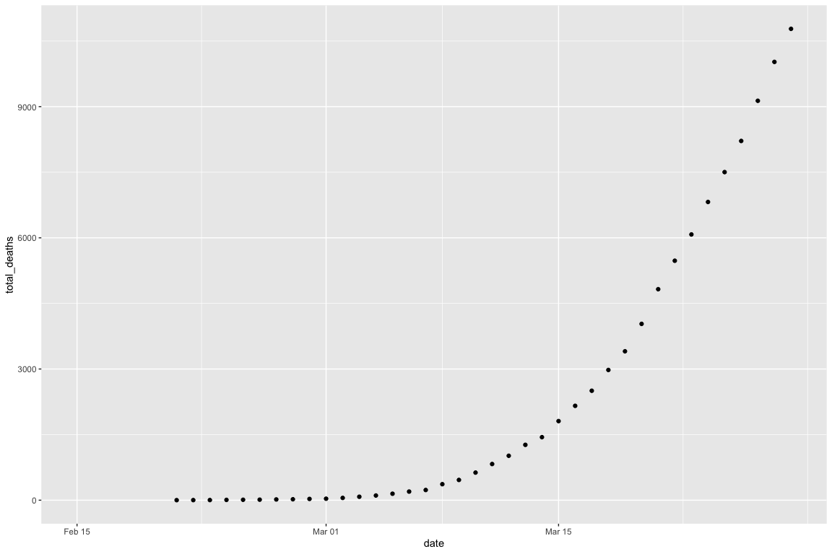
Plot of Fatalities

Slide 14
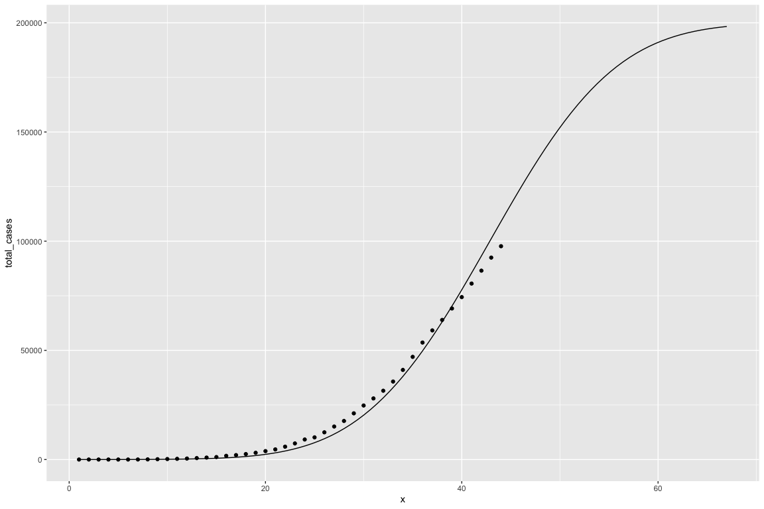
Plot of Diagnosed Positive Cases with Gauss Error Function

Slide 15
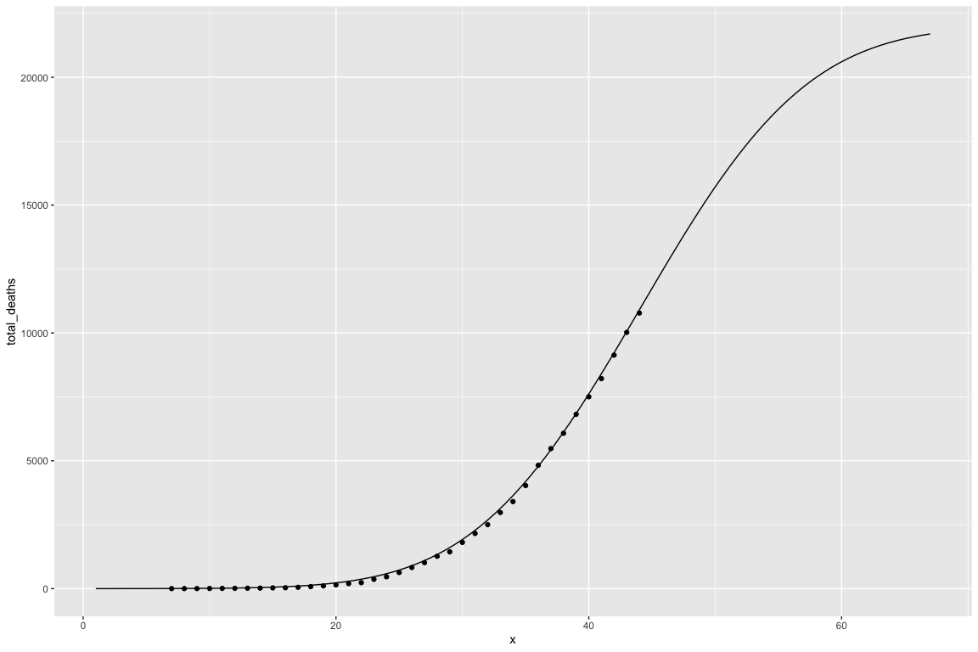
Plot of Fatalities with Gauss Error Function

Slide 16
Australia Simulation

Slide 17
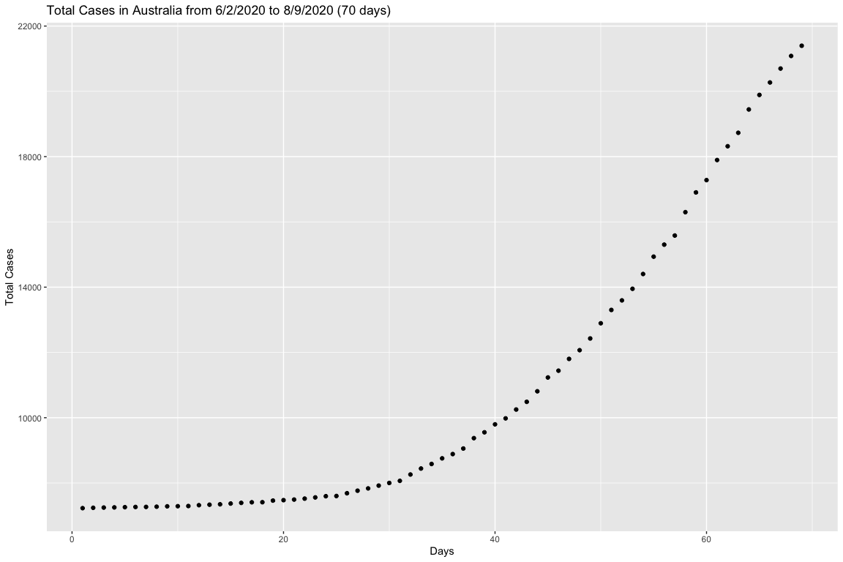
Initial Data for Cases in Australia

Slide 18
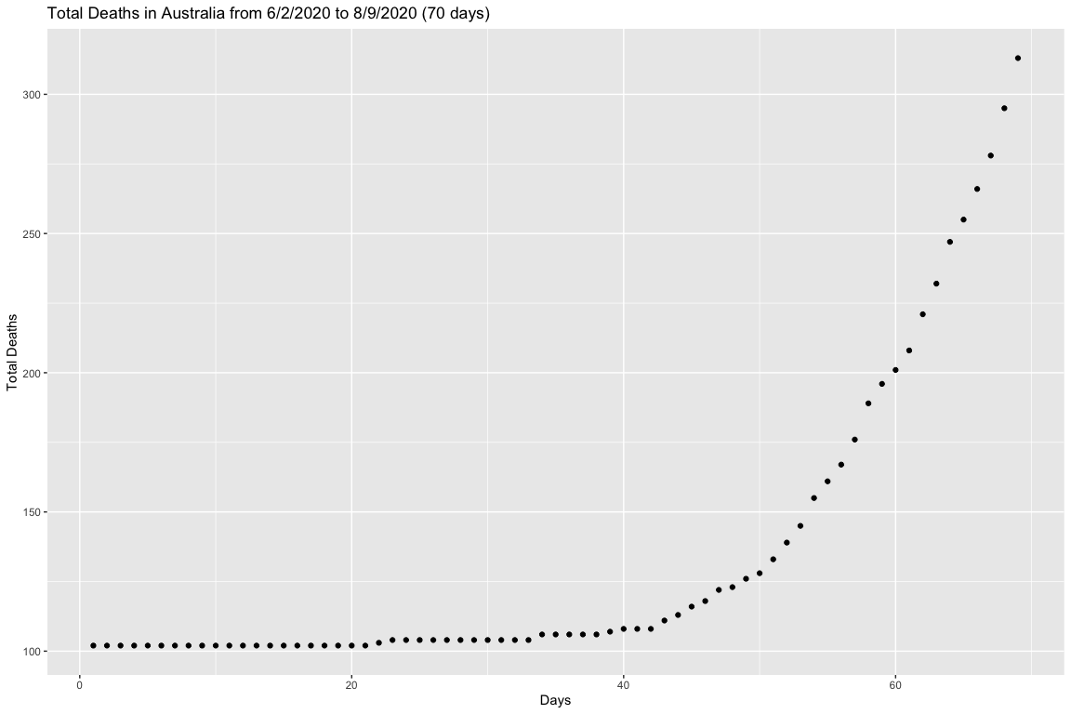
Initial Data for Fatalities in Australia

Slide 19
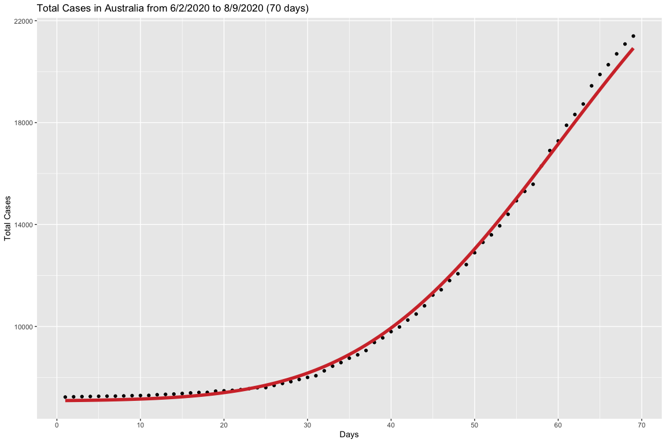
Fitting Gauss Error Function to Cases in Australia

Slide 20
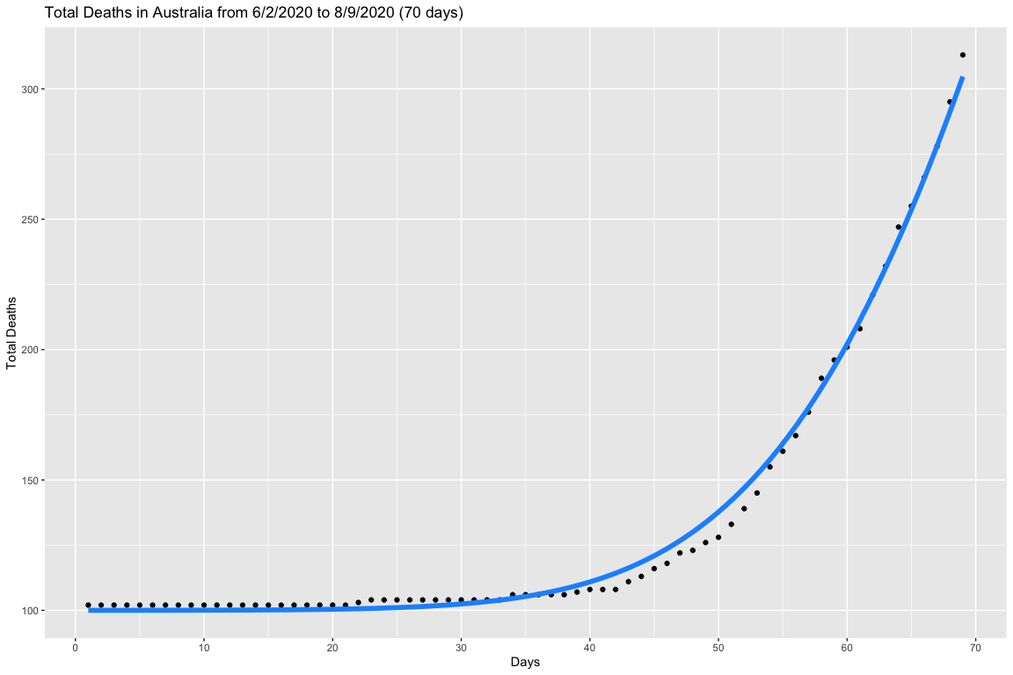
Fitting Gauss Error Function to Fatalities in Australia

Slide 21
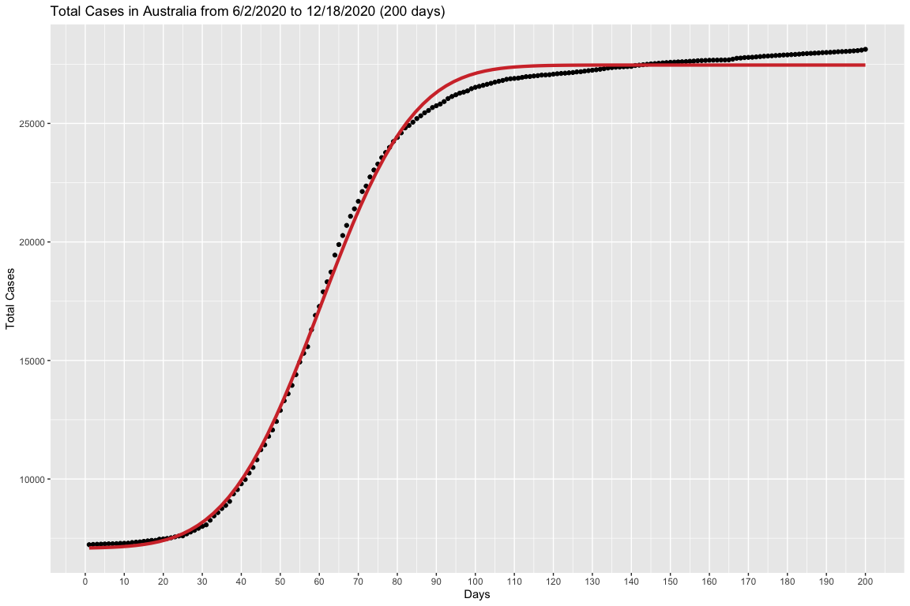
Applying the function to the whole cases dataset

Slide 22
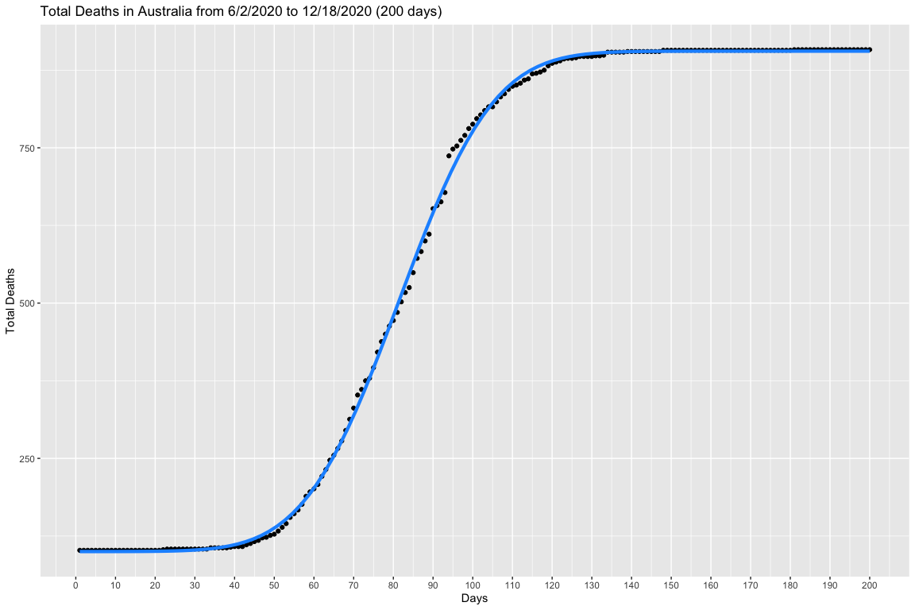
Applying the function to the whole fatalities dataset

Slide 23
Using MonteCarlo Simulation to predict the day of flex
The mean of the day of flex for cases is 60.22 days and the standard deviation is 0.77 days.
The mean of the day of flex for fatalities is 81.4 days and the standard deviation is 0.69 days.

Slide 24

Applying the day of flex indicator to the data (Cases)

Slide 25
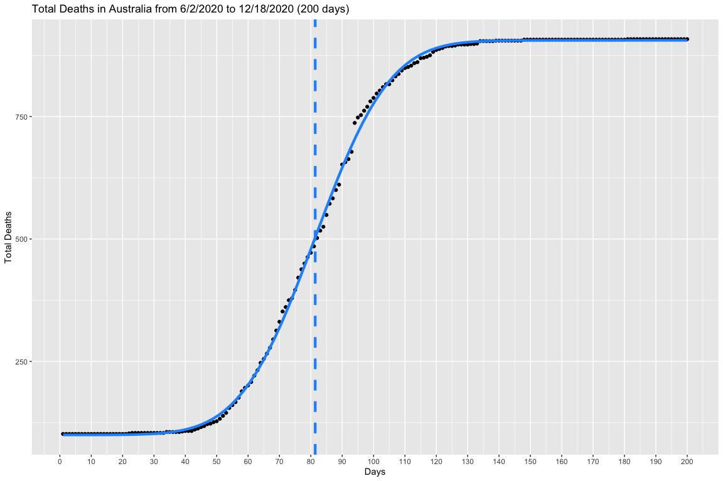
Applying the day of flex indicator to the data (Fatalities)

Slide 26
Monte Carlo Simulations

Slide 27
China

Slide 28
Italy

Slide 29
Australia

Slide 30
Works Cited
Link to study:
I. Ciufolini, A. Paolozzi, Prediction of the time evolution of the Covid-19 Pandemic in Italy by a Gauss Error Function and Monte Carlo simulations. Submitted to BioRxiv on 03.26.2020 and transferred on 03.27.2020 to MedRxiv. https://doi.org/10.1101/2020.03.27.20045104
Link to covid data:
https://covid19.who.int/

